Slide 1
demo_for_ccgb Weekly Update
20220815
Jon Mah
Garud and Lohmueller Labs

Slide 2
Summary
Figure 2
Likelihood surface
Pi
MIDAS
Supplement / Misc. Writing

Slide 3
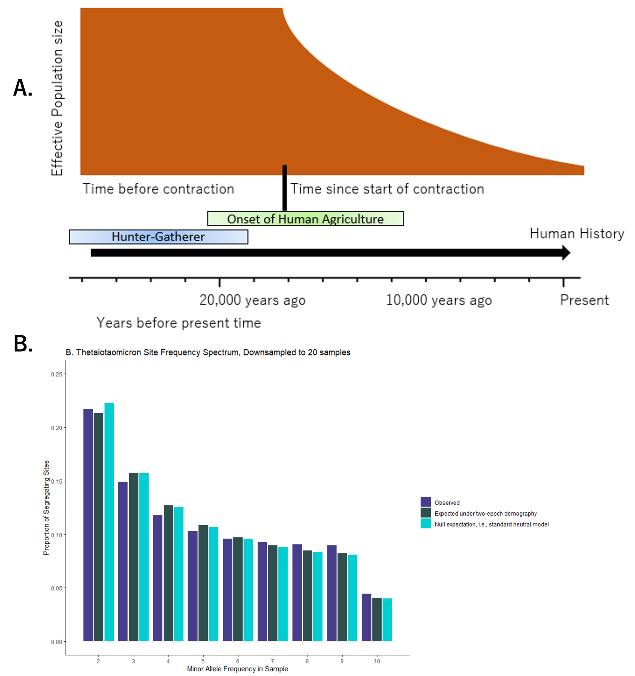
Figure 2
Empirical data fits
Poorly to two-epoch
Also it doesn’t really
Make sense to show
The results that
Give “bad” time
Pick a better example,
e.g., B. intestinihominis
On supplemental full
figure report best model +
Empirical + one-epoch only
For species w/ contraction In table show all

Slide 4
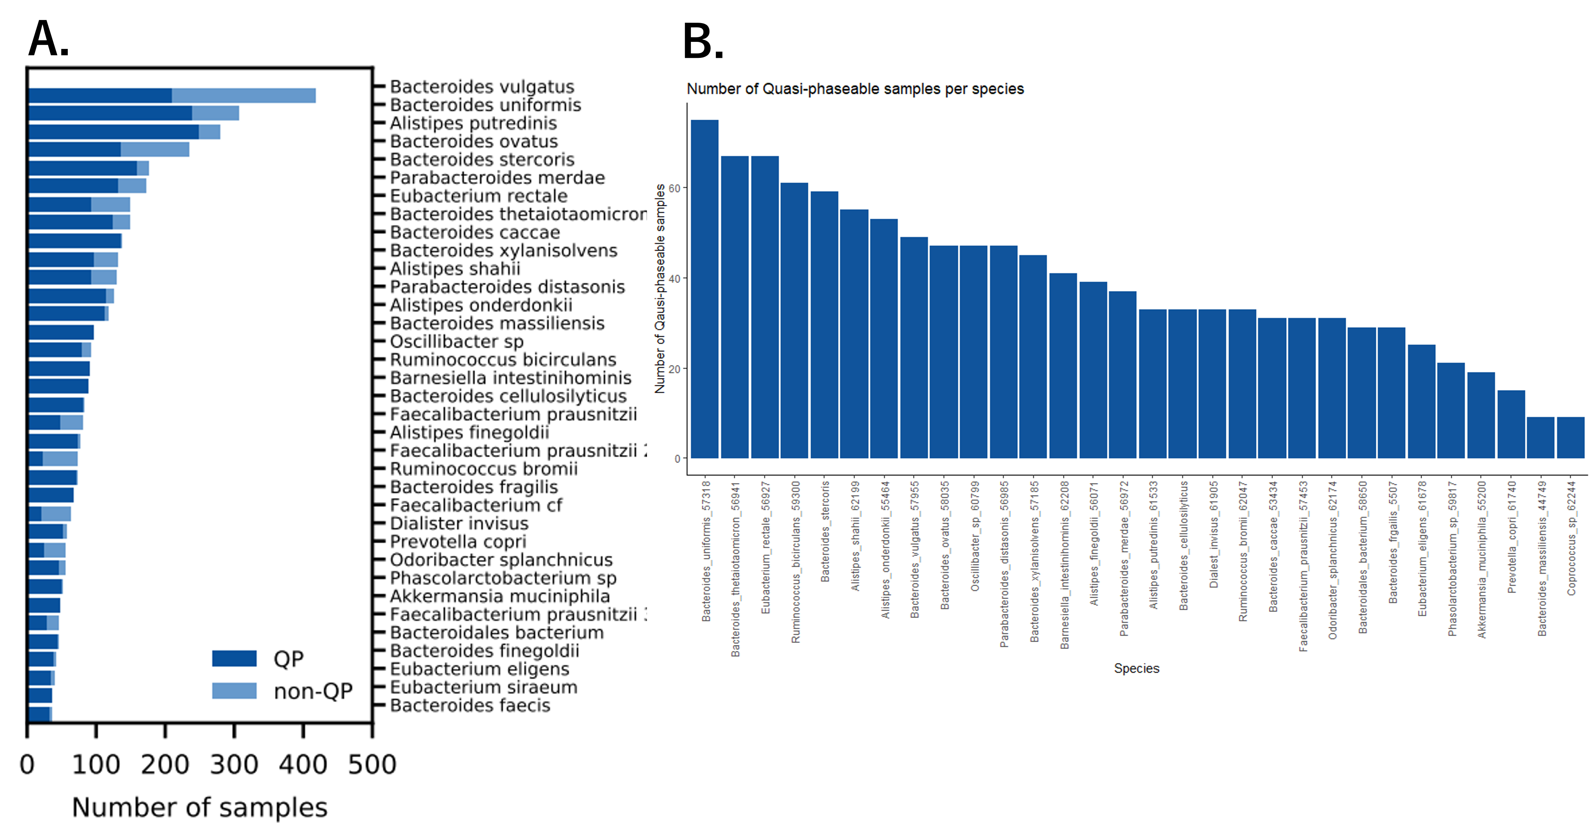
Figure to include?

Slide 5
Likelihood Surface
A. muciniphila
A. onderdonkii
B. thetaiotaomicron
B. xylanisolvens
B. intestinihominis
P. distasonis
P. merdae – Taking a long time to resolve, not sure why

Slide 6
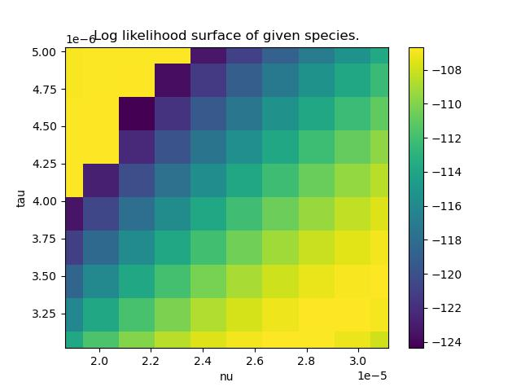
A. muciniphila
Kirk suggests taking
A closer look at a singular
Species to have better initial
For MLE’s
Of note, the ridge pattern
Is counter to what we might
Expect a priori, i.e., we would
Expect that the ridge should
Top left to bottom right.
Big contraction + small time
==
Small contraction + big time

Slide 7
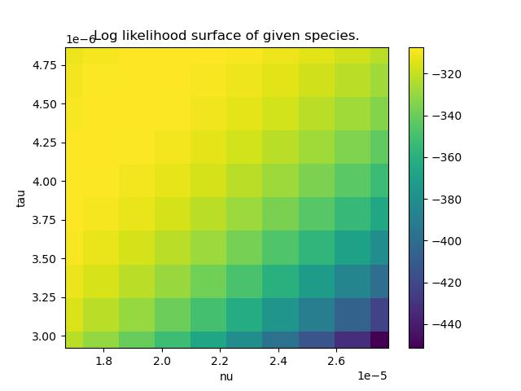
A. onderdonkii

Slide 8
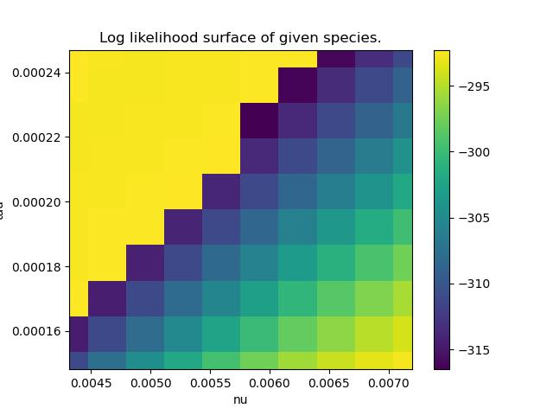
B. thetaiotaomicron

Slide 9
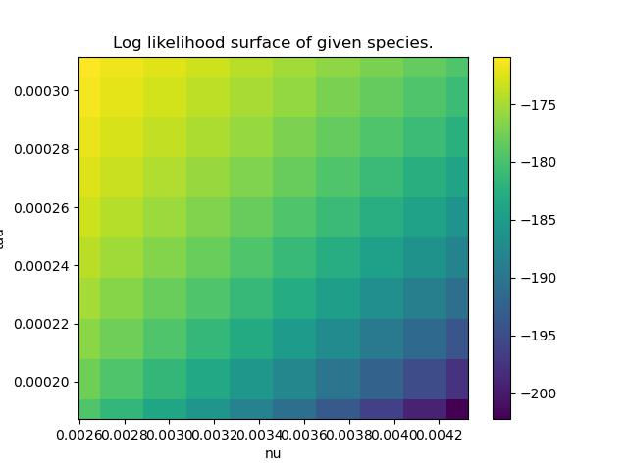
B. xylanisolvens

Slide 10
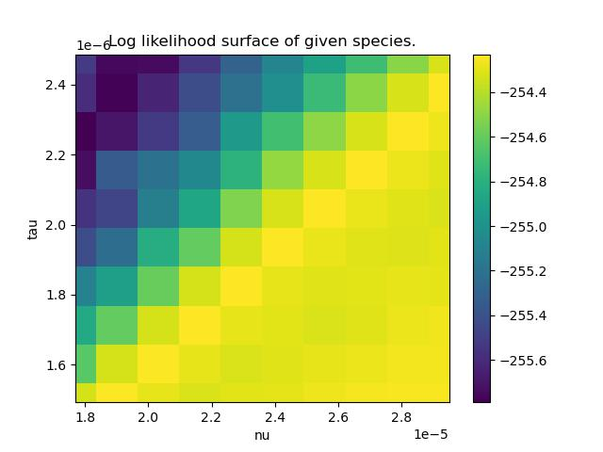
B. intestinihominis

Slide 11
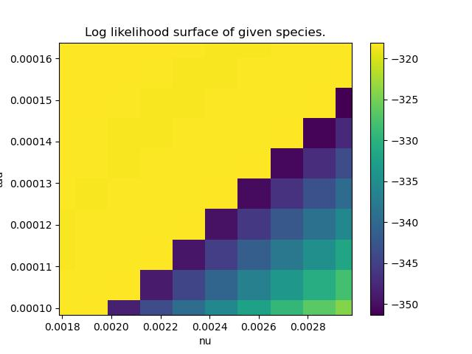
P. distasonis

Slide 12
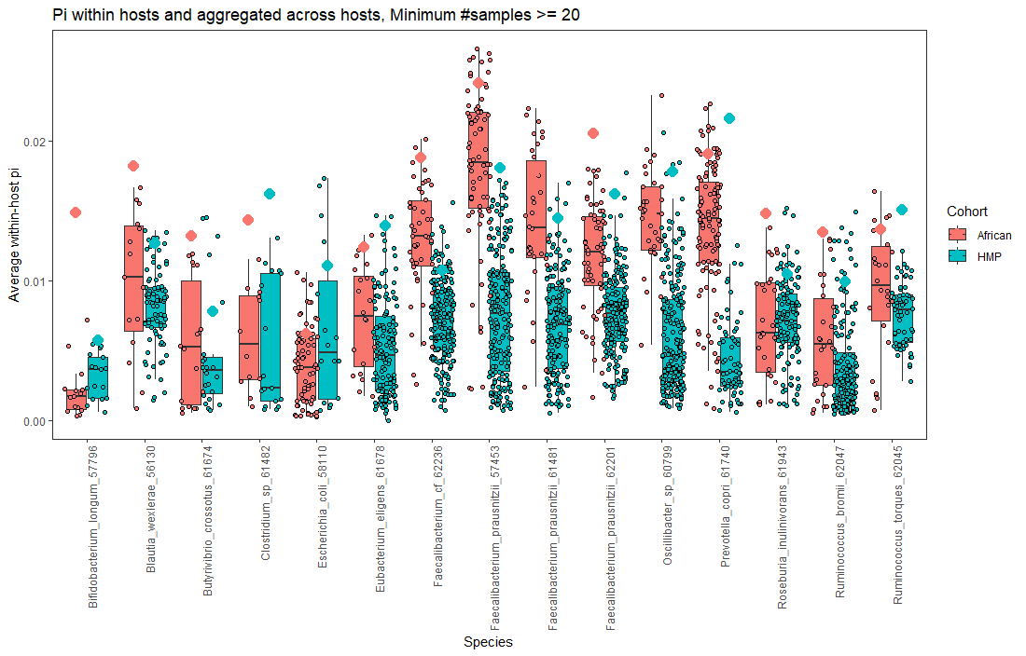
Pi (slightly old)

Slide 13
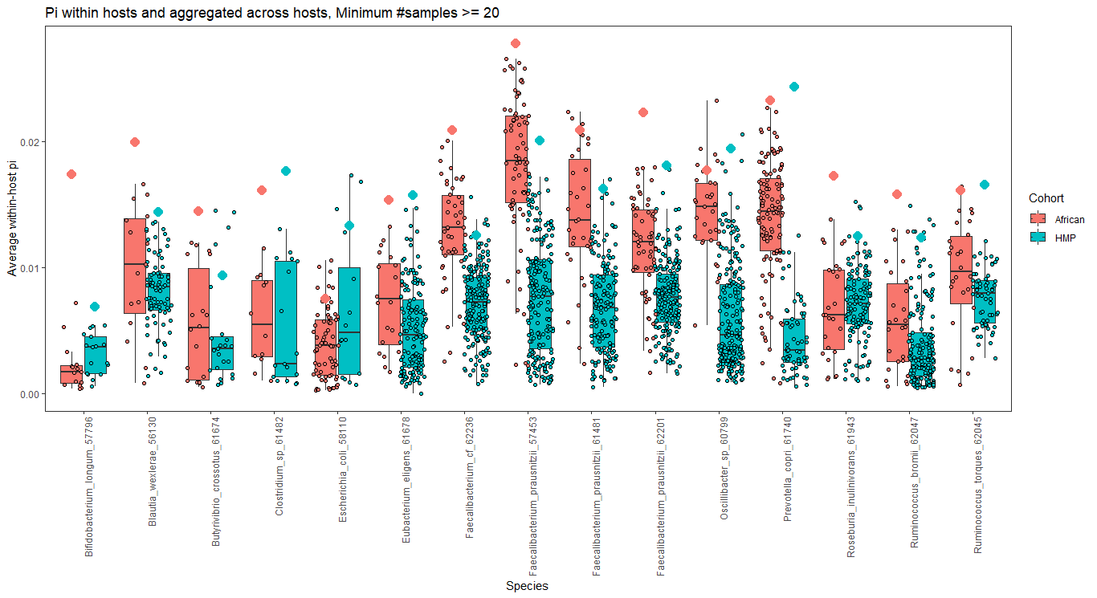
Pi (Ethiopian data removed, account for time point)
I’ve not done this,
But pi can also be
Computed using
The “Shloessnig”
method
Order species by diamond ala Nayfach
Pick species (not counting for time point) >= 5 hosts for both cohorts, i.e., total >= 10 hosts
5 or other number depending
Order by blue diamonds
Remove title

Slide 14
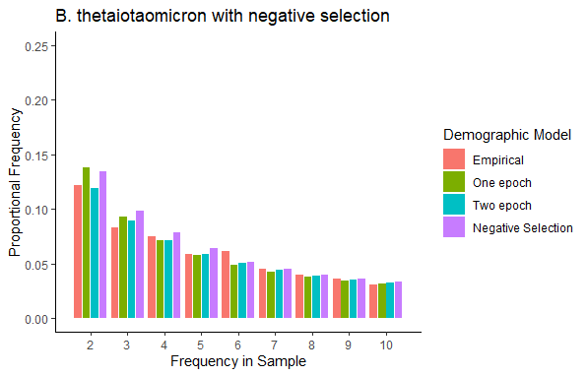
B. Thetaiotaomicron with negative selection

Slide 15
MIDAS Oral
Species_profile.txt = 339/339
Species union step finished for 186 people (339 unique time x host points)
Snps step = 320/339 hosts
Genes step = 324/339 hosts

Slide 16
TODO
Writing
Results: New version of figure 2:
Cornejo-esque demographic model (but contraction)
SFS for B. thetaiotaomicron
Possibly include likelihood plot
Update cartoons / figures with current script
Methods:
Remove distribution of QP samples
Supplement:
Consult someone with good fashion sense
Cartoon of four demographic models
Distribution of QP samples
SFS’s
Clean-up
Read out loud for MIDAS section

Slide 17
TODO
Prioritize finishing oral data [low burden]:
Run genes and snps step
Run merge step
Talk to Leah, Michael, Nandita about Pi computation (Tuesday 3P PST)
Remove Ethiopian data
Plot likelihood surface
Fit negative selection for SFS on downsampled data

Slide 18
Todo 20220815
Write in greater detail about nucleotide diversity figure
Read through:
Suzuki 2021
Spencer 2022
Tamburini
Orsted 2022
What does pi mean at different magnitudes? 10e-2 vs. 10e-4
10e-2 might suggest differences between strains
10e-4

Slide 19
TODO 20220815
Fix species script for oral data
SFSs for supplement + main text (B. intestinihominis)
Likelihood search + expanded plotting
Look for better SFS fit
Pi chart set to IID
Hit up Kirk for the LL deets
Bounce off microb stuff to make sure I don’t talk to myself too much

