Slide 1
Effective Population size
Time before contraction
Time since start of contraction
Onset of Human Agriculture
Hunter-Gatherer
Human History
20,000 years ago
10,000 years ago
Present
Years before present time

Slide 2
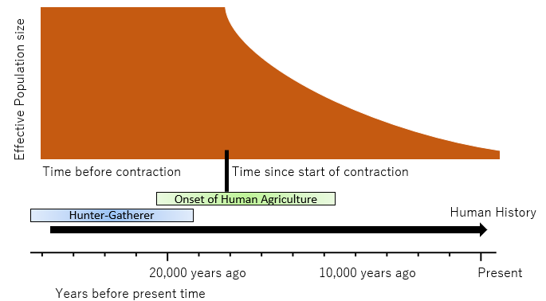
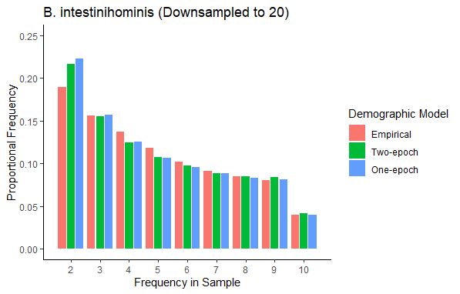
A.
B.

Slide 3
Two-epoch
Exponential
or
or
Contraction
Expansion
Contraction
Expansion
One instantaneous size change
Exponential growth or decay
Bottlegrowth or Bottledecay
Three-epoch
or
or
or
or
or
or
Instantaneous size change → exponential growth or decay
Two instantaneous size changes
Notes:
Now that we have evidence that North American gut microbiomes have depleted genetic diversity relative to African gut microbiomes, likely due to differences in diet, environment, and a host of other factors which can broadly be grouped together as “urbanization”, we proceeded with inferring the demographic models, which allow us to infer parameters such as the time since the last major demographic event and the magnitude of any change in population size. Here, we used four different demographic models, with cartoons (explain cartoons).

Slide 4
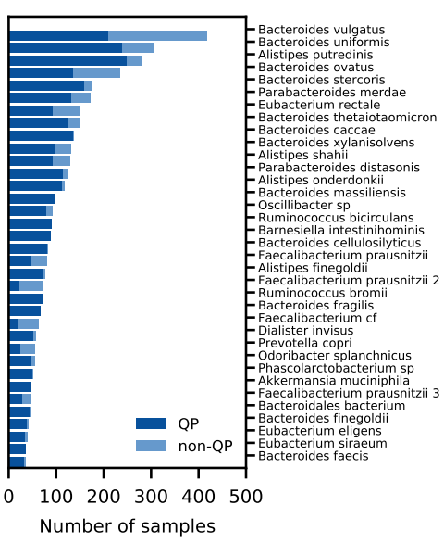
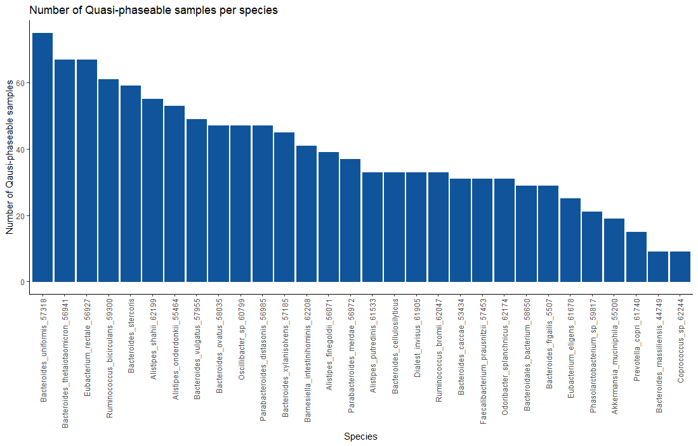
A.
B.

