Slide 1
demo_for_ccgb Weekly Update
20211028
Jon Mah
Garud and Lohmueller Labs

Slide 2
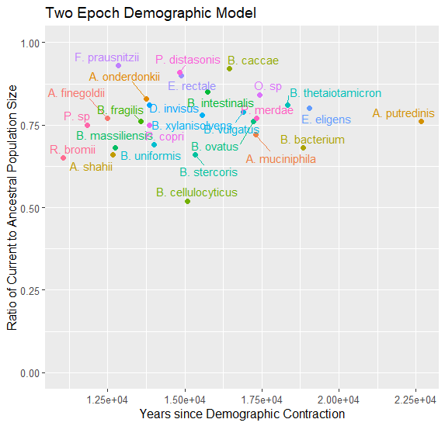
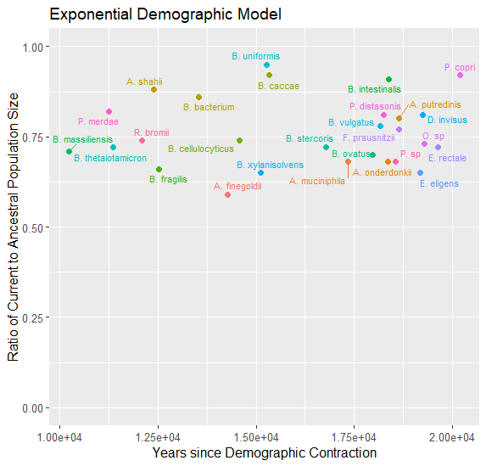
I have MLE’s for 29 species under the two epoch and the exponential model

Slide 3
Oral Data Download
I have all the files downloaded (still including the “v2” files) in fastq.tar.bz2 format.
These are still stored on scratch, but I have them pinged so they won’t be removed, and worst-case scenario it takes about 6 hours to redownload all 501, and shorter to download the 340 that we actually need.
I’m working on a way to systematically decompress and compress them into the right format (current method takes too long). I’m pretty sure I can just use a job array and some bash, but I’m bad at bash so it’s taking a while to figure out.

Slide 4
NDSEG
BAA # N00014-21-S-B001
Gut Microbiology for Warfighter Resilience
Contact: Dr. Kristy Hentchel
Host-microbial interactions in response to stressors, with a long-term goal of enhancing warfighter resilience.
Psychological, social, and environmental stressors on the host and its gut microbiota
Focus on host/microbiome interactions relating to sensory systems
Not interested in infectious or autimmune disease, pregnancy or neonatal issues, or metabolic disorders
We might be able to spin urbanization (encompassing changes to diet, introduction of antibiotics and hygiene practices, etc.) as a stressor on the microbiome as evidenced by demographic contractions?
It sounds like they’re typically looking at more short-term exposures.

Slide 5
NDSEG
“Understanding the impact of urbanization-driven stressors on the gut and oral microbiome”
500 word personal statement + a page on how this work relates to naval survival
Set Monday aside for this exercise

Slide 6
//TODO
Midas → demographic inference, etc for oral data
Find best fit for remaining demographic models (three epoch and bottleneck)
Good species command
Print out sample sizes, determine which is converging and which isn’t
Make sure I understand the methods being used, e.g., polarization, clade control
Which species are not converging, what is their sample size
Work on paper outline

Slide 7
//TODO
What is PI for rural vs. urban data
SFS diagram / panel with and without negative selection
Includes inference of DFE
Schematic for demographic models
Check up on MIDAS for oral data
Monday: NDSEG
Tuesday: Use good_species command, determine sample size and which inferences fail
Wednesday: Try inferring DFE (input the MLE demographic model)
Send update to Nandita
Thursday: Meeting
Following Week: PI

