Slide 1
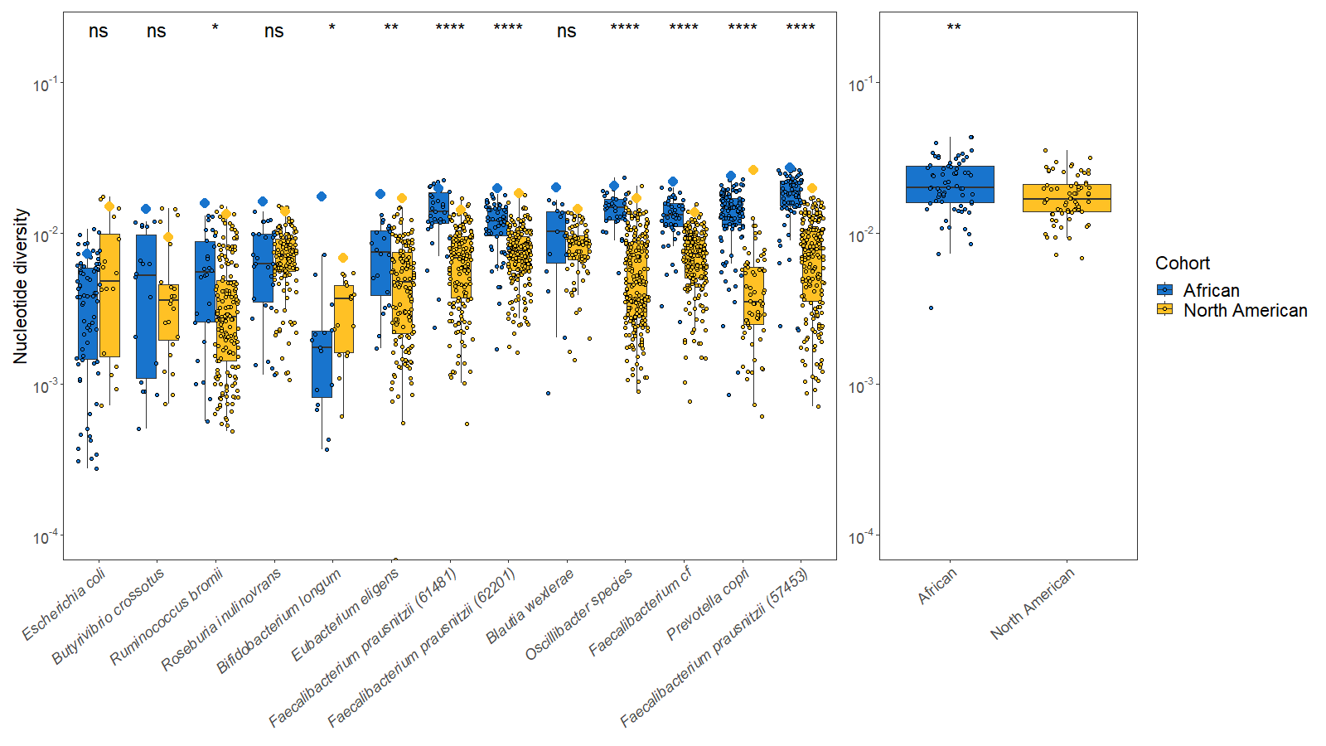
A
B

Slide 2


Slide 3
One-epoch
Two-epoch
Three-epoch
or
or
or
Demographic
Equilibrium
Contraction
Expansion
Constant effective
population size
One instantaneous size change
Two instantaneous size changes
One-epoch
Two-epoch
Three-epoch
Time
Constant effective
population size
One instantaneous size change
Two instantaneous size changes
A
B
C
One-epoch
Two-epoch
Three-epoch
Constant effective
population size
One instantaneous size change
Two instantaneous size changes
Time
Effective Population Size
Notes:
Now that we have evidence that North American gut microbiomes have depleted genetic diversity relative to African gut microbiomes, likely due to differences in diet, environment, and a host of other factors which can broadly be grouped together as “urbanization”, we proceeded with inferring the demographic models, which allow us to infer parameters such as the time since the last major demographic event and the magnitude of any change in population size. Here, we used four different demographic models, with cartoons (explain cartoons).

Slide 4
A
B
C
One-epoch
Two-epoch
Three-epoch
Constant effective
population size
One instantaneous size change
Two instantaneous size changes
Time
Effective Population Size
A
B
C
One-epoch
Two-epoch
Three-epoch
Time
Constant effective
population size
One instantaneous size change
Two instantaneous size changes
Notes:
Now that we have evidence that North American gut microbiomes have depleted genetic diversity relative to African gut microbiomes, likely due to differences in diet, environment, and a host of other factors which can broadly be grouped together as “urbanization”, we proceeded with inferring the demographic models, which allow us to infer parameters such as the time since the last major demographic event and the magnitude of any change in population size. Here, we used four different demographic models, with cartoons (explain cartoons).

Slide 5
One-epoch
Two-epoch
Three-epoch
Ancestral
Time
Current
Constant effective
population size
One instantaneous size change
Two instantaneous size changes

Slide 6
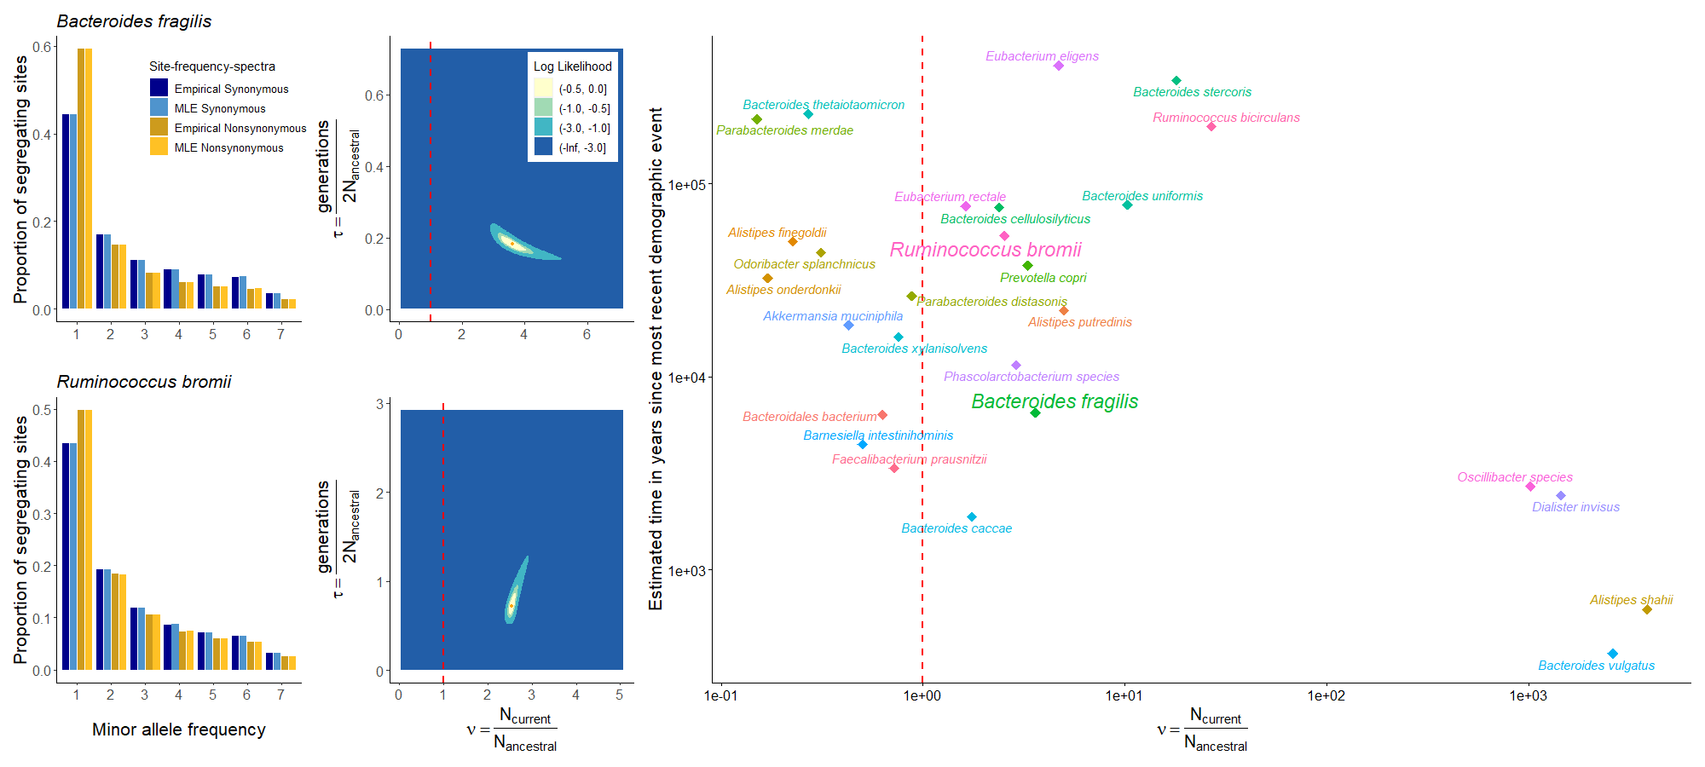
A
C
E
B
D

Slide 7
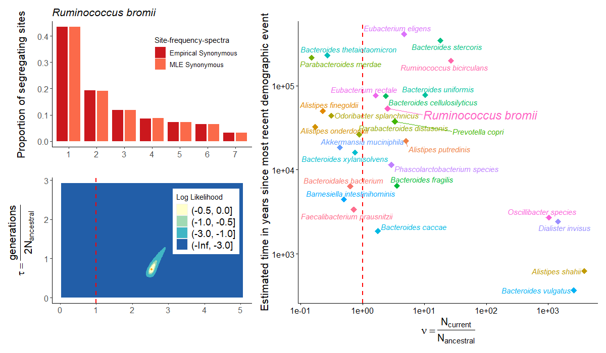

Slide 8
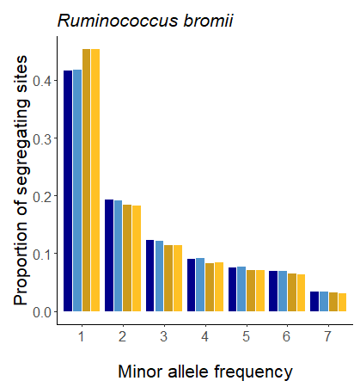

Slide 9
Expansion
Contraction
Site Frequency Spectra
Site Frequency Spectra
30.00%
30.00%
22.50%
22.50%
Proportional Frequency
Proportional Frequency
15.00%
15.00%
7.50%
7.50%
0.00%
1 2 3 4
5
6
7
8
0.00%
1 2 3 4
5
6
7
8
Mutation class (Singletons, doubletons, tripletons, etc.)
Mutation class (Singletons, doubletons, tripletons, etc.)

Slide 10
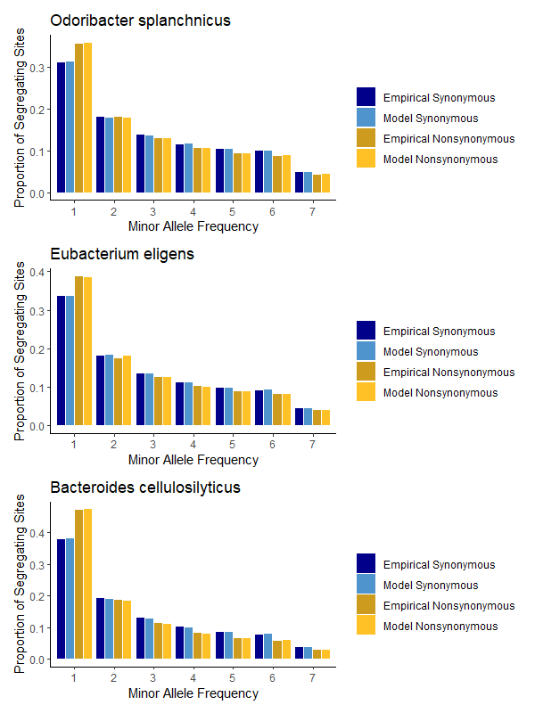

Slide 11
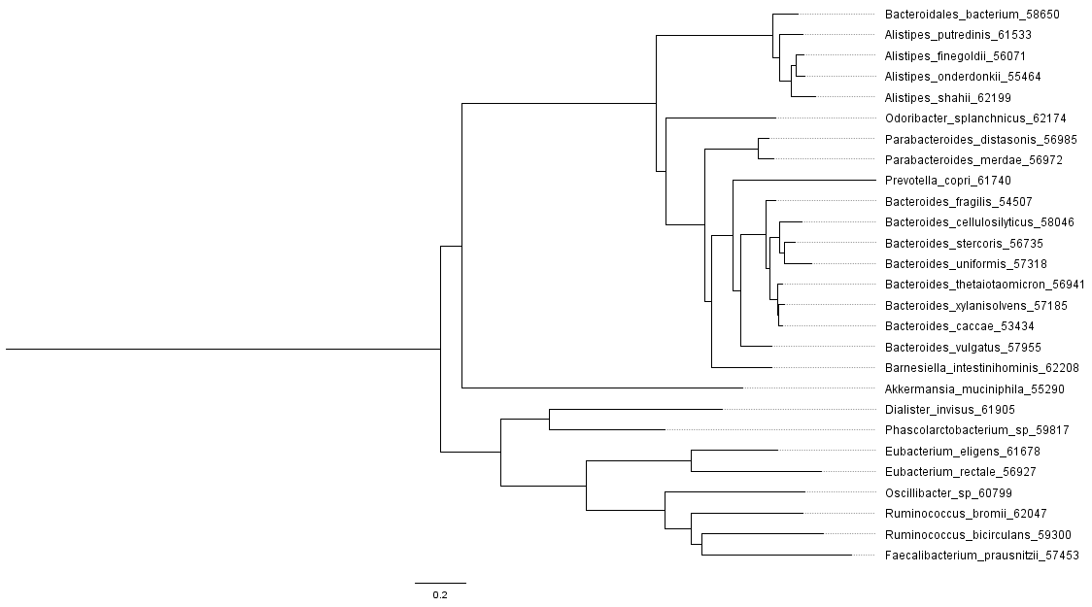
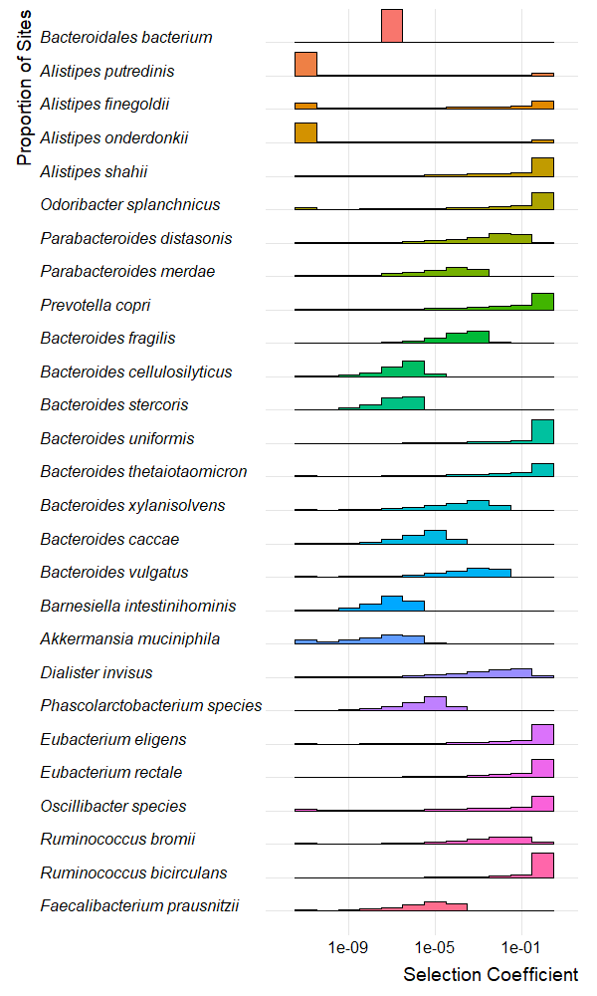
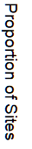
Notes:
Gamma_high

Slide 12
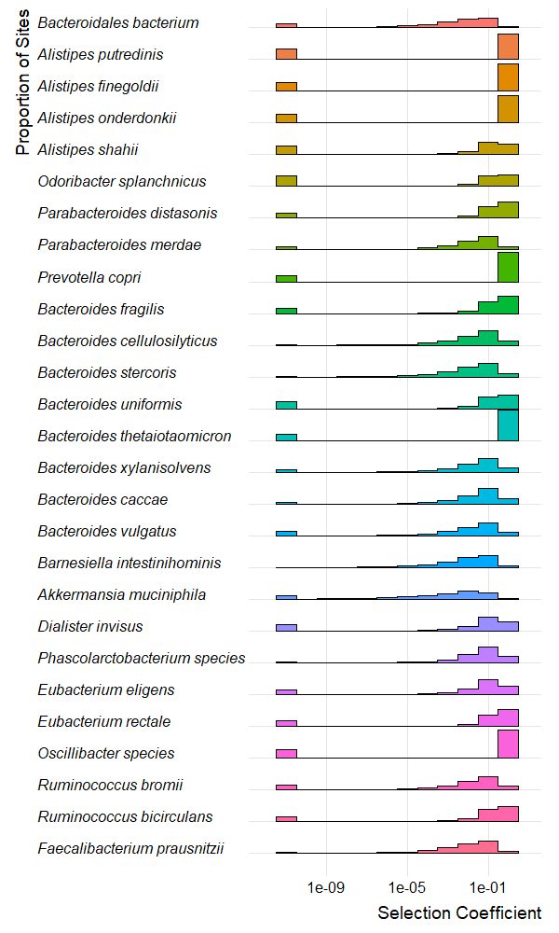
Notes:
Supplemental Figure 3

Slide 13
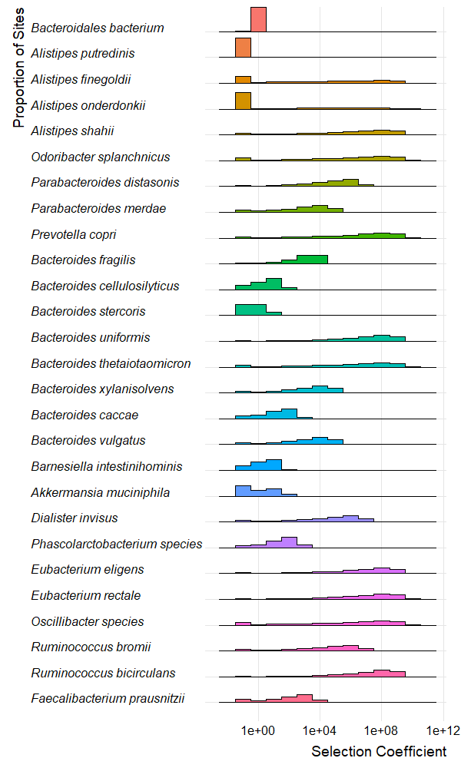
Notes:
Gamma_dadi_dfe

Slide 14
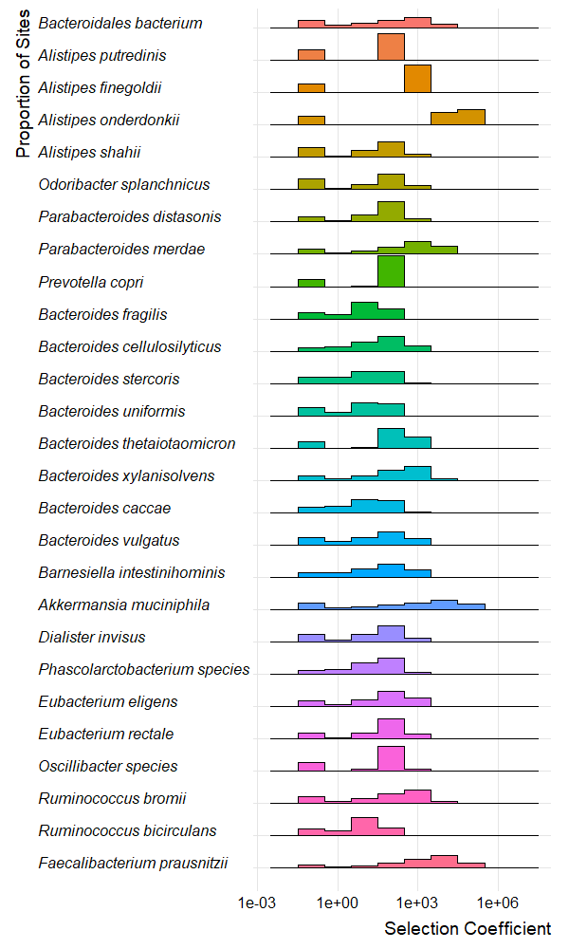
Notes:
Neugamma_dadi_dfe

Slide 15
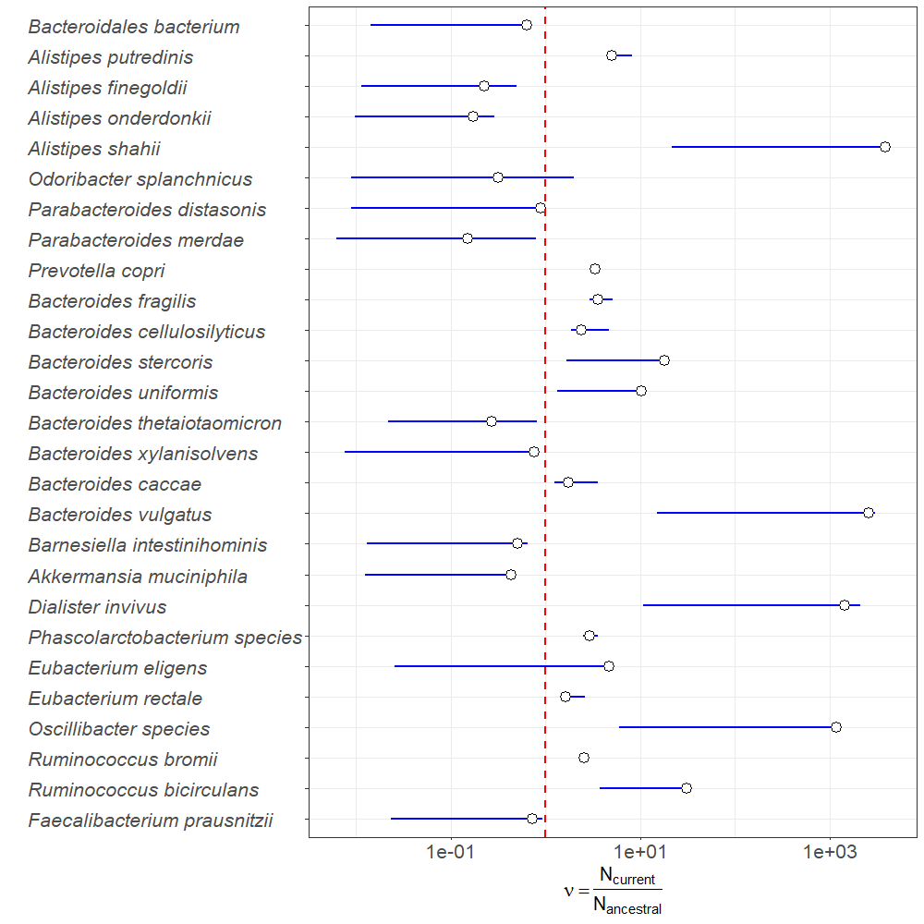

Slide 16
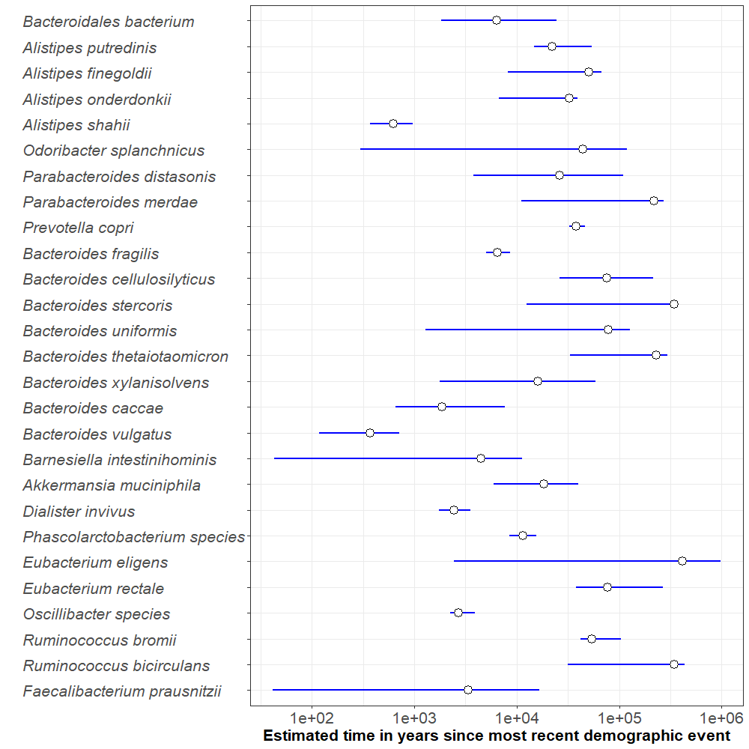

Slide 17
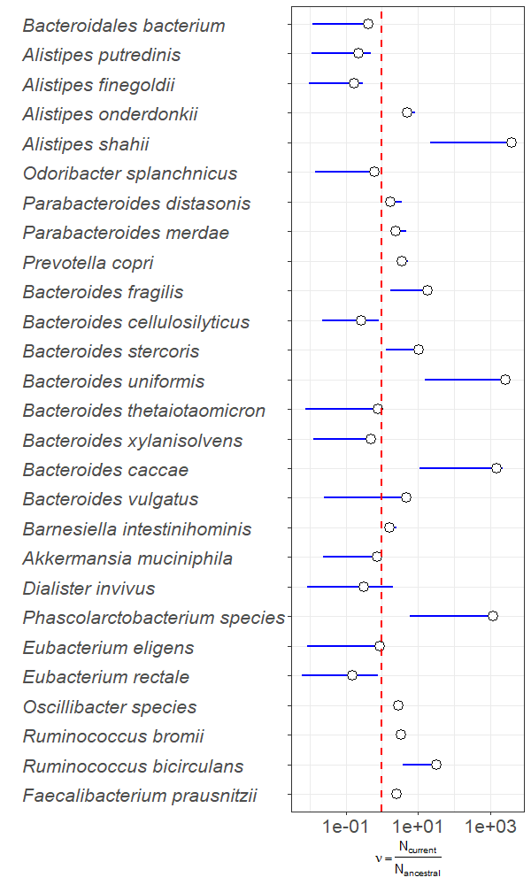
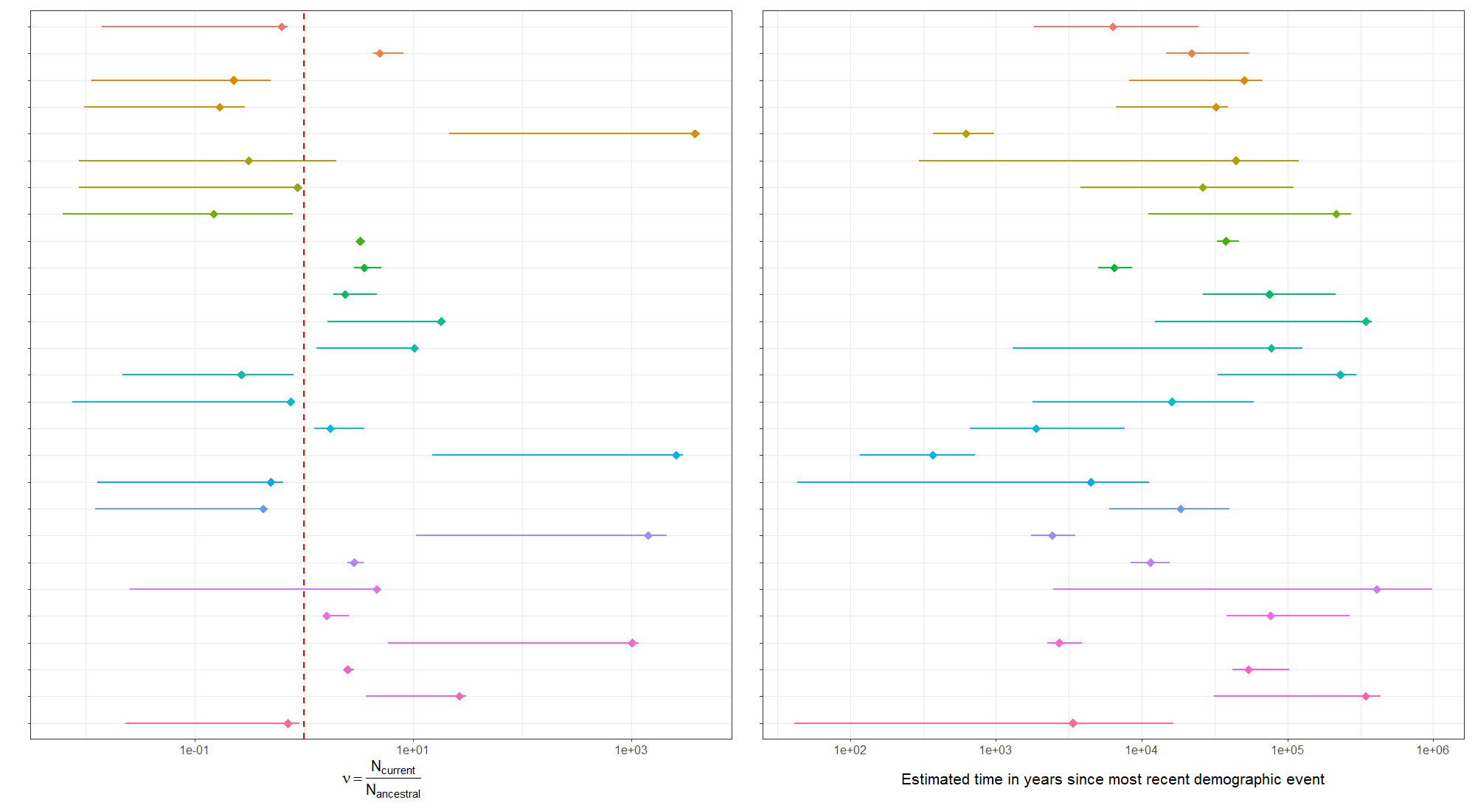

Slide 18
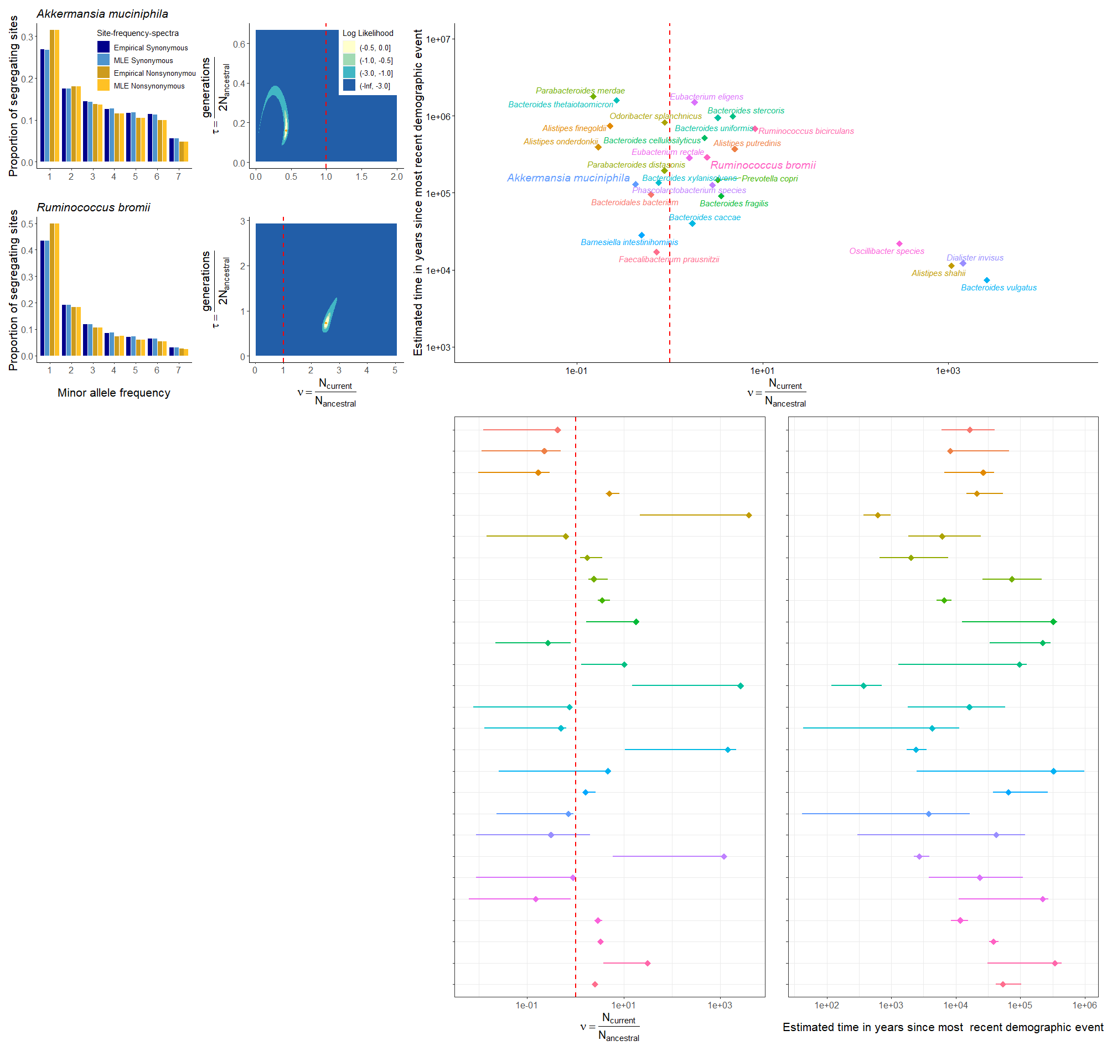
A
C
E
B
D
F
G
H

Slide 19
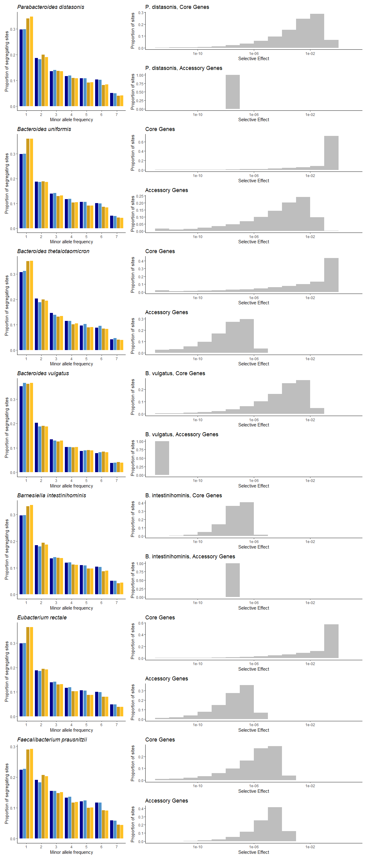
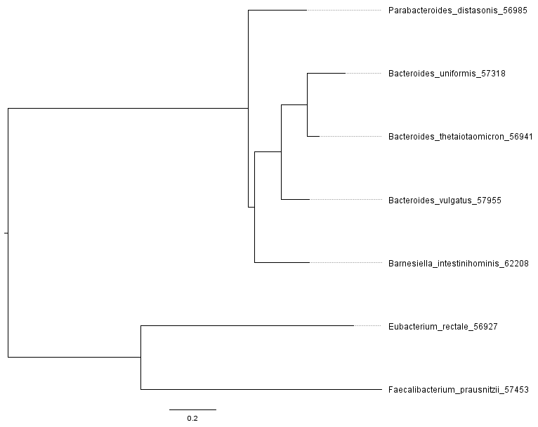
A
B
Notes:
Figure 5

Slide 20
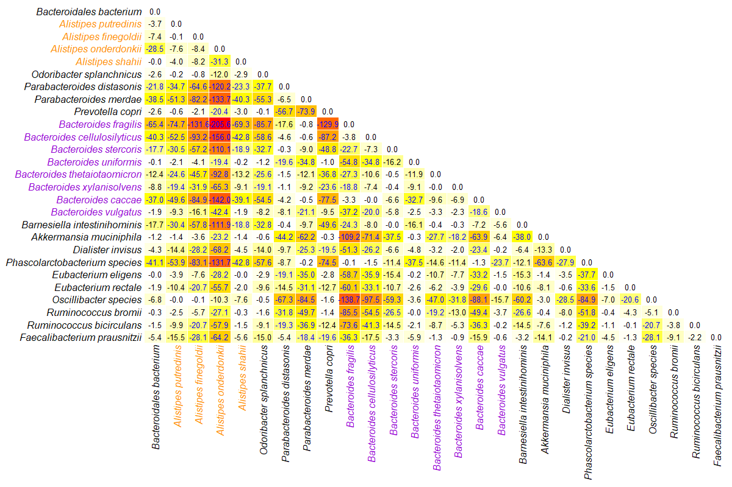

Slide 21
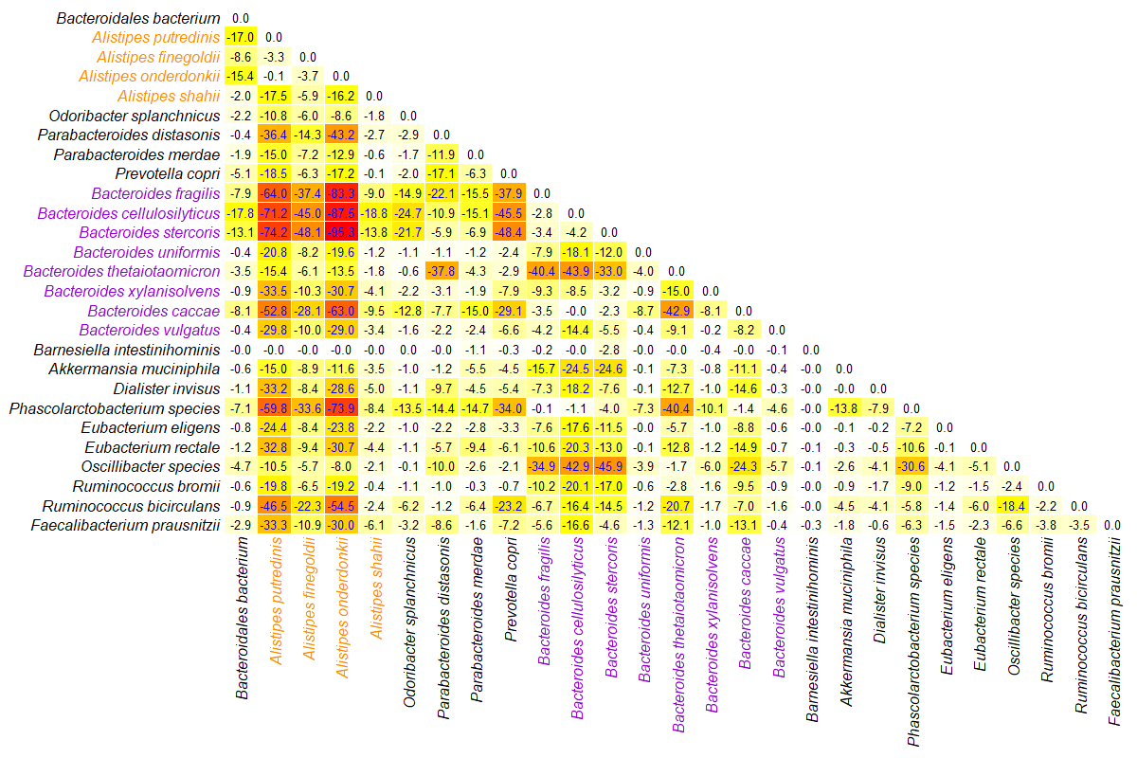

Slide 22


A
B

Slide 23
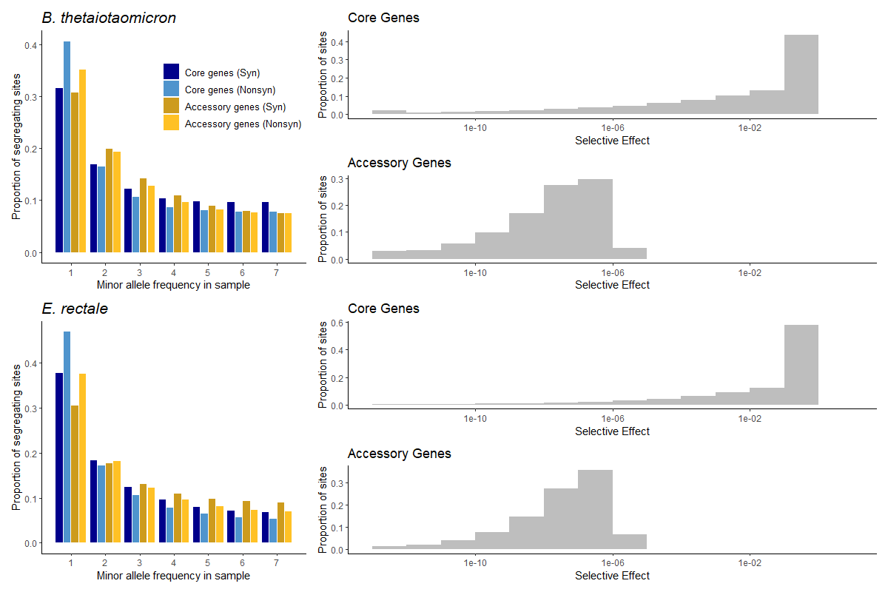
A
C
B
D

Slide 24
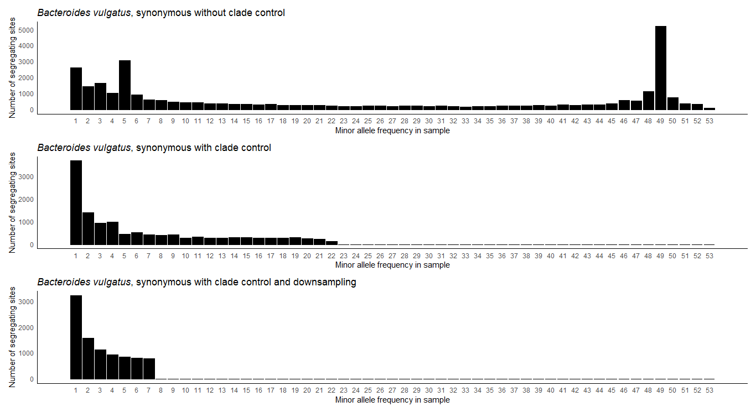

Slide 25
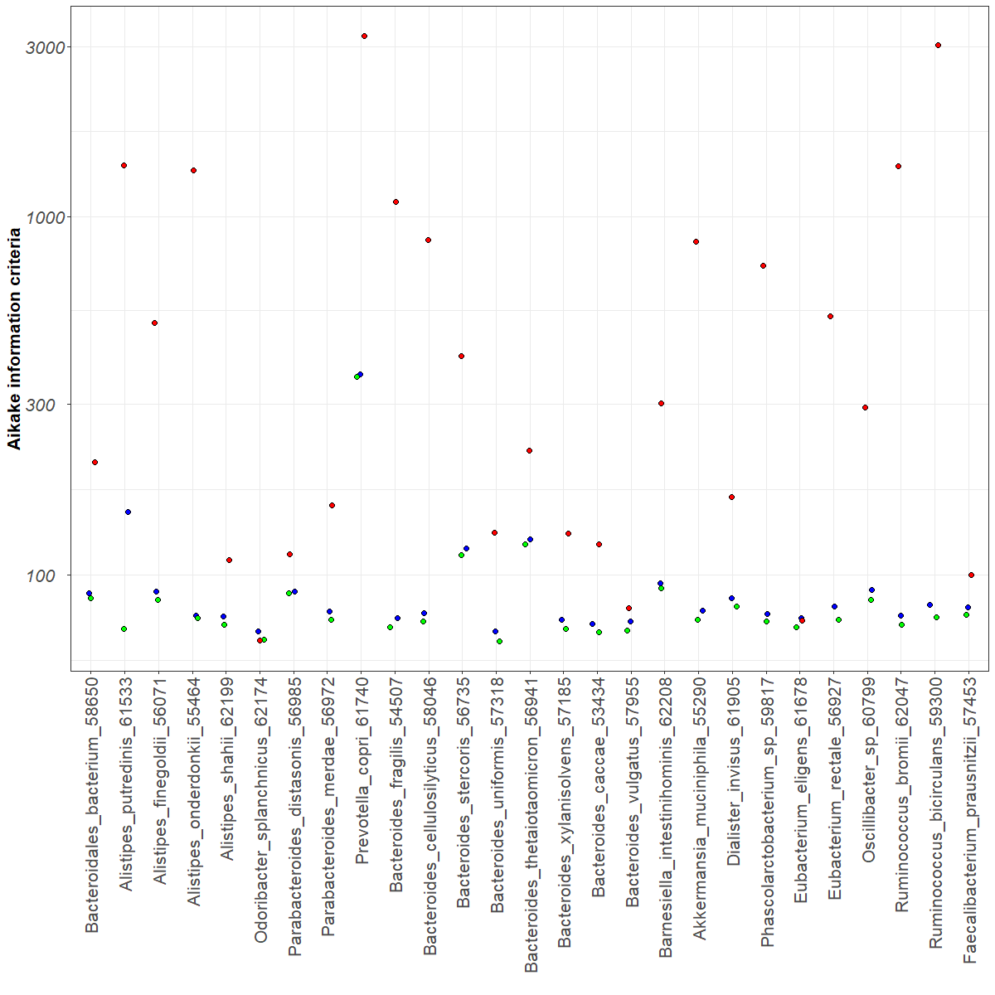

Slide 26
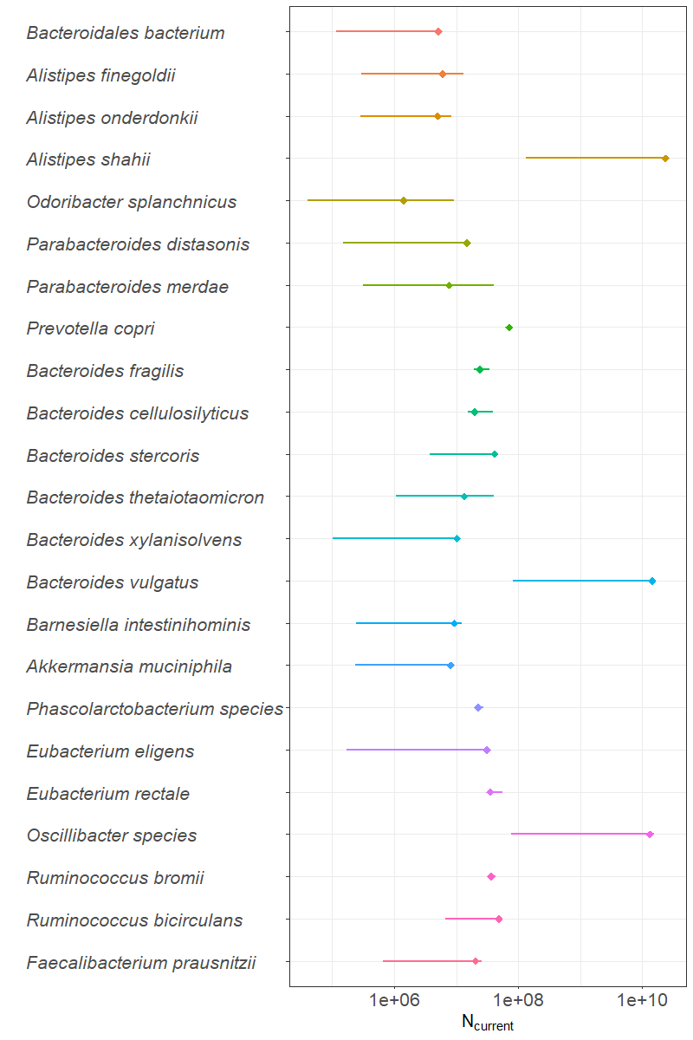

Slide 27
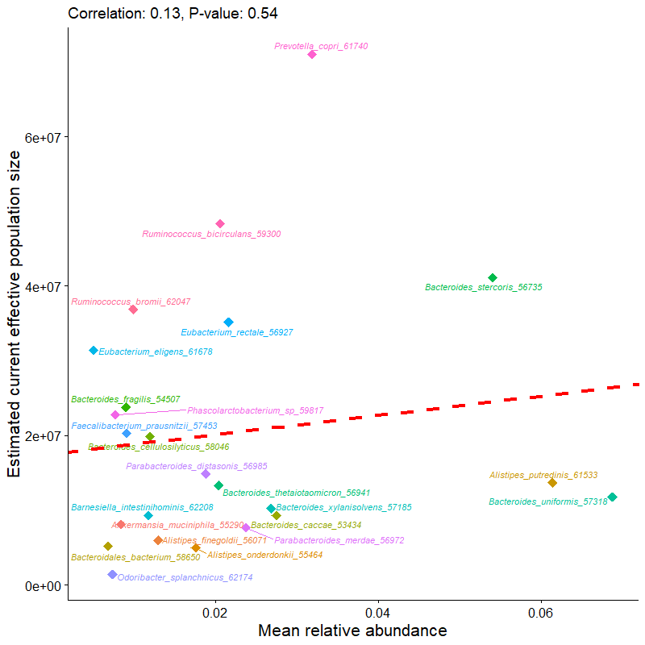
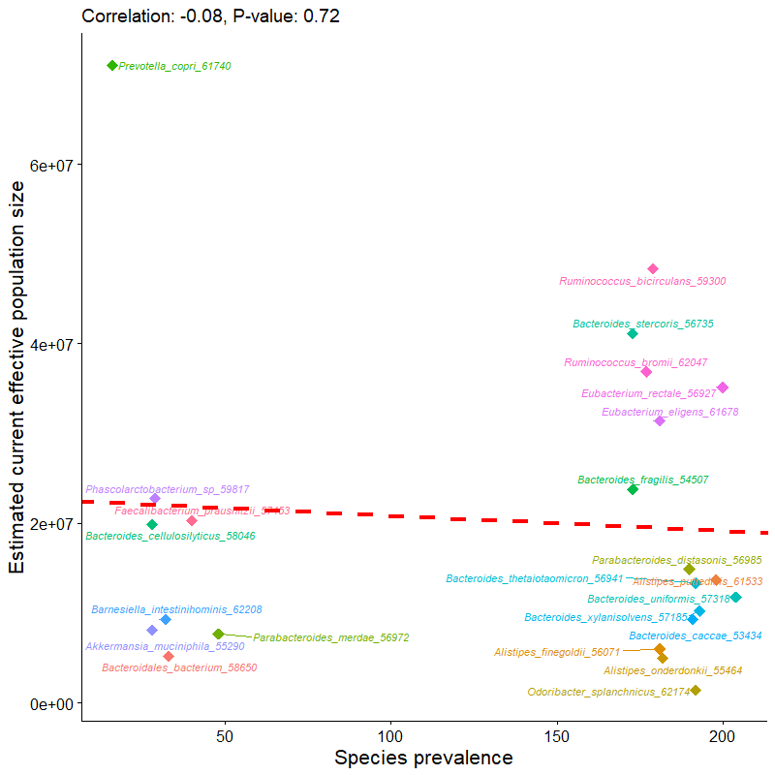
A
B

