Slide 1
demo_for_ccgb Weekly Update
20220822
Jon Mah
Garud and Lohmueller Labs

Slide 2
Summary
Figure 2
Sanity checks on B. intestinihominis
Likelihood surface expanded
Better (?) demographic inferences
Supplement / Misc. Writing

Slide 3
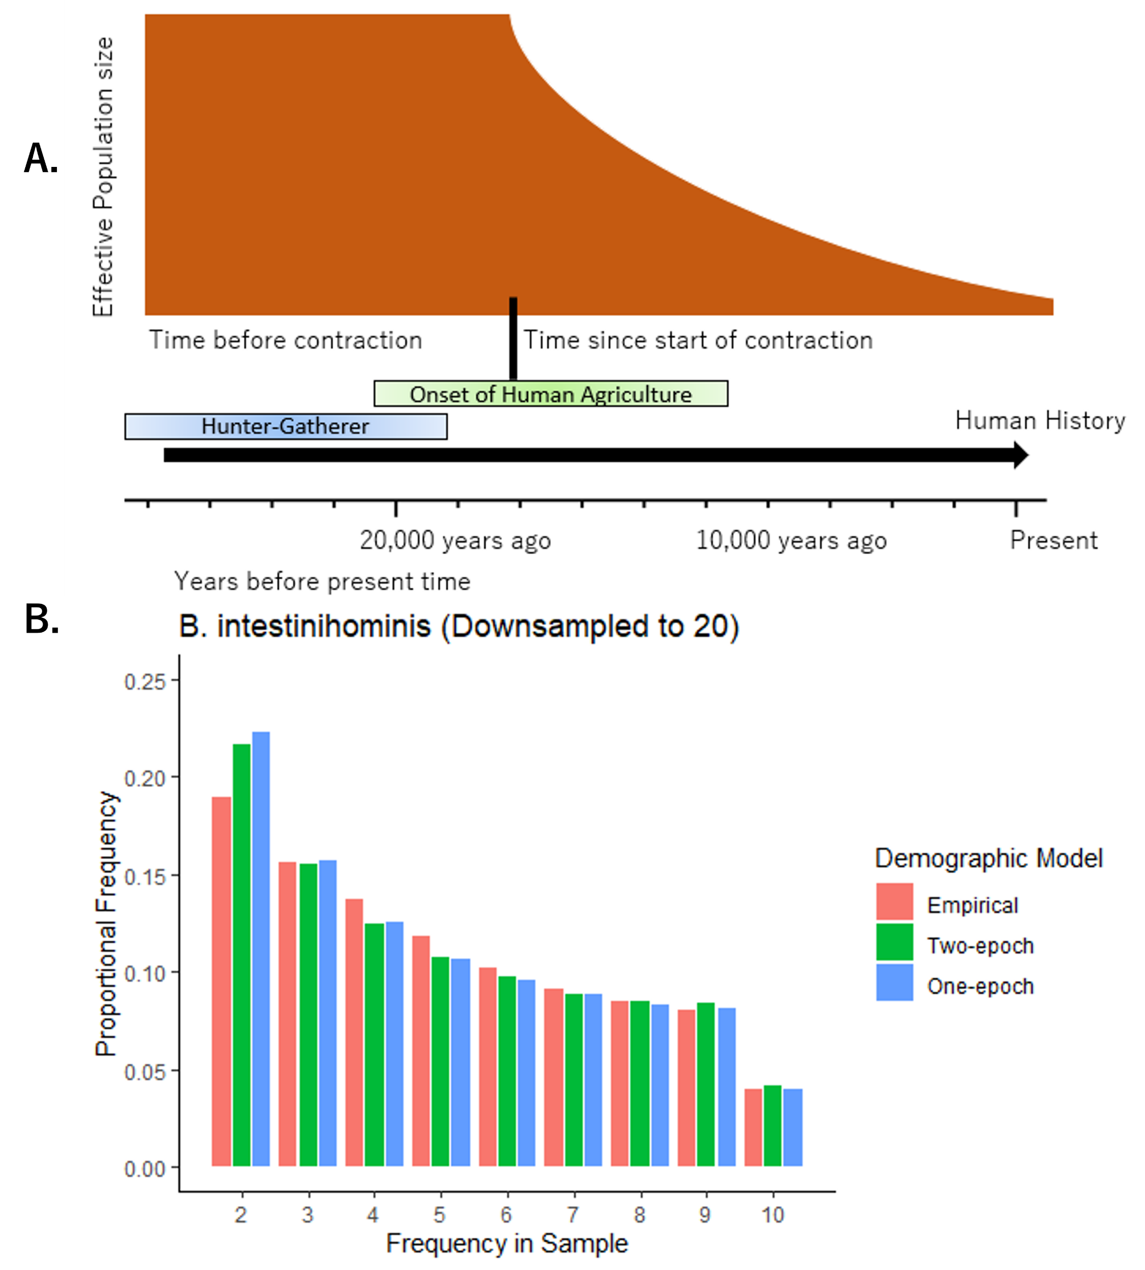
Figure 2
On supplemental full
figure report best model +
Empirical + one-epoch only
For species w/ contraction In table show all

Slide 4
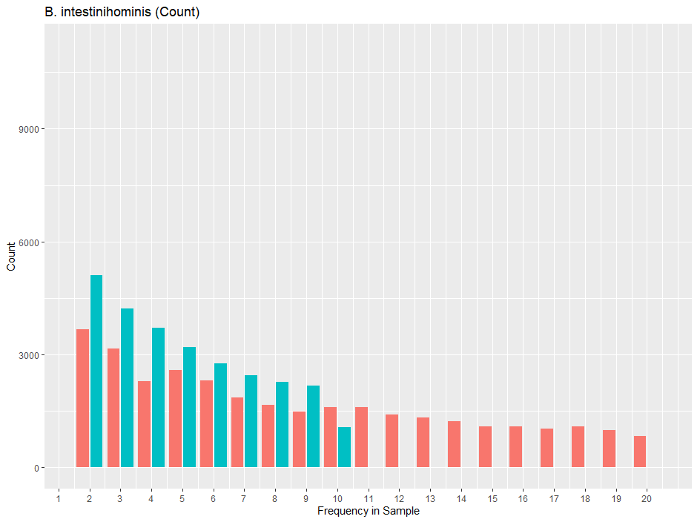
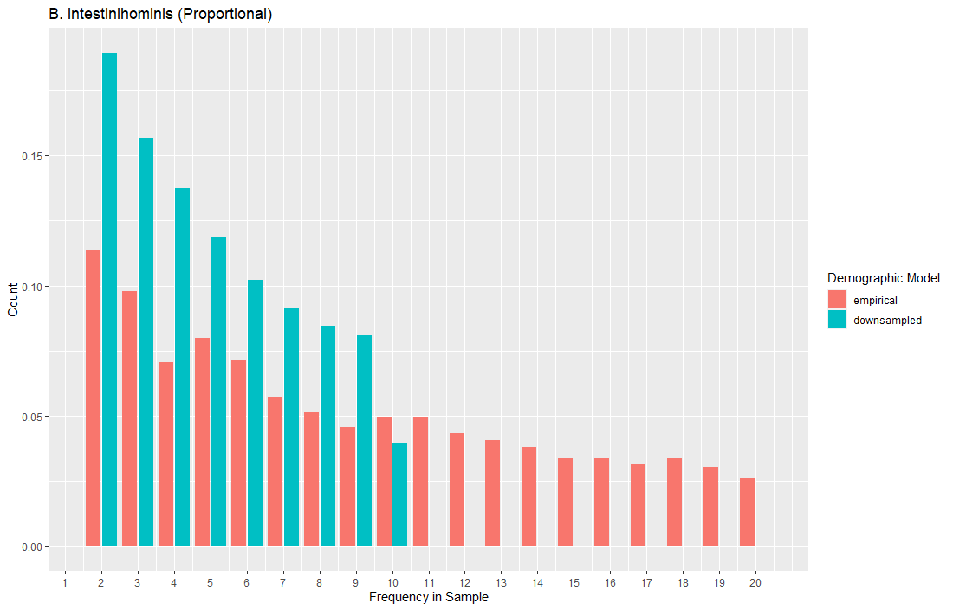
Sanity Check figures

Slide 5
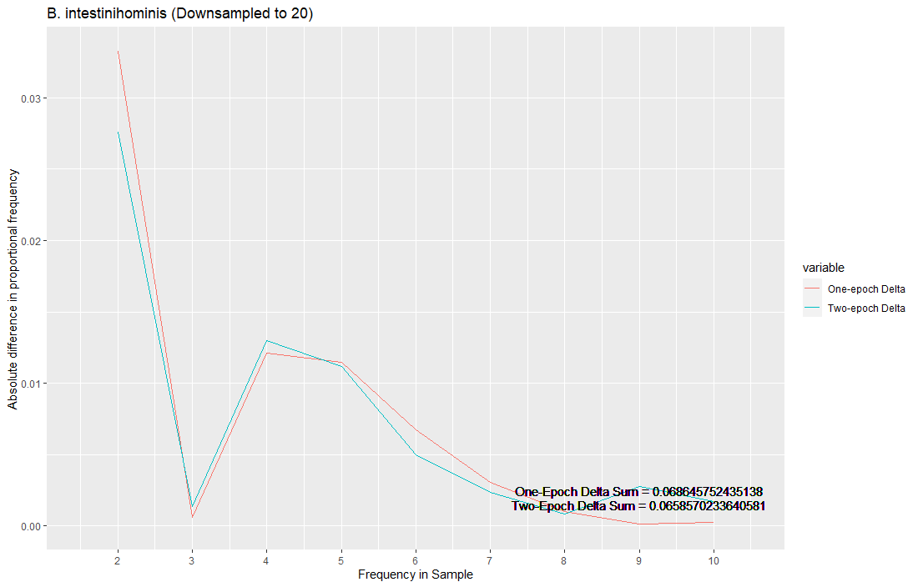
Sanity Check figures

Slide 6
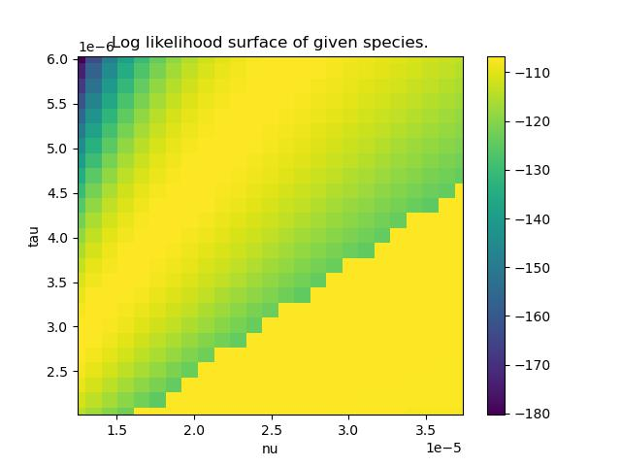
A. muciniphila
Kirk suggests taking
A closer look at a singular
Species to have better initial
For MLE’s
Of note, the ridge pattern
Is counter to what we might
Expect a priori, i.e., we would
Expect that the ridge should
Top left to bottom right.
Big contraction + small time
==
Small contraction + big time

Slide 7
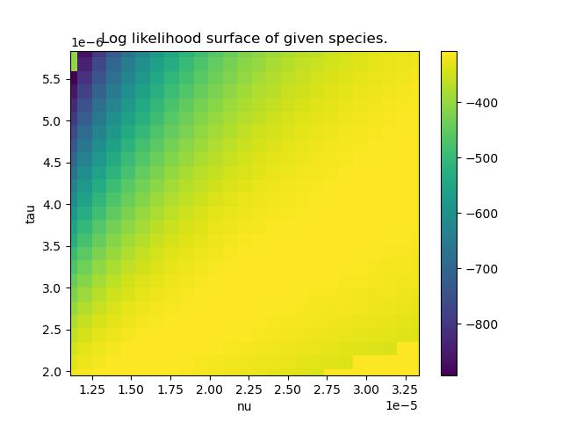
A. onderdonkii

Slide 8
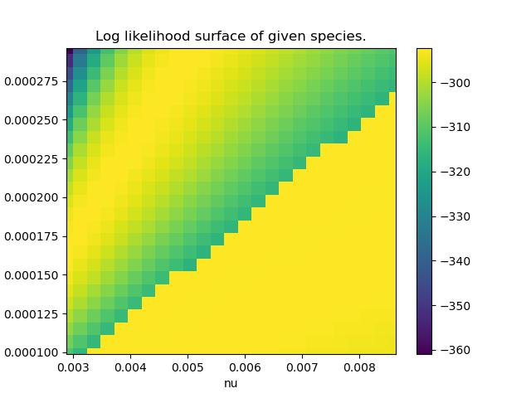
B. thetaiotaomicron
Best fit parameters: [0.00575632 0.00019757].
Maximum multinomial log composite likelihood: -86.5301510885.
There’s a plotting error! I think I figured it out though

Slide 9
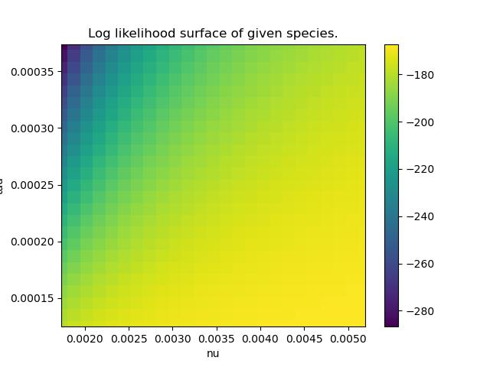
B. xylanisolvens

Slide 10
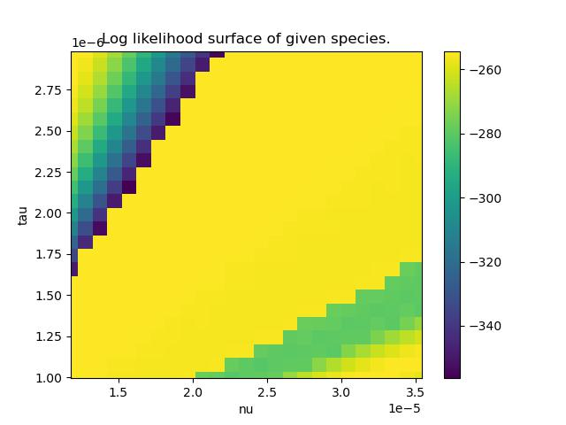
B. intestinihominis

Slide 11
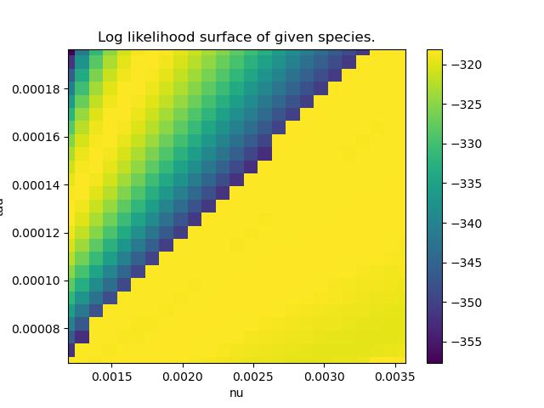
P. distasonis

Slide 12
Todo 20220815
Write in greater detail about nucleotide diversity figure
Read through:
Suzuki 2021
Spencer 2022
Tamburini
Orsted 2022
What does pi mean at different magnitudes? 10e-2 vs. 10e-4
10e-2 might suggest differences between strains
10e-4

Slide 13
TODO 20220815
Fix species script for oral data
SFSs for supplement + main text (B. intestinihominis)
Likelihood search + expanded plotting
Look for better SFS fit
Pi chart set to IID
Hit up Kirk for the LL deets
Bounce off microb stuff to make sure I don’t talk to myself too much

