Slide 1
demo_for_ccgb Weekly Update
20211208
Jon Mah
Garud and Lohmueller Labs

Slide 2
Summary of update
Bottleneck + Exponential Decay demographic model inferences
Met with Kirk to update (also quarterly meeting thing)
Sounds like plan is to rope him in further when we’re finishing up the Dadi/Fitdadi analysis stuff, shooting for occasional meetings during winter quarter
Species union script completed
a few species steps didn’t complete due to memory error when outputting (produced empty species_list.txt, wasn’t caught programmatically) so those need to be rerun prior to union, then genes + snps step
Paired t.test for across-host pi, touched up on figures
Updating write-up as I’m posting this.

Slide 3
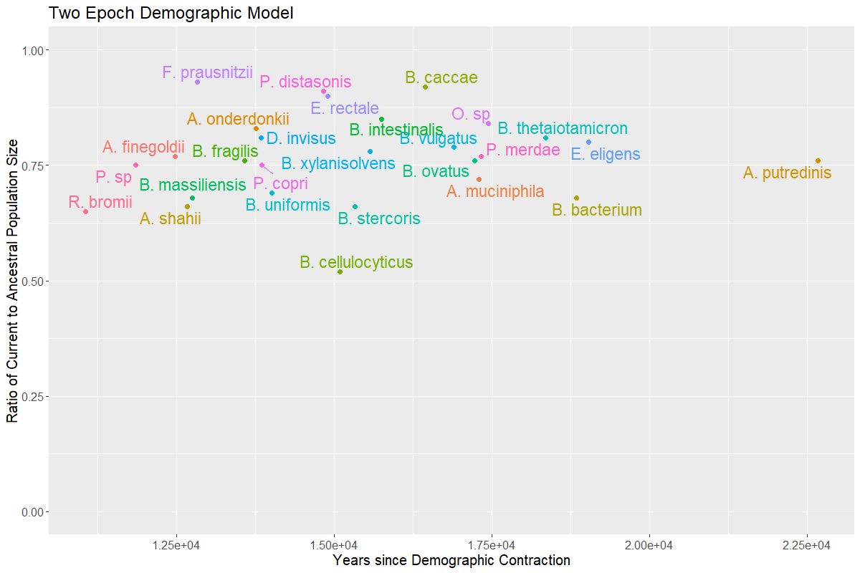
Two Epoch Model

Slide 4
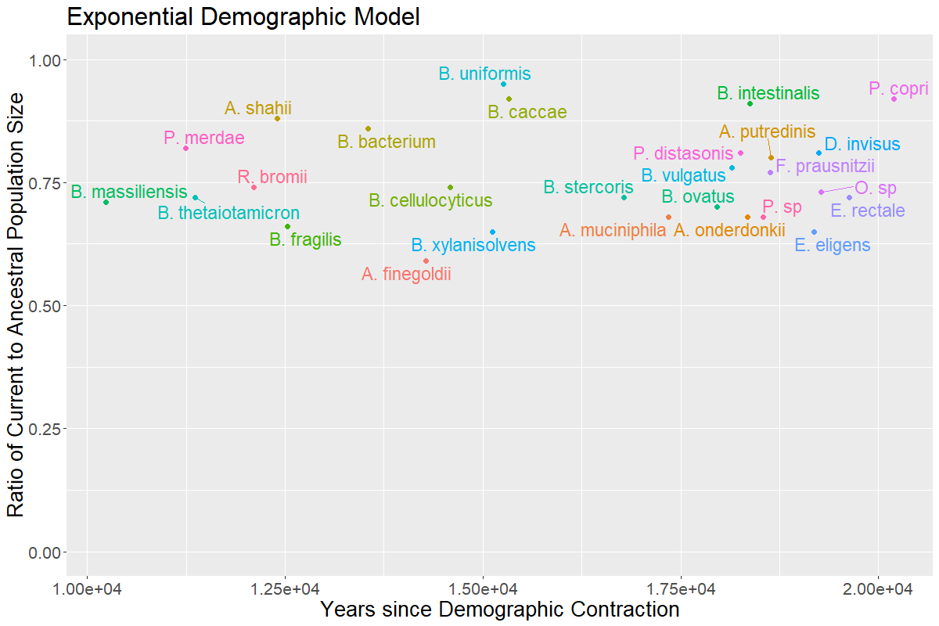


Exponential Decay Model

Slide 5
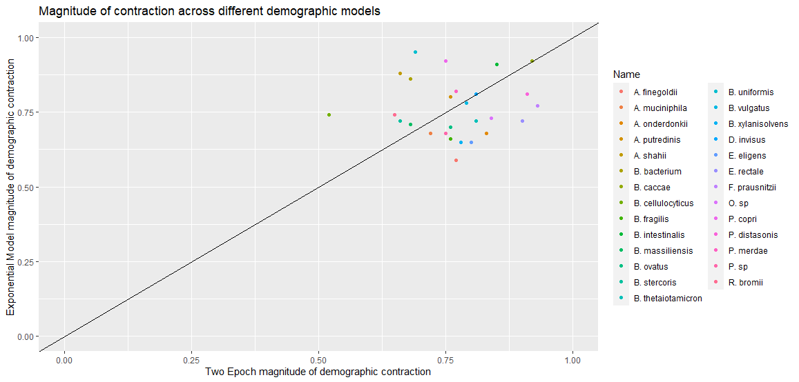
Comparing Magnitude of Contraction
Kirk suggests
plotting out
magnitude of
contraction
divided by
length of time
to see if
there's a correlation
Notes:
Look into magnitude of contraction divided by time as a analog to size of

Slide 6
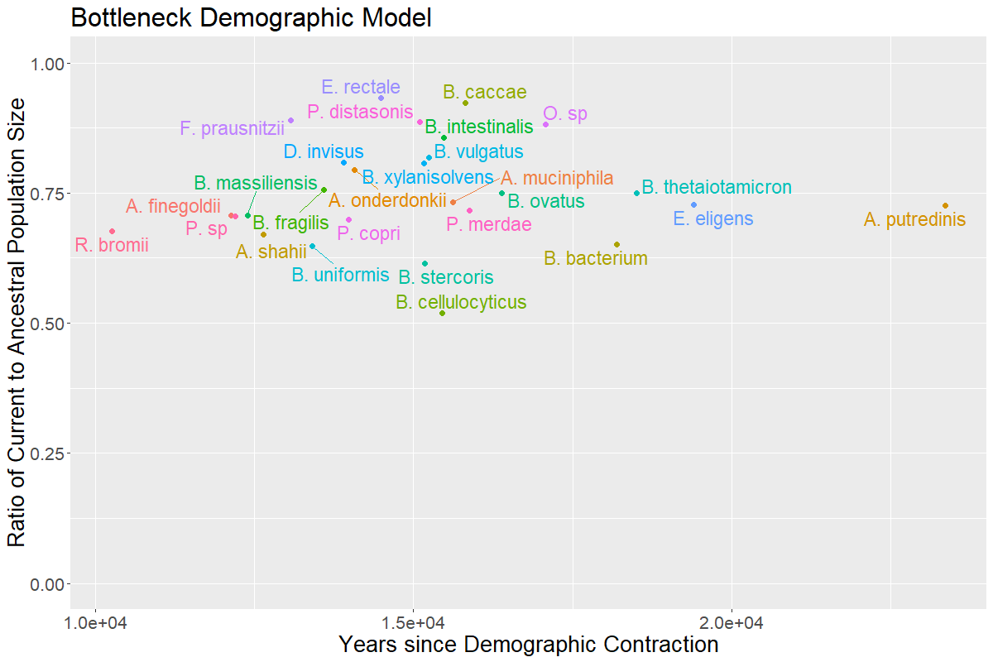



Bottlegrowth Model
Notes:
Compare to one epoch model to strengthen evidence of contraction (one epoch model does not include any demographic events and only fits current and ancestral population size)
Good to check to verify that there is truly a contraction
Lead to further plots with more epochs / more parameters, showing not very much gain in likelihood fit.
Fix parameters to be aligned with human demography, i.e., consider null to be human demography

Slide 7
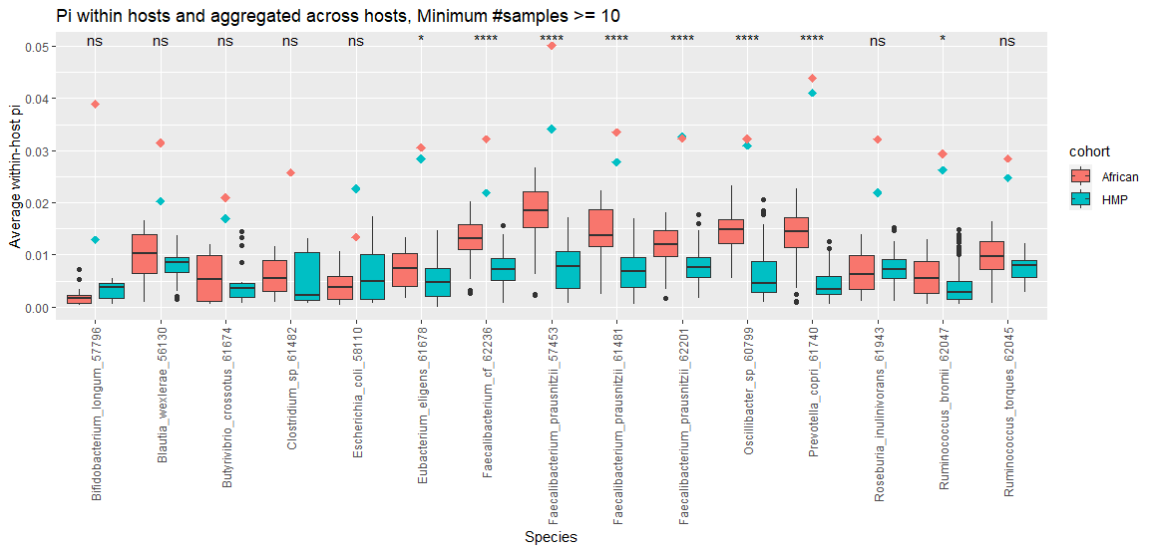
Comparing pi across populations

Slide 8
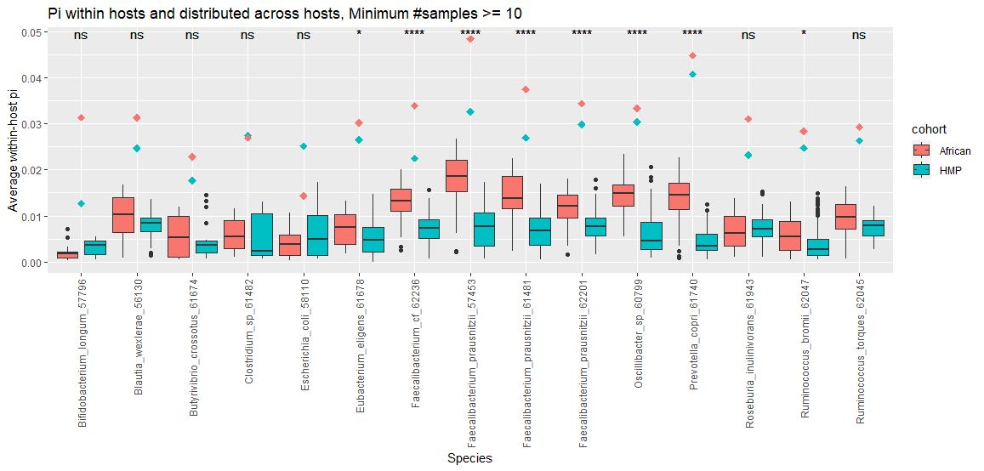
Comparing pi across populations
Notes:
Paired t-test within-and-across-host pi

Slide 9
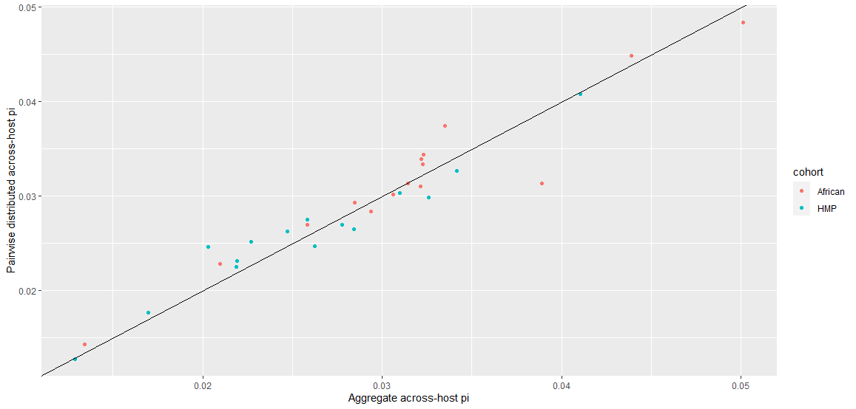
Across-host pi methods comparison
Notes:
Share in lab meeting

Slide 10
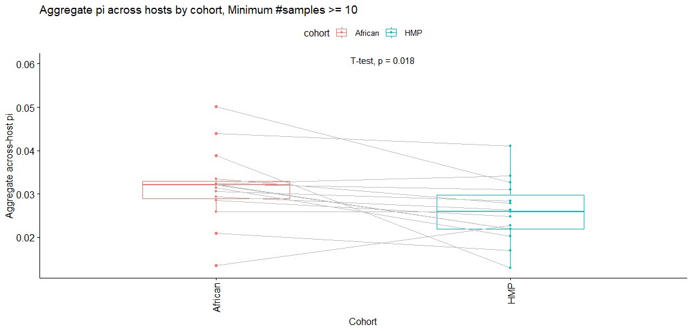
Paired t-test for aggregate across-host pi

Slide 11
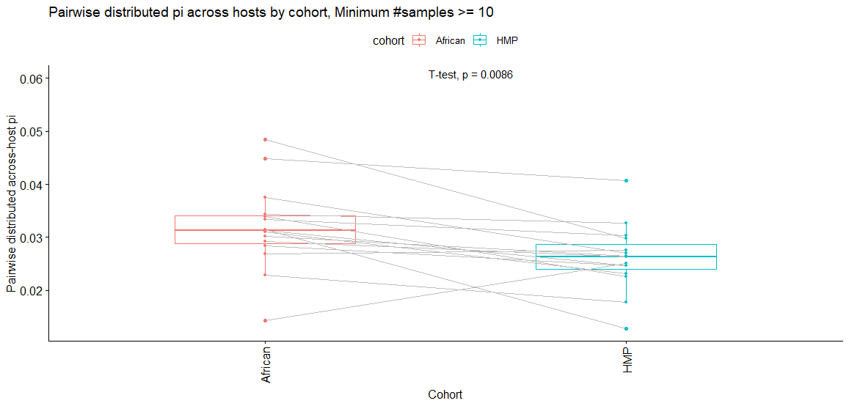
Paired t-test for pairwise distributed across-host pi

Slide 12
Pi comparison thoughts
Paired t-test comparing across-host pi estimates through both methods (aggregate and pairwise) give p-values less than 0.05.
Pairwise method is more significant

Slide 13
//TODO
Midas → demographic inference, etc for oral data
Find best fit for remaining demographic models (three epoch and bottleneck)
Good species command
Print out sample sizes, determine which is converging and which isn’t
Make sure I understand the methods being used, e.g., polarization, clade control
Which species are not converging, what is their sample size
Work on paper outline

