Slide 1
demo_for_ccgb Weekly Update
20211208
Jon Mah
Garud and Lohmueller Labs

Slide 2
Summary of Update
Strike vote called off! (UC recognized the grad student union)
Lit search
Across pi + significance bars
MIDAS wip (will check in tomorrow or later tonight)
Write-up wip (will have fleshed out tomorrow)

Slide 3
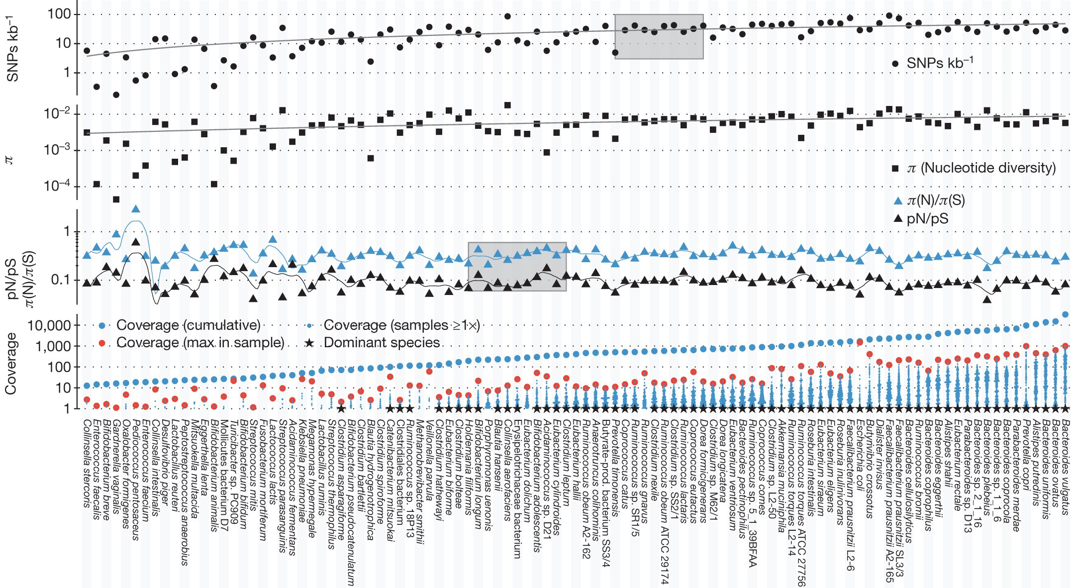
Lit search (how other people describe nucleotide diversity or pi)
Siegfried Schloissnig et al., Nature 2012

Slide 4
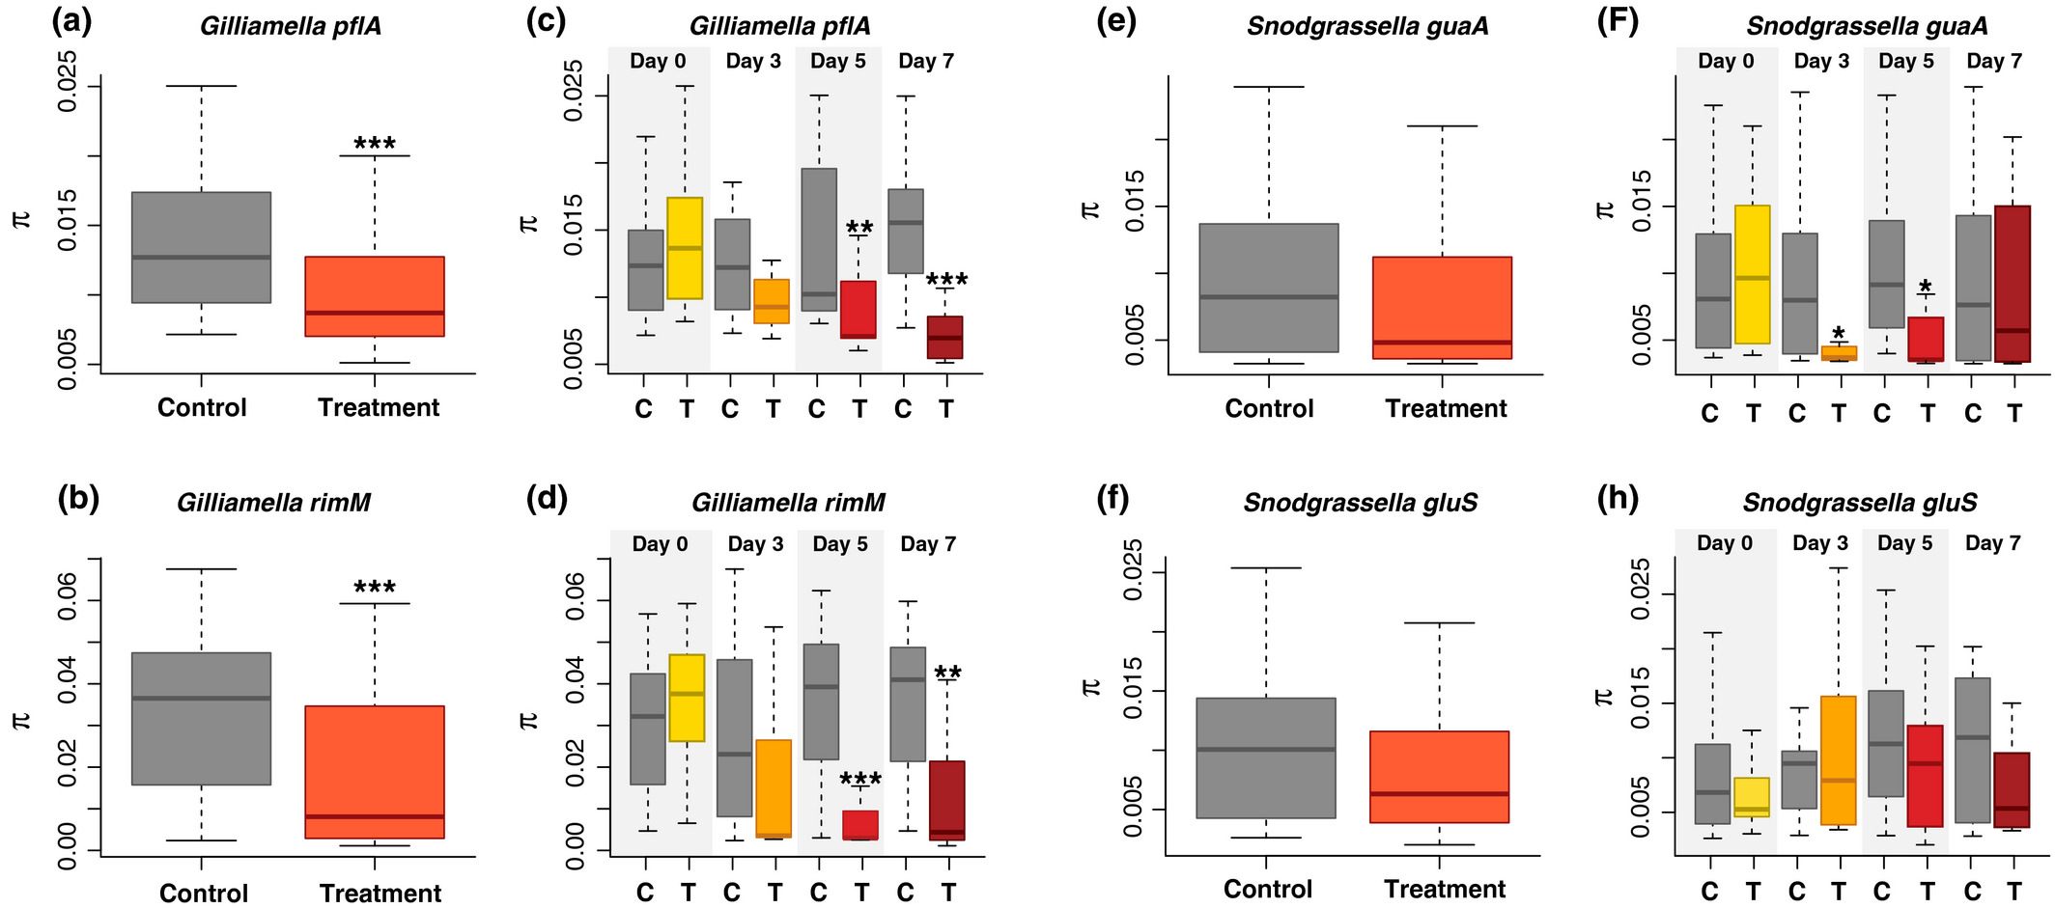
Lit search (how other people describe nucleotide diversity or pi)
Raymann et al., Mol. Ecol. 2017
Notes:
Look for examples of nucleotide diversity across different populations
Look for plots which resemble nucleotide diversity in human gut microbiomes from different populations.

Slide 5
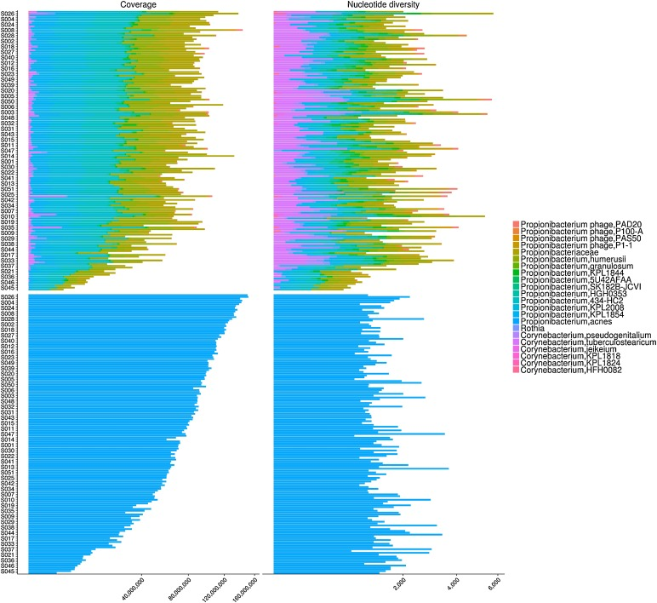
Lit search (how other people describe nucleotide diversity or pi)
Woerner et al., Genetics 2018

Slide 6
Lit search TLDR
Some people use boxplots, some people use bar plots, some people use dot plots. I think for comparison, a boxplot or violin plot or other form of visual distribution is the cleanest, and also can demonstrate statistical significance.

Slide 7
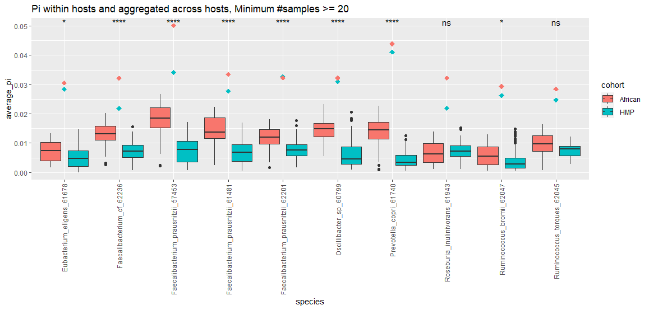
Comparing pi across populations
Boxplots describing the distribution of pi values computed within and across hosts. Broadly, African pi values are computed to be higher values than North American pi values for species in which we have >=20 samples for both cohorts.
The larger dots in the center of each species indicate the aggregate pi value across hosts for that species and cohort.
The asterisks indicate the level of significance (parametric t-test):
ns: p > 0.05
*: p <= 0.05
**: p <= 0.01
***: p <= 0.001
****: P <= 0.0001
Notes:
Paired t-test within-and-across-host pi
Within host pi for one strain is typically 10^-3 or less
Within host pi for two strains is typically 10^-2 or less

Slide 8
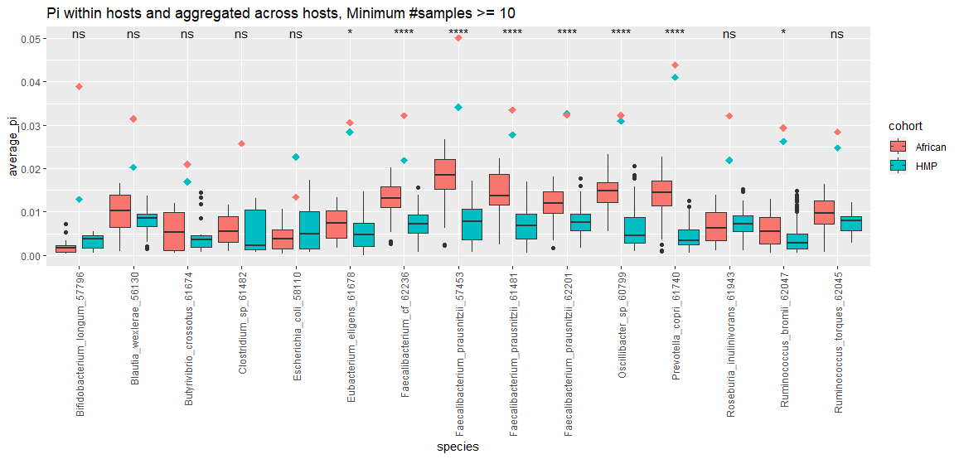
Comparing pi across populations
This is the same as the previous boxplot, except including data for species in which we have >=10 samples for both cohorts.
Add paired t test for each species in either cohort
Clean up plot, e.g., larger dot?
Docs for aggregate across-host pi method

Slide 9
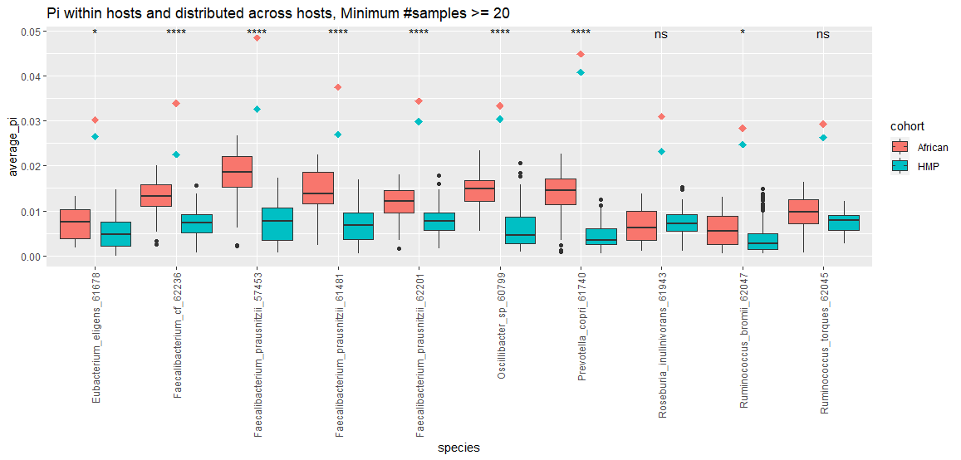
Comparing pi across populations
This is the same as previous but showing pi across hosts when calculated in a pairwise manner and then averaged.
Notes:
Paired t-test within-and-across-host pi

Slide 10
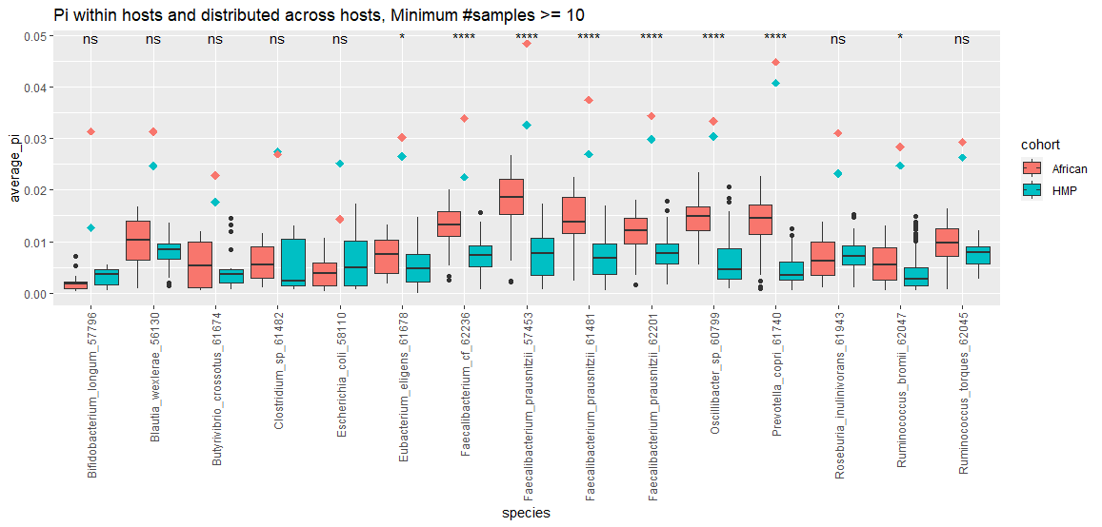
Comparing pi across populations
Note that changing the t-test is comparing the distribution of average pi values, and is unchanged whether you look at pairwise or aggregate methods of across-pi comparison.

Slide 11
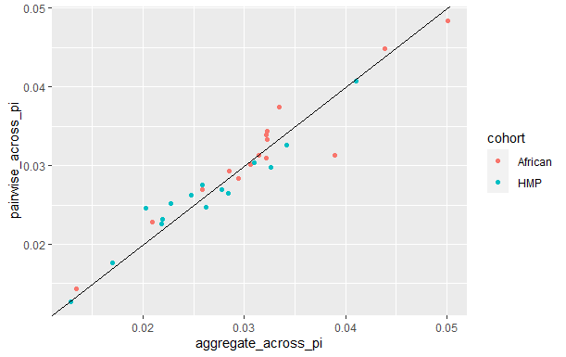
Across-host pi methods comparison
Notes:
Share in lab meeting

Slide 12
Pi comparison thoughts
Across pi is higher than the within-host pi values for the most part (even in species not shown in previous slides)
The value of the across-host pi values is higher than in estimated in the original midas biorxiv, however, I think this can be attributed to a couple of factors
African pi values are generally higher (HMP is closer to original estimates)
Excluding low-sample-depth sites likely raises estimates of pi, since low-sample-depth sites are more likely to have a heterozygosity of 0.
Generally, African pi values are higher (within and across hosts)
This is more significant in samples for which we have more data, i.e., at least 20 samples per cohort is 9/10 significant, 8/10 if you account for multiple hypothesis testing.

Slide 13
//TODO
Midas → demographic inference, etc for oral data
Find best fit for remaining demographic models (three epoch and bottleneck)
Good species command
Print out sample sizes, determine which is converging and which isn’t
Make sure I understand the methods being used, e.g., polarization, clade control
Which species are not converging, what is their sample size
Work on paper outline

