Slide 1
demo_for_ccgb Weekly Update
20211208
Jon Mah
Garud and Lohmueller Labs

Slide 2
Summary of update
Happy New Year! I hope you had a restful break, or at the very least as restful as possible of a “break” you could have had amidst the currently ongoing endtimes!
Finished dadi models
Didn’t get to species step until later on in break, some are still running / need to be rerun (memory error, I suspect from other jobs leaking)
Bad news: roommate tested positive and I expect to test positive soon
Good news: while I’m sick I can rerun things!

Slide 3
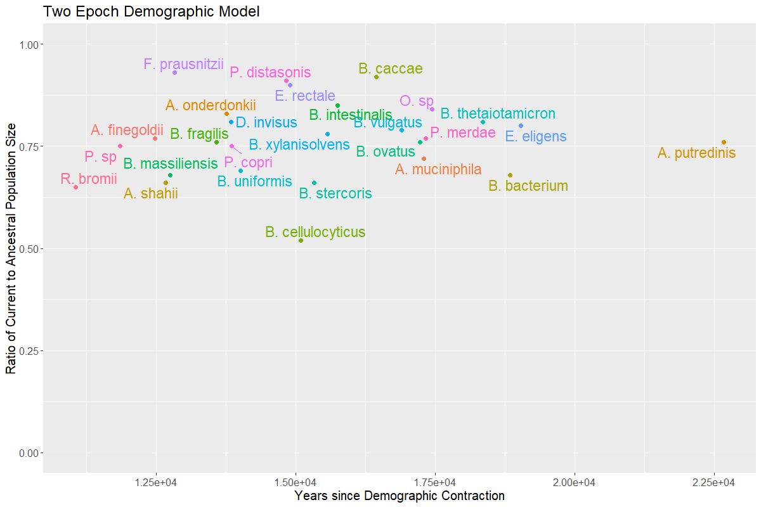
Two Epoch Model

Slide 4
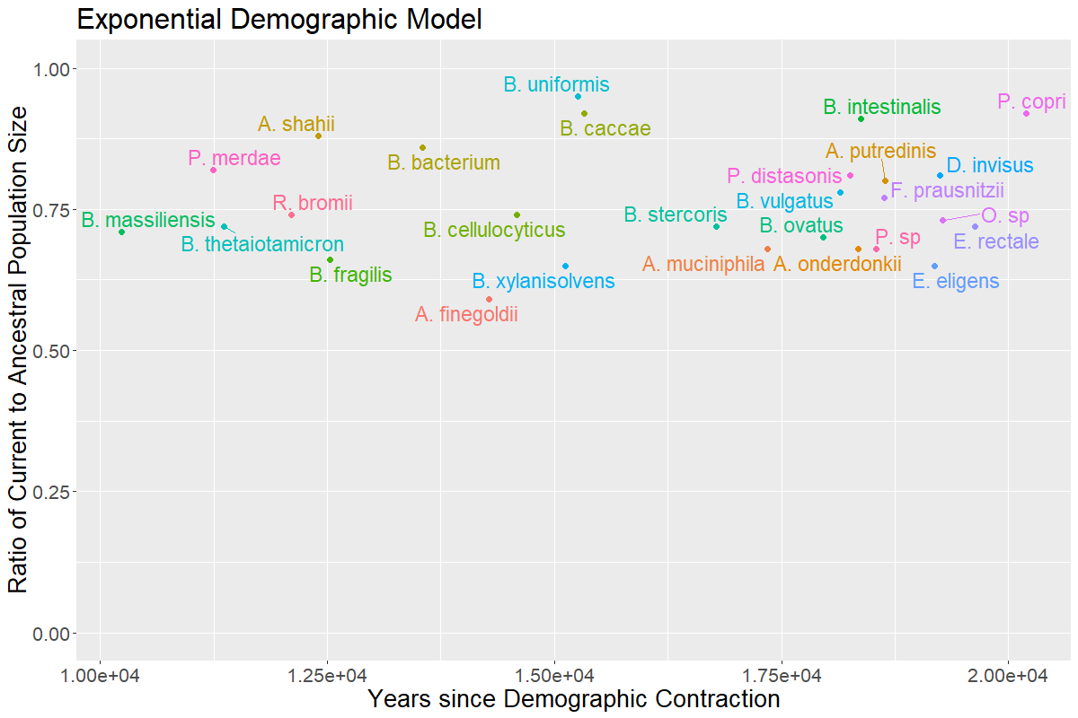


Exponential Decay Model

Slide 5
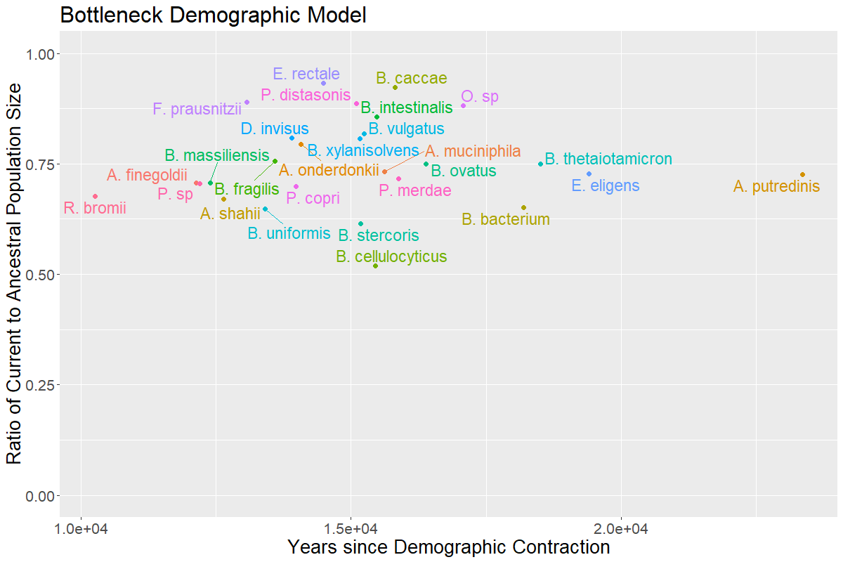



Bottlegrowth Model
Notes:
Compare to one epoch model to strengthen evidence of contraction (one epoch model does not include any demographic events and only fits current and ancestral population size)
Good to check to verify that there is truly a contraction
Lead to further plots with more epochs / more parameters, showing not very much gain in likelihood fit.
Fix parameters to be aligned with human demography, i.e., consider null to be human demography

Slide 6
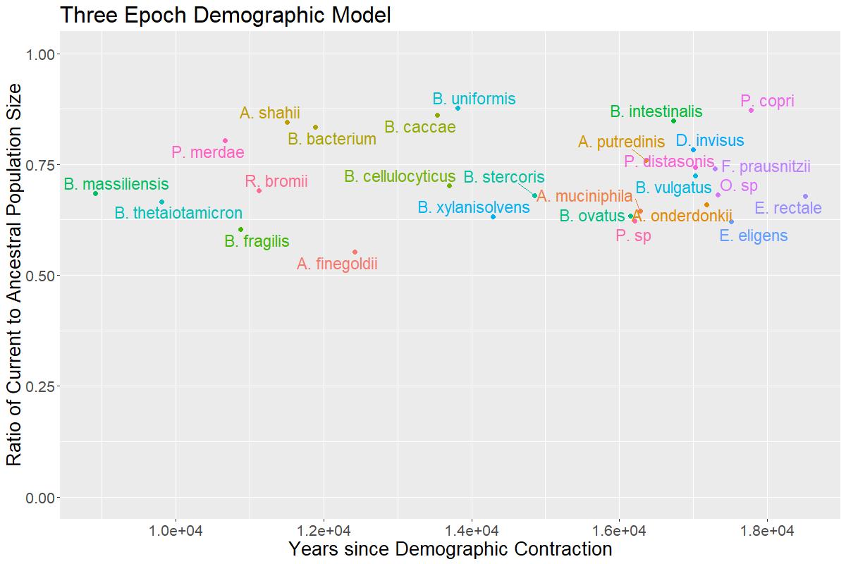

Three Epoch Model
Notes:
Compare to one epoch model to strengthen evidence of contraction (one epoch model does not include any demographic events and only fits current and ancestral population size)
Good to check to verify that there is truly a contraction
Lead to further plots with more epochs / more parameters, showing not very much gain in likelihood fit.
Fix parameters to be aligned with human demography, i.e., consider null to be human demography

Slide 7
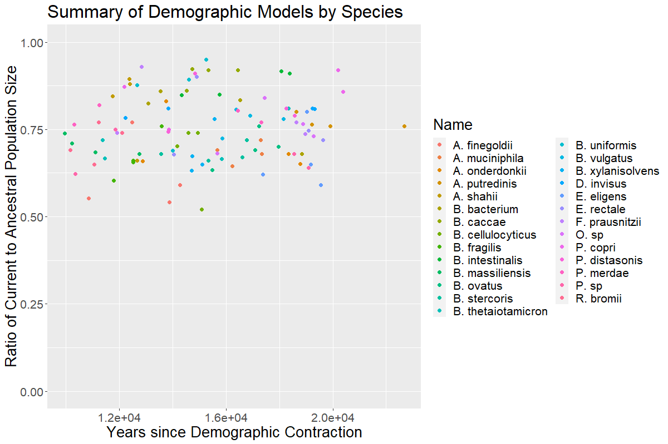
Comparing Demographic Model Inference across Species

Slide 8
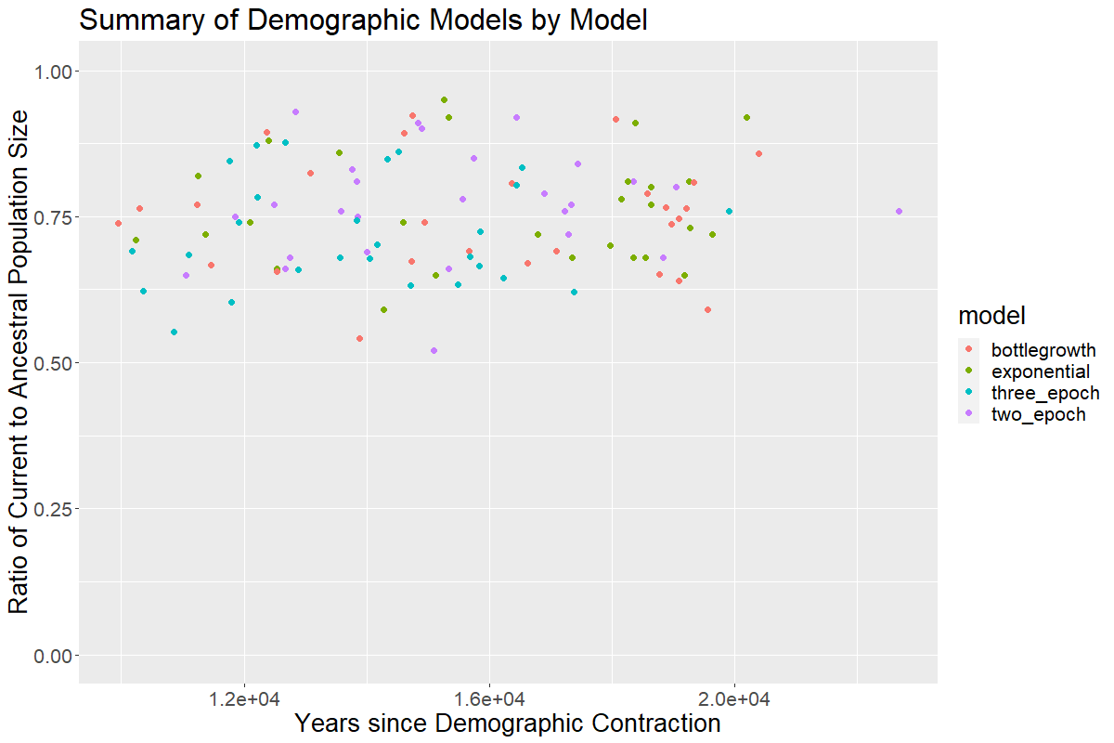
Comparing Species across Demographic Models

Slide 9
//TODO
Midas → demographic inference, etc for oral data
Make sure I understand the methods being used, e.g., polarization, clade control
Which species are not converging, what is their sample size
Work on paper outline

Slide 10
Misc. other analysis that I want to follow up on later
See next few slide(s)

Slide 11
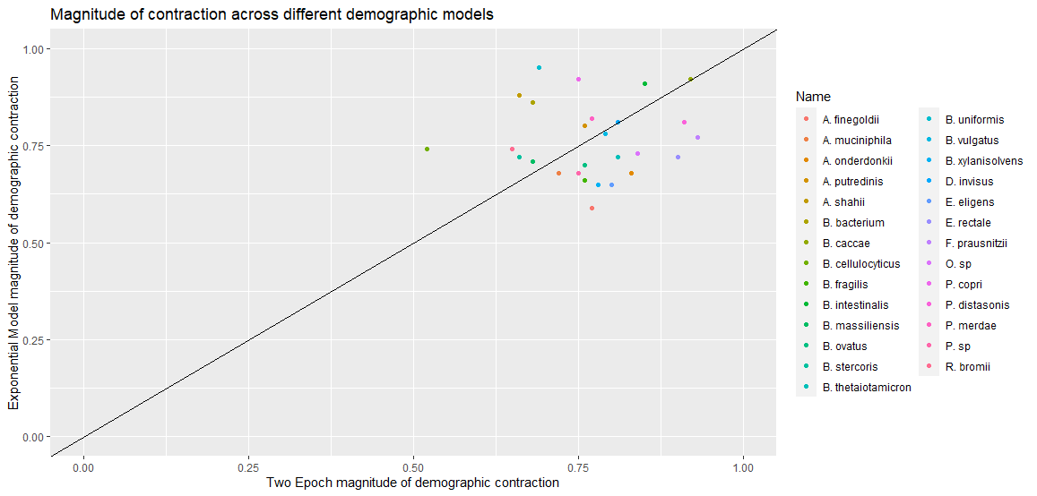
Comparing Magnitude of Contraction
Kirk suggests
plotting out
magnitude of
contraction
divided by
length of time
to see if
there's a correlation
Notes:
Look into magnitude of contraction divided by time as a analog to size of

