Slide 1
demo_for_ccgb Weekly Update
20211208
Jon Mah
Garud and Lohmueller Labs

Slide 2
Summary of Update
I spent Thanksgiving Break catching up on documentation and commenting on old scripts while waiting for jobs to finish running on Hoffman2 (for computing pi)
I’m waiting on the MIDAS merge step right now and will hopefully (Leah says it might take up to 24 hours???) have that done by tomorrow’s meeting.
Computing pi within and across hosts is mostly done
I still have a few jobs running that took longer than 36 hours (all HMP data)

Slide 3
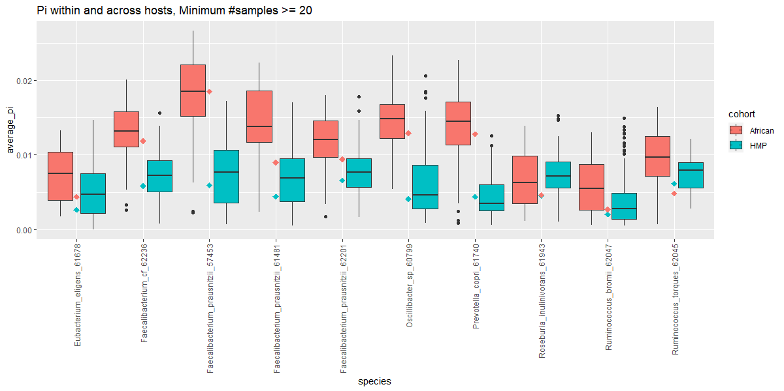
Comparing pi across populations
Boxplots describing the distribution of pi values computed within and across hosts. Broadly, African pi values are computed to be higher values than North American pi values for species in which we have >=20 samples for both cohorts.
The larger dots in the center of each species indicate the average pi value across hosts for that species and cohort.
Notes:
Paired t-test within-and-across-host pi

Slide 4
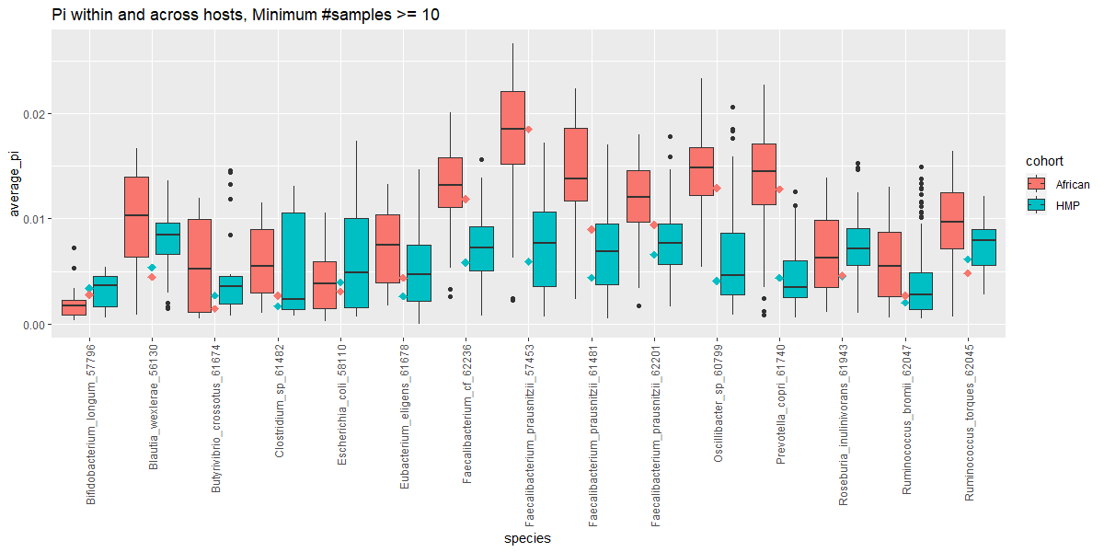
Comparing pi across populations
This is the same as the previous boxplot, except including data for species in which we have >=10 samples for both cohorts.

Slide 5
//TODO
Midas → demographic inference, etc for oral data
Find best fit for remaining demographic models (three epoch and bottleneck)
Good species command
Print out sample sizes, determine which is converging and which isn’t
Make sure I understand the methods being used, e.g., polarization, clade control
Which species are not converging, what is their sample size
Work on paper outline

Slide 6
//TODO
Check literature for pi comparison figures – if someone else has done similar analysis, make sure to cite
(ok to recreate)
Do literature search on pi comparison figure, add write-up describing results by next week.
Perform t-tests for significance.
Fix across-pi computation, consider two methods (pairwise pi calculation for two samples, take average vs. consider all alleles at same time)
Fix MIDAS species step, check in on Monday or before

