Slide 1
demo_for_ccgb Rotation Update
20210111
Jon Mah
Garud Lab

Slide 2
Logistics
As a heads-up I plan to take Jan 20th off (either hiding in a bunker or celebrating, depending on the state of democracy) if that’s ok.
Happy MLK Jr. Day!
Congrats on pulling the Uno reverse card RE: soft selective sweeps

Slide 3
Project Aim
Science Goal: Infer the demographic history of common commensal gut bacteria
Training Goal: Learn popgen tools / tech for microbiome
Personal Goal: Have fun ☺!

Slide 4
Gameplan
Initially focus on B. vulgatus
Create syn / ns SFSs
Compare to expectation of SFS
Given clade data (e.g., continent of origin), create PCA plot
Run Dadi to determine best fit demographic model
Start with Omar Conejo’s model(s)
Perhaps find link to human demography?
Apply to other species
Apply to other data sets (include African data, Peruvian data)

Slide 5
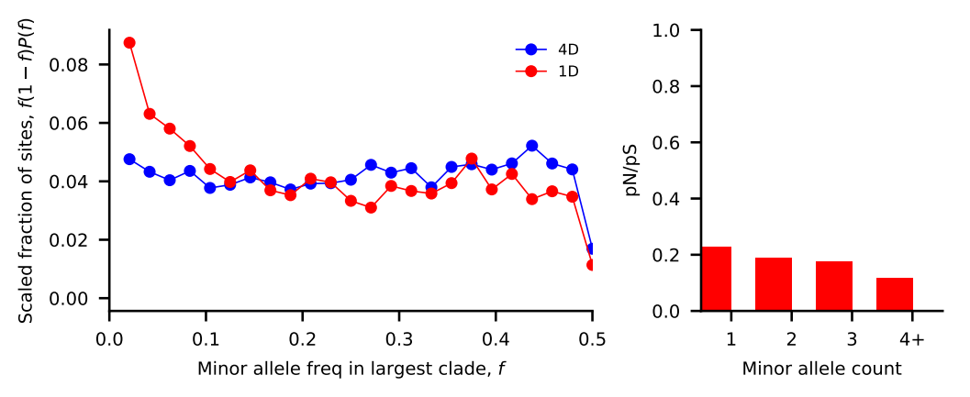
Progress
Read through `microbiome_evolution` codebase
I have a rough idea of how things work together, file format, etc.
Recreate figure output from `plot_within_clade_sfs`
Output sfs in file format
The count locations are:
1 2 3 4…
The synonymous SFS is:
3066 1346 904 727…
The nonsynonymous SFS is:
3254 1171 732 513…

Slide 6

SFS for B. vulgatus

Slide 7
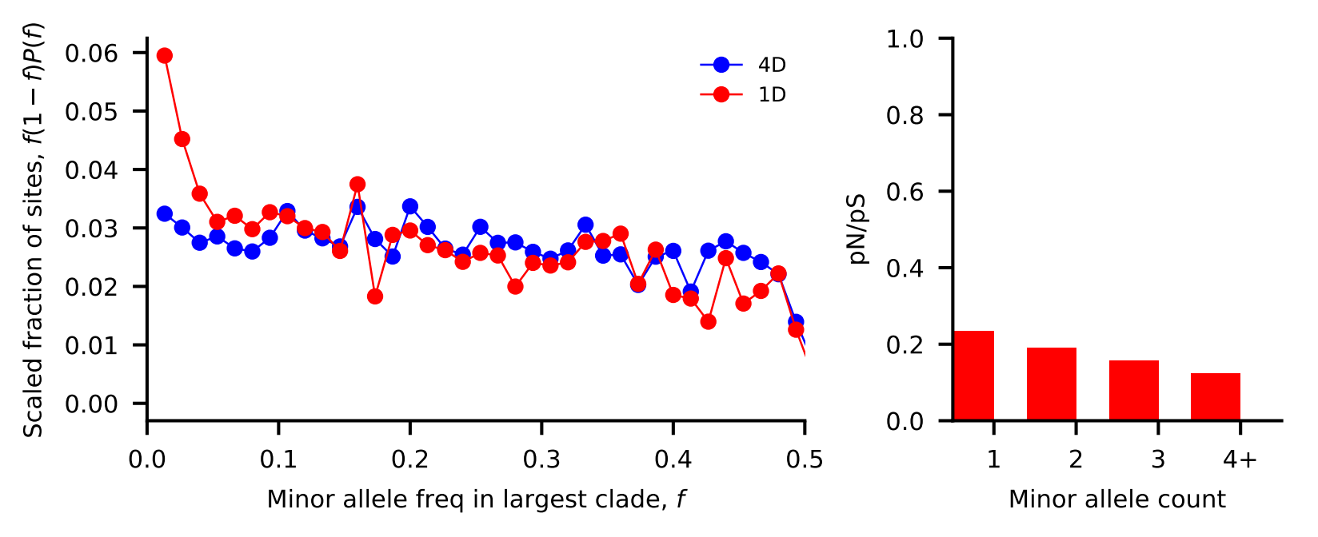
SFS for B. uniformis

Slide 8
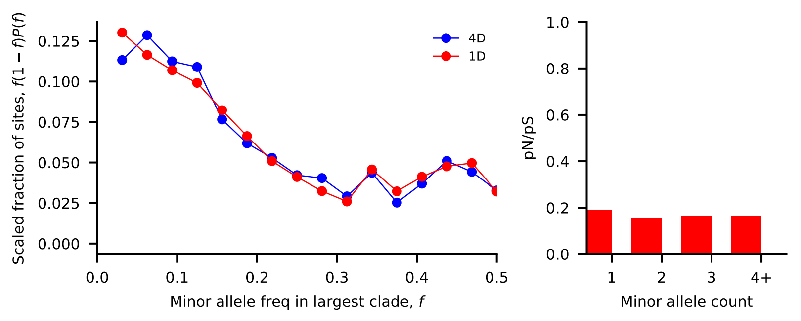
SFS for A. putredinis

Slide 9
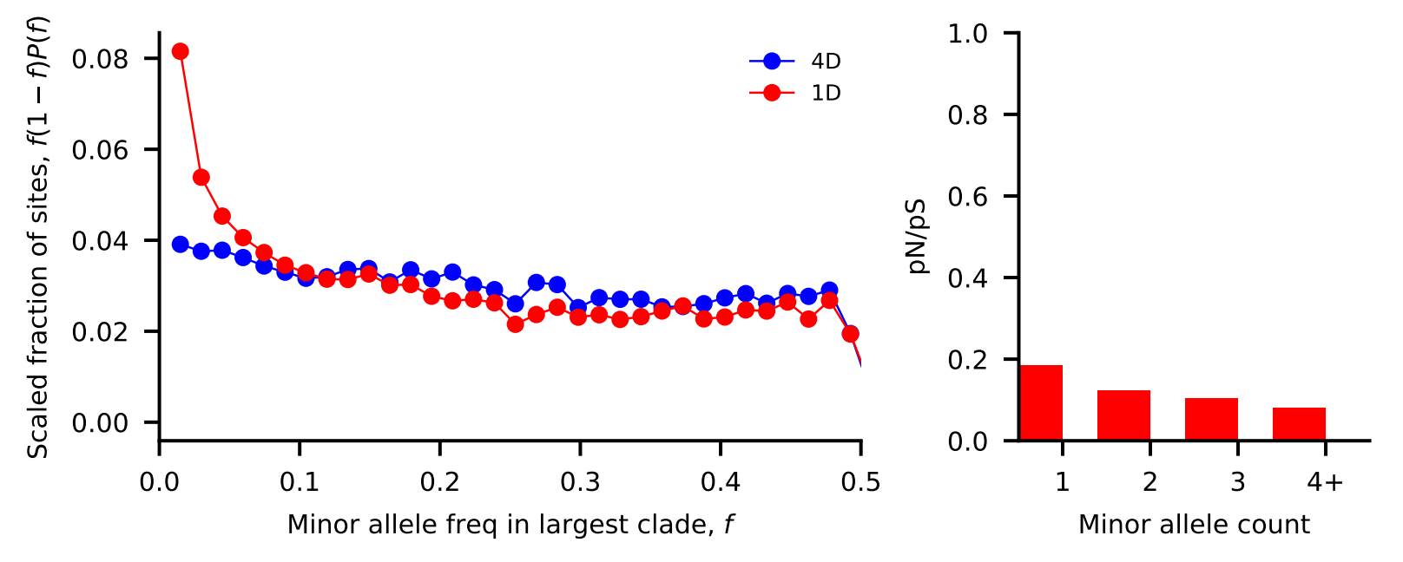
SFS for E. rectale

Slide 10
//TODO
Touch up plotting script
E.g., parse input and output so that it can quickly plot different a different species.
Find reasonable initial guesses for demographic params
Read scripts without debug mode
Read about microbial demographics: H. pylori (Falush), P. copri (Tett), truong2017microbial
Read Midas paper (nayfach2016integrated)
Download microbiome data, run Midas

Slide 11
Standing questions
Investigate edge length distribution
Compare commensal bacteria to human demography
Compare commensal bacteria to pathogens

