Slide 1
demo_for_ccgb Weekly Update
20220214
Jon Mah
Garud and Lohmueller Labs

Slide 2
Summary of Update
Fitting more complex models with and without singletons to B. thetaiotamicron

Slide 3
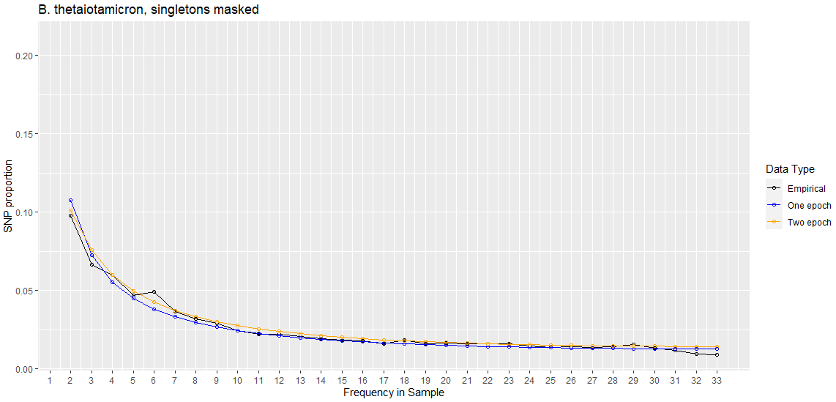
Two Epoch | Masking Singletons
Best Nu | 1.00111020e-01
Best T (in years) | 9093.112279
Two-epoch log likelihood | -292.381165778
One-epoch log likelihood | -360.547850479

Slide 4
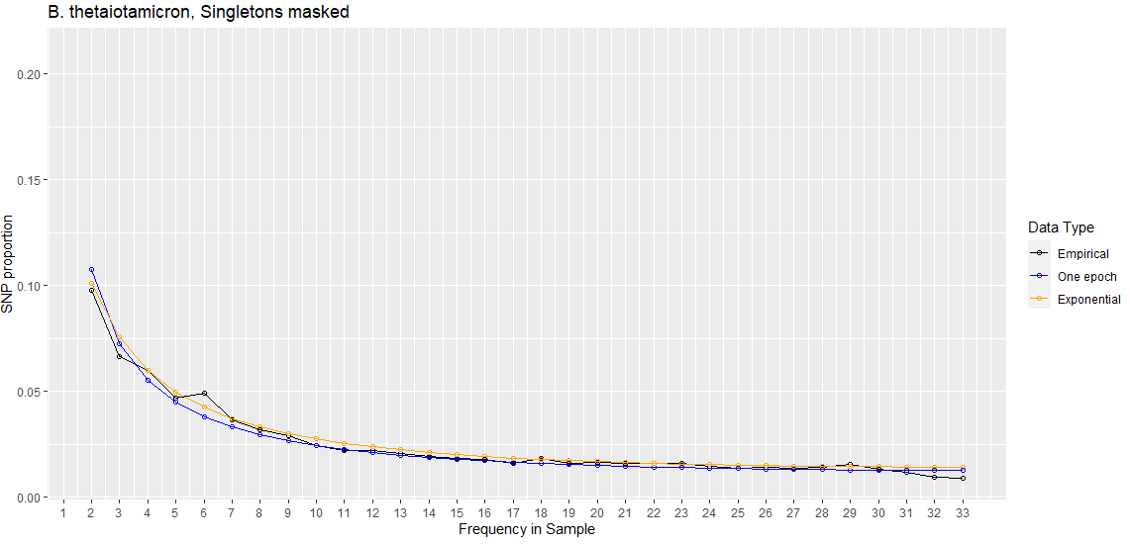
Exponential (Decay) | Masking Singletons
Best Nu | 1.07129257e-01
Best T (in years) | 13446.23105
Exponential log likelihood | -292.647328917
One-epoch log likelihood | -360.547850479

Slide 5
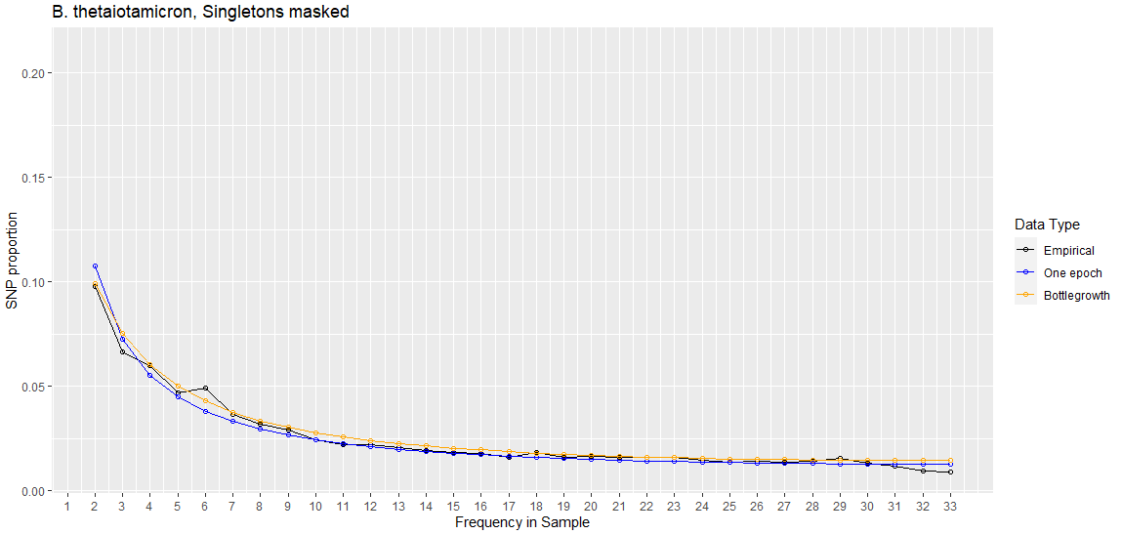
Bottlegrowth | Masking Singletons
Best Nu | 9.07058262e-02
Best T (in years) | 13485.86161
Bottlegrowth log likelihood | -293.019837289
One-epoch log likelihood | -360.547850479

Slide 6
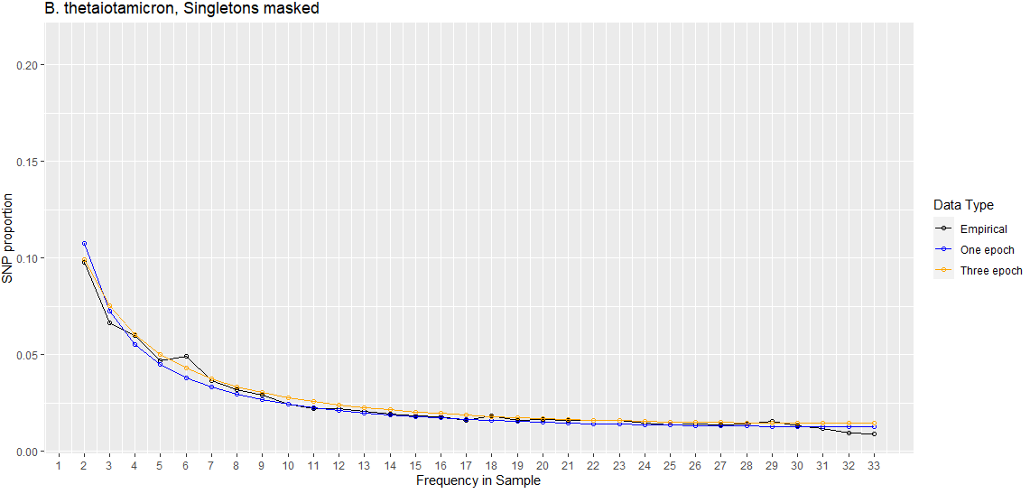
Three Epoch | Masking Singletons
Best Nu | 1.06804355e-01
Best T (in years) | 15225.36953
Three-epoch log likelihood | -294.274998577
One-epoch log likelihood | -360.547850479

Slide 7
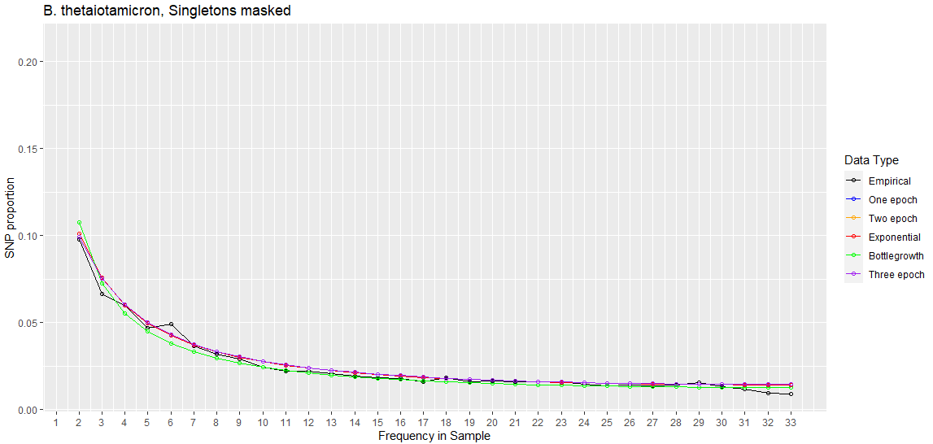

Slide 8
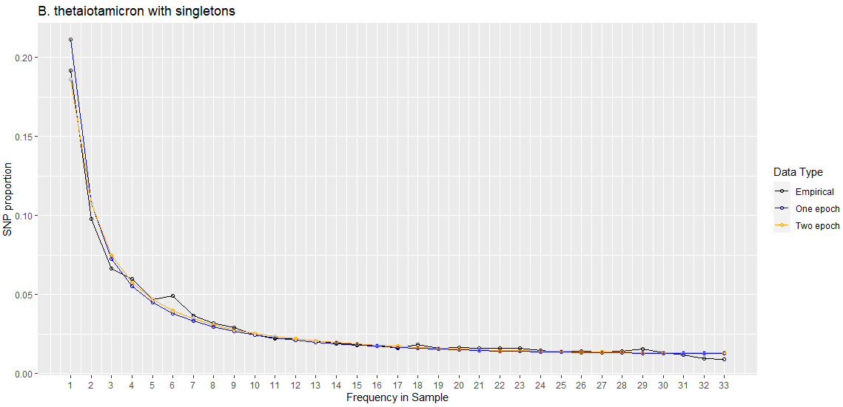
Two Epoch | With Singletons
Best Nu | 3.66872423e-03
Best T (in years) | 10352025.73
Two-epoch log likelihood | -348.31818418
One-epoch log likelihood | -432.953887663

Slide 9
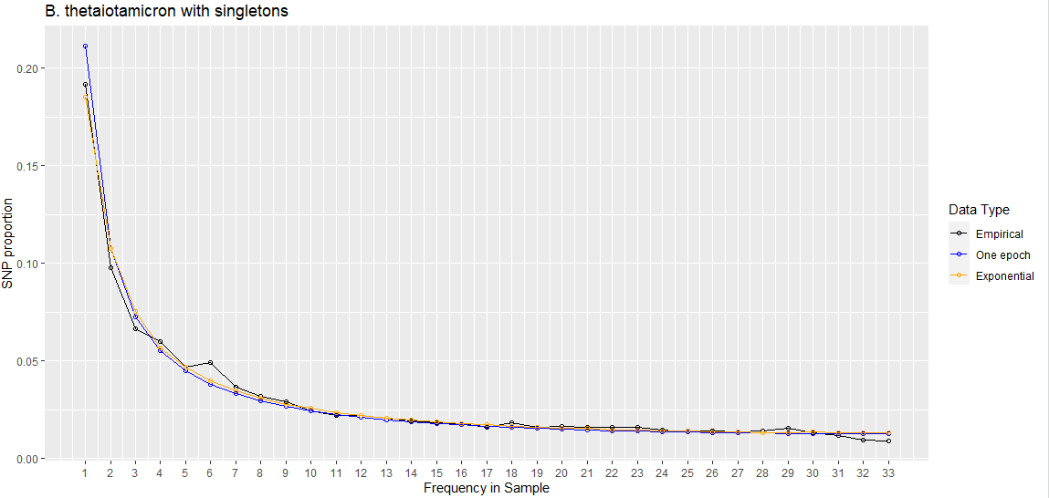
Exponential (Decay) | With Singletons
Best Nu | 3.67E-03
Best T (in years) | 9944895.084
Exponential log likelihood | -343.854586866
One-epoch log likelihood | -432.953887663

Slide 10
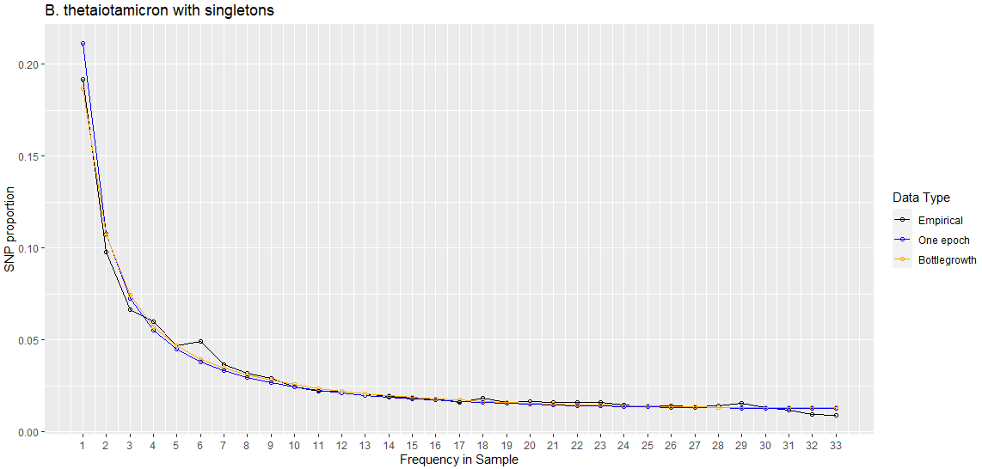
Bottlegrowth | With Singletons
Best Nu | 5.63E-03
Best T (in years) | 8048292.299
Bottlegrowth log likelihood | -348.187325983
One-epoch log likelihood | -432.953887663

Slide 11
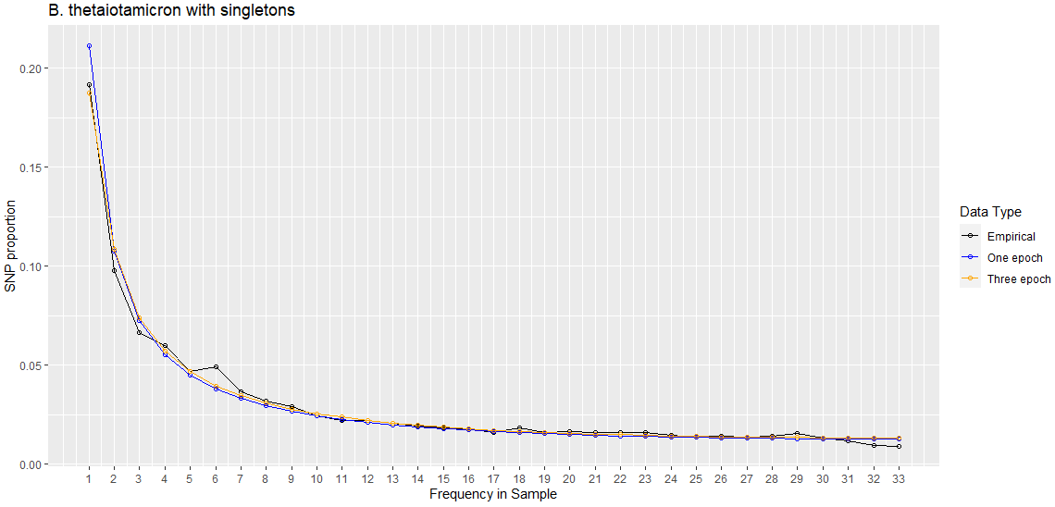
Three Epoch | With Singletons
Best Nu | 7.94514730e-03
Best T (in years) | 8949490.755
Three-epoch log likelihood | -348.566328737
One-epoch log likelihood | -432.953887663

Slide 12
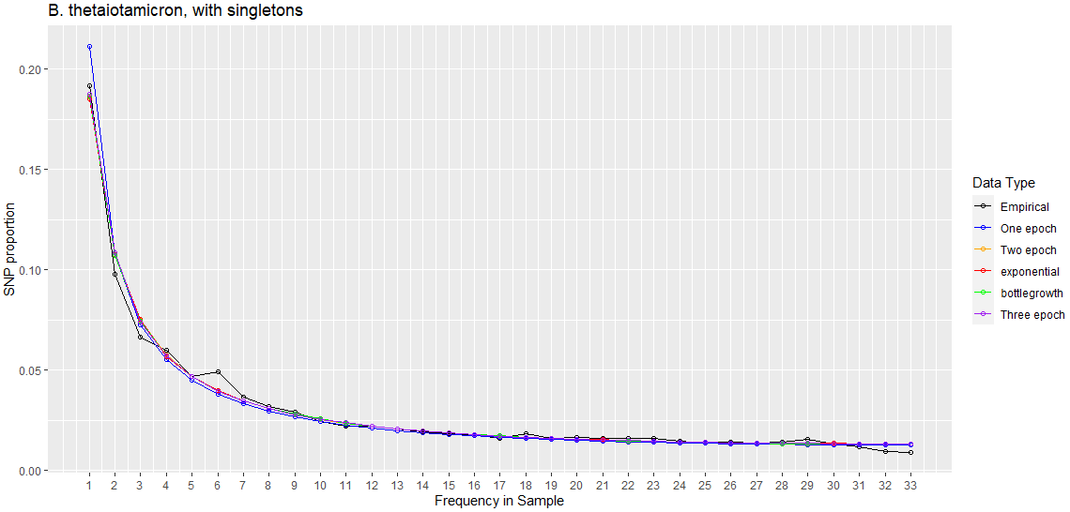

Slide 13
Thoughts
More complex models don’t seem to fit especially better in terms of likelihood or SFS
When masking singletons, there is greater variation in the inferred SFS by model in terms of SFS

Slide 14
//TODO
Look into confidence intervals
Poisson sample SFS
Dadi.Spectrum_mod.sample(self)
Bootstrap VCF
1000 SFS’s, run MLE inference on each SFS, 5% and 95% of param space is our CI
By end of quarter:
Try and finish fecal analysis
Try and finish MIDAS stuff
Look at sparsing SFS
Instead of doing all the populations and models, just take a closer look at two
Search space really well

Slide 15
//TODO
Look into confidence intervals
Poisson sample SFS
Dadi.Spectrum_mod.sample(self)
Bootstrap VCF
1000 SFS’s, run MLE inference on each SFS, 5% and 95% of param space is our CI

Slide 16
//TODO
By end of quarter:
Try and finish fecal analysis
Try and finish MIDAS stuff

Slide 17
//TODO
Look at sparsing SFS
Instead of doing all the populations and models, just take a closer look at two
Search space really well

