Slide 1
demo_for_ccgb Weekly Update
20220901
Jon Mah
Garud and Lohmueller Labs

Slide 2
Summary
MIDAS
Likelihood Surface plots

Slide 3
MIDAS
Missing 21 species from snps output
Actinomyces_viscosus_57672
Fusobacterium_periodonticum_58002
Gemella_haemolysans_61762
Granulicatella_elegans_61945
Haemophilus_parahaemolyticus_60505
Haemophilus_parainfluenzae_57123
Haemophilus_parainfluenzae_62356
Haemophilus_parainfluenzae_62468
Haemophilus_paraphrohaemolyticus_58563
Haemophilus_sputorum_53575
Neisseria_sp_61995
Porphyromonas_sp_57899
Prevotella_nanceiensis_44721
Prevotella_sp_61856
Rothia_mucilaginosa_58144
Streptococcus_parasanguinis_58487
Streptococcus_sp_57750
Streptococcus_sp_61820
Streptococcus_vestibularis_56030
Veillonella_sp_62404
Veillonella_sp_62611
Will contact Raffaella

Slide 4
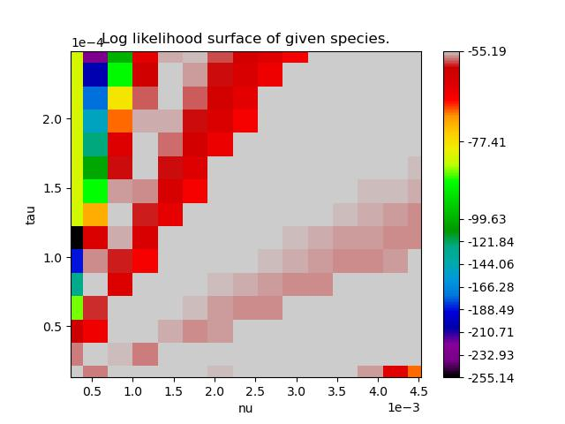

P. Distasonis (CustomNorm)
Color distribution is split evenly
between top 20 percent and bottom 80
This is what I’m thinking of going
With
Kirk’s Suggestions
Maybe make everything below a certain threshold just a “bad color”
Maybe make everything above a certain threshold a “good color”
Maybe make tick marks at points relative to best
Breakpoints: -3, -6, -10, -15, <-15
Add star or dot around MLE (inferred, not given)
-66
Sanity check
More extreme contraction + short time should be the same as less extreme + longer time

Slide 5

P. Distasonis (CustomNorm)
Color distribution is less
severely weighted
towards max values

Slide 6
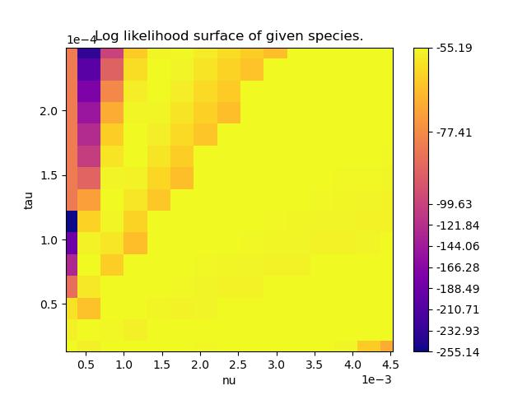
P. Distasonis (different color scheme)
Color distribution is split evenly
between top 20 percent and bottom 80

Slide 7
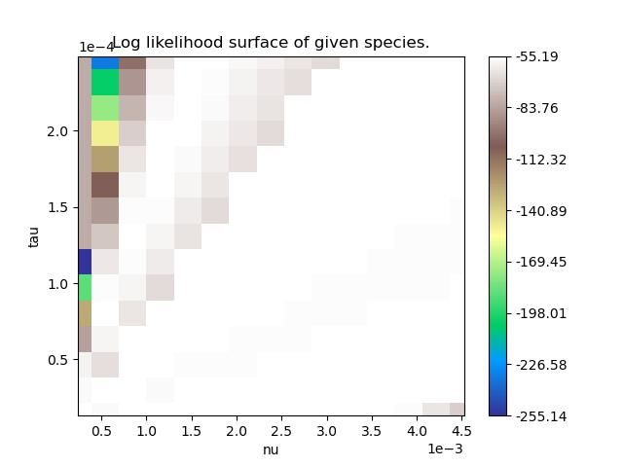
P. Distasonis (Linear)
Color distribution is linear

Slide 8
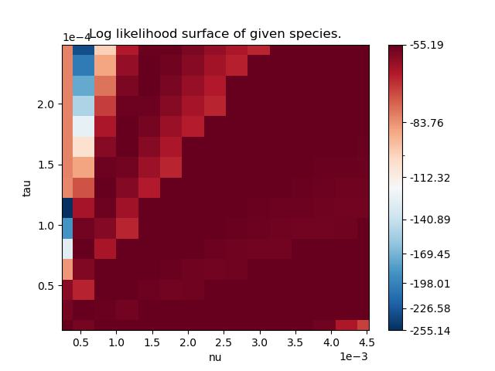
P. Distasonis (SymLogNorm)
Color distribution is logscaled
against low values

Slide 9
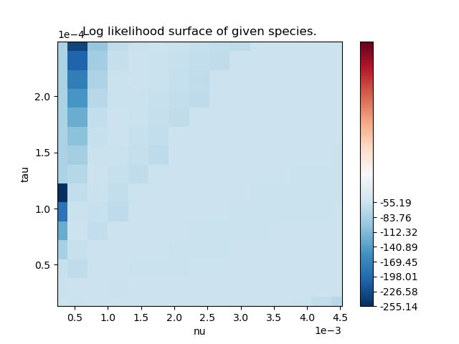
P. Distasonis (CenteredNorm)
Color distribution is centered around median values

Slide 10
TODO 20220829
SFSs for supplement + main text (B. intestinihominis)
Merge snps step with a smaller directory of two files
Pi plot, species with >= 5 hosts in both cohorts instead of original list
Wilcoxon rank sum test

