Slide 1
demo_for_ccgb Rotation Update
20210317
Jon Mah
Garud Lab

Slide 2
Logistics
Friendly reminder that we had daylight savings this past weekend!

Slide 3
Project Aim
Science Goal: Infer the demographic history of common commensal gut bacteria
Training Goal: Learn popgen tools / tech for microbiome
Personal Goal: Have fun ☺!

Slide 4
Gameplan
Initially focus on B. vulgatus
Create syn / ns SFSs
Compare to expectation of SFS
Given clade data (e.g., continent of origin), create PCA plot
Run Dadi to determine best fit demographic model
Start with Omar Conejo’s model(s)
Perhaps find link to human demography?
Apply to other species
Apply to other data sets (include African data, Peruvian data)

Slide 5
Progress
Fixed and reworked DFE inference
Previously I was taking 3 different DFE’s per demographic model (for 12 DFE’s total), but this was resulting in memory errors.
Now I take the best demographic model and use that for DFE inference, with two models incorporating selection:
Gamma-distributed DFE
Neutral-gamma-distributed DFE, i.e., a pointmass of 30% at s=0 (neutral mutations) with the remaining 70% being drawn from a gamma distribution.
Code is commented and documented (still wip)

Slide 6
Implementation details (for following slides)
Input synonymous SFS’s: output from `plot_within_clade_sfs.py`.
High prevalence species:
B. vulgatus, B. ovatus, B. uniformis, E. rectale.
Four demographic models
exponential growth, two-epoch, bottleneck + growth, three-epoch
Mask singletons OR mask singletons + doubletons
Model still infers masked alleles, but they are excluded in likelihood calculation

Slide 7
Implementation details (for following slides)
For each input species
For each model:
Take 25 initial guesses for parameter space (parameters differ by model)
For each initial guess:
Iterate through gradient ascent to find maximum likelihood for <= 50 steps
Compute model params and log likelihood
Output log likelihood and model params of best initial guess + iterations
For best model:
Fit nonsynonymous SFS using fitdadi, with selection fit to:
Gamma-distributed DFE
Neutral-gamma-distributed DFE with point-mass of 30% at s=0

Slide 8
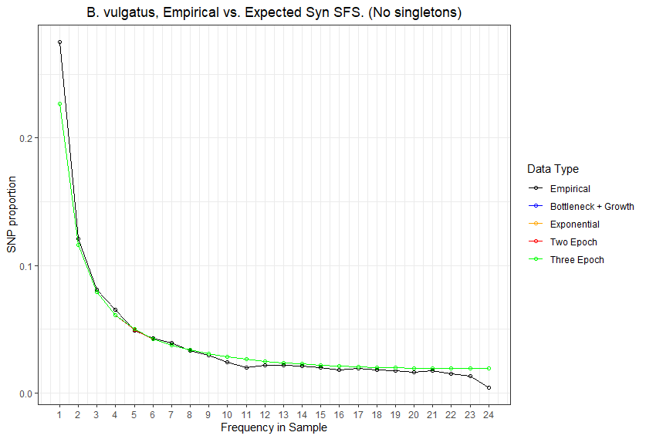
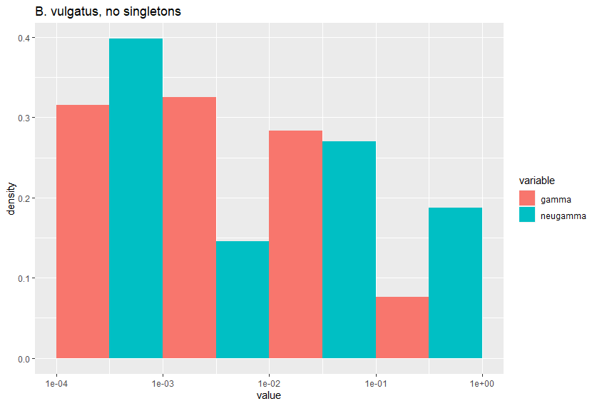
The X-axis of the DFE plot is the absolute value of the selection coefficient, s.
The Y-axis of the DFE plot is the proportion of the distribution in that bin.
We typically split the DFE into discrete bins on a log10 scale.
Left-ward bins are closer to 0, while right-ward bins are closer to 1
For this data set, most of the data is shifted left, which suggests weak purifying selection.

Slide 9
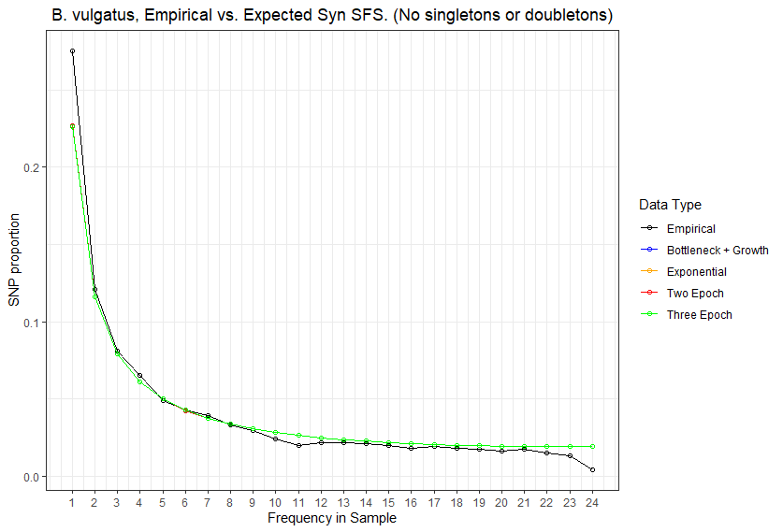
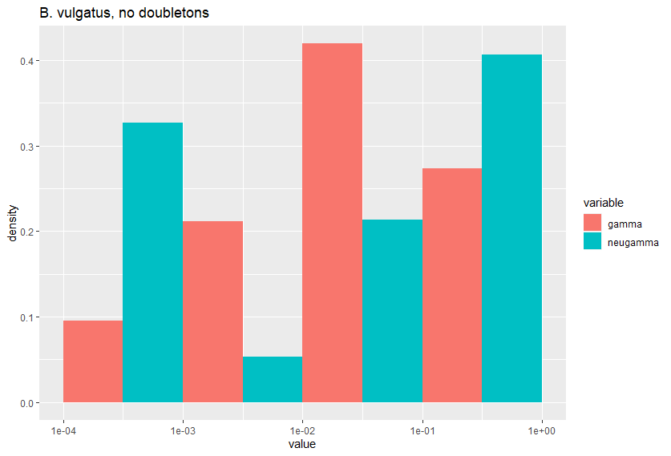
The X-axis of the DFE plot is the absolute value of the selection coefficient, s.
The Y-axis of the DFE plot is the proportion of the distribution in that bin.
We typically split the DFE into discrete bins on a log10 scale.
Left-ward bins are closer to 0, while right-ward bins are closer to 1
For this data set, I don’t think inference had strong consensus between the two models, likely due to the missing data.

Slide 10
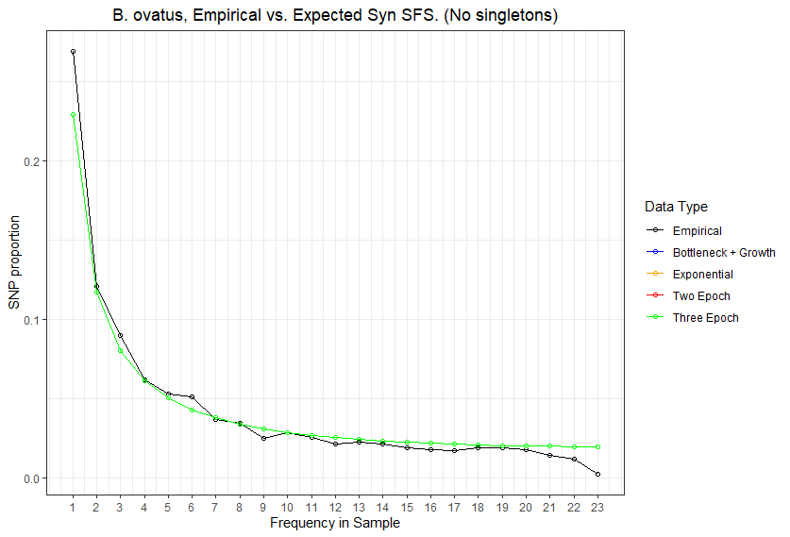
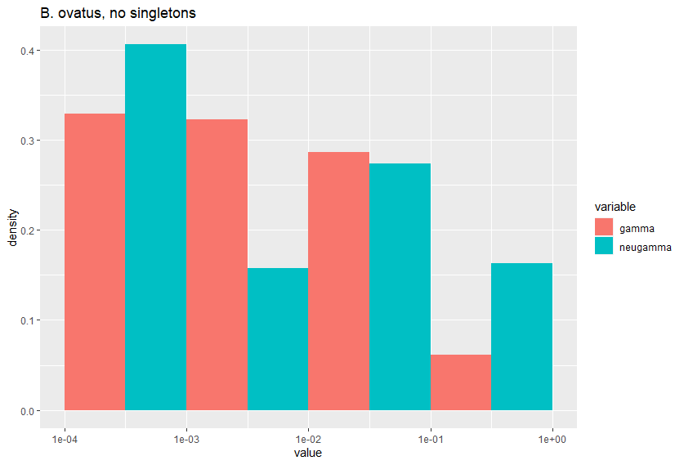
The X-axis of the DFE plot is the absolute value of the selection coefficient, s.
The Y-axis of the DFE plot is the proportion of the distribution in that bin.
We typically split the DFE into discrete bins on a log10 scale.
Left-ward bins are closer to 0, while right-ward bins are closer to 1
For this data set, most of the data is shifted left, which suggests weak purifying selection.

Slide 11
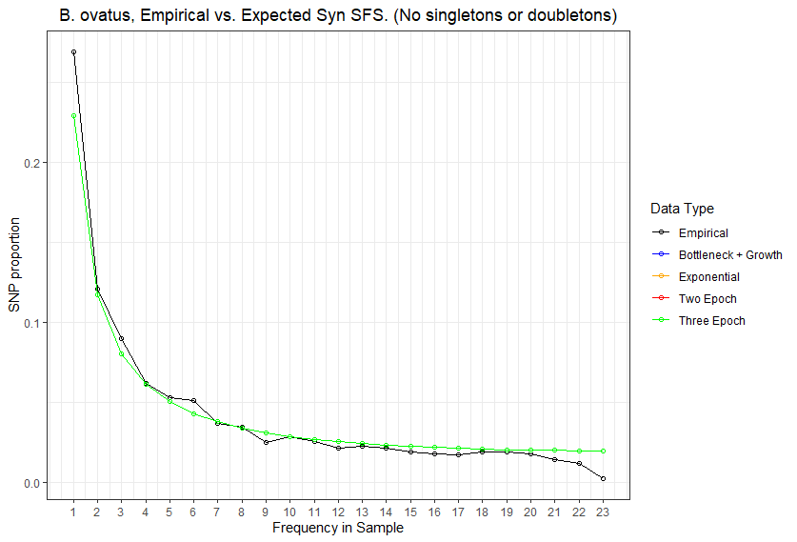
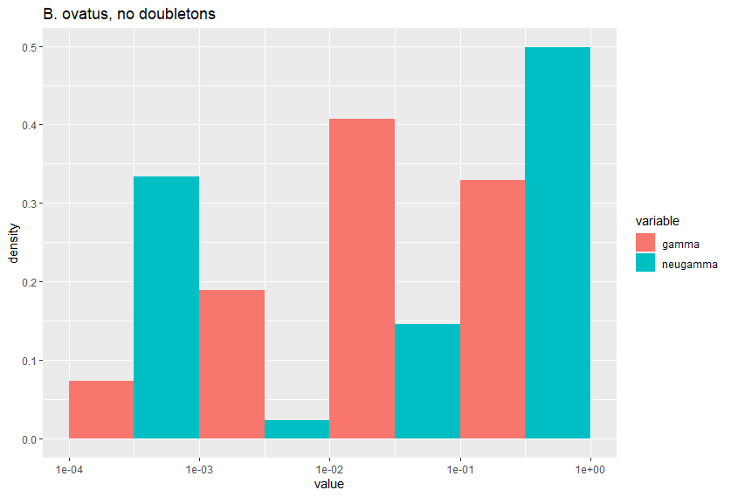
The X-axis of the DFE plot is the absolute value of the selection coefficient, s.
The Y-axis of the DFE plot is the proportion of the distribution in that bin.
We typically split the DFE into discrete bins on a log10 scale.
Left-ward bins are closer to 0, while right-ward bins are closer to 1
For this data set, I don’t think inference had strong consensus between the two models, likely due to the missing data.

Slide 12
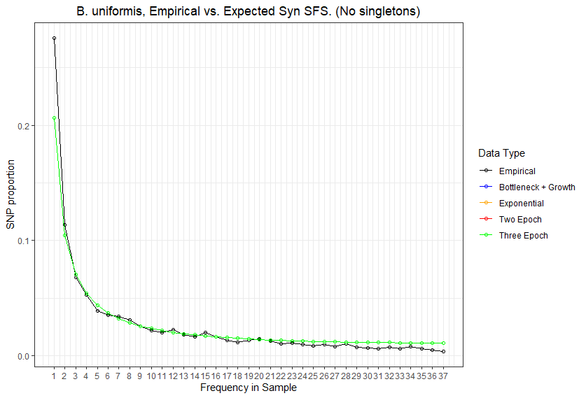
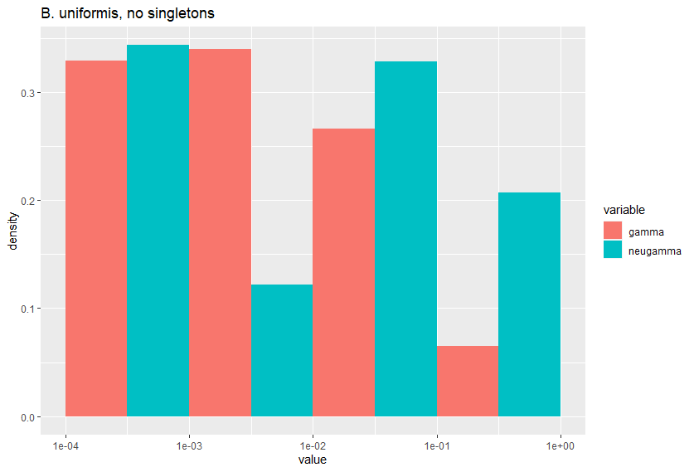
The X-axis of the DFE plot is the absolute value of the selection coefficient, s.
The Y-axis of the DFE plot is the proportion of the distribution in that bin.
We typically split the DFE into discrete bins on a log10 scale.
Left-ward bins are closer to 0, while right-ward bins are closer to 1
For this data set, most of the data is shifted left, which suggests weak purifying selection.

Slide 13
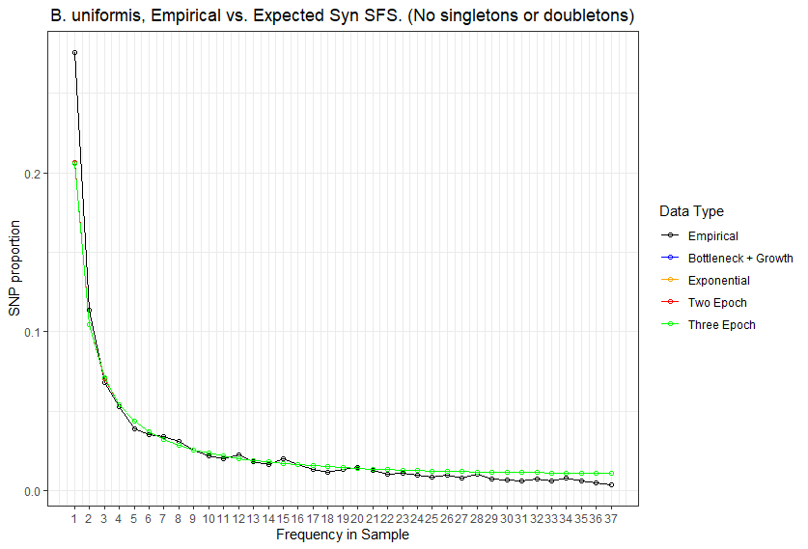
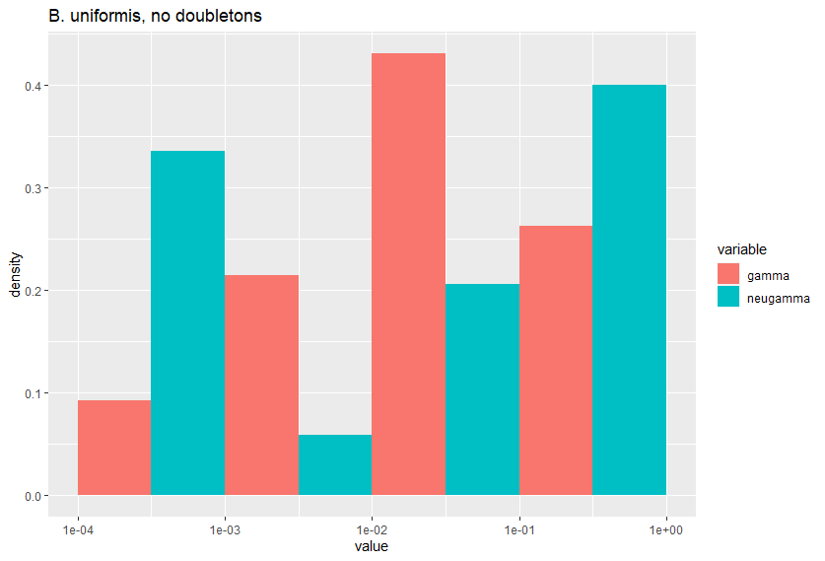
The X-axis of the DFE plot is the absolute value of the selection coefficient, s.
The Y-axis of the DFE plot is the proportion of the distribution in that bin.
We typically split the DFE into discrete bins on a log10 scale.
Left-ward bins are closer to 0, while right-ward bins are closer to 1
For this data set, I don’t think inference had strong consensus between the two models, likely due to the missing data.

Slide 14
//TODO
Prep slides for lab meeting
Finish docs
Compute log likelihoods
Remake figure 3
Apply pipeline to top 40 species

Slide 15
Standing questions
Overall goal: determine if our method is what results in getting these types of parameters
Poisson vs. Multinomial log likelihood
Neutral selection on non-synonymous vs. non-neutral selection on non-synonymous
P. copri!
(Look at unique species and see if we have same pattern)
(Look at the other top 40 species to see if we have any sort of pattern)
Recombination vs. qp-phasing?
Vs. PCA? (E.g., Novembre Europe paper)
Dadi vs. edge-length distribution / tree-based method
Comparison to simulated / recapitulated data based on recombination rates.
Investigate edge length distribution
Compare commensal bacteria to human demography
Compare commensal bacteria to pathogens

