Slide 1
demo_for_ccgb Rotation Update
20210601
Jon Mah
Garud and Lohmueller Labs

Slide 2
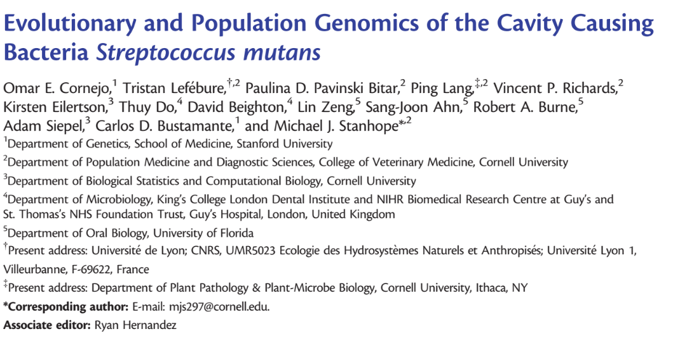

Slide 3
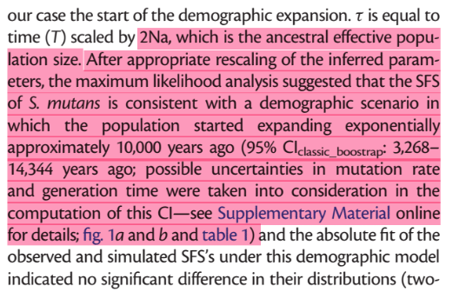
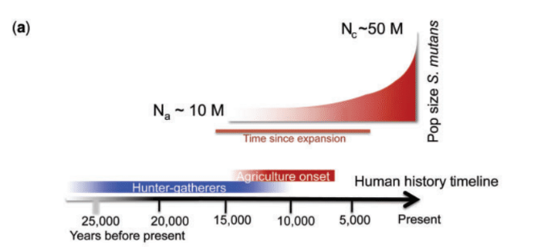
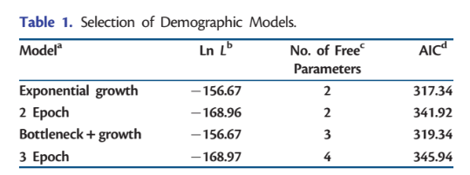
Population expansion ~ 10,000 years ago
This timeline roughly matches with the onset of human agriculture, suggesting a possible link between this commensal mouth bacteria and humans ending their hunter-gather behavior.
They used four demographic models:
Exponential growth
Two Epoch
Bottleneck + Growth
Three Epoch

Slide 4
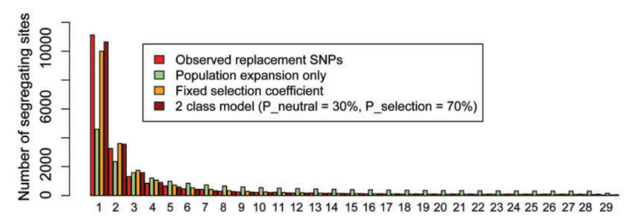
They also computed the expected SFS for silent (synonymous) and replacement (nonsynonymous) sites
Red is observed nonsynonymous
Green is their expectation using the synonymous sites
Orange is with a DFE fixed at a single value
Brown is with 30% neutral, and 70% at a fixed single value

Slide 5
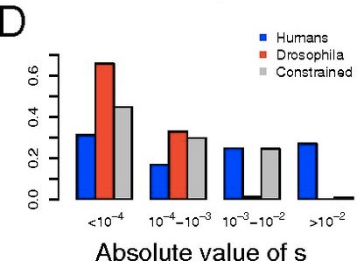
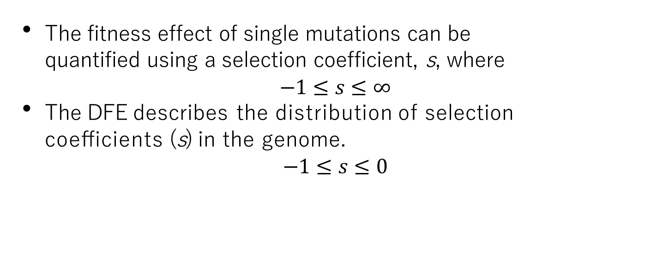
The Distribution of Fitness Effects
The fitness effect of single mutations can be quantified using a selection coefficient, s, where
$$−1≤s≤∞$$
The DFE describes the distribution of selection coeﬃcients (s) in the genome.
$$−1≤s≤0$$
Humans have a larger proportion of lethal/strongly deleterious mutations than fly.
Source: Huber et al., 2017 PNAS
Notes:
Like with any balanced breakfast, let’s start with some math.
Suppose we take a single mutation and quantify its effect on fitness using a selection coefficient, denoted as s.
Let us define s as the resulting change in population size in the case that our given mutation arises in the population.
It follows that the value of s must be constrained between -1, in which case our mutation is highly deleterious, and positive infinity, in which case our mutation is highly beneficial.
Next, rather than focus on individual mutations, let us evaluate every mutation which occurs across the whole genome. We can fit a distribution to these values of s, i.e., a distribution of fitness effects or DFE. The DFE lets us quantify the proportion of deleterious, neutral, and adaptive mutations entering a population.
Of possible interest to the people here, although we contextualize the results of DMS using site-specific amino acid preferences, other people look at DMS through the lens of the DFE. So it’s not like avengers-level, but there is some crossover in the literature. Importantly, we made some population genetics assumptions, for example we assume that time approaches infinity, and thus all beneficial mutations have already fixed in the population. As a result, we constrain the value of s to be between -1 and 0.
Previous work by a former postdoc has shown that, between highly divergent species such as humans and fruit flies, the DFE is very distinct. We sought to investigate on what scale of evolutionary time the DFE has detectable changes, and whether certain demographic constraints affect the DFE.

Slide 6


We compute the site frequency spectra from quasi-phased gut microbiome data.
(Models isolates from individuals)
1
Selection Pressure
Site Frequency Spectra
Demography
Linked Selection
30.00%
22.50%
Proportional Frequency
We want to control for demography and linked selection.
15.00%
7.50%
0.00%
1 2 3 4
5
6
7
8
Mutation class (Singletons, doubletons, tripletons, etc.)
Notes:
Let’s talk methods. From our input data we can compute a summary statistic known as a site frequency spectrum, which describes the proportional frequency of mutation classes, i.e., singletons, doubletons, tripletons, etc. Site frequency spectra are known to be primarily influenced by three forces, being selection pressure, demography, and linked selection. We need to isolate the effect of selection pressure, as that is the driving force on shifts in the DFE.
This is an example graphic of a site frequency spectrum. The x-axis shows mutation class and the y-axis shows proportional frequency.

Slide 7
We split the site frequency spectra into synonymous and nonsynonymous mutations.
2
Demography Linked selection Selection pressure
30.00%
Demography
Linked selection
Nonsynonymous
Synonymous
22.50%
15.00%
7.50%
0.00%
1
2
3
4
5
6
7
8
Notes:
To do this, we split the site frequency spectra into including only synonymous or nonsynonymous mutations. We believe that, because synonymous mutations have almost no effect on fitness, they are not subject to selection pressure, so splitting these mutation types should allow us to isolate the effects of selection pressure, from which we can infer the DFE.
This is another example graphic. I took the purple site frequency spectra and split it into blue and red, representing either synonymous or nonsynonymous mutations.

Slide 8
We use dadi to infer demography and
linked selection.
3
Dadi (Gutenkunst et al 2009) to infer
demographic model with synonymous sites
Demography
Linked selection
Nonsynonymous
Synonymous
30.00%
22.50%
15.00%
7.50%
0.00%
1
2
3
4
5
6
7
8
Notes:
We use a statistical inference package from the Gutenkunst group known as dadi to fit a population-demographics model which considers both demographic parameters and the effects of linked selection. For anyone interested, dadi stands for “diffusion approximation for demographic inference.” In summary, we take the maximum composite likelihood approximate solution to the diffusion equation, except, rather than modeling heat over a sheet of metal, we are modeling how abstract evolutionary properties propagate over a genome.

Slide 9

We masked some low frequency sites.
3
Dadi (Gutenkunst et al 2009) to infer
demographic model with synonymous sites
Demography
Linked selection
Nonsynonymous
Synonymous
30.00%
22.50%
15.00%
7.50%
0.00%
1
2
3
4
5
6
7
8
Notes:
We use a statistical inference package from the Gutenkunst group known as dadi to fit a population-demographics model which considers both demographic parameters and the effects of linked selection. For anyone interested, dadi stands for “diffusion approximation for demographic inference.” In summary, we take the maximum composite likelihood approximate solution to the diffusion equation, except, rather than modeling heat over a sheet of metal, we are modeling how abstract evolutionary properties propagate over a genome.

Slide 10
We use fitdadi to isolate the effect of selection pressure and infer the DFE.
4
Fitdadi (Kim et al 2017) to infer the DFE
with non-synonymous sites using the inferred demography
Demography Linked selection Selection pressure
30.00%
Nonsynonymous
Synonymous
22.50%
15.00%
7.50%
0.00%
1
2
3
4
5
6
7
8
Notes:
We then use another statistical inference package published by a former graduate student known as fitdadi. For anyone interested, fit stands for fit, because Kirk is legit an amateur powerlifter. In summary, we assume that the selection coefficients, s, fall into a gamma distribution. Fitdadi infers the maximum composite likelihood shape and scale parameters of this gamma distribution, which gives us a gamma-distributed DFE.

Slide 11
Implementation details (for following slides)
Input synonymous SFS’s
High prevalence species:
B. vulgatus, B. ovatus, B. uniformis.
Four demographic models
exponential growth, two-epoch, bottleneck + growth, three-epoch
Mask singletons OR mask singletons + doubletons
Model still infers masked alleles, but they are excluded in likelihood calculation

Slide 12
Implementation details (for following slides)
For each input species
For each model:
Take 25 initial guesses for parameter space (parameters differ by model)
For each initial guess:
Iterate through gradient ascent to find maximum likelihood for <= 50 steps
Compute model params and log likelihood
Output log likelihood and model params of best initial guess + iterations
For best model:
Fit nonsynonymous SFS using fitdadi, with selection fit to:
Gamma-distributed DFE
Neutral-gamma-distributed DFE with point-mass of 30% at s=0

Slide 13
Exponential Growth | no singletons |  |  | no singletons or doubletons
 | Masking singletons |  |  | Masking singletons and Doubletons
 | b_vulgatus | b_ovatus | b_uniformis | b_vulgatus | b_ovatus | b_uniformis
LL | -142.247484 | -181.635 | -253.217 | -131.836 | -174.082 | -230.274
Theta | 2364.571488 | 2302.292 | 2054.491 | 2325.776 | 2274.387 | 1998.255
Nu_a | 6.67E-01 | 6.24E-01 | 4.80E-01 | 1.61E-01 | 1.38E-01 | 1.85E-01
Nu_b | N/A | N/A | N/A | N/A | N/A | N/A
T_12 | 4.22E-06 | 5.35E-06 | 1.89E-06 | 5.78E-06 | 6.17E-06 | 6.49E-06
T_23 | N/A | N/A | N/A | N/A | N/A | N/A
N_e | 1.18229E+12 | 1.15E+12 | 1.03E+12 | 1.16E+12 | 1.14E+12 | 9.99E+11
N_a | 1.77366E+12 | 1.85E+12 | 2.14E+12 | 7.22E+12 | 8.25E+12 | 5.41E+12
T_12 (scaled) | 14971968.8 | 19732245 | 8094681 | 83478897 | 1.02E+08 | 70213082
T_23 (scaled) | N/A | N/A | N/A | N/A | N/A | N/A
exp_time (years) | 14058.18666 | 18527.93 | 7600.639 | 78383.94 | 95572.59 | 65927.78

Slide 14
Exponential growth demographic diagram (exponential decay or growth over time)
N_a = 1.77366E+12, 1.85E+12, 2.14E+12
T_12 = 14058.18666, 18527.93, 7600.639
N_e = 1.18229E+12, 1.15E+12, 1.03E+12

Slide 15
Two-epoch demographic diagram (One epoch, a length of time, then instantaneous size change to a second epoch)
N_a = 1.87827E+12, 1.64E+12, 1.44E+12
T_12 = 13212.9557, 16972.92, 5737.915
N_e = 1.18229E+12, 1.15E+12, 1.03E+12

Slide 16
Bottleneck growth demographic diagram (Instantaneous size change, then exponential growth or decay over a length of time)
N_a = 2.67E+12, 2.74E+12, 2.51E+12
N_b = 8.61E+12, 1.27E+13, 6.60E+12
T_12 = 17750.45461, 24074.01, 18745.55
N_e = 1.18229E+12, 1.15E+12, 1.03E+12

Slide 17
Three-epoch demographic diagram (Epoch, time, instantaneous size change, epoch, time, instantaneous size change, epoch)
N_a = 4.07E+12, 7.18E+12, 4.33E+12
T_12 = 31630.66235, 36898.05, 24676.49
N_b = 8.61E+12, 1.27E+13, 6.60E+12
T_23 = 31047.92246, 34572.84, 26574.54
N_e = 1.18229E+12, 1.15E+12, 1.03E+12

Slide 18
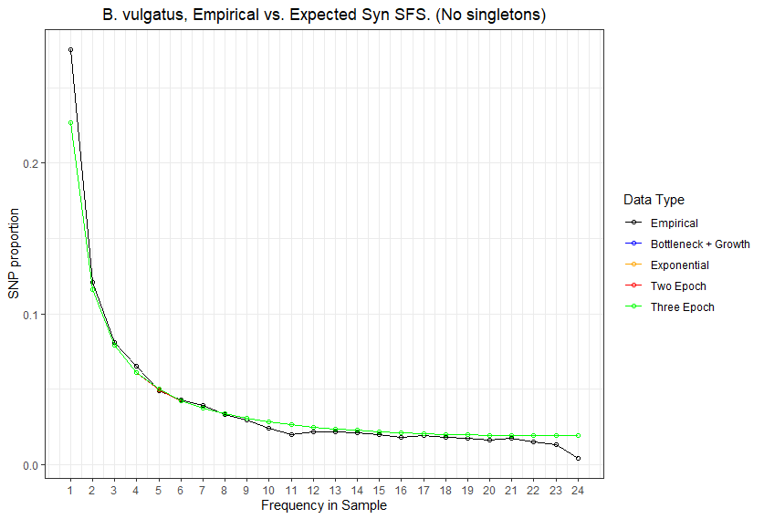
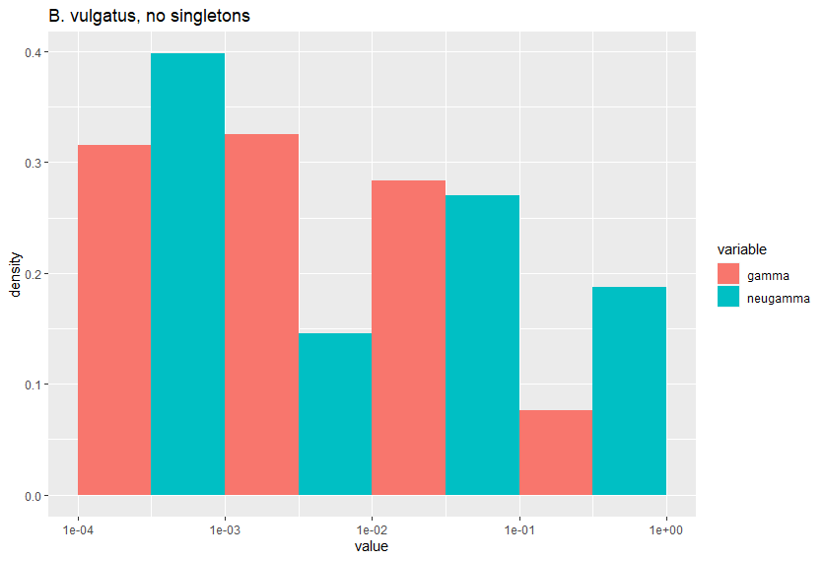
The X-axis of the DFE plot is the absolute value of the selection coefficient, s.
The Y-axis of the DFE plot is the proportion of the distribution in that bin.
We typically split the DFE into discrete bins on a log10 scale.
Left-ward bins are closer to 0, while right-ward bins are closer to 1
For this data set, most of the data is shifted left, which suggests weak purifying selection.

Slide 19
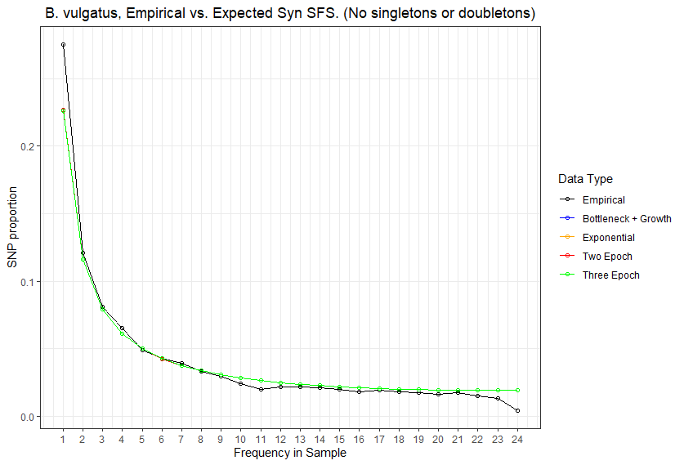
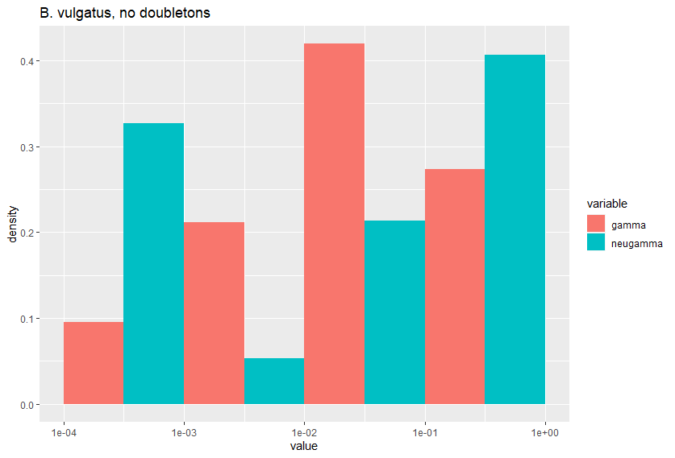
The X-axis of the DFE plot is the absolute value of the selection coefficient, s.
The Y-axis of the DFE plot is the proportion of the distribution in that bin.
We typically split the DFE into discrete bins on a log10 scale.
Left-ward bins are closer to 0, while right-ward bins are closer to 1
For this data set, I don’t think inference had strong consensus between the two models, likely due to the missing data.

Slide 20
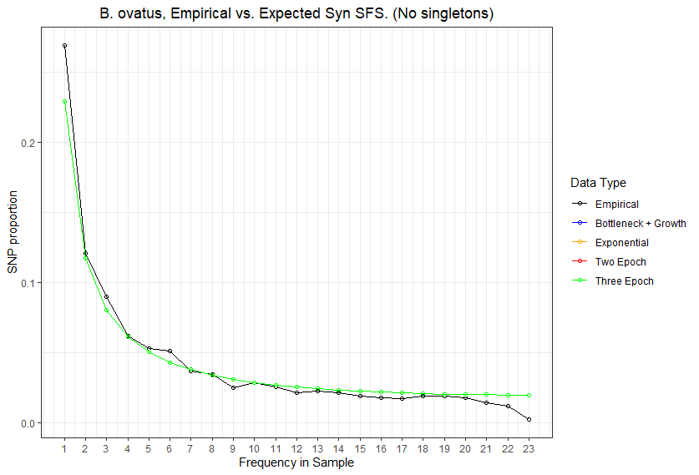
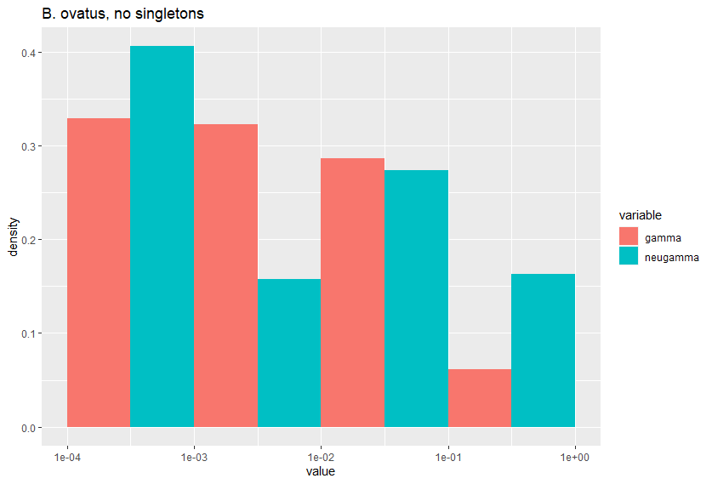
The X-axis of the DFE plot is the absolute value of the selection coefficient, s.
The Y-axis of the DFE plot is the proportion of the distribution in that bin.
We typically split the DFE into discrete bins on a log10 scale.
Left-ward bins are closer to 0, while right-ward bins are closer to 1
For this data set, most of the data is shifted left, which suggests weak purifying selection.

Slide 21
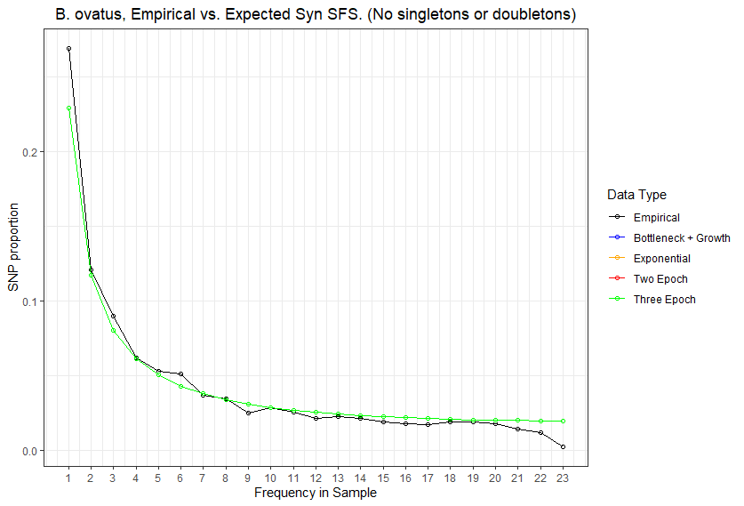
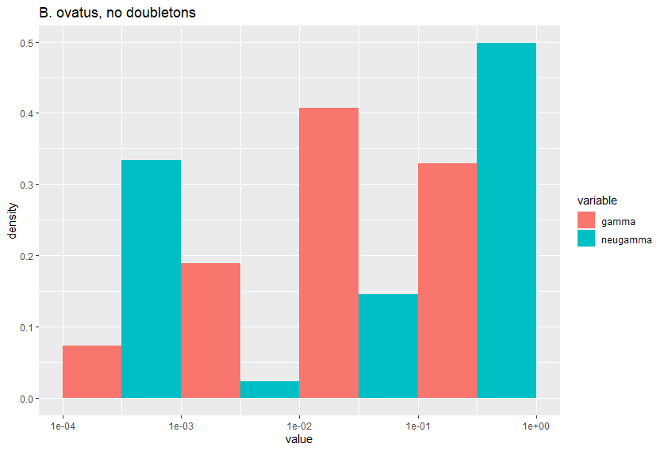
The X-axis of the DFE plot is the absolute value of the selection coefficient, s.
The Y-axis of the DFE plot is the proportion of the distribution in that bin.
We typically split the DFE into discrete bins on a log10 scale.
Left-ward bins are closer to 0, while right-ward bins are closer to 1
For this data set, I don’t think inference had strong consensus between the two models, likely due to the missing data.

Slide 22
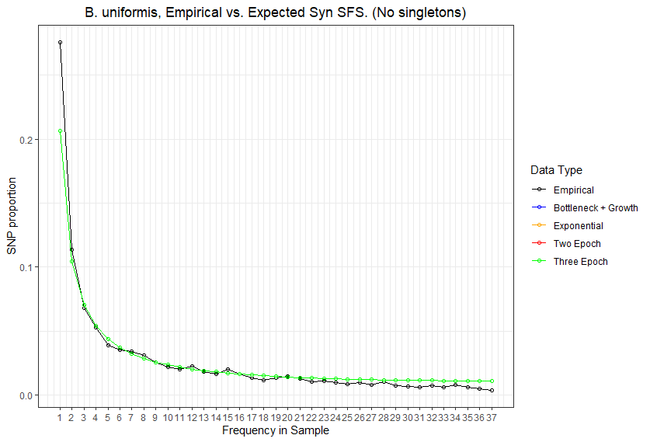
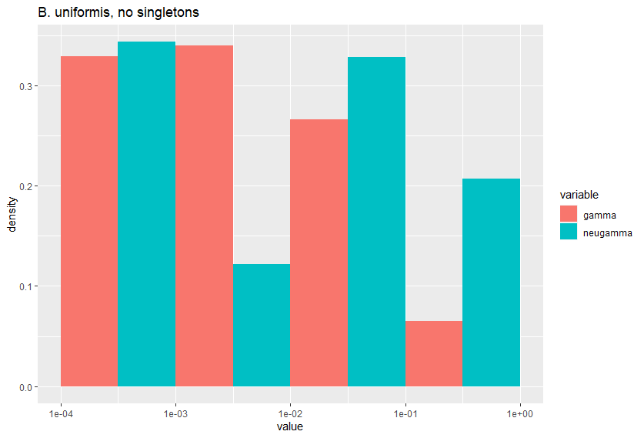
The X-axis of the DFE plot is the absolute value of the selection coefficient, s.
The Y-axis of the DFE plot is the proportion of the distribution in that bin.
We typically split the DFE into discrete bins on a log10 scale.
Left-ward bins are closer to 0, while right-ward bins are closer to 1
For this data set, most of the data is shifted left, which suggests weak purifying selection.

Slide 23
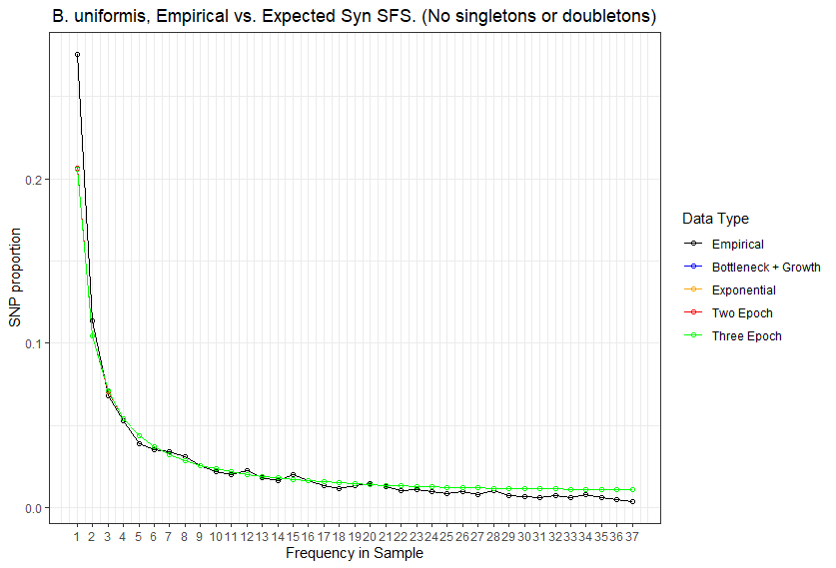
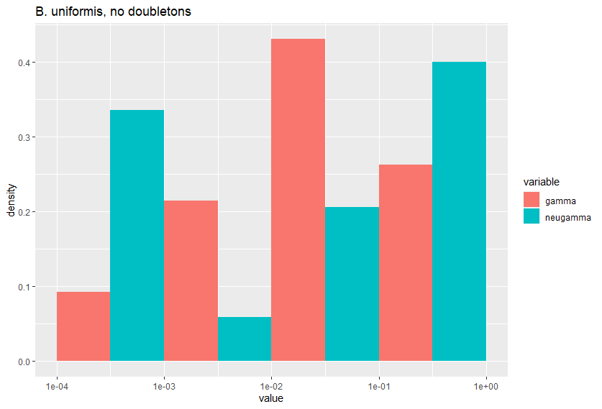
The X-axis of the DFE plot is the absolute value of the selection coefficient, s.
The Y-axis of the DFE plot is the proportion of the distribution in that bin.
We typically split the DFE into discrete bins on a log10 scale.
Left-ward bins are closer to 0, while right-ward bins are closer to 1
For this data set, I don’t think inference had strong consensus between the two models, likely due to the missing data.

Slide 24
Future Directions
Overall goal: determine if our method is what results in getting these types of parameters
Poisson vs. Multinomial log likelihood
Neutral selection on non-synonymous vs. non-neutral selection on non-synonymous
P. copri!
(Look at unique species and see if we have same pattern)
(Look at the other top 40 species to see if we have any sort of pattern)
Recombination vs. qp-phasing?
Vs. PCA? (E.g., Novembre Europe paper)
Dadi vs. edge-length distribution / tree-based method
Comparison to simulated / recapitulated data based on recombination rates.
Investigate edge length distribution
Compare commensal bacteria to human demography
Compare commensal bacteria to pathogens

Slide 25
Possible extensions
Apply broadly to different species for a microbiome-wide demographic inference
Focus on specific bacteria, e.g., P. copri

Slide 26
Notes with Nandita and Kirk
Can we find a negative control?
Strep Mutans? (I don’t think we have this for microbiome, but yes in general)
Can we find:
Is there a consistent pattern within oral microbiome vs. gut microbiome species? Ex: Did oral species expand and gut species contrast?
Construct a null based on demographic patterns (oral / gut, rho/mu, contraction or expansion) and see if inference agrees
High rho/mu, contraction | High rho/mu, expansion
Low rho/mu, contraction | Low rho/mu, expansion

Slide 27
Notes with Kirk and Nandita
LD, ABC, joint inference
Do LD patterns support the general notion of a demographic contraction?
Look at something other than the SFS, just to determine or search for more evidence of a contraction vs. an expansion
Recapitulate LD from inferred model
Consider purifying selection
Do other summary statistics recapitulate this pattern of demographic contraction?
Pi, diversity at gene level, diversity at species level

Slide 28
Paper Layout
Results show demographic contraction in gut bacteria aligning with human agricultural expansion
Compare inference to null expectation / control cases
Do other summary statistics support this demographic contraction?
Pi, gene level diversity, species level diversity, etc.
LD, dN/dS, edge-length distribution
We think these three points constitute a manuscript

Slide 29
Boring logistical stuff
Jon wants to hide in a cave after WQE, but down to meet after
Tentative meeting time sometime between July 18th and July 23rd.
Hash out further logistics at that time.
For this stretch, mostly meet with Nandita, but meet with Kirk when useful / when we get stuck.

Slide 30
//TODO
Prep slides for lab meeting
Finish docs
Compute log likelihoods
Remake figure 3
Apply pipeline to top 40 species

