Slide 1
demo_for_ccgb Weekly Update
20220713
Jon Mah
Garud and Lohmueller Labs

Slide 2
Summary of Update
Benchmarks for species step
Dadi outputs for downsampled species

Slide 3



Inference of the demographic history of commensal gut microbes
Jonathan Mah
Lohmueller and Garud Labs
July 13th, 2022
Notes:
Good morning, guys, gals, and non-binary pals! My name’s Jon Mah, I’m a 2nd year Bioinformatics PhD student at UCLA co-advised by Professor Kirk Lohmueller and Professor Nandita Garud, and time permitted, I’ll be discussing some of my ongoing work concerning demographic inference of the human gut microbiome. Framed a little more scientifically, I’ll be discussing a little project that I like to call:

Slide 4
Inference of the demographic history of commensal gut microbes “Poopulation Genetics”
Jonathan Mah
Lohmueller and Garud Labs
July 13th, 2022
Notes:
Poopulation Genetics (I’m very mature for my age)
Before I get too out of control, I’d like to thank the organizers for giving me this chance to share my work.

Slide 5
Time
Two-epoch
Time
Contraction
Expansion
Effective Population size
Effective Population size

Slide 6
Site Frequency Spectra
Contraction
30.00%
22.50%
Dadi
Proportional Frequency
15.00%
Expansion
7.50%
0.00%
1 2 3 4
5
6
7
8
Mutation class (Singletons, doubletons, tripletons, etc.)

Slide 7
Example SFS
Expansion
Contraction
Site Frequency Spectra
Site Frequency Spectra
30.00%
30.00%
22.50%
22.50%
Proportional Frequency
Proportional Frequency
15.00%
15.00%
7.50%
7.50%
0.00%
1 2 3 4
5
6
7
8
0.00%
1 2 3 4
5
6
7
8
Mutation class (Singletons, doubletons, tripletons, etc.)
Mutation class (Singletons, doubletons, tripletons, etc.)

Slide 8
We use multiple demographic models to account for different types of demography
Two-epoch
Exponential
or
or
Contraction
Expansion
Contraction
Expansion
One instantaneous size change
Exponential growth or decay
Bottlegrowth or Bottledecay
Three-epoch
or
or
or
or
or
or
Instantaneous size change → exponential growth or decay
Two instantaneous size changes
Notes:
Now that we have evidence that North American gut microbiomes have depleted genetic diversity relative to African gut microbiomes, likely due to differences in diet, environment, and a host of other factors which can broadly be grouped together as “urbanization”, we proceeded with inferring the demographic models, which allow us to infer parameters such as the time since the last major demographic event and the magnitude of any change in population size. Here, we used four different demographic models, with cartoons (explain cartoons).

Slide 9
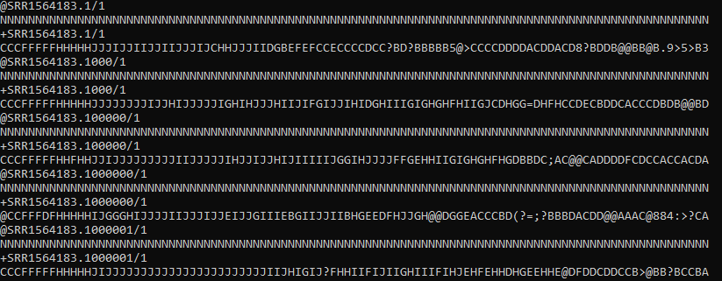
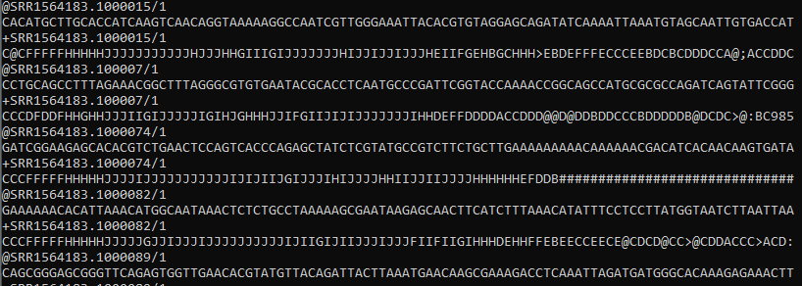
Species step on oral data

Slide 10
Benchmarking
Run | Runtime | Memory Usage
SRS011090 [previously working] | 80.31 minutes | 18.31 Gb
SRS011090 (w/o 100% N lines) | 77.38 minutes | 19.22 Gb
SRS011090 (w/o 95% N lines) | 24.81 minutes | 4.23 Gb
SRS014530 [previously failing] | 83.95 minutes | 15.51 Gb
SRS014530 (w/o 100% N lines) | 87.42 minutes | 18.09 Gb
SRS 014530 (w/o 95% N lines) | 37.51 minutes | 8.58 Gb

