Slide 1
demo_for_ccgb Weekly Update
20220224
Jon Mah
Garud and Lohmueller Labs

Slide 2
Summary of Update
Approximating `species_profile.txt` from working files
Replacing N
Works in small cases, I still have some bugs in actual files
Looking into code refactoring to deal with large text files
Dadi models still WIP

Slide 3
Approximating `species_profile.txt`
Grab all `*species_profile.txt` files
Concatenate all non-head lines
Remove zero-entries
Count prevalence of each species
Remove duplicate species from dataframe, keeping highest read count example of each species
Take top 100 by prevalence

Slide 4
Approximating `species_profile.txt`
789 unique species found across `*species_profile.txt`
Highest prevalence: 160 (all files surveyed)
Lowest prevalence: 2
Average prevalence: 129.0749
Median prevalence: 142.5

Slide 5
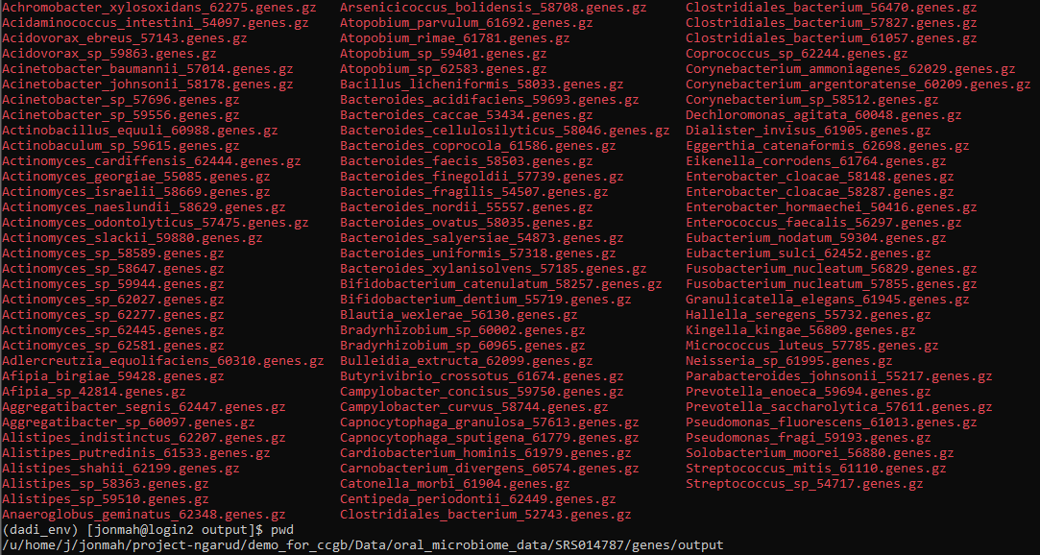
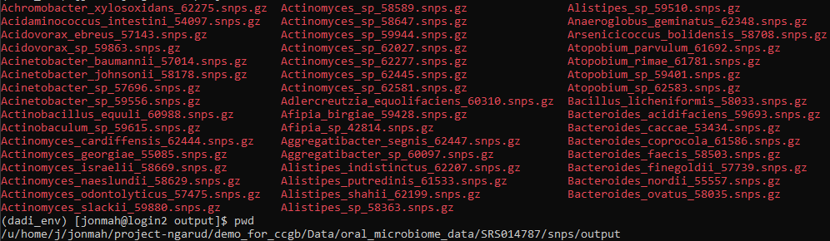
Approximating `species_profile.txt`
We have output for most of genes and snps (some jobs need to rerun), let’s revisit SRS014787 (file index 19, which was previously failing)

Slide 6
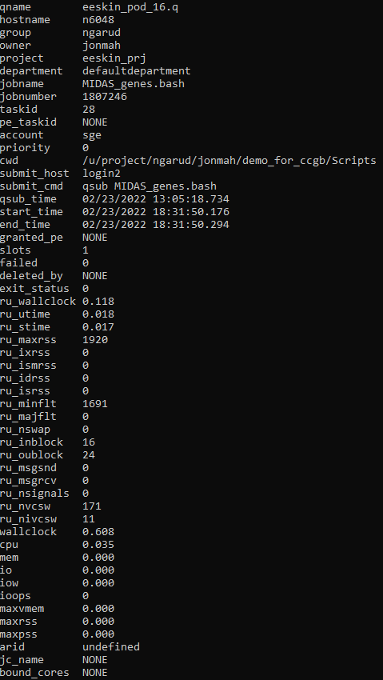
Approximating `species_profile.txt`
Some need to be rerun, I am still troubleshooting these cases, e.g., SRS015592, the file in which Leah found the N’s case.
Snps step created output but genes step did not
This occurred for a few files, specifically snps worked but genes did not. I’ll try again with terminal.
No error output or exit code

Slide 7
Replacing N
Open input file
Open output file
For line in input file, if next line contains all N’s, remove this line and next line
Else, write line to output file
Original approach consists of using a list to index all lines
This one did work but took a long time, even for test files (longer than the actual MIDAS commands for test files). I don’t think it’s computationally feasible for the actual files.
New approach uses one loop and is faster than standard text manipulation, but it might not work for larger files?
Still troubleshooting this part. Output sometimes still contains N’s when searching through. One idea is to run it multiple times.

Slide 8
Quick benchmarking
Working runtime (sec) | “Failing” runtime (sec) | “Fixed” runtime (sec)
29.873 | 78.330 | 34.220
25.621 | 60.147 | 26.558
37.957 | 49.214 | 31.892
26.636 | 82.677 | 30.076
33.710 | 72.150 | 26.431
29.306 | 50.237 | 27.946
26.551 | 64.556 | 34.595
38.315 | 64.008 | 30.164
22.745 | 52.122 | 26.092
19.932 | 83.576 | 28.519
Note that all these runs are over the same test file, and rows do not
have corresponding results, i.e., each row is just a different benchmarking run.
There doesn’t seem to be a trend in memory usage. I suspect previous memory issues with larger files
were due to extremely long runtime.

Slide 9
//TODO
Look into confidence intervals
Poisson sample SFS
Dadi.Spectrum_mod.sample(self)
Bootstrap VCF
1000 SFS’s, run MLE inference on each SFS, 5% and 95% of param space is our CI
By end of quarter:
Try and finish fecal analysis
Try and finish MIDAS stuff
Look at sparsing SFS
Instead of doing all the populations and models, just take a closer look at two
Search space really well

