Slide 1
demo_for_ccgb Weekly Update
20220907
Jon Mah
Garud and Lohmueller Labs

Slide 2
Summary
MIDAS
IID Pi plot with Hosts >= 5
Likelihood plots
Writing

Slide 3
MIDAS
21 Species have faulty output
Actinomyces_viscosus_57672
Fusobacterium_periodonticum_58002
Gemella_haemolysans_61762
Granulicatella_elegans_61945
Haemophilus_parahaemolyticus_60505
Haemophilus_parainfluenzae_57123
Haemophilus_parainfluenzae_62356
Haemophilus_parainfluenzae_62468
Haemophilus_paraphrohaemolyticus_58563
Haemophilus_sputorum_53575
Neisseria_sp_61995
Porphyromonas_sp_57899
Prevotella_nanceiensis_44721
Prevotella_sp_61856
Rothia_mucilaginosa_58144
Streptococcus_parasanguinis_58487
Streptococcus_sp_57750
Streptococcus_sp_61820
Streptococcus_vestibularis_56030
Veillonella_sp_62404
Veillonella_sp_62611
When run individually, sometimes completes, sometimes does not

Slide 4
MIDAS
15 Species which don’t work
Actinomyces_viscosus_57672
Granulicatella_elegans_61945
Haemophilus_parahaemolyticus_60505
Haemophilus_parainfluenzae_62356
Haemophilus_parainfluenzae_62468
Haemophilus_paraphrohaemolyticus_58563
Haemophilus_sputorum_53575
Neisseria_sp_61995
Prevotella_sp_61856
Rothia_mucilaginosa_58144
Streptococcus_parasanguinis_58487
Streptococcus_sp_57750
Streptococcus_sp_61820
Streptococcus_vestibularis_56030
Veillonella_sp_62611
When run individually, sometimes completes, sometimes does not
Email Raffaella with documentation on error cases
Case one: Merge step works with input directory
Case two: Merge step only works with input species
Case three: Merge step fails with input directory or with input species

Slide 5
MIDAS
Species with working output
Catonella_morbi_61904
Fusobacterium_periodonticum_58002
Gemella_haemolysans_61762
Haemophilus_parainfluenzae_57123
Porphyromonas_sp_57899
Prevotella_melaninogenica_58075
Prevotella_nanceiensis_44721
Veillonella_sp_62404

Slide 6
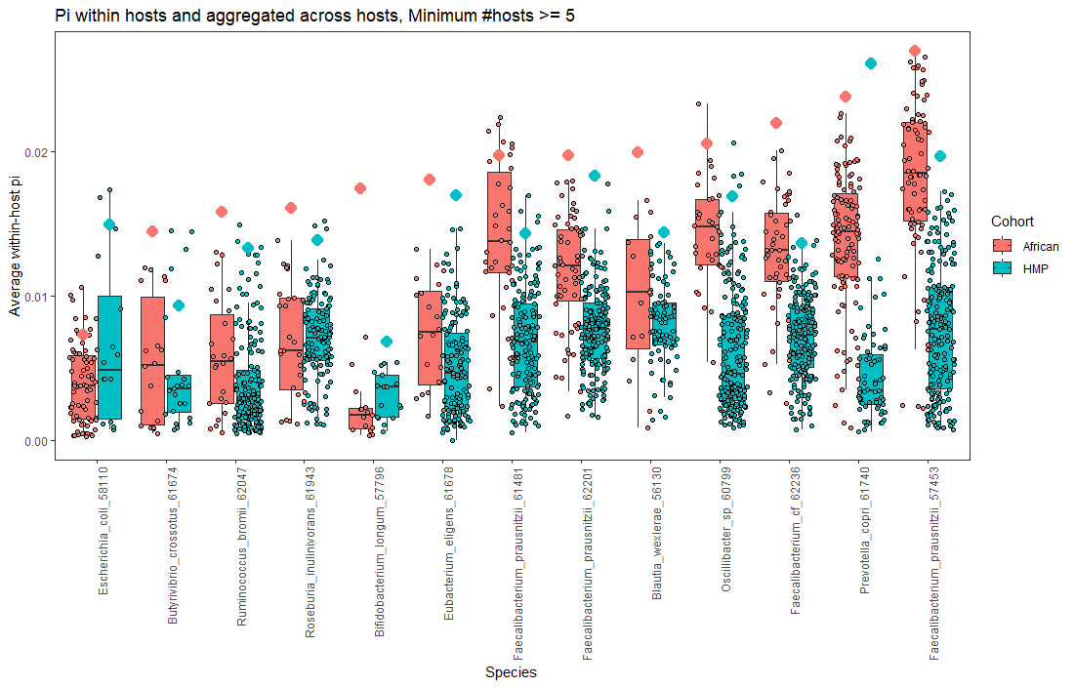
Pi (IID, hosts >= 5 for both cohorts)
Faecalibacterium Prauznitzii (12345)

Slide 7
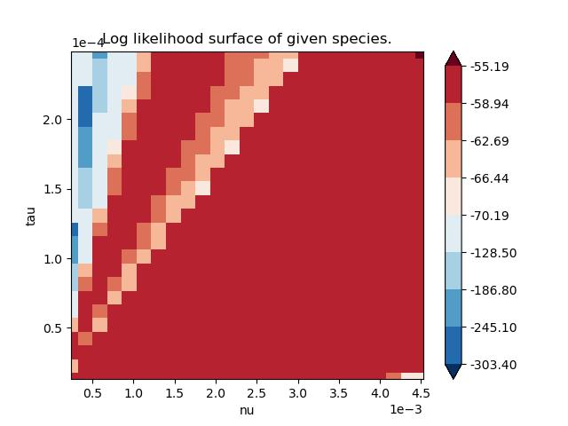
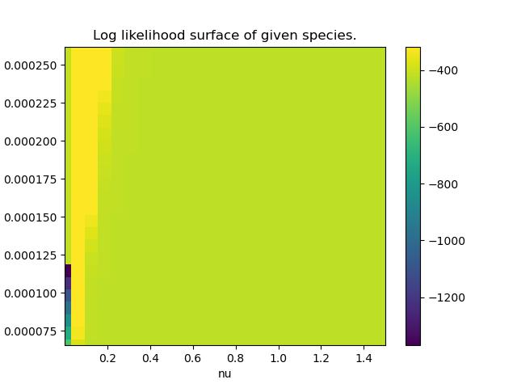
P. Distasonis (CustomNorm)
Plan for Log likelihood surface plots:
Several tick marks for varying degrees of “good likelihood” * Less tick marks for “bad” likelihoods
Suggestions
Show difference in log likelihood between contraction vs. expansion on one plot Sample wider parameter space
Use range of right and plotting elements of left

Slide 8
TODO 20220907
EMAIL RAFFAELLA
Writing about Pi results (consult overleaf for more detailed notes)
Plotting:
Show contrast between expansion and contraction
Evaluate log likelihood over wider parameter space, including values of nu that are bigger than one (indicating expansion), consider bigger range of Tau
Goal is less to find the maximum and more so to see the landscape of likelihoods

