Slide 1
demo_for_ccgb Rotation Update
20210201
Jon Mah
Garud Lab

Slide 2
Logistics
Moving forward, I assume we’ll be meeting at 2:00 PM PST on Wednesdays
Do you have any recommendations, comments, or opinions on a Spring rotation advisor?

Slide 3
Project Aim
Science Goal: Infer the demographic history of common commensal gut bacteria
Training Goal: Learn popgen tools / tech for microbiome
Personal Goal: Have fun ☺!

Slide 4
Gameplan
Initially focus on B. vulgatus
Create syn / ns SFSs
Compare to expectation of SFS
Given clade data (e.g., continent of origin), create PCA plot
Run Dadi to determine best fit demographic model
Start with Omar Conejo’s model(s)
Perhaps find link to human demography?
Apply to other species
Apply to other data sets (include African data, Peruvian data)

Slide 5
Progress
I believe I found the post-processed snp data, from which we can perform PCA
Code map and/or road map on following slides
We should def chat about this to make sure I understand things
Preliminary PCA script (this should work even if I have the wrong data, but I would have to do some formatting).

Slide 6
Implementation plan (for PCA)
plot_within_clade_sfs.py
plot_within_clade_sfs.py
SFS graphic (output)
calculate_highcoverage_samples (Method)
diversity_utils.calculate_haploid_samples
parse_midas_data.parse_within_sample_sfs
sfs_utils.calculate_polymorphism_rates_from_sfs_map
def parse_within_sample_sfs(species_name, allowed_variant_types=set(['1D','2D','3D','4D'])):
# First write (filtered) genome-wide coverage distribution
sfs_file = bz2.BZ2File("%ssnps/%s/within_sample_sfs.txt.bz2" % (data_directory, species_name),"r")
sfs_file.readline() # header
It appears that the sfs is computed from a within-sample sfs that has already been processed

Slide 7
Implementation plan (for PCA)
postprocess_midas_data.py
# Calculate within person SFS
# this produces within_sample_sfs.txt.bz2.
sys.stderr.write('Calculating within-sample SFSs...\n’)
# os.system('python %scalculate_within_person_sfs.py %s' % (parse_midas_data.scripts_directory, species_name))
sys.stderr.write('Done calculating within-sample SFSs!\n')
calculate_within_person_sfs.py
# Open post-processed MIDAS output
snp_file = bz2.BZ2File("%ssnps/%s/annotated_snps.txt.bz2" % (parse_midas_data.data_directory, species_name),"r")

Slide 8
Implementation plan (for PCA)
annotated_snps.txt.bz2
site_id 700021824 700033665 700038158 700101366 700111296c 700163628 700164192
NZ_GL830844|162|626939.3.peg.2|2D|R|1 0,13 0,2 0,13 0,3 0,0 0,10 0,9
NZ_GL830844|163|626939.3.peg.2|2D|R|1 0,13 0,2 0,13 0,3 0,0 0,10 0,9
NZ_GL830844|164|626939.3.peg.2|1D|R|1 0,12 0,2 0,14 0,2 0,0 0,9 0,9
NZ_GL830844|165|626939.3.peg.2|2D|R|9.999e-05 0,12 0,2 0,14 0,3 0,0 9,9 0,9
NZ_GL830844|166|626939.3.peg.2|1D|R|1 0,12 0,2 0,14 0,4 0,0 0,9 0,9
NZ_GL830844|167|626939.3.peg.2|1D|R|1 0,12 0,3 0,14 0,4 0,0 0,9 0,10
NZ_GL830844|168|626939.3.peg.2|2D|R|1 0,13 0,2 0,14 0,4 0,0 0,9 0,10
NZ_GL830844|169|626939.3.peg.2|1D|R|1 0,14 0,3 0,15 0,4 0,0 0,8 0,10
NZ_GL830844|170|626939.3.peg.2|1D|R|1 0,14 0,2 1,15 0,4 0,0 0,8 0,9
…
First row is column titles, where the column corresponds to an individual
`site_id` is a string of chromosome|location|gene_name|variant_type|polarization|p-value
Following entries are a pair of alts|depth, i.e., the number of alternative alleles, and the depth of the read.
I believe the p-value is the p-value for identifying a SNP (and I proceed with this assumption).

Slide 9
Implementation plan (for PCA)
(Pseudocode)
For first line in input:
line.split(1:n) is individuals
for each line in input:
line.split(1:n)[0] is alts
line.split(1:n)[1] is refs
if alts >= refs / 2 and alts >= 1
# if more alts than refs
assign 1
else
assign 0
Originally, I planned to use 0, 1, 2, 3 as code for the alleles, but I don’t think this will work since
C and G are not between A and T in terms of value, so I decided to go with reference vs alternative
allele, where reference is encoded as 0 and alternative is encoded as 1.

Slide 10
Implementation plan (for PCA)
This is example input with Phascolarctobacterium_succinatutens
given input as:
site_id 700021824 700033665 700038158 700101366 700111296c 700163628 700164192
NZ_GL830844|162|626939.3.peg.2|2D|R|1 0,13 0,2 0,13 0,3 0,0 0,10 0,9
NZ_GL830844|163|626939.3.peg.2|2D|R|1 0,13 0,2 0,13 0,3 0,0 0,10 0,9
NZ_GL830844|164|626939.3.peg.2|1D|R|1 0,12 0,2 0,14 0,2 0,0 0,9 0,9
NZ_GL830844|165|626939.3.peg.2|2D|R|9.999e-05 0,12 0,2 0,14 0,3 0,0 9,9 0,9
…
NZ_GL830844|195|626939.3.peg.2|2D|R|9.999e-05 17,17 5,5 15,15 5,5 0,0 13,13 8,8
…
NZ_GL830844|234|626939.3.peg.2|2D|R|9.999e-05 0,16 0,3 0,21 0,4 0,51 12,12 0,7
…
NZ_GL830844|278|626939.3.peg.2|1D|R|0.0069993 0,12 0,3 0,22 0,4 0,19 0,10 2,7
results in output as:
700021824, 700033665, 700038158, 700101366, 700111296c, 700163628, 700164192
0, 0, 0, 0, 0, 1, 0
1, 1, 1, 1, 0, 1, 1
0, 0, 0, 0, 0, 1, 0
0, 0, 0, 0, 0, 0, 0

Slide 11
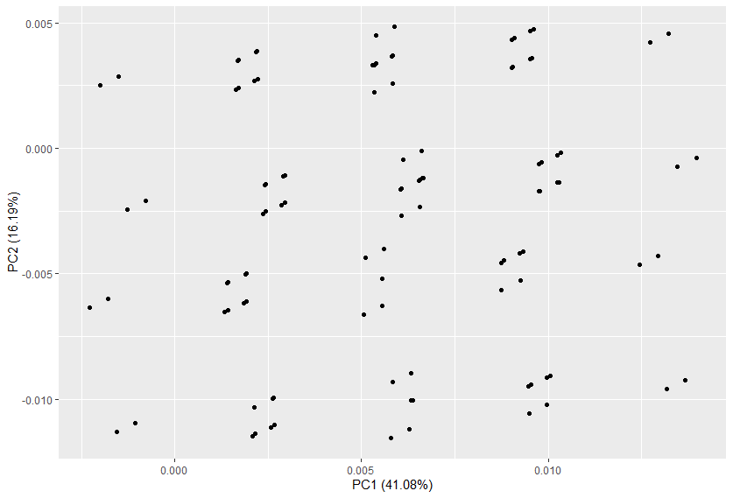
Results
Here is what the PCA looks like for
Phascolarctobacterium_succinatutens.
Note that this was a sparse data
set that I used for testing.
I expect to see more from higher
density data, e.g., B. vulgatus,
and am currently running that, but
it will take a bit more time (B.vulgatus
has about 200 times as much data as
P. succinatutens). I might want to
refactor code down the line
to make things run faster.

Slide 12
Implementation plan (for PCA)
For the following plots, I used a minimum depth of 5.
The way this was applied was that sites were only included if every individual had a depth of at least 5.
Applying this with higher thresholds, e.g., 20 and 10, resulted in no sites being added (since at least one individual might not meet the minimum depth reuirement).
I think moving forward a smarter way to do the minimum depth would be to exclude data from individuals, e.g., N/A, but not the entire SNP.

Slide 13
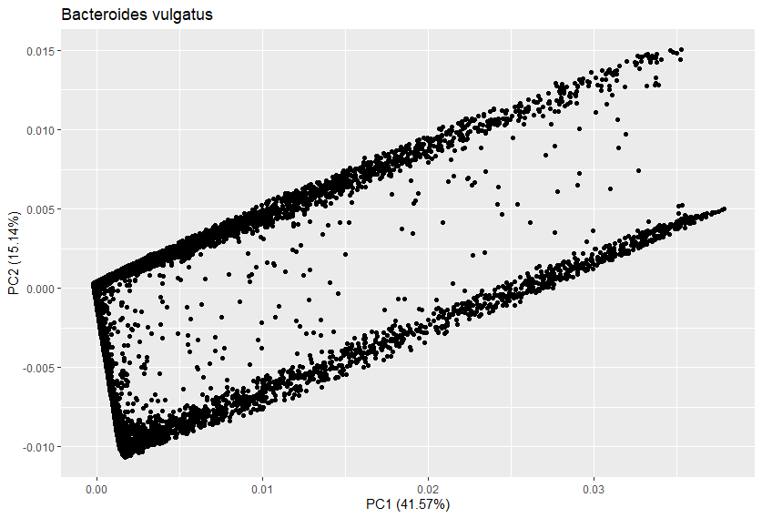
Bacteroides vulgatus (min depth = 5)
There’s definitively some structure, but it looks pretty wacky.

Slide 14
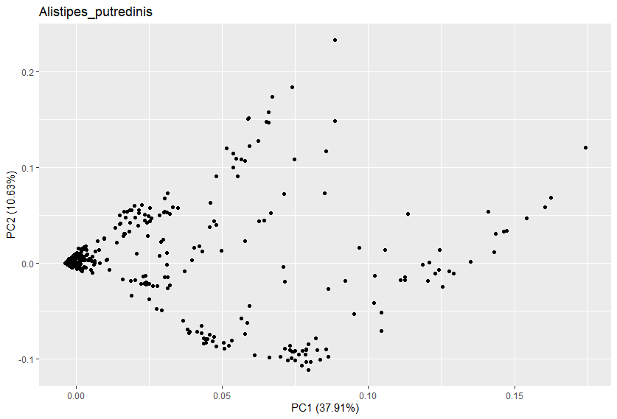
Alistipes putredinis (min depth = 5)
Looks more “PCA-ish”.

Slide 15
//TODO
Run MIDAS on downloaded data.
Check in with Nandita to make sure I’m using the write input
Run PCA on other samples

Slide 16
Standing questions
Investigate edge length distribution
Compare commensal bacteria to human demography
Compare commensal bacteria to pathogens

