Slide 1
demo_for_ccgb Weekly Update
20211118
Jon Mah
Garud and Lohmueller Labs

Slide 2
Oral Data Download
I have all the files transferred onto project-ngarud and correctly compressed / decompressed. Moving forward I plan to prioritize getting MIDAS to run on these so that we can free up some space.

Slide 3
NDSEG
Recommendation due tomorrow (I think you submitted earlier today, thanks!)
I’ll finish this tonight / tomorrow morning

Slide 4
Comparing pi across populations
Takes a long time – I don’t have a particularly elegant or efficient method due to memory constraints.
Here’s what I have so far for species which overlap between cohorts and have at least >=5 samples for both cohorts

Slide 5
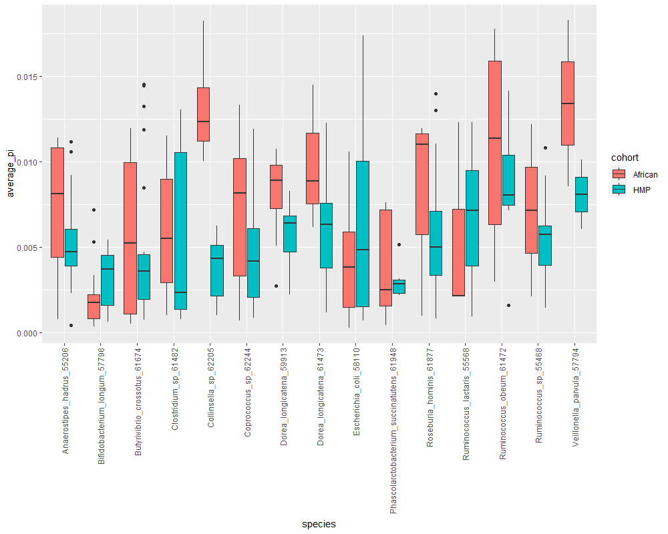

Slide 6
//TODO
Midas → demographic inference, etc for oral data
Find best fit for remaining demographic models (three epoch and bottleneck)
Good species command
Print out sample sizes, determine which is converging and which isn’t
Make sure I understand the methods being used, e.g., polarization, clade control
Which species are not converging, what is their sample size
Work on paper outline

Slide 7
//TODO
Additional analysis:
Consider pi across hosts
Once pi computation is complete across species for both cohorts, perform paired t-test to determine if pi is significantly different between HMP and African data (either on species level or overall)

