Slide 1
demo_for_ccgb Weekly Update
20220210
Jon Mah
Garud and Lohmueller Labs

Slide 2
Summary of Update
Confidence intervals
Approach 1:
Poisson sample SFS
Dadi.Spectrum_mod.sample(self)
Approach 2:
Bootstrap VCF
1000 SFS’s, run MLE inference on each SFS, 5% and 95% of param space is our CI
 | Site 1 | Site 2 | … | Site n
Ind. 1 | 0 | 1 | … | 0
Ind. 2 | 0 | 2 | … | 0
… | … | … | … | …
Ind n | 1 | 1 | … | 1

Slide 3
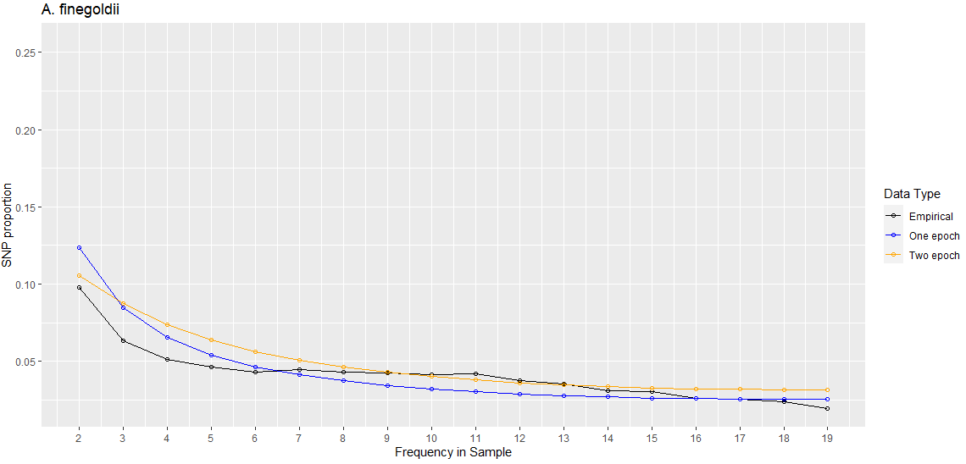
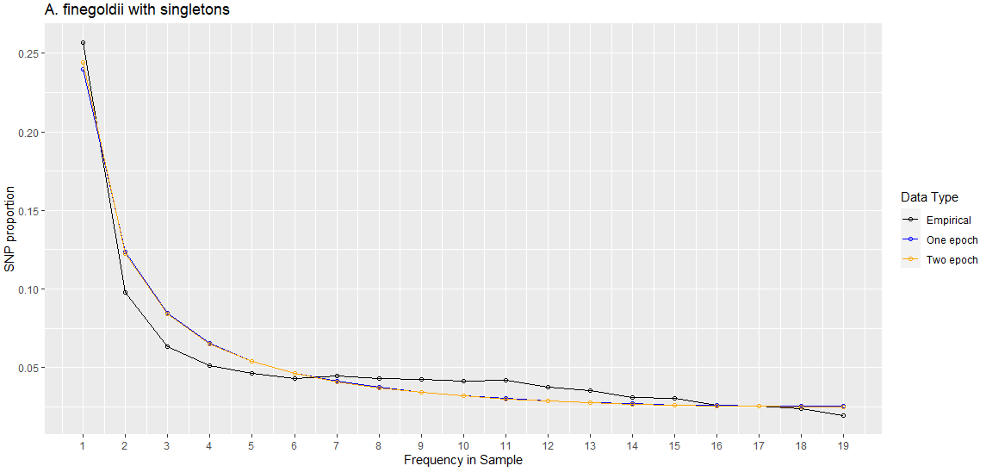
Species | A. finegoldii [shown] | No masking
Best Nu | 0.00233553 | 3.16555418e-01
Best Starting params | [7.15395598e-02, 8.46888606e-06] | [1.14740392e-01, 5.81318649e-06]
Two-epoch log likelihood | -258.020487646 | -491.701645262
One-epoch log likelihood | -479.21577207 | -498.896273053

Slide 4
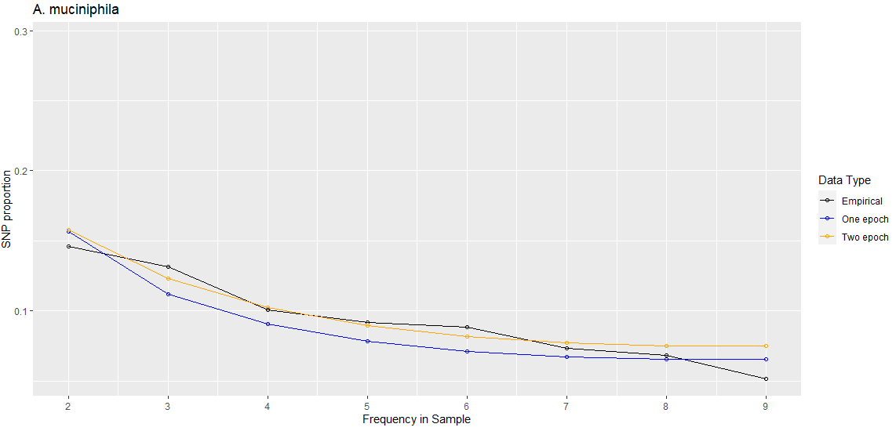
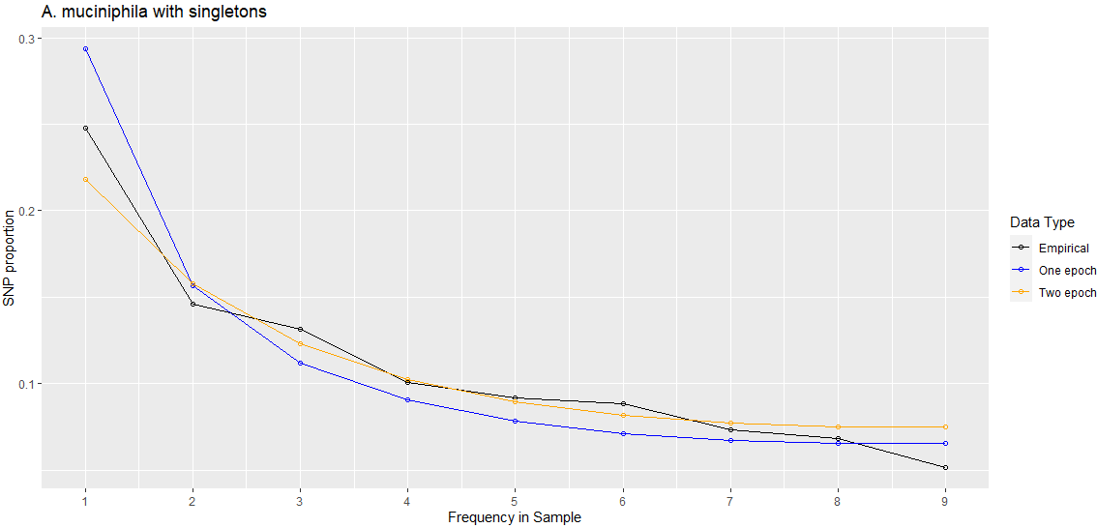
Species | A. muciniphila [shown] | No masking
Best Nu | 0.00315201 | 0.00663707
Best Starting params | [6.95824984e-02, 1.26594098e-05] | [2.85076127e-01, 1.40050296e-05]
Two-epoch log likelihood | -106.700944499 | -127.818481371
One-epoch log likelihood | -154.628390672 | -325.661416998

Slide 5
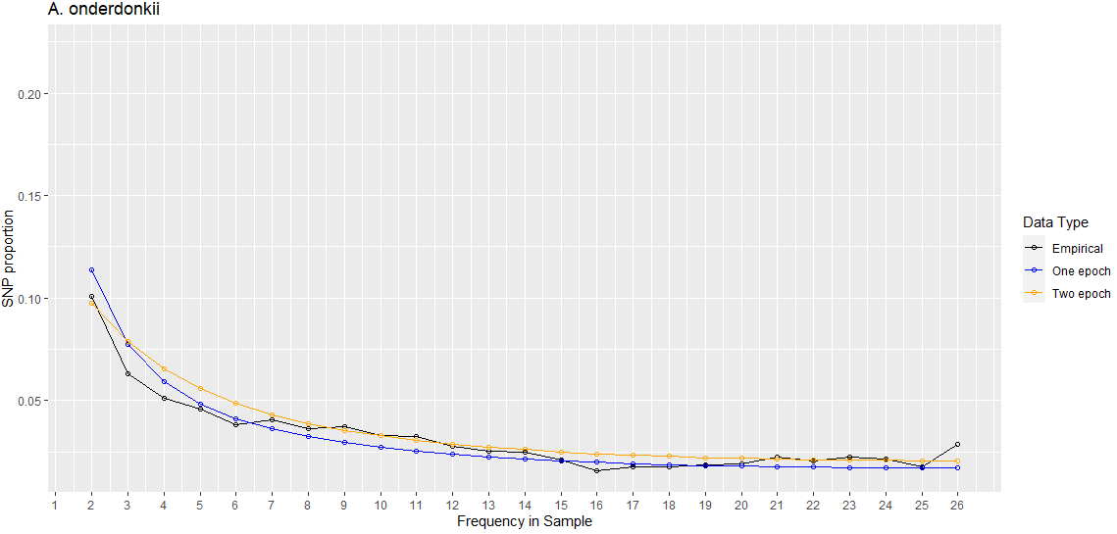
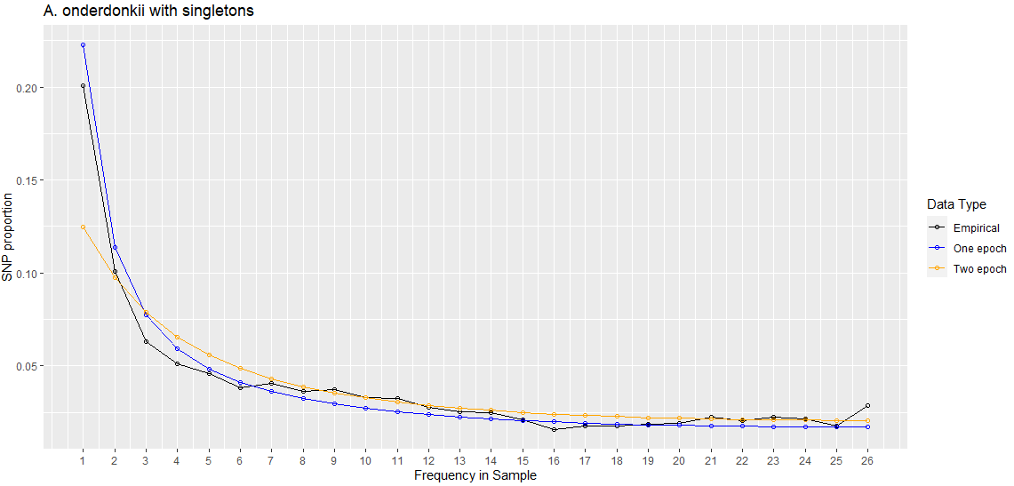
Species | A. onderdonkii [shown] | No masking
Best Nu | 0.00684189 | 0.01698749
Best Starting params | [1.75492930e-01, 1.72045434e-05] | [6.43509057e-01, 1.82233725e-05]
Two-epoch log likelihood | -306.804782802 | -400.467168718
One-epoch log likelihood | -409.666652485 | -453.284486831

Slide 6
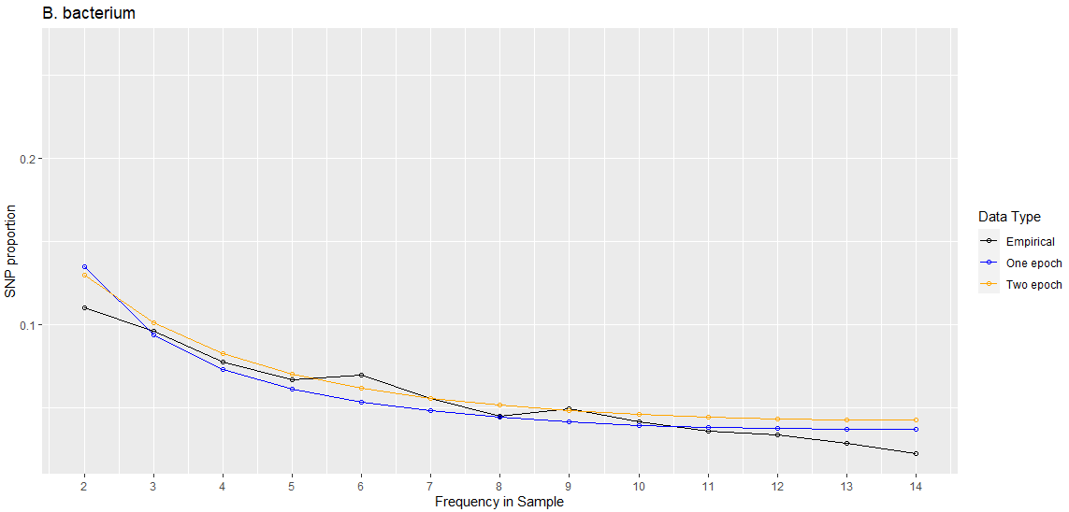
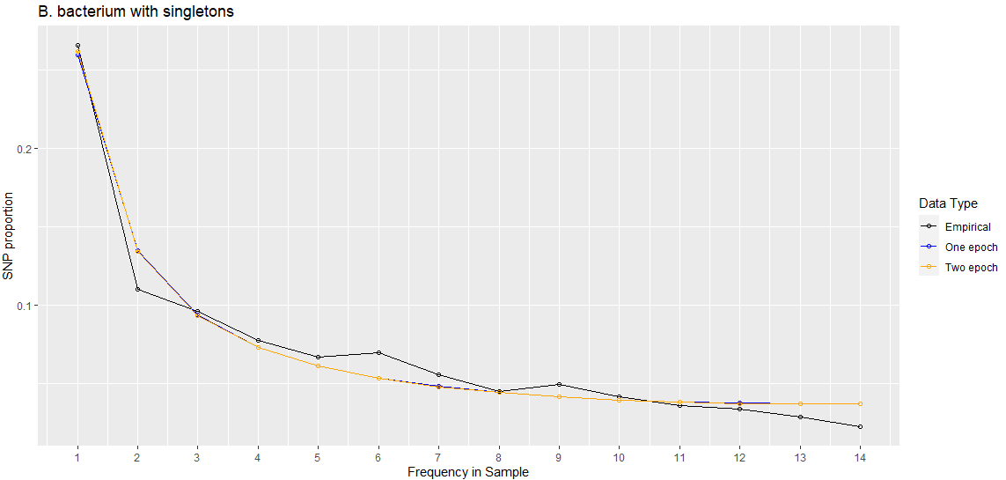
Species | B. bacterium [shown] | No masking
Best Nu | 0.00384582 | 8.00000000e+00
Best Starting params | [1.43685810e-01, 8.31714592e-06] | [1.13472476e+00, 1.62394420e-05]
Two-epoch log likelihood | -172.294607416 | -229.216380647
One-epoch log likelihood | -224.025922804 | -229.453899008

Slide 7
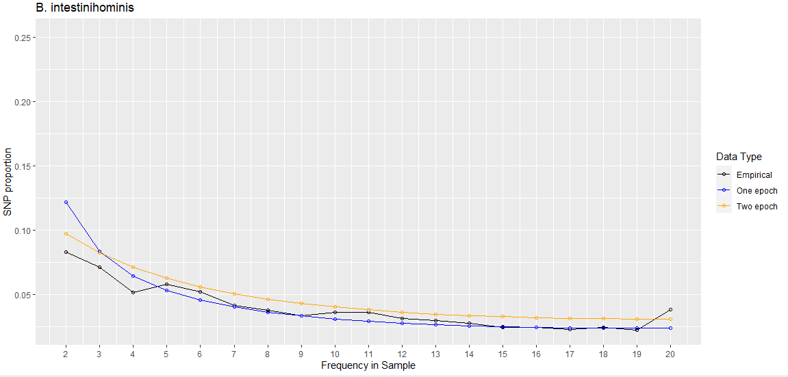
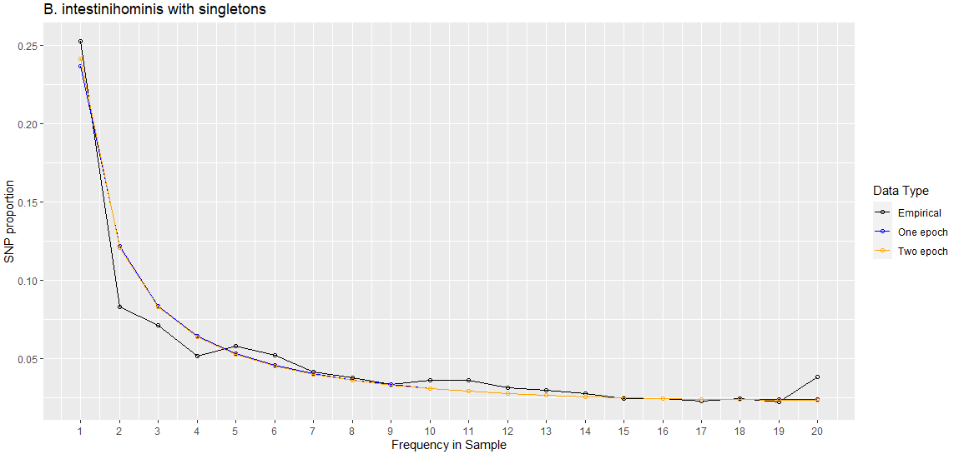
Species | B. intestinihominis [shown] | No masking
Best Nu | 0.0037498 | 1.79804821e-01
Best Starting params | [1.05727090e-01, 1.41697945e-05] | [8.59275166e-02, 7.09105287e-06]
Two-epoch log likelihood | -254.234850576 | -724.158464668
One-epoch log likelihood | -701.532028657 | -739.501271233

Slide 8
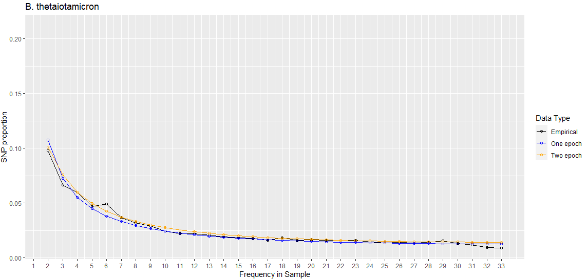
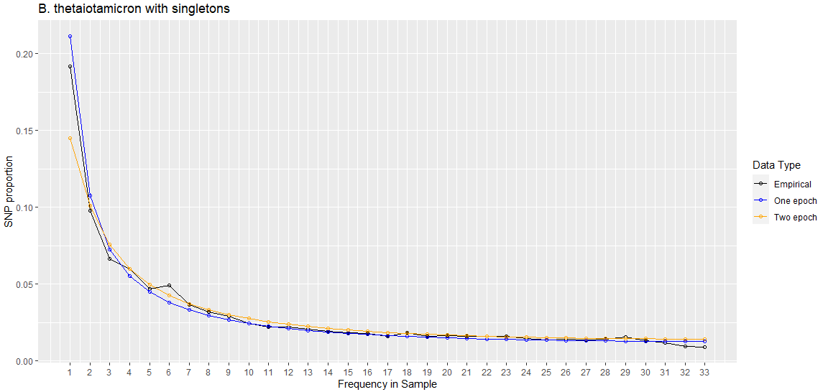
Species | B. thetaiotamicron [shown] | No masking
Best Nu | 0.00633643 | 7.94514730e-03
Best Starting params | [1.11098337e-01, 9.27590937e-06] | [5.46546503e-02, 1.14468430e-05]
Two-epoch log likelihood | -292.381165778 | -348.097010233
One-epoch log likelihood | -360.547850479 | -432.953887663

Slide 9
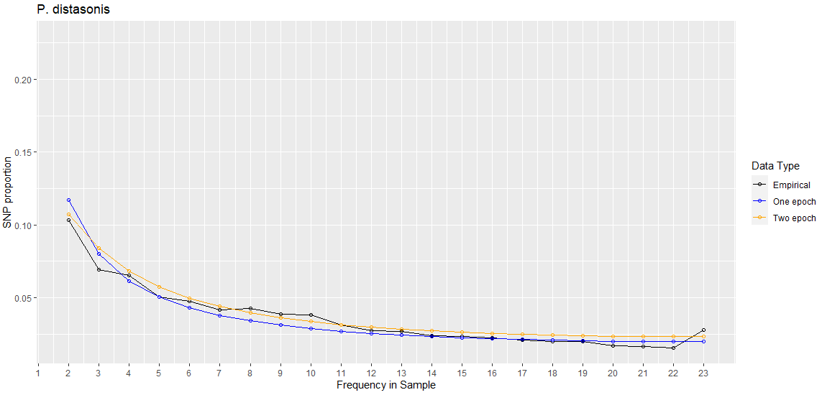
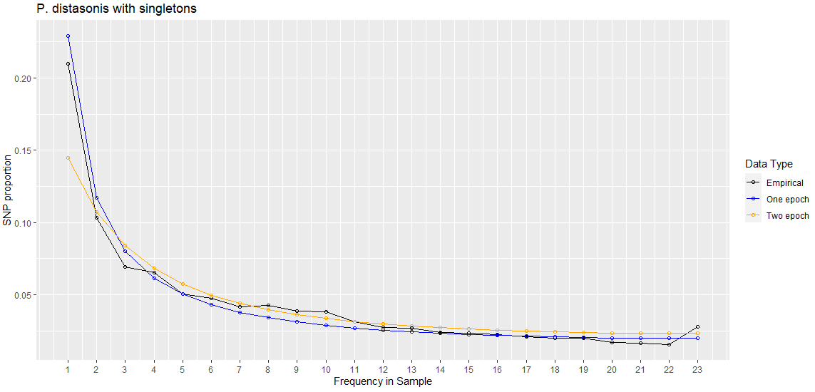
Species | P. distasonis [shown] | No masking
Best Nu | 0.00352228 | 0.01461395
Best Starting params | [7.44134295e-02, 7.45804647e-06] | [3.23350697e-0,1 9.80307401e-06]
Two-epoch log likelihood | -318.036213868 | -410.122721596
One-epoch log likelihood | -421.232898312 | -472.73364692

Slide 10
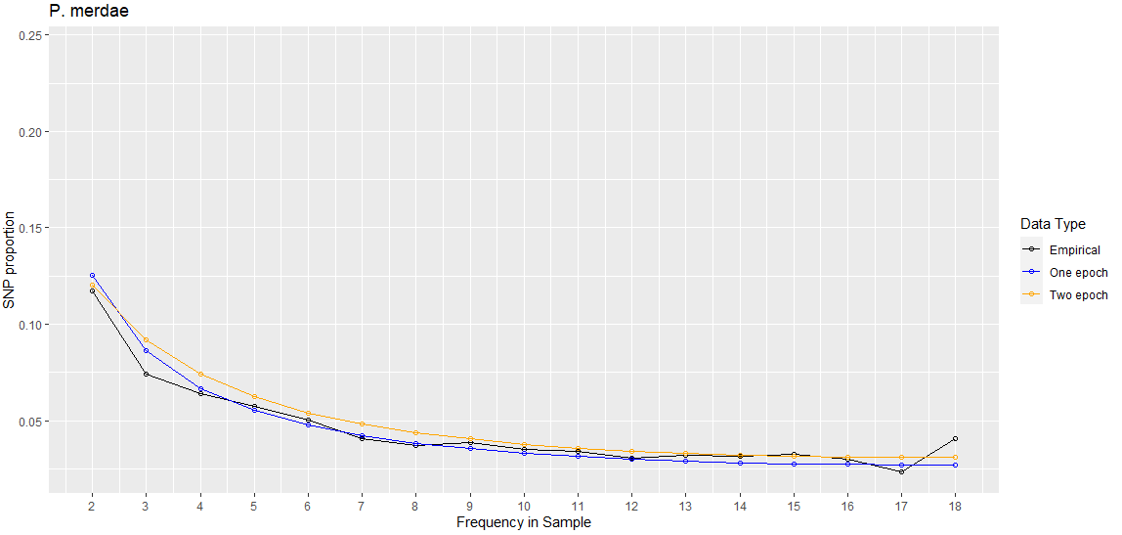
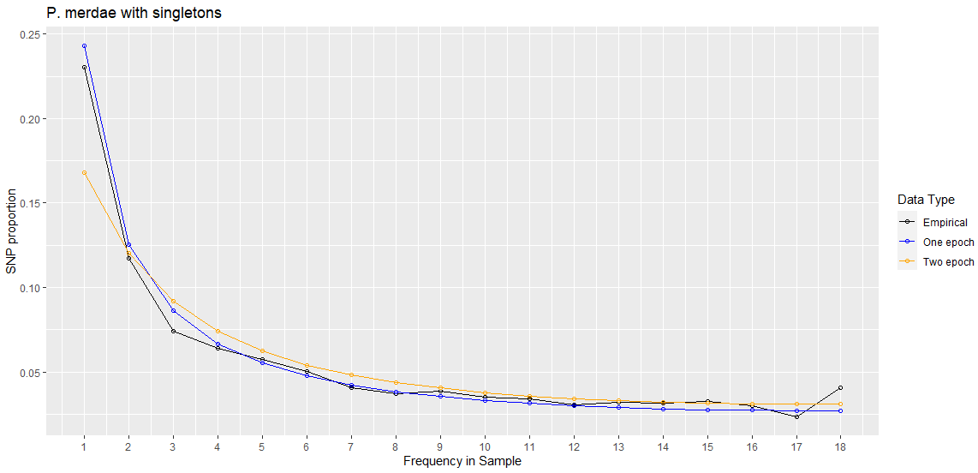
Species | P. merdae [shown] | No masking
Best Nu | 0.00600145 | 1.51738741e-02
Best Starting params | [1.14191974e-01, 1.50772180e-05] | [2.08806763e-01, 9.08037126e-06]
Two-epoch log likelihood | -153.083354001 | -182.781394466
One-epoch log likelihood | -179.740046365 | -194.945099937

Slide 11
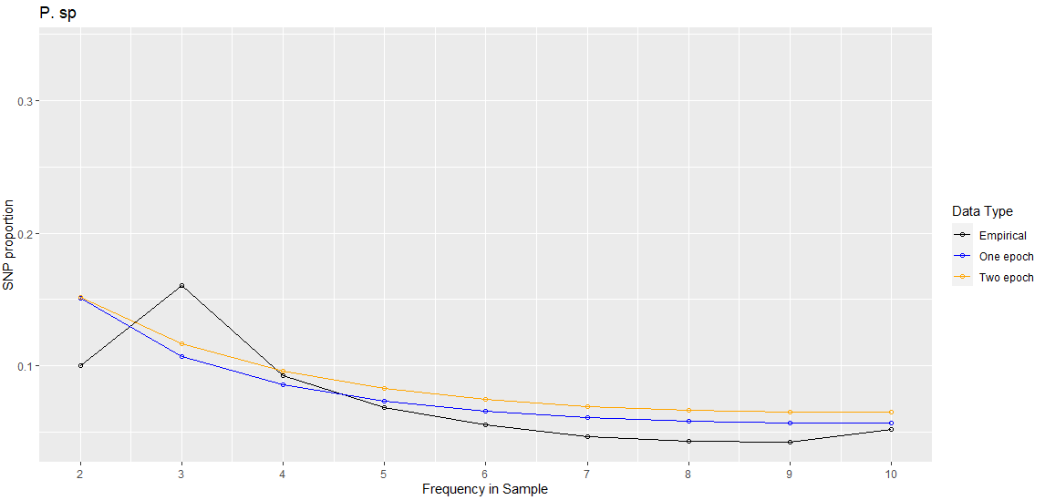
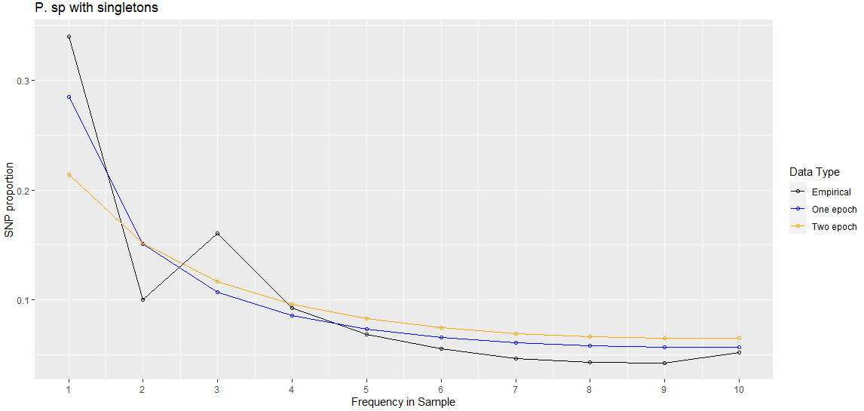
Species | P. sp [shown] | No masking
Best Nu | 0.00395808 | 4.67725555e-01
Best Starting params | [7.44995804e-02, 1.30477726e-05] | [1.60100853e-01, 5.83075069e-06]
Two-epoch log likelihood | -418.920443969 | -538.651173833
One-epoch log likelihood | -446.321619655 | -548.201437719

Slide 12
//TODO
Convert time param to years
Show masked singleton SFS for masked singleton inference
Show non-masked SFS for non-masked inference
Look into confidence intervals
Poisson sample SFS
Dadi.Spectrum_mod.sample(self)
Bootstrap VCF
1000 SFS’s, run MLE inference on each SFS, 5% and 95% of param space is our CI

Slide 13
//TODO
Wednesday:
Ask lab for help on species step errors
Make google doc of path for FASTA file that I can’t
I can also put one in project-ngarud
By end of quarter:
Try and finish fecal analysis
Try and finish MIDAS stuff

Slide 14
//TODO
Take a look at more complex models – e.g., bottlegrowth.
Rationale is that neither one or two epoch inferences are fitting well (with or without singletons)
Three-epoch and bottlegrowth with and without singletons
Look at sparsing SFS
Instead of doing all the populations and models, just take a closer look at two
Search space really well

