Slide 1
demo_for_ccgb Rotation Update
20210310
Jon Mah
Garud Lab

Slide 2
Logistics
I messed up my conda environment on Hoffman2 so I’m rebuilding this over night ☹. Hopefully it’ll be done by tomorrow morning.

Slide 3
Project Aim
Science Goal: Infer the demographic history of common commensal gut bacteria
Training Goal: Learn popgen tools / tech for microbiome
Personal Goal: Have fun ☺!

Slide 4
Gameplan
Initially focus on B. vulgatus
Create syn / ns SFSs
Compare to expectation of SFS
Given clade data (e.g., continent of origin), create PCA plot
Run Dadi to determine best fit demographic model
Start with Omar Conejo’s model(s)
Perhaps find link to human demography?
Apply to other species
Apply to other data sets (include African data, Peruvian data)

Slide 5
Progress
Implemented fitting for nonsynonymous SFS using fitdadi
This technically infers the DFE, but there are some bugs with this part
New script/pipeline: `fit_demographic_model_and_DFE.py`
I’m now reporting the proportional SFS since it’s more interpretable

Slide 6
Implementation details (for following slides)
Input synonymous SFS’s: output from `plot_within_clade_sfs.py`.
High prevalence species:
B. vulgatus, B. ovatus, B. uniformis, E. rectale.
Four demographic models
exponential growth, two-epoch, bottleneck + growth, three-epoch
Mask singletons OR mask singletons + doubletons
Model still infers masked alleles, but they are excluded in likelihood calculation

Slide 7
Implementation details (for following slides)
For each input species
For each model:
Take 25 initial guesses for parameter space (parameters differ by model)
For each initial guess:
Iterate through gradient ascent to find maximum likelihood for <= 50 steps
Compute model params and log likelihood
Output log likelihood and model params of best initial guess + iterations
Fit nonsynonymous SFS using fitdadi, with selection fit to:
Gamma-distributed DFE (this is the only one that works currently, and is being reported)
Neutral-gamma distributed DFE (some proportion with neutral point-mass)
Mixed-uniform-distributed DFE (DFE split into bins on log10 scale)

Slide 8
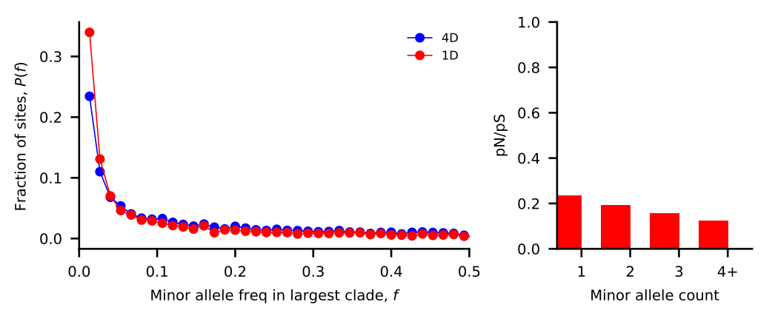
Bacteroides vulgatus [masked singletons]
Nu_a: contemporary population relative to ancestral population before first epoch
Nu_b: contemporary population relative to ancestral population before second epoch
T_1: Duration of first epoch (units of 2 * N_a)
T_2: Duration of second epoch (units of 2 * N_a)
Model | Exponential growth | Two-epoch | Bottleneck + growth | Three-epoch
Log Likelihood | -142.247483648 | -142.247483618 | -142.247486317 | -142.247518266
Theta | 2364.57148832 | 2364.57148822 | 2364.5714969 | 2364.57159963
Nu_a | 6.66580916e-01 | 6.29456013e-01 | 1.37235899e-01 | 3.87789109e-01
Nu_b | N/A | N/A | 4.43303719e-01 | 2.90685973e-01
T_12 | 4.22065001e-06 | 3.74595473e-06 | 3.54411669e-06 | 4.14123142e-06
T_23 | N/A | N/A | N/A | 4.06493644e-06

Slide 9
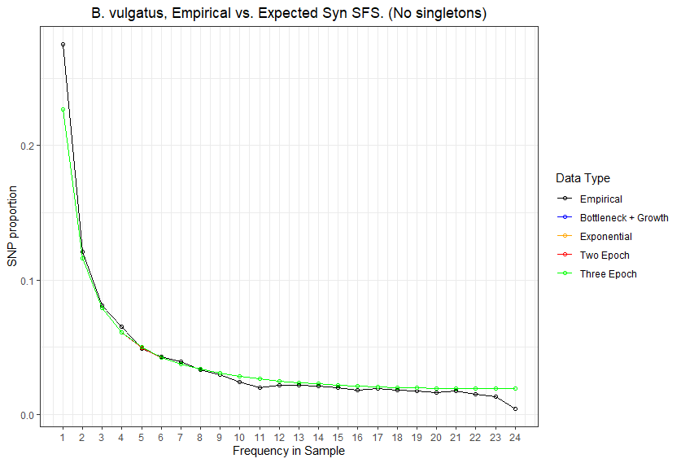
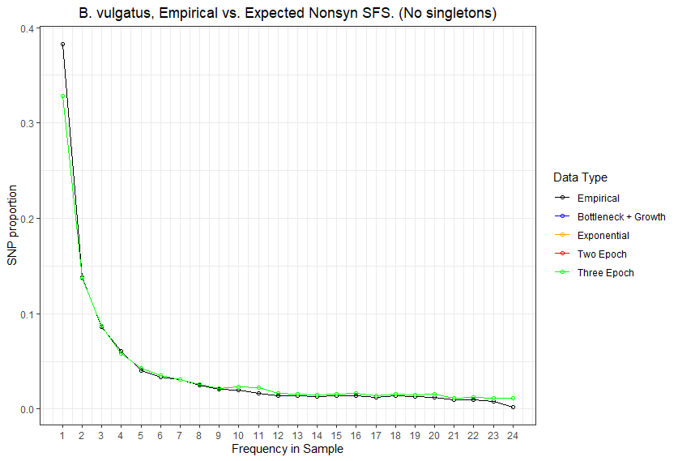

Slide 10
Bacteroides vulgatus [masked <= doubletons]
Nu_a: contemporary population relative to ancestral population before first epoch
Nu_b: contemporary population relative to ancestral population before second epoch
T_1: Duration of first epoch (units of 2 * N_a)
T_2: Duration of second epoch (units of 2 * N_a)
Model | Exponential growth | Two-epoch | Bottleneck + growth | Three-epoch
Log Likelihood | -131.835854371 | -131.8358543 | -131.835854385 | -131.835856665
Theta | 2325.77602805 | 2325.77602778 | 2325.77602809 | 2325.77603653
Nu_a | 1.61157070e-01 | 1.81242206e-01 | 5.18932449e-02 | 1.81639251e-01
Nu_b | N/A | N/A | 1.70715514e-01 | 1.57054198e-01
T_12 | 5.78439809e-06 | 5.74354330e-06 | 6.27484161e-06 | 9.87432271e-06
T_23 | N/A | N/A | N/A | 7.63857578e-06

Slide 11
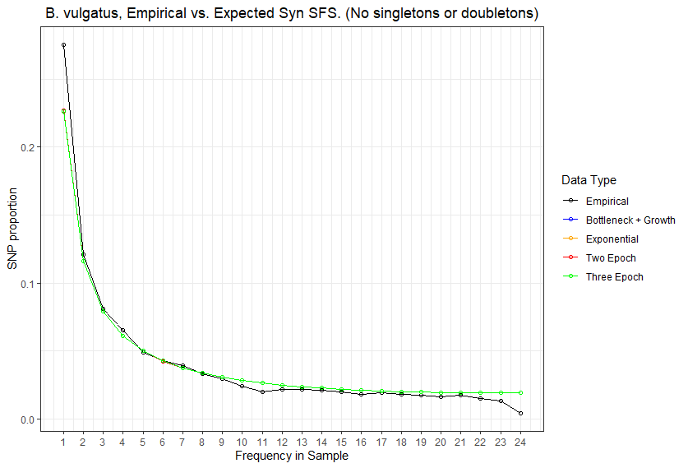
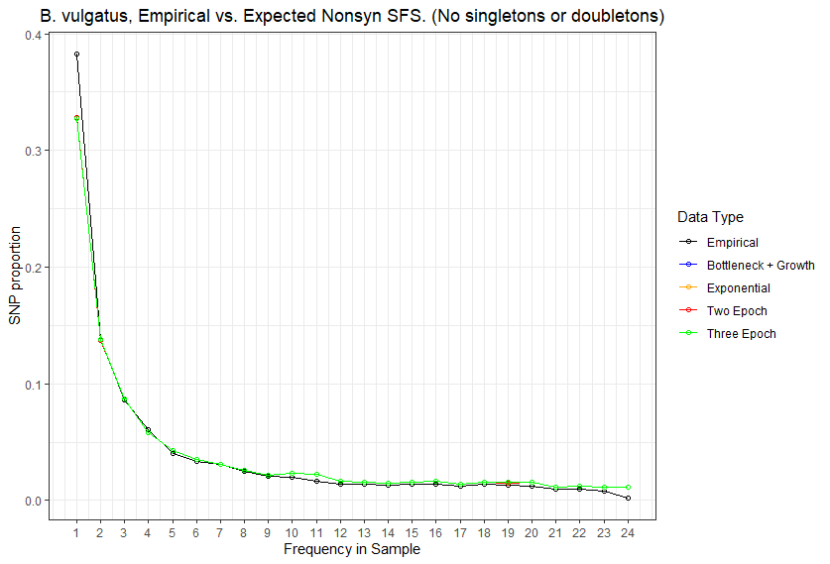

Slide 12
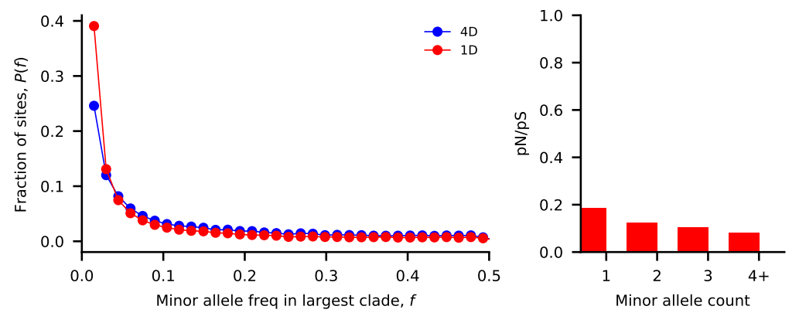
Bacteroides ovatus [masked singletons]
Nu_a: contemporary population relative to ancestral population before first epoch
Nu_b: contemporary population relative to ancestral population before second epoch
T_1: Duration of first epoch (units of 2 * N_a)
T_2: Duration of second epoch (units of 2 * N_a)
Model | Exponential growth | Two-epoch | Bottleneck + growth | Three-epoch
Log Likelihood | -181.635397973 | -181.635397248 | -181.635401442 | -181.635435384
Theta | 2302.29240418 | 2302.29240093 | 2302.29241973 | 2302.29257181
Nu_a | 6.23704625e-01 | 7.02244758e-01 | 9.04162347e-02 | 2.13866355e-01
Nu_b | N/A | N/A | 4.19634741e-01 | 1.60268125e-01
T_12 | 5.34558180e-06 | 5.51358609e-06 | 4.67314199e-06 | 2.73551889e-06
T_23 | N/A | N/A | N/A | 2.56313382e-06

Slide 13
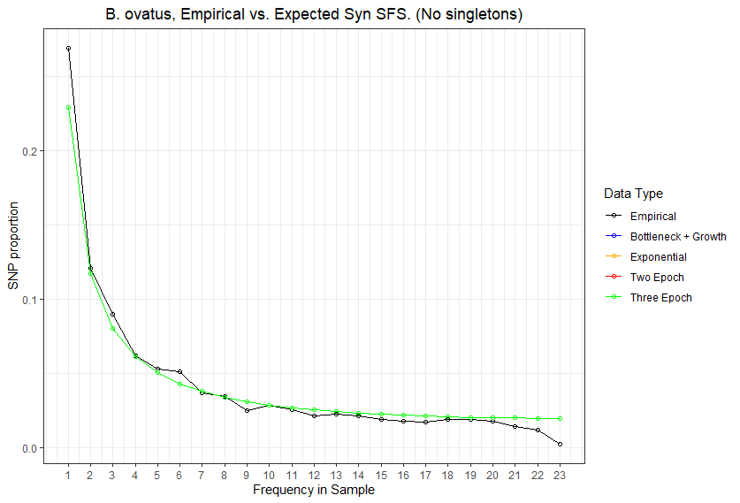
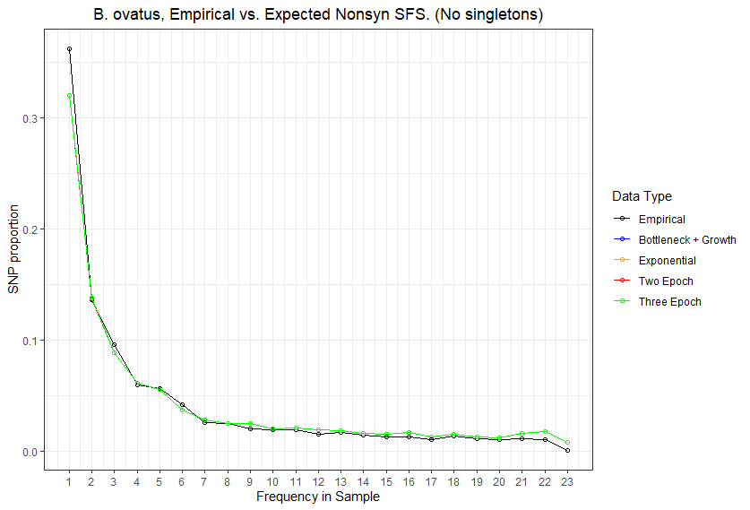

Slide 14
Bacteroides ovatus [masked <= doubletons]
Nu_a: contemporary population relative to ancestral population before first epoch
Nu_b: contemporary population relative to ancestral population before second epoch
T_1: Duration of first epoch (units of 2 * N_a)
T_2: Duration of second epoch (units of 2 * N_a)
Model | Exponential growth | Two-epoch | Bottleneck + growth | Three-epoch
Log Likelihood | -174.082255637 | -174.082255281 | -174.082255156 | -174.082256325
Theta | 2274.38737772 | 2274.38737702 | 2274.38737677 | 2274.38737907
Nu_a | 1.37881451e-01 | 1.48171075e-01 | 1.88445625e-01 | 1.63614354e-01
Nu_b | N/A | N/A | 1.85953469e-01 | 1.37682362e-01
T_12 | 6.17055681e-06 | 5.26856194e-06 | 5.79573721e-06 | 5.28685885e-06
T_23 | N/A | N/A | N/A | 5.32469006e-06

Slide 15
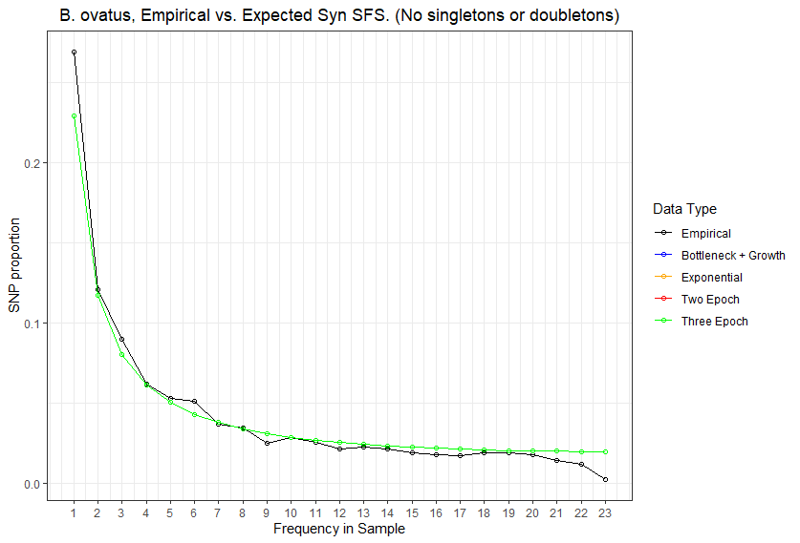
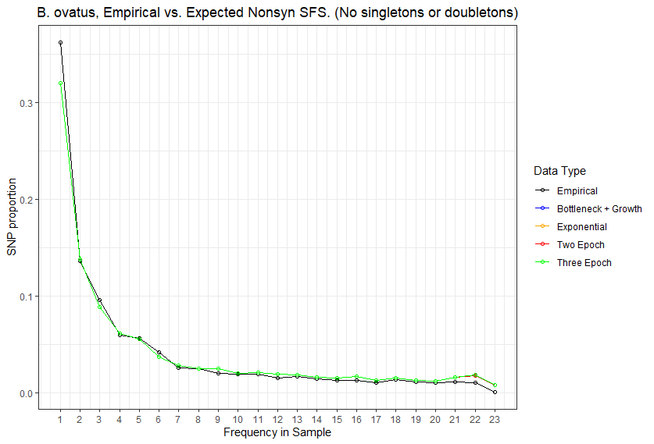

Slide 16
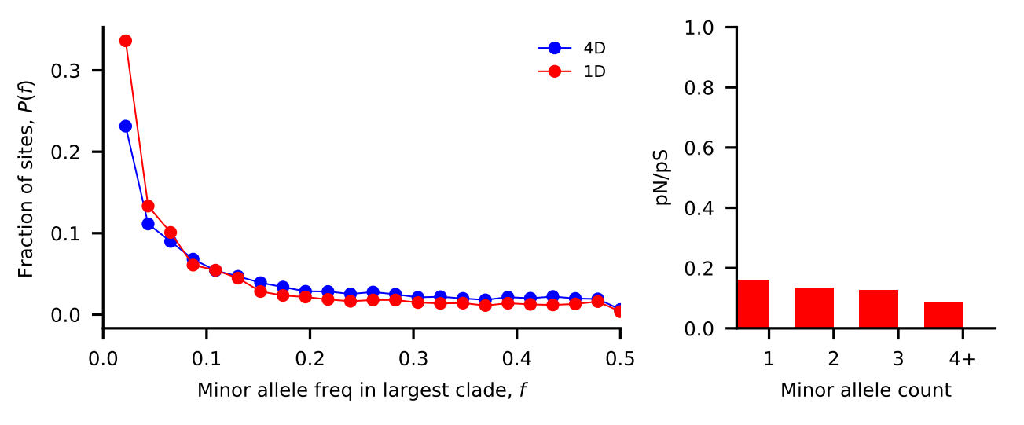
Bacteroides uniformis [masked singletons]
Nu_a: contemporary population relative to ancestral population before first epoch
Nu_b: contemporary population relative to ancestral population before second epoch
T_1: Duration of first epoch (units of 2 * N_a)
T_2: Duration of second epoch (units of 2 * N_a)
Model | Exponential growth | Two-epoch | Bottleneck + growth | Three-epoch
Log Likelihood | -253.217146369 | -253.217143694 | -253.217169755 | -253.217362503
Theta | 2054.49141356 | 2054.49140968 | 2054.49144756 | 2054.49172791
Nu_a | 4.80162841e-01 | 7.12256859e-01 | 1.55550793e-01 | 2.17180887e-01
Nu_b | N/A | N/A | 4.09160345e-01 | 2.37005310e-01
T_12 | 1.89183803e-06 | 2.11853690e-06 | 3.97591431e-06 | 3.03170302e-06
T_23 | N/A | N/A | N/A | 3.26489369e-06

Slide 17
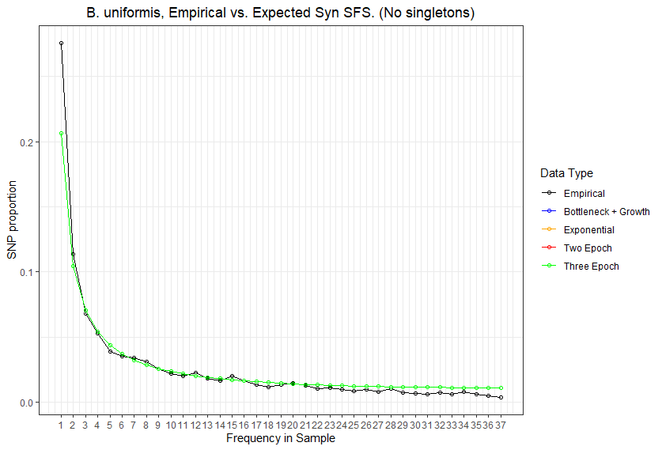
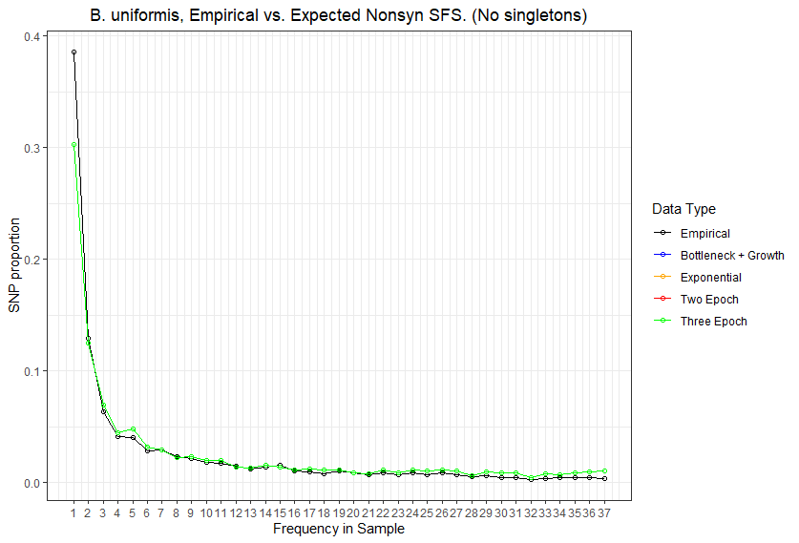

Slide 18
Bacteroides uniformis [masked <= doubletons]
Nu_a: contemporary population relative to ancestral population before first epoch
Nu_b: contemporary population relative to ancestral population before second epoch
T_1: Duration of first epoch (units of 2 * N_a)
T_2: Duration of second epoch (units of 2 * N_a)
Model | Exponential growth | Two-epoch | Bottleneck + growth | Three-epoch
Log Likelihood | -230.274343919 | -230.274343689 | -230.274343838 | -230.274347992
Theta | 1998.25465652 | 1998.25465555 | 1998.25465618 | 1998.2546738
Nu_a | 1.84666920e-01 | 1.86322091e-01 | 1.14669962e-01 | 1.46505347e-01
Nu_b | N/A | N/A | 1.82675926e-01 | 1.49928597e-01
T_12 | 6.48867925e-06 | 5.26371303e-06 | 6.02905845e-06 | 7.63293066e-06
T_23 | N/A | N/A | N/A | 5.99746626e-06

Slide 19
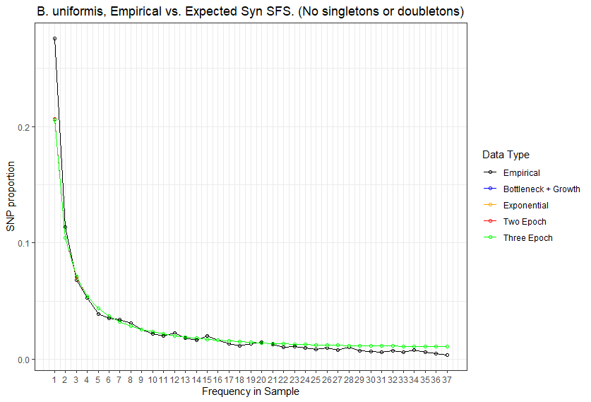
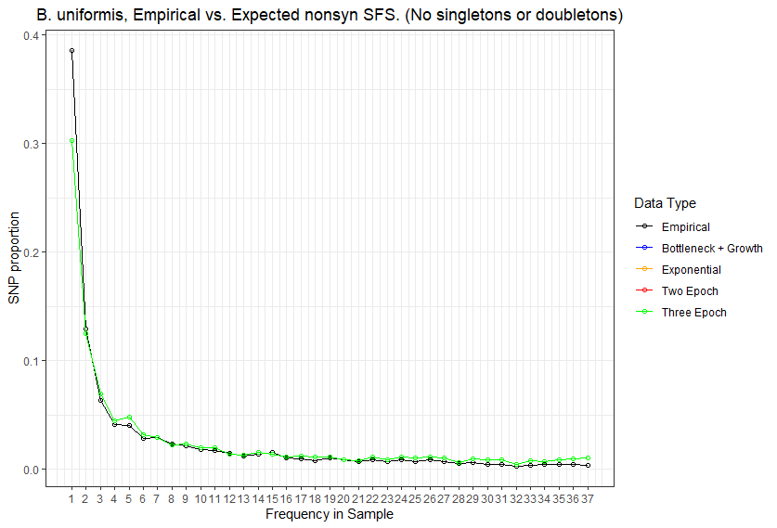

Slide 20
//TODO

Slide 21
Standing questions
Investigate edge length distribution
Compare commensal bacteria to human demography
Compare commensal bacteria to pathogens

