Slide 1
demo_for_ccgb Weekly Update
20220926
Jon Mah
Garud and Lohmueller Labs

Slide 2
Summary
IID Pi + Wilcoxin RS test
MIDAS snps merge (complete)
Likelihood plots
Lit search on recombination
Writing

Slide 3
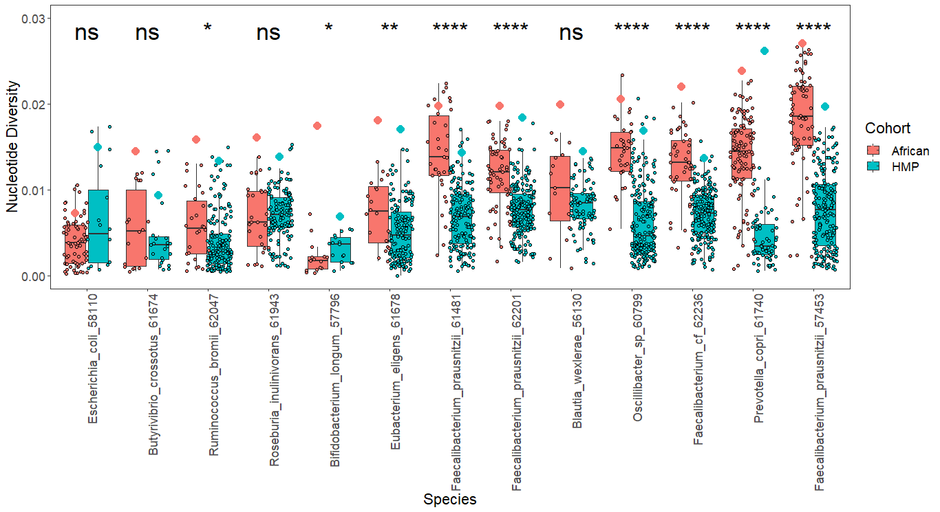
IID Pi + Wilcoxin RS
Notes:
Y-axis

Slide 4
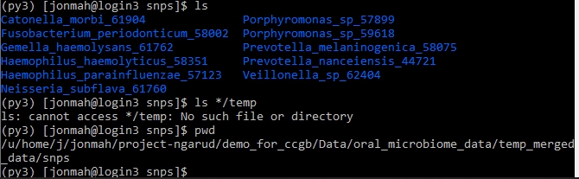
MIDAS snps merge
Previously there were several species for which the merge snps step was not working, i.e., would throw an error
These work now, and no longer produce a misc. */temp/ subdirectory

Slide 5
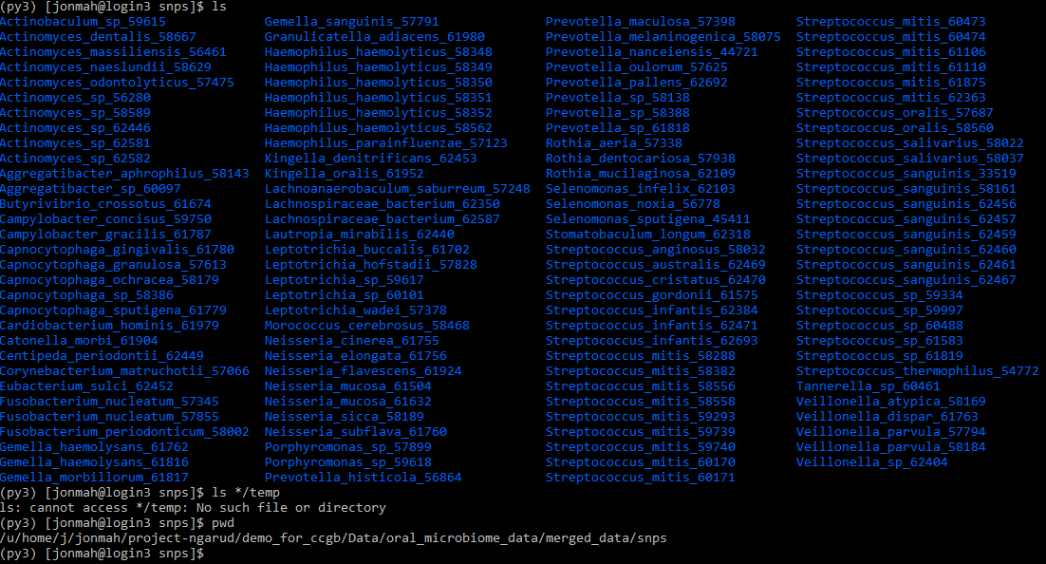
MIDAS snps merge
MIDAS Checklist
Species step
Species-union step
/u/project/ngarud/jonmah/demo_for_ccgb/Data/oral_microbiome_data/species_union
Genes step
Snps step
/u/project/ngarud/jonmah/demo_for_ccgb/Data/oral_microbiome_data/midas_output
Species, genes, snps merged
/u/project/ngarud/jonmah/demo_for_ccgb/Data/oral_microbiome_data/merged_data
132 species merged from snps
230 species merged from genes
Note that genes has lower minimum sample depth

Slide 6
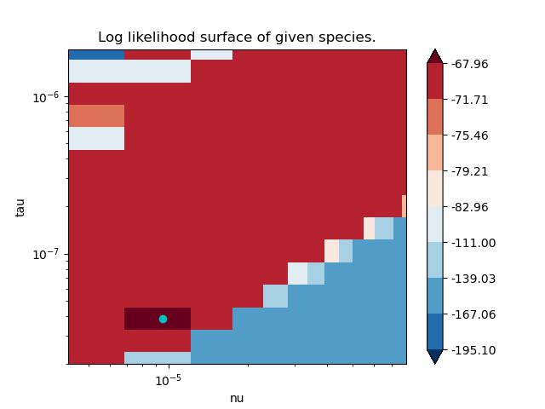
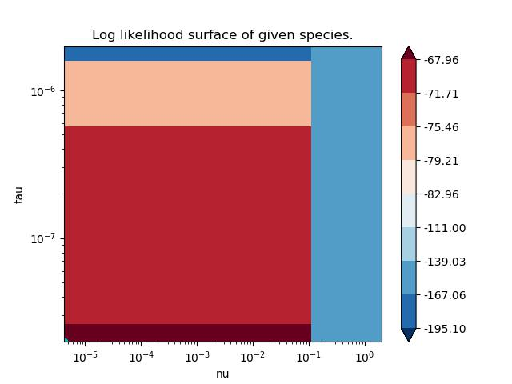
Likelihood Plots – B. intestinihominis
More areas sampled
Add vertical line to zoomed out plot for
Contraction vs. expansion

Slide 7
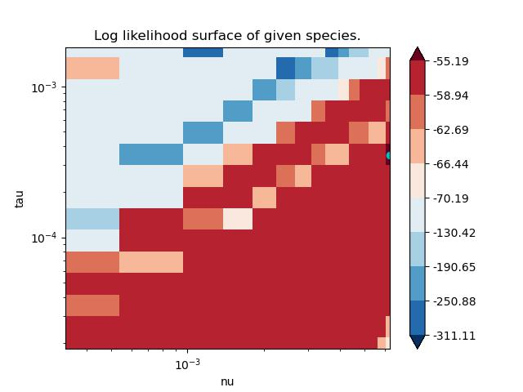
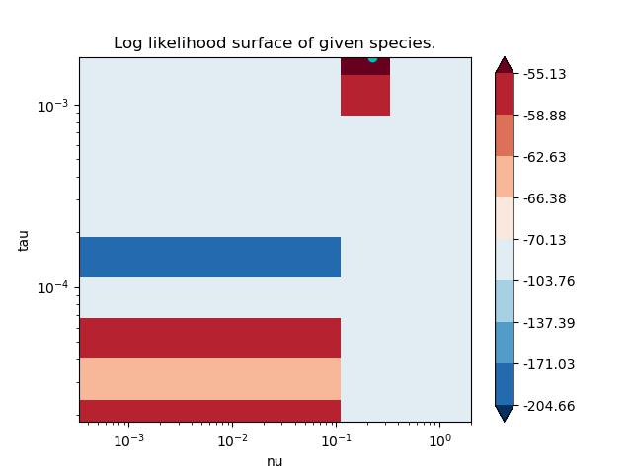
Likelihood Plots – P. distasonis

Slide 8
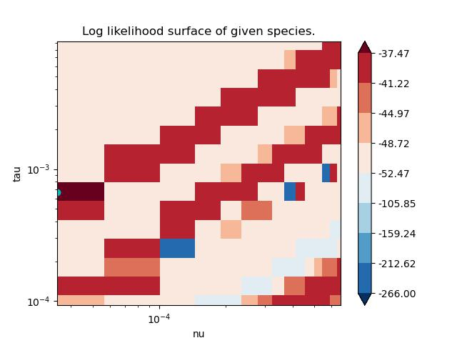
Likelihood Plots – B. xylanisolvens

Slide 9
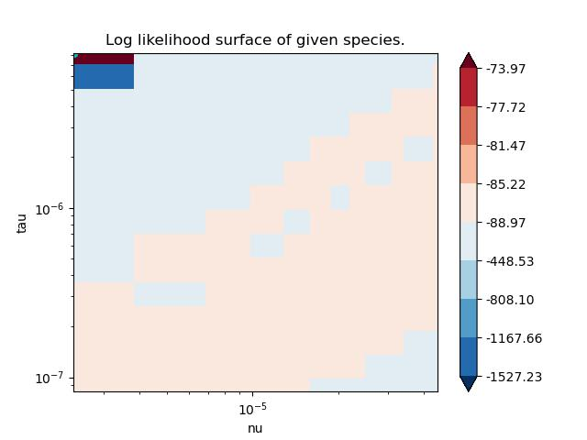
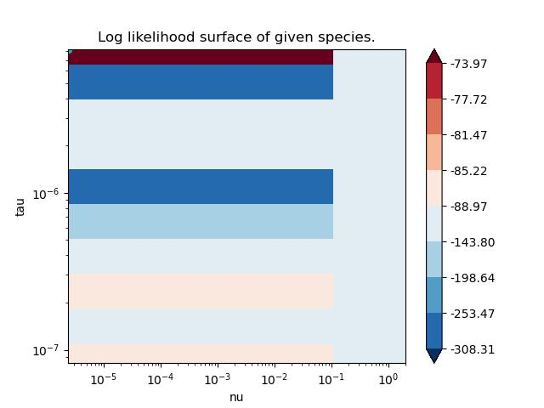
Likelihood Plots – B. thetaiotaomicron

Slide 10
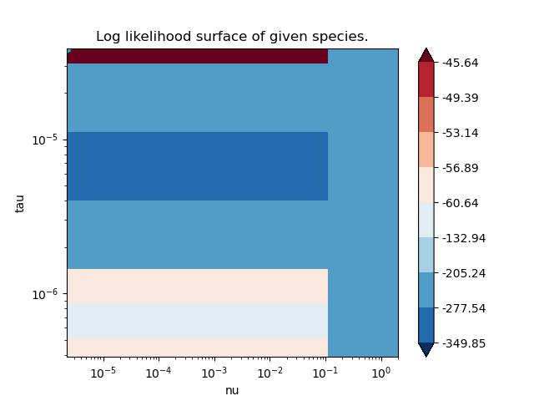
Likelihood Plots – A. onderdonkii

Slide 11
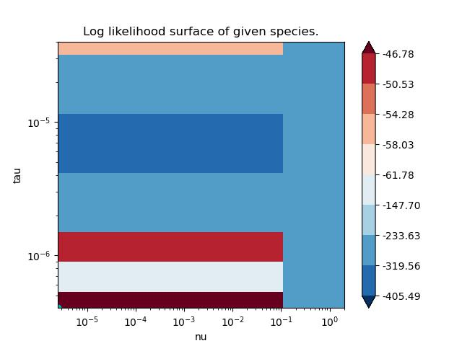
Likelihood Plots – A. muciniphila

Slide 12
Lit search on recombination
What is known about recombination in Bacteria?
How much recombination is there in commensal gut bacteria?
What points does Cornejo make about recombination?
Bacteria which undergo natural transformation (take in environmental), such as S. mutans have high rates of homologous recombination, particularly in core genome
Previous studies suggest ~8x more contribution to genetic diversity from rho than mu
Cornejo et al estimate ~6x more contribution to genetic diversity from rho than mu

Slide 13
TODO
Y-axis on nucleotide diversity plot
Likelihood Surface
Vertical line for contraction vs. expansion
Higher sampling depth in surface
John Maynard-Smith “How Clonal are Bacteria”

