Slide 1
demo_for_ccgb Weekly Update
20220411
Jon Mah
Garud and Lohmueller Labs

Slide 2
Summary of Update
Comparing rho (recombination) vs. mu (mutation rate) and increase in log likelihood.

Slide 3
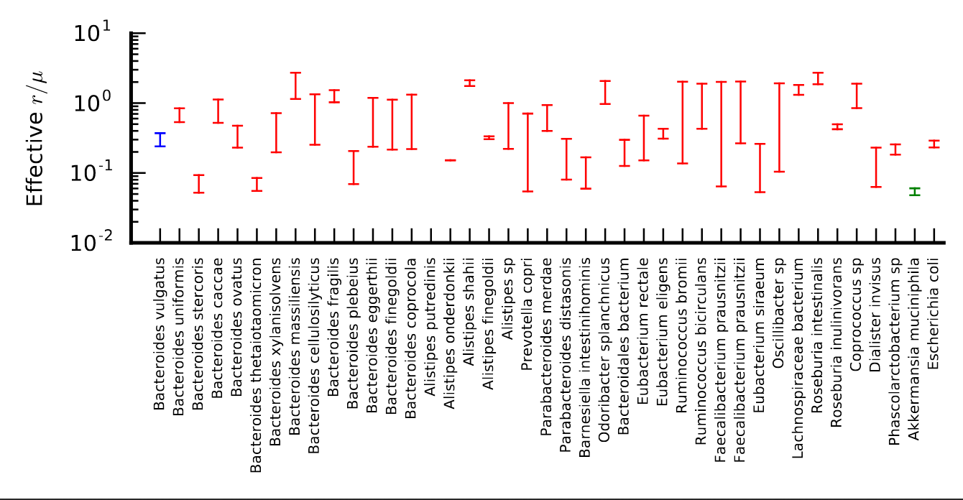
Rho vs. Mu

Slide 4
Thoughts
Synonymous and Nonsynomous sfs’s differ
Model sfs’s (either for demography or for DFE) differ less (as best I can tell)
Synonymous to Demography has better fit than Nonsynonymous to DFE
There might be a systematic weakness in our inference and fitting – I am not sure why.
DFE inferences in general are pretty close to each other in microbiome

Slide 5
//TODO
species prevalence figure
data export script
writing
midas merge

