Slide 1
demo_for_ccgb Weekly Update
20220808
Jon Mah
Garud and Lohmueller Labs

Slide 2
Summary
Updated Pi values
Midas Oral Data
Writing

Slide 3
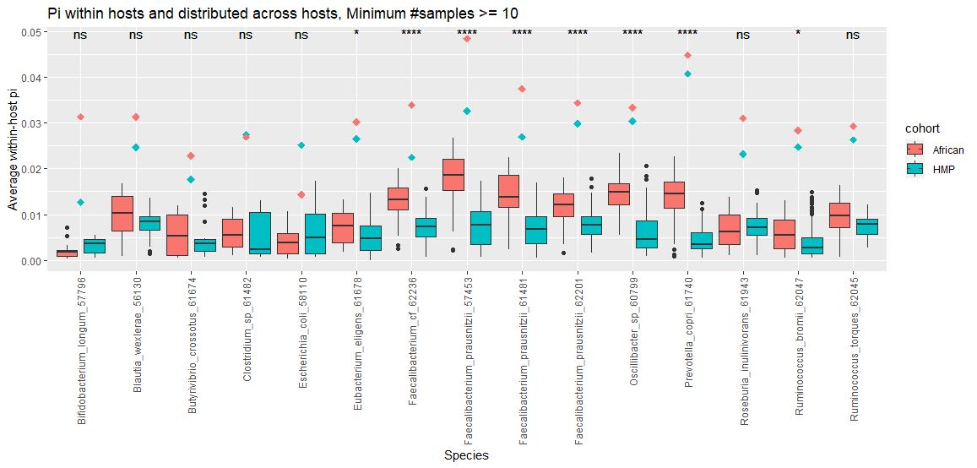
Old Pi Plot (pairwise)

Slide 4
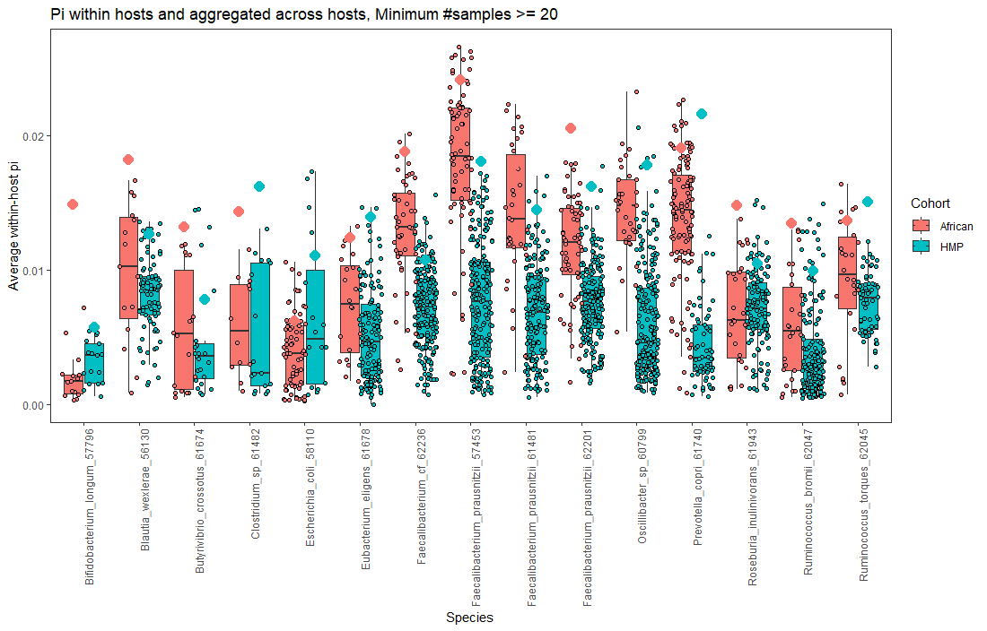
Updated Pi Plot (pairwise)

Slide 5
MIDAS Oral
Species_profile.txt = 339/339
Species union step finished for 186 people (339 unique time x host points)
Snps step = 182/186 hosts
Genes step = 114/186 hosts

Slide 6
TODO
Writing
Results: New version of figure 2:
Cornejo-esque demographic model (but contraction)
SFS for B. thetaiotaomicron
Possibly include likelihood plot
Update cartoons / figures with current script
Methods:
Remove distribution of QP samples
Supplement:
Consult someone with good fashion sense
Cartoon of four demographic models
Distribution of QP samples
SFS’s
Clean-up
Read out loud for MIDAS section

Slide 7
TODO
Prioritize finishing oral data [low burden]:
Run genes and snps step
Run merge step
Talk to Leah, Michael, Nandita about Pi computation (Tuesday 3P PST)
Remove Ethiopian data
Plot likelihood surface
Fit negative selection for SFS on downsampled data

