Slide 1
demo_for_ccgb Weekly Update
20220815
Jon Mah
Garud and Lohmueller Labs

Slide 2
Summary
Figure 2
Likelihood surface
Pi
MIDAS
Supplement / Misc. Writing

Slide 3
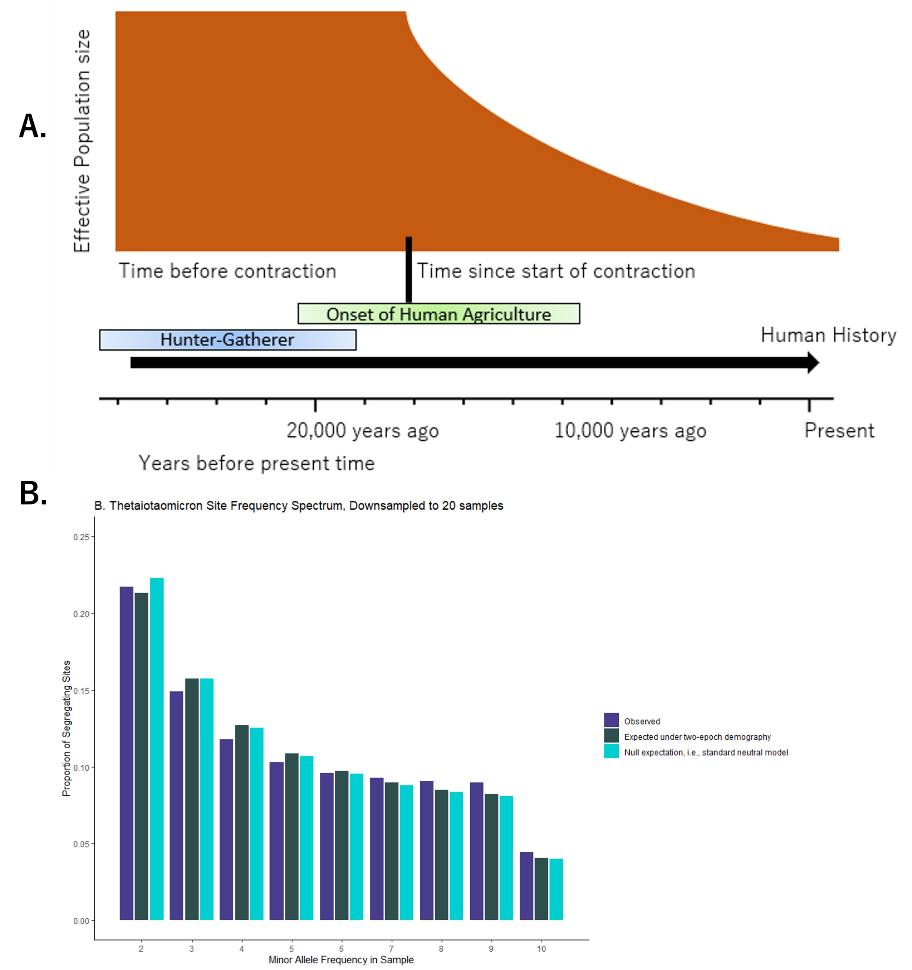
Figure 2

Slide 4
Likelihood Surface
A. muciniphila
A. onderdonkii
B. thetaiotaomicron
B. xylanisolvens
B. intestinihominis
P. distasonis
P. merdae – Taking a long time to resolve, not sure why

Slide 5
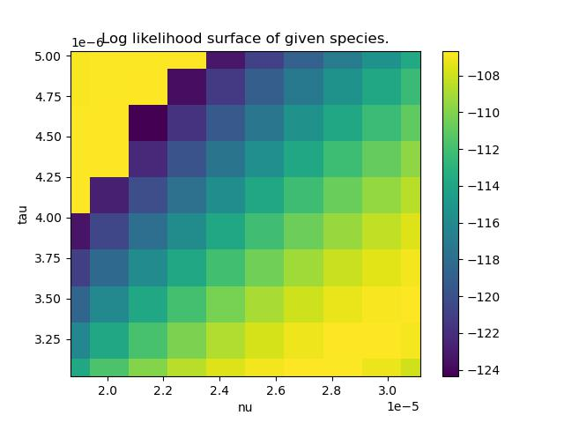
A. muciniphila

Slide 6
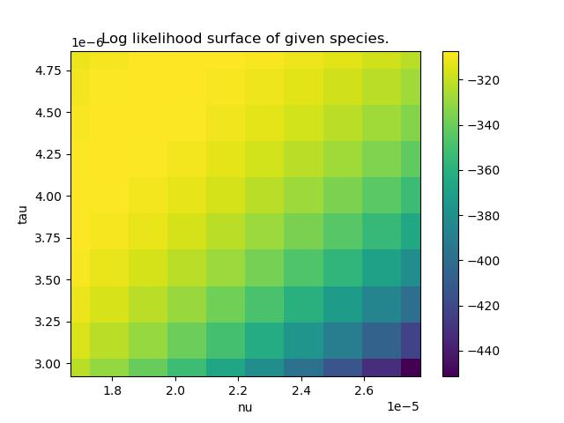
A. onderdonkii

Slide 7
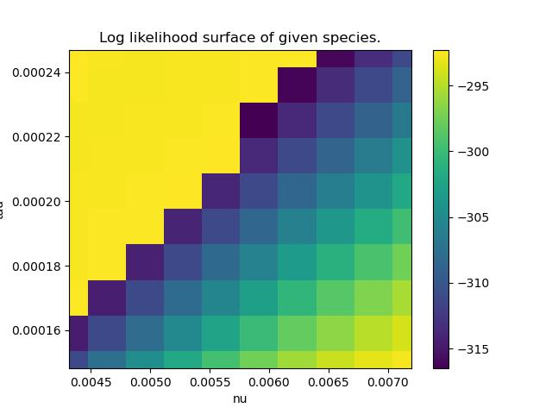
B. thetaiotaomicron

Slide 8
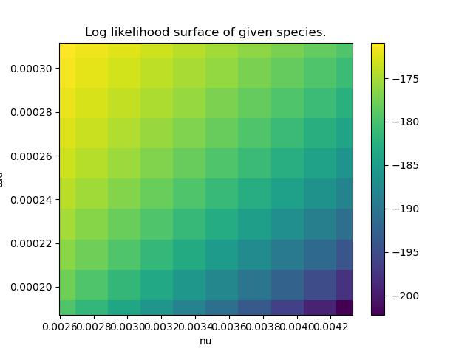
B. xylanisolvens

Slide 9
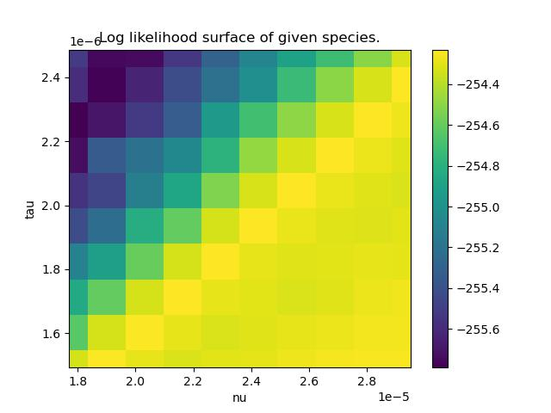
B. intestinihominis

Slide 10
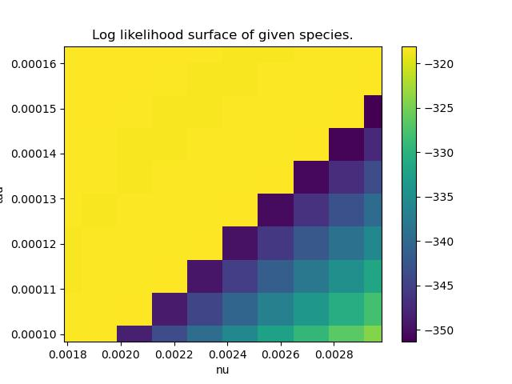
P. distasonis

Slide 11
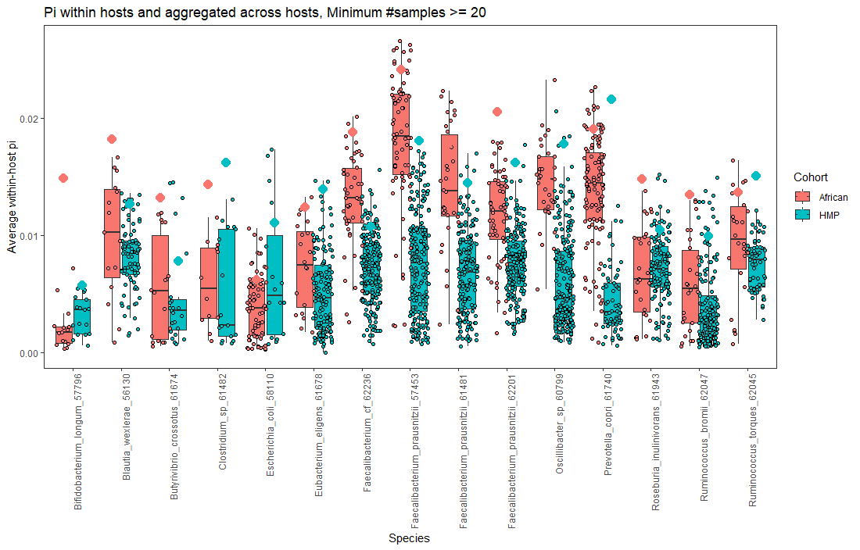
Pi

Slide 12
MIDAS Oral
Species_profile.txt = 339/339
Species union step finished for 186 people (339 unique time x host points)
Snps step = 320/339 hosts
Genes step = 334/339 hosts

Slide 13
TODO
Writing
Results: New version of figure 2:
Cornejo-esque demographic model (but contraction)
SFS for B. thetaiotaomicron
Possibly include likelihood plot
Update cartoons / figures with current script
Methods:
Remove distribution of QP samples
Supplement:
Consult someone with good fashion sense
Cartoon of four demographic models
Distribution of QP samples
SFS’s
Clean-up
Read out loud for MIDAS section

Slide 14
TODO
Prioritize finishing oral data [low burden]:
Run genes and snps step
Run merge step
Talk to Leah, Michael, Nandita about Pi computation (Tuesday 3P PST)
Remove Ethiopian data
Plot likelihood surface
Fit negative selection for SFS on downsampled data

