Slide 1
demo_for_ccgb Weekly Update
20220124
Jon Mah
Garud and Lohmueller Labs

Slide 2
Summary of Update
Happy Lunar New Year!
Spent some time on recruitment, let me know if you want me to scope out anyone else
Sherif seems cool!
Greta seems cool!
SFS comparisons for demographic models
Fitting defined model WIP
I think I figured out how but have to iron out some bugs

Slide 3
Log Likelihood Results
Species | finegoldii | muciniphila | putredinis | A. shahii | B. caccae
Two Epoch | -322.838445518 | -108.804915489 | -1377.6483033 | -216.820753804 | -97.8013529137
One Epoch (SNM) | -479.21577207 | -154.628390672 | -1722.25607796 | -216.820715173 | -98.8749495265
Species | B. cellulosilyticus | B. fragilis | B. massiliensis | B. xylanisolvens | E. rectale
Two Epoch | -1167.48967523 | -311.019501502 | -20.3617449819 | -166.062898282 | -621.966130869cd ..
One Epoch (SNM) | -1167.48954551 | -311.019473484 | -20.3617427569 | -166.0628826 | -621.965862866

Slide 4
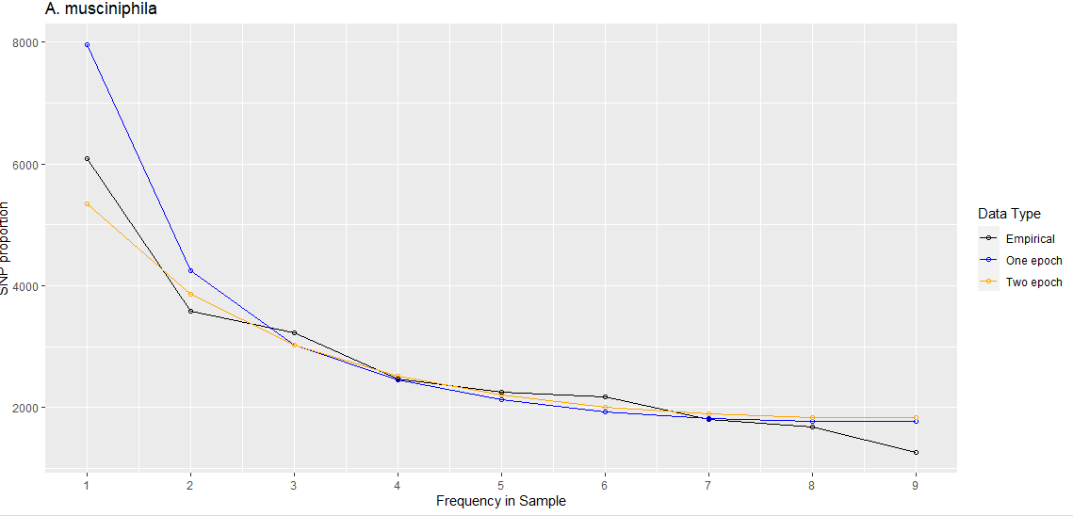
A. muciniphila

Slide 5
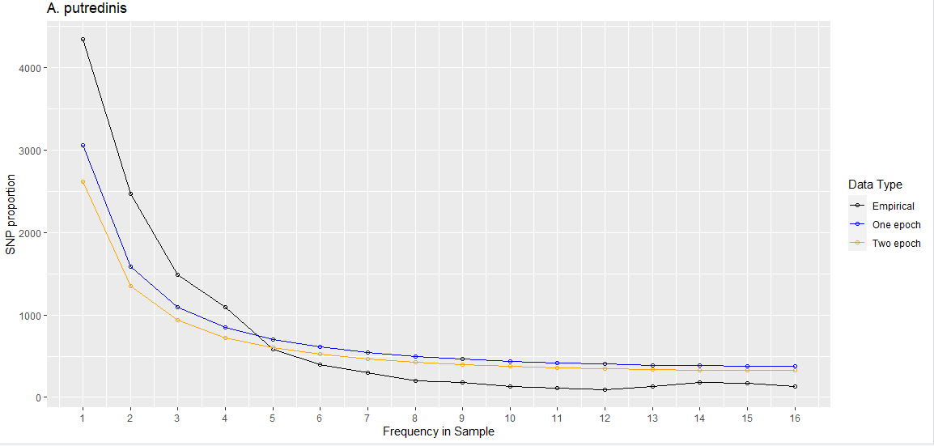
A. putredinis

