Slide 1
demo_for_ccgb Weekly Update
20220202
Jon Mah
Garud and Lohmueller Labs

Slide 2
Summary of Update
Given model SFS (from any inference) and empirical data, I can compute log likelihood
I don’t believe there is a way to quickly compute a likelihood from just params, you also need the model SFS.
However, I think you can quickly fit params → model sfs → likelihood, but that’s still WIP
Took a closer look at several demographic inferences from when I first started fitting the demographic models and compared two-epoch vs. one-epoch.
For some, there is difference in likelihood and SFS, but not all
Plotted out SFS comparison for three examples (one with same and two with different likelihood)

Slide 3
Overall thoughts on status of project
I’m somewhat disappointed that many of these inferences essentially suggest that there is not strong evidence of such a contraction, but this was for sure a good thing to check
It still holds that for some species we find a population contraction, and I think that reporting demographic models of ~30 species (of which some demonstrate interesting demographic trends) is still cool.
I think that maybe looking a little more closely into why only some species have demographic contractions is also potentially exciting (e.g., is it due to certain selective pressures on specific mutations or microbial functions?)

Slide 4
Log Likelihood Results
Species | B. vulgatus | B. uniformis | A. putredinis | E. rectale | B. stercoris
Two Epoch | -142.247487889 | -253.217173904 | -1377.6483033 | -621.965867927 | -508.742298381
One Epoch (SNM) | -142.247482051 | -253.217142467 | -1377.64826898 | -621.965862866 | -508.742293081
Species | finegoldii | muciniphila | B. cellulolyticus | B. fragilis | E. eligens
Two Epoch | -278.496899764 | -108.804915489 | -1167.48967523 | -311.019501502 | -226.737990541
One Epoch (SNM) | -479.21577207 | -154.628390672 | -1167.48954551 | -311.019473484 | -226.737989406

Slide 5
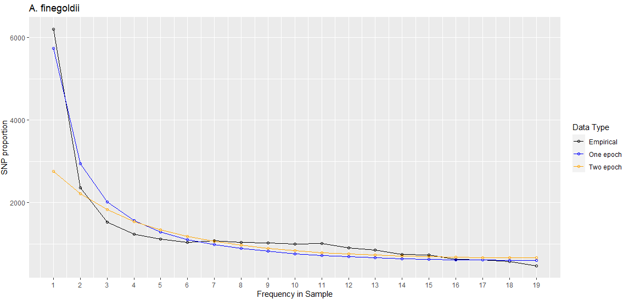
A. finegoldii

Slide 6
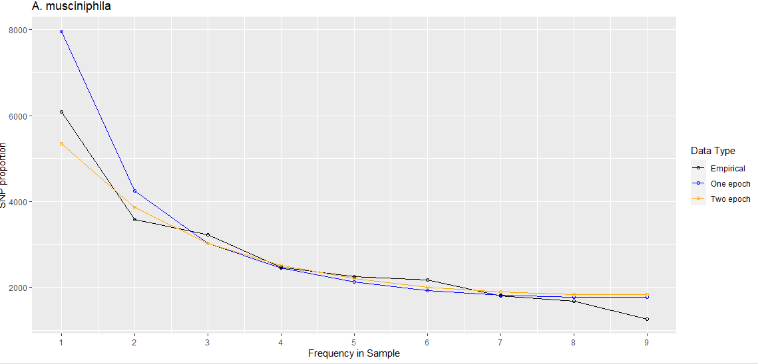
A. muciniphila

Slide 7
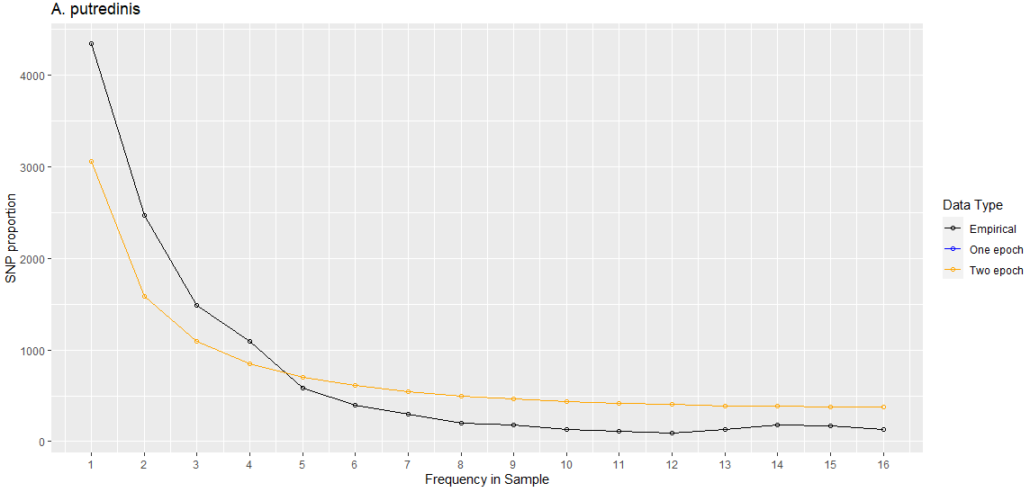
A. putredinis (sfs and likelihood are the same)

