Slide 1
demo_for_ccgb Weekly Update
20220901
Jon Mah
Garud and Lohmueller Labs

Slide 2
Summary
Likelihood Surface plots

Slide 3
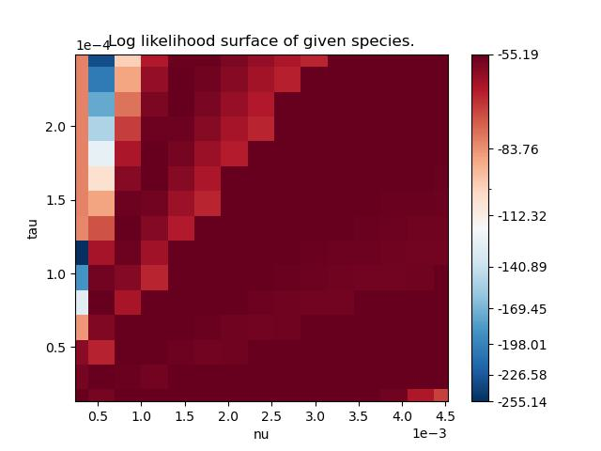
P. Distasonis (SymLogNorm)

Slide 4
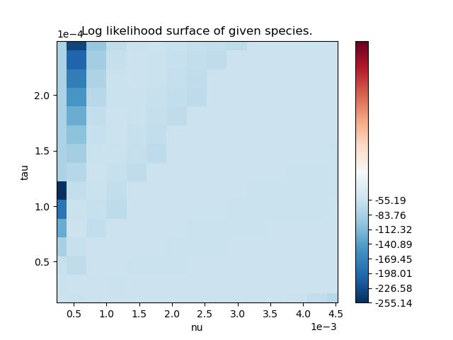
P. Distasonis (CenteredNorm)

Slide 5
P. Distasonis (CustomNorm)

Slide 6
TODO 20220829
SFSs for supplement + main text (B. intestinihominis)
Merge snps step with a smaller directory of two files
Pi plot, species with >= 5 hosts in both cohorts instead of original list
Wilcoxon rank sum test

