Slide 1
demo_for_ccgb Lab Meeting
20210128
Jon Mah
Garud Lab

Slide 2
Progress
Better inferences for demographic models (more iterations, initial guesses)
Computed expectation for SFS and compared to empirical
“Downloaded” Midas (it’s already on the cluster, but I can run it)
Download(ing?) Madagascar and Ethiopian data
I’m a little stumped on this!
It appears that the sra directory: ftp://ftp-trace.ncbi.nih.gov/sra/sra-instant/ is missing.
SRAtools requires GLIBC ver. 2.14, which I can’t sudo apt-update on Hoffman.
I am trying to build some form of conda environment or docker container with sratools on local, and then importing to hoffman2.

Slide 3
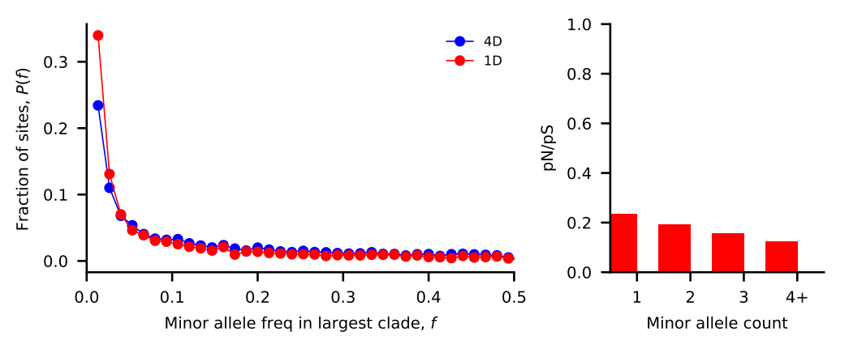
Bacteroides vulgatus
Nu_a: contemporary population relative to ancestral population before first epoch
Nu_b: contemporary population relative to ancestral population before second epoch
T_1: Duration of first epoch (units of 2 * N_a)
T_2: Duration of second epoch (units of 2 * N_a)
Model | Exponential growth | Two-epoch | Bottleneck + growth | Three-epoch
Log Likelihood | -123.582830394 | -115.548611105 | -114.478986615 | -115.763713816
Nu_a | 2.34360421 | 1.46471105 | 0.99063457 | 1.43575234
Nu_b | N/A | N/A | 1.53009861 | 1.43566152
T_12 | 0.05432866 | 0.20111674 | 0.44283702 | 0.28861314
T_23 | N/A | N/A | N/A | 0.01340126

Slide 4
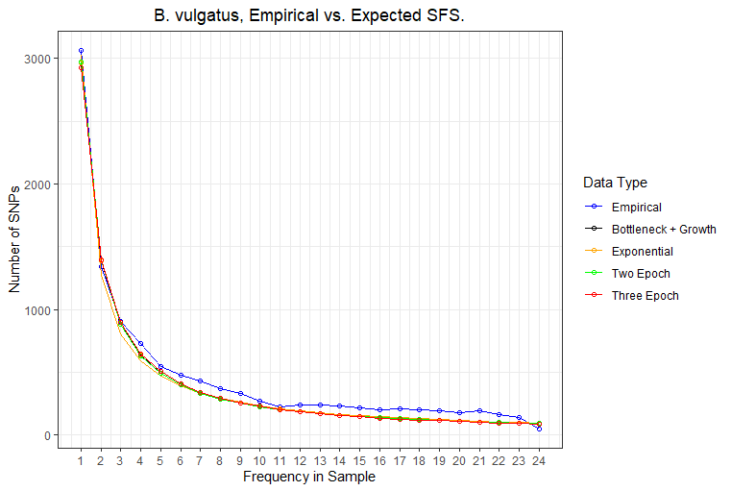
Bacteroides vulgatus SFS comparison
The empirical sfs is shown in blue, while the expected SFS under different demographic models is shown in either black, orange, green, or red.
The expected SFS’s have high precision, i.e., are close to each other, but visibly differ from the empirical SFS, particularly are higher allele frequencies.

Slide 5
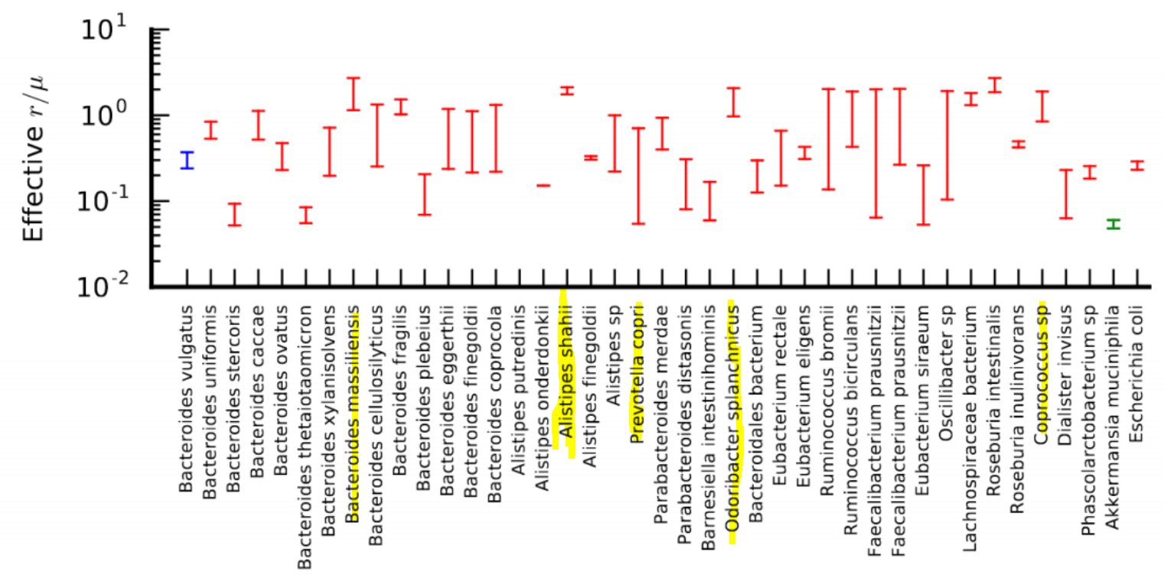
SFS’s with high recombination

Slide 6
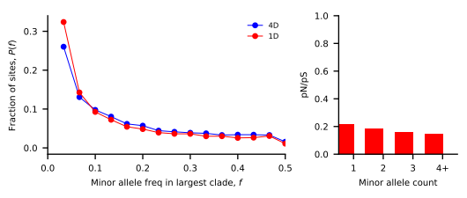
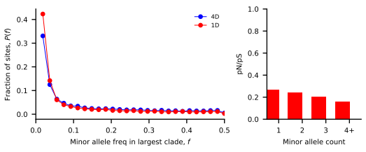
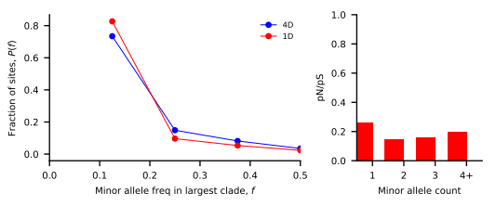
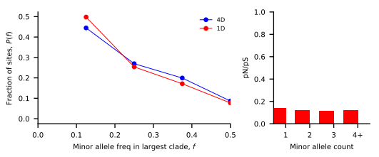
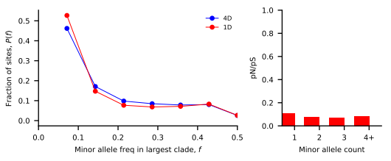
SFS’s with high recombination
O. splanchnicus
A. shahii
B. massilliensis
Coprococcus sp
P. copri

Slide 7
//TODO
Figure out data download, Midas
Look at Dadi’s internal sfs comparison
Look at 2D heatmap
Reread Cornejo
Difference in methodology and results

Slide 8
Standing questions
Investigate edge length distribution
Compare commensal bacteria to human demography
Compare commensal bacteria to pathogens

