Slide 1
demo_for_ccgb Rotation Update
20210310
Jon Mah
Garud Lab

Slide 2
Logistics
I messed up my conda environment on Hoffman2 so I’m rebuilding this over night ☹. Hopefully it’ll be done by tomorrow morning.
Fun fact: Hoffman2 stores snapshots of your local profile ☺

Slide 3
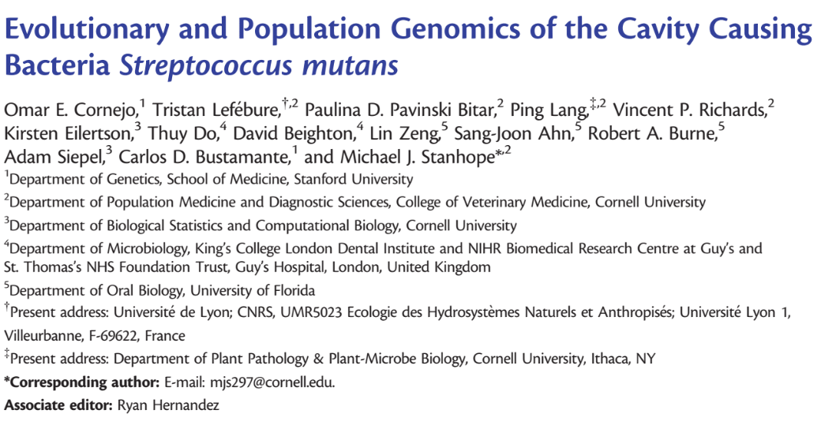

Slide 4
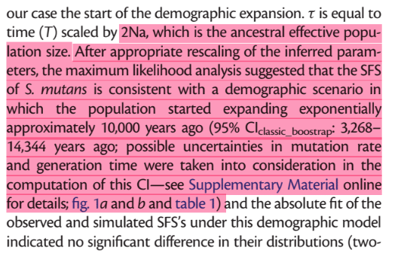
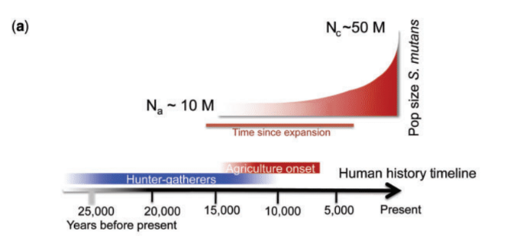
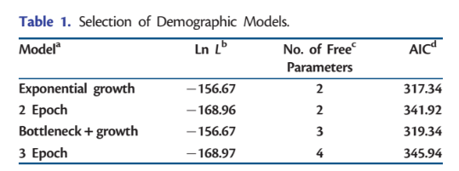
Population expansion ~ 10,000 years ago
This timeline roughly matches with the onset of human agriculture, suggesting a possible link between this commensal mouth bacteria and humans ending their hunter-gather behavior.
They used four demographic models:
Exponential growth
Two Epoch
Bottleneck + Growth
Three Epoch

Slide 5
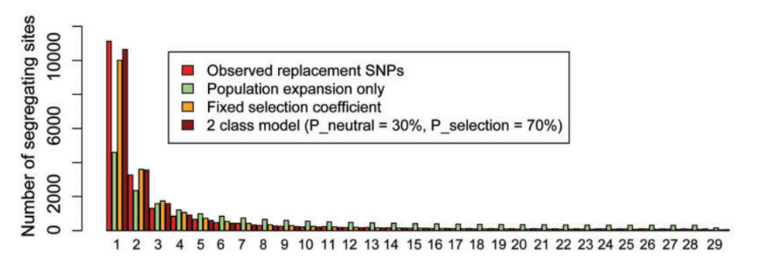
They also computed the expected SFS for silent (synonymous) and replacement (nonsynonymous) sites
Red is observed nonsynonymous
Green is their expectation using the synonymous sites
Orange is with a DFE fixed at a single value
Brown is with 30% neutral, and 70% at a fixed single value

Slide 6
Project Aim
Science Goal: Infer the demographic history of common commensal gut bacteria
Training Goal: Learn popgen tools / tech for microbiome
Personal Goal: Have fun ☺!

Slide 7
Gameplan
Initially focus on B. vulgatus
Create syn / ns SFSs
Compare to expectation of SFS
Given clade data (e.g., continent of origin), create PCA plot
Run Dadi to determine best fit demographic model
Start with Omar Conejo’s model(s)
Perhaps find link to human demography?
Apply to other species
Apply to other data sets (include African data, Peruvian data)

Slide 8
Progress
Implemented fitting for nonsynonymous SFS using fitdadi
This technically infers the DFE, but there are some bugs with this part
New script/pipeline: `fit_demographic_model_and_DFE.py`
I’m now reporting the proportional SFS since it’s more interpretable

Slide 9
Implementation details (for following slides)
Input synonymous SFS’s: output from `plot_within_clade_sfs.py`.
High prevalence species:
B. vulgatus, B. ovatus, B. uniformis, E. rectale.
Four demographic models
exponential growth, two-epoch, bottleneck + growth, three-epoch
Mask singletons OR mask singletons + doubletons
Model still infers masked alleles, but they are excluded in likelihood calculation

Slide 10
Implementation details (for following slides)
For each input species
For each model:
Take 25 initial guesses for parameter space (parameters differ by model)
For each initial guess:
Iterate through gradient ascent to find maximum likelihood for <= 50 steps
Compute model params and log likelihood
Output log likelihood and model params of best initial guess + iterations
Fit nonsynonymous SFS using fitdadi, with selection fit to:
Gamma-distributed DFE (this is the only one that works currently, and is being reported)
Neutral-gamma distributed DFE (some proportion with neutral point-mass)
Mixed-uniform-distributed DFE (DFE split into bins on log10 scale)

Slide 11
Exponential Growth | no singletons |  |  | no singletons or doubletons
 | Masking singletons |  |  | Masking singletons and Doubletons
 | b_vulgatus | b_ovatus | b_uniformis | b_vulgatus | b_ovatus | b_uniformis
LL | -142.247484 | -181.635 | -253.217 | -131.836 | -174.082 | -230.274
Theta | 2364.571488 | 2302.292 | 2054.491 | 2325.776 | 2274.387 | 1998.255
Nu_a | 6.67E-01 | 6.24E-01 | 4.80E-01 | 1.61E-01 | 1.38E-01 | 1.85E-01
Nu_b | N/A | N/A | N/A | N/A | N/A | N/A
T_12 | 4.22E-06 | 5.35E-06 | 1.89E-06 | 5.78E-06 | 6.17E-06 | 6.49E-06
T_23 | N/A | N/A | N/A | N/A | N/A | N/A
N_e | 1.18229E+12 | 1.15E+12 | 1.03E+12 | 1.16E+12 | 1.14E+12 | 9.99E+11
N_a | 1.77366E+12 | 1.85E+12 | 2.14E+12 | 7.22E+12 | 8.25E+12 | 5.41E+12
T_12 (scaled) | 14971968.8 | 19732245 | 8094681 | 83478897 | 1.02E+08 | 70213082
T_23 (scaled) | N/A | N/A | N/A | N/A | N/A | N/A
exp_time (years) | 14058.18666 | 18527.93 | 7600.639 | 78383.94 | 95572.59 | 65927.78

Slide 12
Exponential growth demographic diagram (exponential decay or growth over time)
N_a = 1.77366E+12, 1.85E+12, 2.14E+12
T_12 = 14058.18666, 18527.93, 7600.639
N_e = 1.18229E+12, 1.15E+12, 1.03E+12

Slide 13
Two Epoch | no singletons |  |  | no singletons or doubletons
 | Masking singletons |  |  | Masking singletons and doubletons
 | b_vulgatus | b_ovatus | b_uniformis | b_vulgatus | b_ovatus | b_uniformis
LL | -142.247484 | -181.635 | -253.217 | -131.836 | -174.082 | -230.274
Theta | 2364.571488 | 2302.292 | 2054.491 | 2325.776 | 2274.387 | 1998.255
Nu_a | 6.29E-01 | 7.02E-01 | 7.12E-01 | 1.81E-01 | 1.48E-01 | 1.86E-01
Nu_b | N/A | N/A | N/A | N/A | N/A | N/A
T_12 | 3.75E-06 | 5.51E-06 | 2.12E-06 | 5.74E-06 | 5.27E-06 | 5.26E-06
T_23 | N/A | N/A | N/A | N/A | N/A | N/A
N_e | 1.18229E+12 | 1.15E+12 | 1.03E+12 | 1.16E+12 | 1.14E+12 | 9.99E+11
N_a | 1.87827E+12 | 1.64E+12 | 1.44E+12 | 6.42E+12 | 7.67E+12 | 5.36E+12
T_12 (scaled) | 14071797.82 | 18076158 | 6110880 | 73703557 | 80871052 | 56451916
T_23 (scaled) | N/A | N/A | N/A | N/A | N/A | N/A
exp_time (years) | 13212.9557 | 16972.92 | 5737.915 | 69205.22 | 75935.26 | 53006.49

Slide 14
Two-epoch demographic diagram (One epoch, a length of time, then instantaneous size change to a second epoch)
N_a = 1.87827E+12, 1.64E+12, 1.44E+12
T_12 = 13212.9557, 16972.92, 5737.915
N_e = 1.18229E+12, 1.15E+12, 1.03E+12

Slide 15
Bottleneck-Growth | no singletons |  |  | no singletons or doubletons
 | Masking singletons |  |  | Masking singletons and doubletons
 | b_vulgatus | b_ovatus | b_uniformis | b_vulgatus | b_ovatus | b_uniformis
LL | -142.247486 | -181.635 | -253.217 | -131.836 | -174.082 | -230.274
Theta | 2364.571497 | 2302.292 | 2054.491 | 2325.776 | 2274.387 | 1998.255
Nu_a | 1.37E-01 | 9.04E-02 | 1.56E-01 | 5.19E-02 | 1.88E-01 | 1.15E-01
Nu_b | 4.43E-01 | 4.20E-01 | 4.09E-01 | 1.71E-01 | 1.86E-01 | 1.83E-01
T_12 | 3.54E-06 | 4.67E-06 | 3.98E-06 | 6.27E-06 | 5.80E-06 | 6.03E-06
T_23 | N/A | N/A | N/A | N/A | N/A | N/A
N_e | 1.18229E+12 | 1.15E+12 | 1.03E+12 | 1.16E+12 | 1.14E+12 | 9.99E+11
N_b | 8.61E+12 | 1.27E+13 | 6.60E+12 | 2.24E+13 | 6.03E+12 | 8.71E+12
N_a | 2.67E+12 | 2.74E+12 | 2.51E+12 | 6.81E+12 | 6.12E+12 | 5.47E+12
T_12 (scaled) | 18904234.16 | 25638819 | 19964012 | 85486526 | 70887366 | 65950639
T_23 (scaled) | N/A | N/A | N/A | N/A | N/A | N/A
exp_time (years) | 17750.45461 | 24074.01 | 18745.55 | 80269.04 | 66560.91 | 61925.48

Slide 16
Bottleneck growth demographic diagram (Instantaneous size change, then exponential growth or decay over a length of time)
N_a = 2.67E+12, 2.74E+12, 2.51E+12
N_b = 8.61E+12, 1.27E+13, 6.60E+12
T_12 = 17750.45461, 24074.01, 18745.55
N_e = 1.18229E+12, 1.15E+12, 1.03E+12

Slide 17
Three-Epoch | no singletons |  |  | no singletons or doubletons
 | Masking singletons |  |  | Masking singletons and doubletons
 | b_vulgatus | b_ovatus | b_uniformis | b_vulgatus | b_ovatus | b_uniformis
LL | -142.247518 | -181.635 | -253.217 | -131.836 | -174.082 | -230.274
Theta | 2364.5716 | 2302.293 | 2054.492 | 2325.776 | 2274.387 | 1998.255
Nu_a | 3.88E-01 | 2.14E-01 | 2.17E-01 | 1.82E-01 | 1.64E-01 | 1.47E-01
Nu_b | 2.91E-01 | 1.60E-01 | 2.37E-01 | 1.57E-01 | 1.38E-01 | 1.50E-01
T_12 | 4.14E-06 | 2.74E-06 | 3.03E-06 | 9.87E-06 | 5.29E-06 | 7.63E-06
T_23 | 4.06E-06 | 2.56E-06 | 3.26E-06 | 7.64E-06 | 5.32E-06 | 6.00E-06
N_e | 1.18229E+12 | 1.15E+12 | 1.03E+12 | 1.16E+12 | 1.14E+12 | 9.99E+11
N_b | 8.61E+12 | 1.27E+13 | 6.60E+12 | 2.24E+13 | 6.03E+12 | 8.71E+12
N_a | 4.07E+12 | 7.18E+12 | 4.33E+12 | 7.40E+12 | 8.26E+12 | 6.66E+12
T_12 (scaled) | 33686655.4 | 39296428 | 26280461 | 1.46E+08 | 87334099 | 1.02E+08
T_23 (scaled) | 33066037.42 | 36820072 | 28301885 | 1.13E+08 | 87959036 | 79934484
exp_time 1 (years) | 31630.66235 | 36898.05 | 24676.49 | 137301.7 | 82003.85 | 95523.03
exp_time 2 (years) | 31047.92246 | 34572.84 | 26574.54 | 106213.8 | 82590.64 | 75055.85

Slide 18
Three-epoch demographic diagram (Epoch, time, instantaneous size change, epoch, time, instantaneous size change, epoch)
N_a = 4.07E+12, 7.18E+12, 4.33E+12
T_12 = 31630.66235, 36898.05, 24676.49
N_b = 8.61E+12, 1.27E+13, 6.60E+12
T_23 = 31047.92246, 34572.84, 26574.54
N_e = 1.18229E+12, 1.15E+12, 1.03E+12

Slide 19
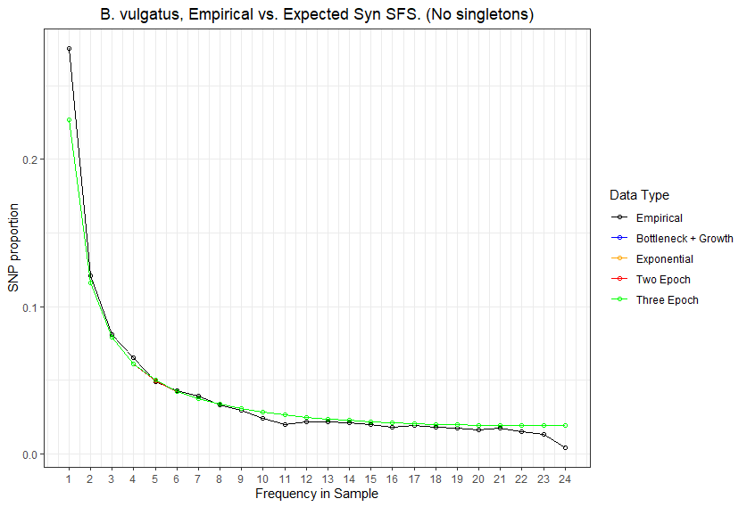
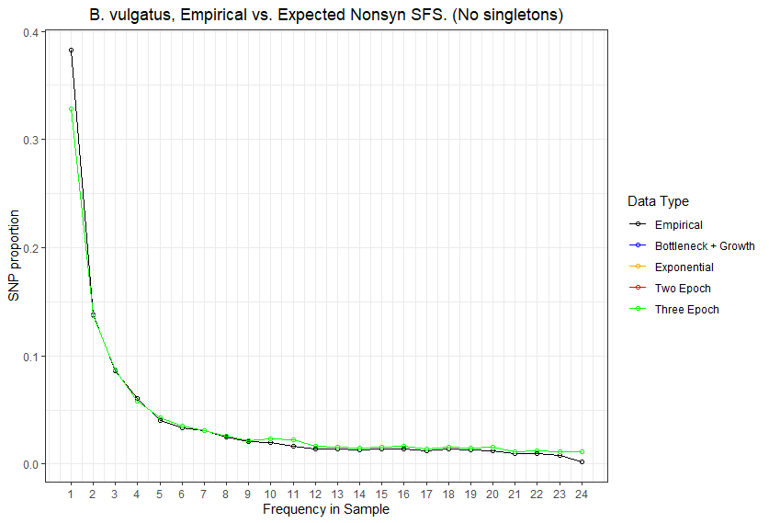

Slide 20
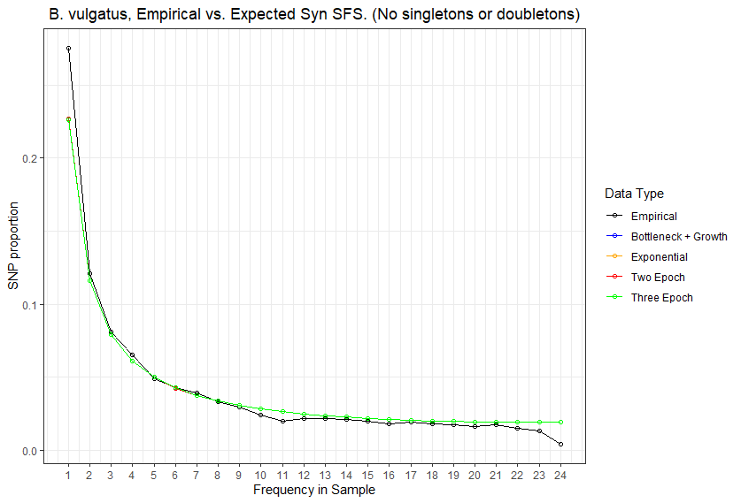
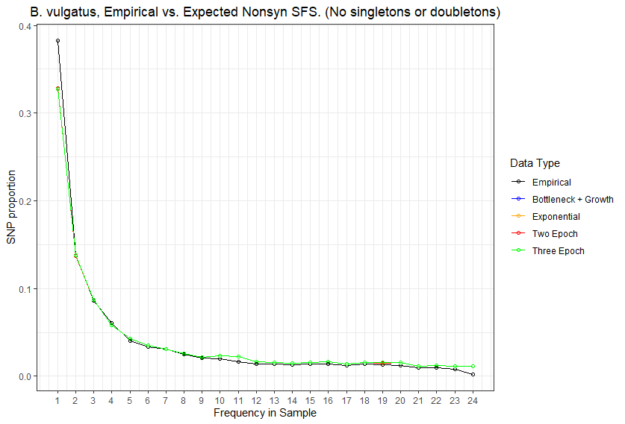

Slide 21
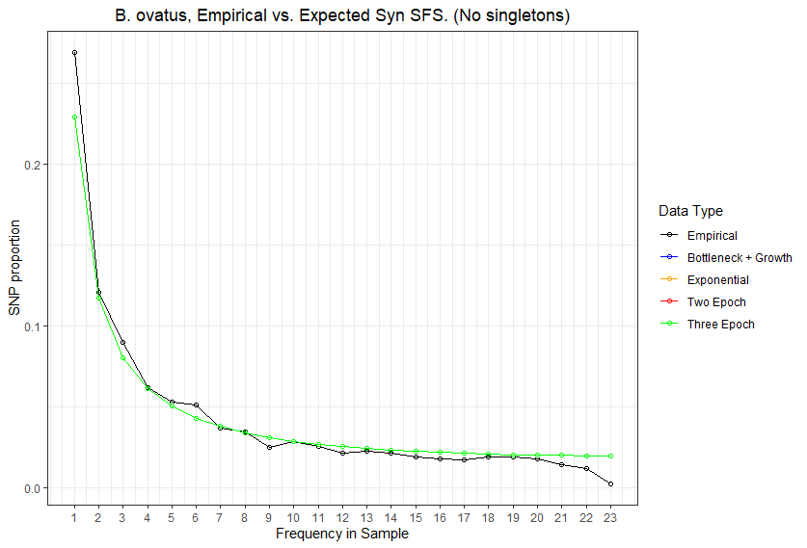
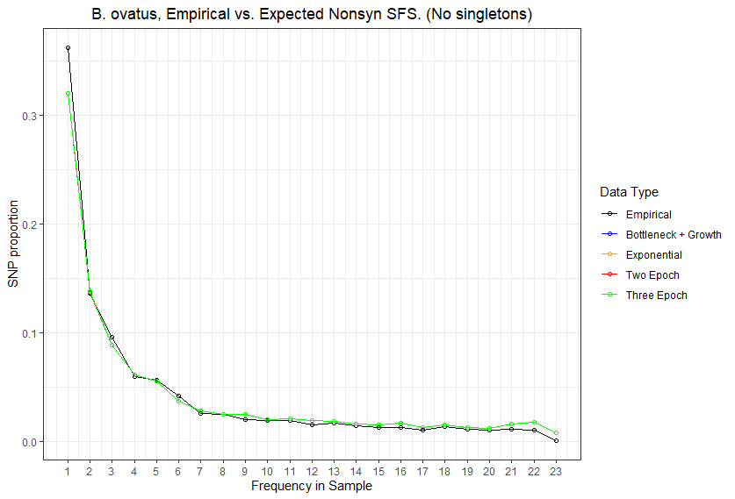

Slide 22
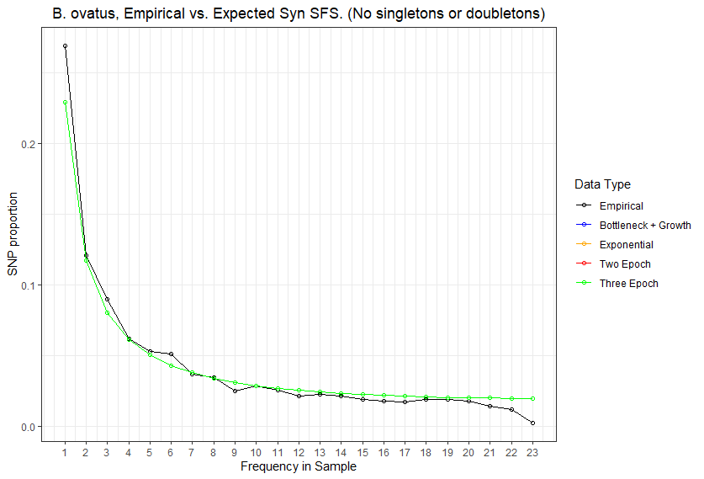
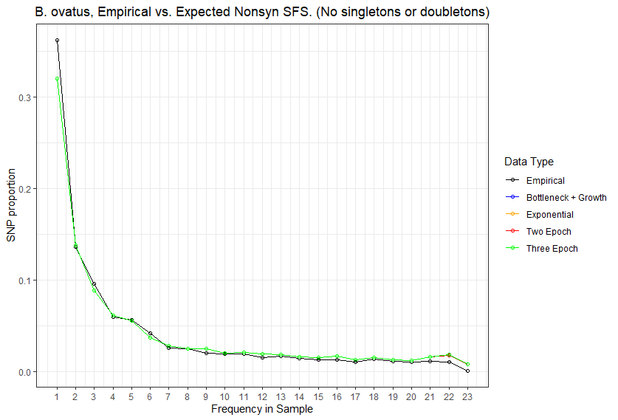

Slide 23
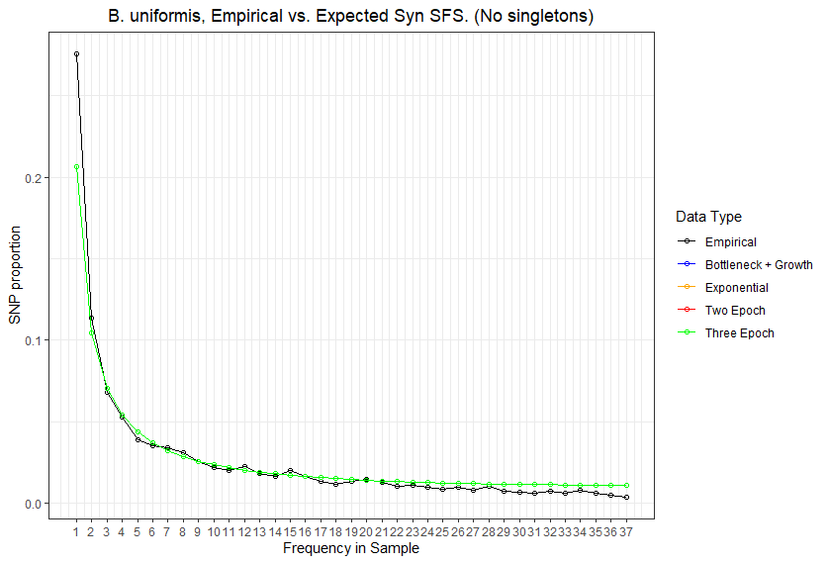
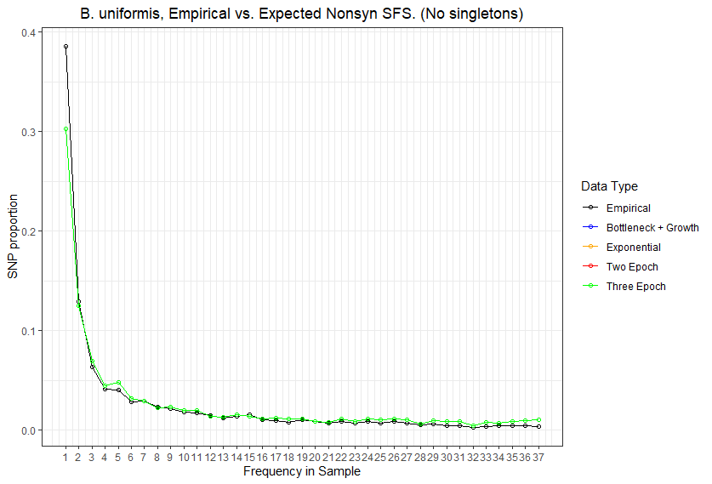

Slide 24
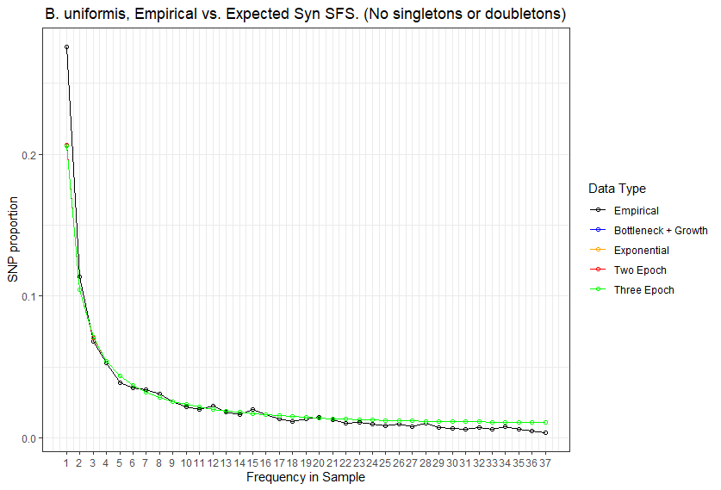
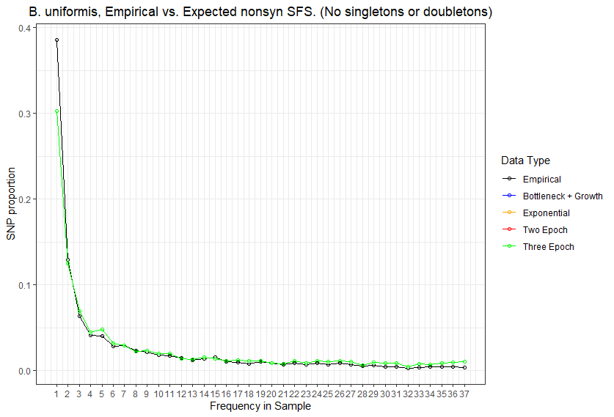

Slide 25
//TODO
Few slides of intro
Sketch of demographic models

Slide 26
Standing questions
Investigate edge length distribution
Compare commensal bacteria to human demography
Compare commensal bacteria to pathogens

