Slide 1
demo_for_ccgb Rotation Update
20210217
Jon Mah
Garud Lab

Slide 2
Logistics

Slide 3
Project Aim
Science Goal: Infer the demographic history of common commensal gut bacteria
Training Goal: Learn popgen tools / tech for microbiome
Personal Goal: Have fun ☺!

Slide 4
Gameplan
Initially focus on B. vulgatus
Create syn / ns SFSs
Compare to expectation of SFS
Given clade data (e.g., continent of origin), create PCA plot
Run Dadi to determine best fit demographic model
Start with Omar Conejo’s model(s)
Perhaps find link to human demography?
Apply to other species
Apply to other data sets (include African data, Peruvian data)

Slide 5
Progress
Still working on implementing selection with demographic inference. I believe this requires also inferring the DFE.
I looked at down sampling, but it had the same issues as previously, i.e., flat likelihood surface and inconsistent param estimates.
Implemented singleton and doubleton masking
Ran pipeline with singletons masked and doubletons masked
I changed the way I calculated the time since expansion based on the Cornejo paper
Mutation rate is between 4.08E-10 and 6.93E-10 → ~5E-10
Cornejo estimates 2-4 divisions per day → ~3 divisions per day

Slide 6
Implementation details (for following slides)
Input synonymous SFS’s: output from `plot_within_clade_sfs.py`.
High prevalence species:
B. vulgatus, B. ovatus, B. uniformis, E. rectale.
Four demographic models
exponential growth, two-epoch, bottleneck + growth, three-epoch
Mask singletons OR mask singletons + doubletons
Model still infers masked alleles, but they are excluded in likelihood calculation
For each input species
For each model:
Take 25 initial guesses for parameter space (parameters differ by model)
For each initial guess:
Iterate through gradient ascent to find maximum likelihood for <= 50 steps
Compute model params and log likelihood
Output log likelihood and model params of best initial guess + iterations

Slide 7
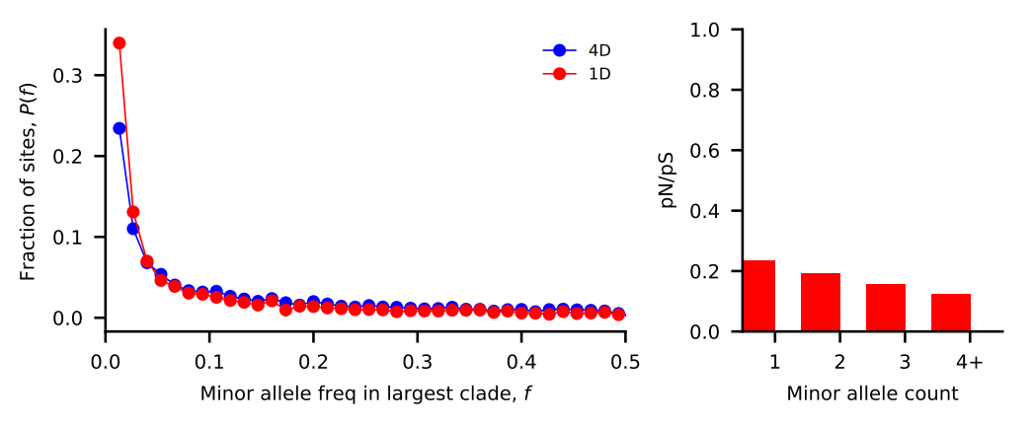
Bacteroides vulgatus [masked singletons]
Nu_a: contemporary population relative to ancestral population before first epoch
Nu_b: contemporary population relative to ancestral population before second epoch
T_1: Duration of first epoch (units of 2 * N_a)
T_2: Duration of second epoch (units of 2 * N_a)
Model | Exponential growth | Two-epoch | Bottleneck + growth | Three-epoch
Log Likelihood | -142.247483648 | -142.247483618 | -142.247486317 | -142.247518266
Theta | 2364.57148832 | 2364.57148822 | 2364.5714969 | 2364.57159963
Nu_a | 6.66580916e-01 | 6.29456013e-01 | 1.37235899e-01 | 3.87789109e-01
Nu_b | N/A | N/A | 4.43303719e-01 | 2.90685973e-01
T_12 | 4.22065001e-06 | 3.74595473e-06 | 3.54411669e-06 | 4.14123142e-06
T_23 | N/A | N/A | N/A | 4.06493644e-06

Slide 8
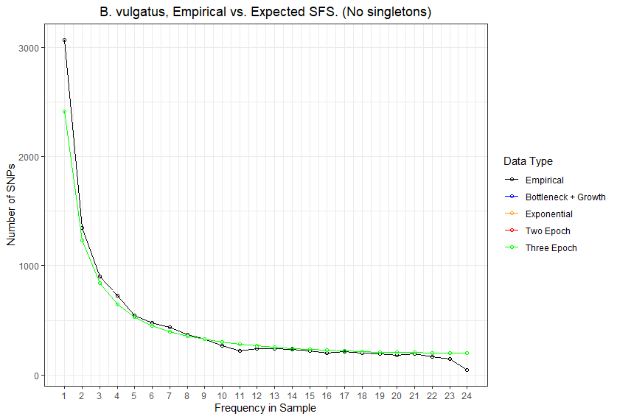

Slide 9
Bacteroides vulgatus [masked <= doubletons]
Nu_a: contemporary population relative to ancestral population before first epoch
Nu_b: contemporary population relative to ancestral population before second epoch
T_1: Duration of first epoch (units of 2 * N_a)
T_2: Duration of second epoch (units of 2 * N_a)
Model | Exponential growth | Two-epoch | Bottleneck + growth | Three-epoch
Log Likelihood | -131.835854371 | -131.8358543 | -131.835854385 | -131.835856665
Theta | 2325.77602805 | 2325.77602778 | 2325.77602809 | 2325.77603653
Nu_a | 1.61157070e-01 | 1.81242206e-01 | 5.18932449e-02 | 1.81639251e-01
Nu_b | N/A | N/A | 1.70715514e-01 | 1.57054198e-01
T_12 | 5.78439809e-06 | 5.74354330e-06 | 6.27484161e-06 | 9.87432271e-06
T_23 | N/A | N/A | N/A | 7.63857578e-06

Slide 10
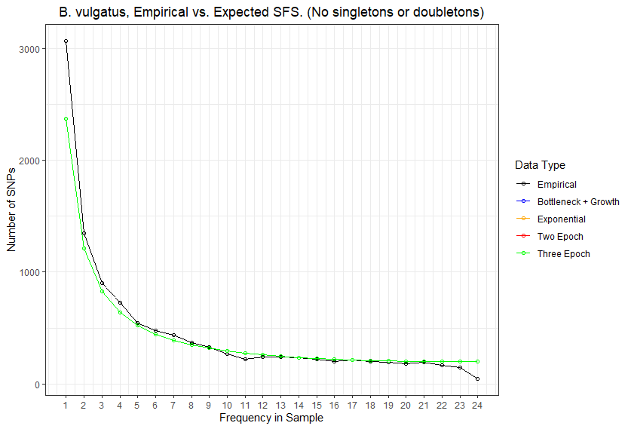

Slide 11
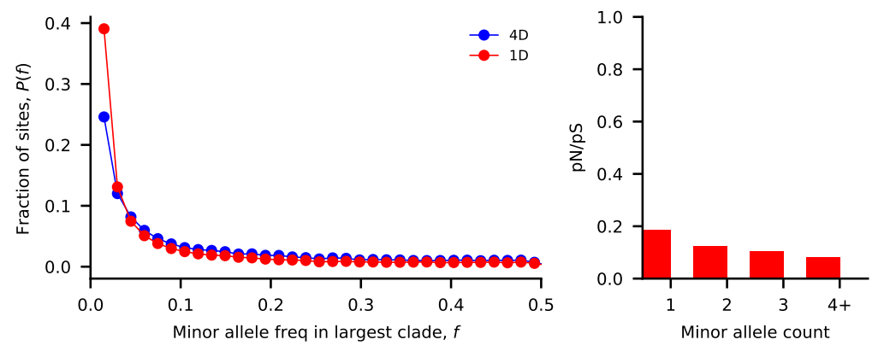
Bacteroides ovatus [masked singletons]
Nu_a: contemporary population relative to ancestral population before first epoch
Nu_b: contemporary population relative to ancestral population before second epoch
T_1: Duration of first epoch (units of 2 * N_a)
T_2: Duration of second epoch (units of 2 * N_a)
Model | Exponential growth | Two-epoch | Bottleneck + growth | Three-epoch
Log Likelihood | -181.635397973 | -181.635397248 | -181.635401442 | -181.635435384
Theta | 2302.29240418 | 2302.29240093 | 2302.29241973 | 2302.29257181
Nu_a | 6.23704625e-01 | 7.02244758e-01 | 9.04162347e-02 | 2.13866355e-01
Nu_b | N/A | N/A | 4.19634741e-01 | 1.60268125e-01
T_12 | 5.34558180e-06 | 5.51358609e-06 | 4.67314199e-06 | 2.73551889e-06
T_23 | N/A | N/A | N/A | 2.56313382e-06

Slide 12
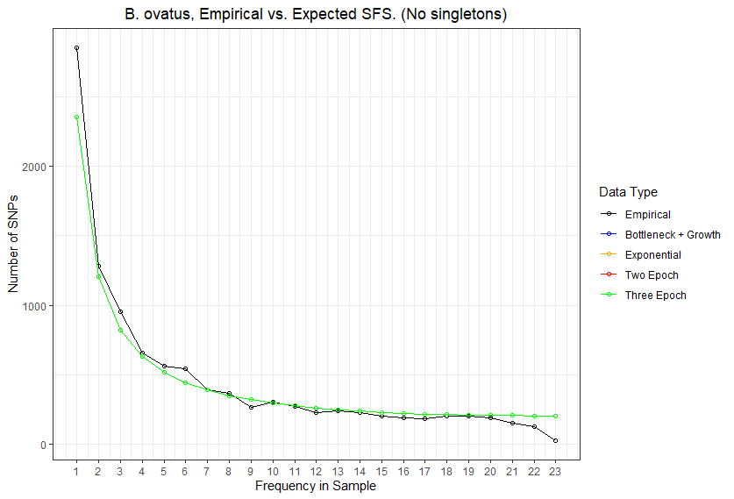

Slide 13
Bacteroides ovatus [masked <= doubletons]
Nu_a: contemporary population relative to ancestral population before first epoch
Nu_b: contemporary population relative to ancestral population before second epoch
T_1: Duration of first epoch (units of 2 * N_a)
T_2: Duration of second epoch (units of 2 * N_a)
Model | Exponential growth | Two-epoch | Bottleneck + growth | Three-epoch
Log Likelihood | -174.082255637 | -174.082255281 | -174.082255156 | -174.082256325
Theta | 2274.38737772 | 2274.38737702 | 2274.38737677 | 2274.38737907
Nu_a | 1.37881451e-01 | 1.48171075e-01 | 1.88445625e-01 | 1.63614354e-01
Nu_b | N/A | N/A | 1.85953469e-01 | 1.37682362e-01
T_12 | 6.17055681e-06 | 5.26856194e-06 | 5.79573721e-06 | 5.28685885e-06
T_23 | N/A | N/A | N/A | 5.32469006e-06

Slide 14
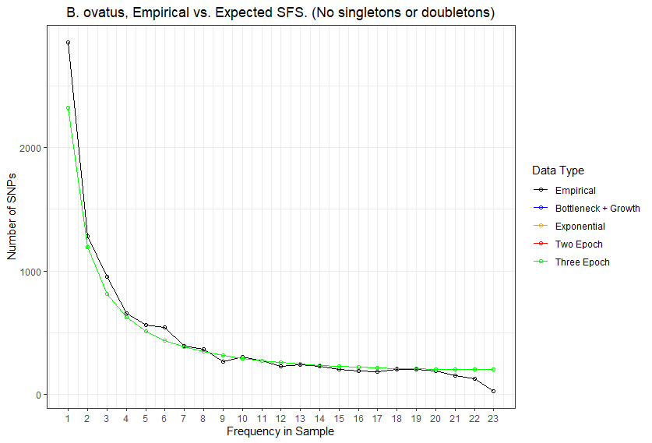

Slide 15
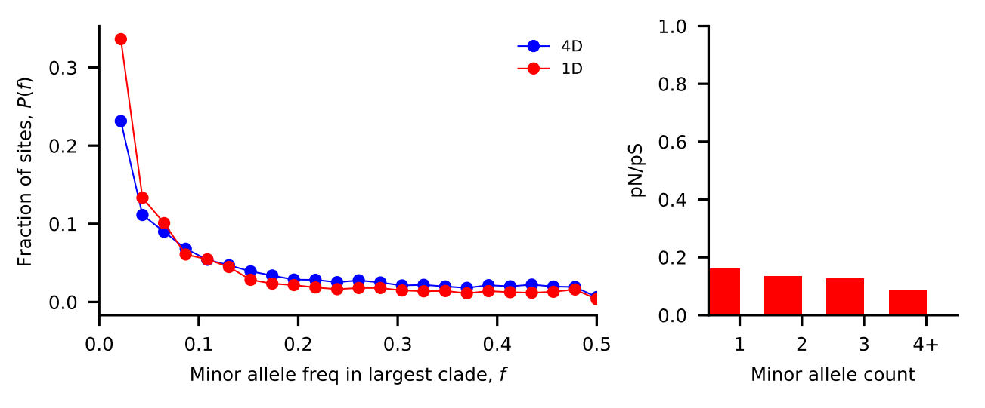
Bacteroides uniformis [masked singletons]
Nu_a: contemporary population relative to ancestral population before first epoch
Nu_b: contemporary population relative to ancestral population before second epoch
T_1: Duration of first epoch (units of 2 * N_a)
T_2: Duration of second epoch (units of 2 * N_a)
Model | Exponential growth | Two-epoch | Bottleneck + growth | Three-epoch
Log Likelihood | -253.217146369 | -253.217143694 | -253.217169755 | -253.217362503
Theta | 2054.49141356 | 2054.49140968 | 2054.49144756 | 2054.49172791
Nu_a | 4.80162841e-01 | 7.12256859e-01 | 1.55550793e-01 | 2.17180887e-01
Nu_b | N/A | N/A | 4.09160345e-01 | 2.37005310e-01
T_12 | 1.89183803e-06 | 2.11853690e-06 | 3.97591431e-06 | 3.03170302e-06
T_23 | N/A | N/A | N/A | 3.26489369e-06

Slide 16
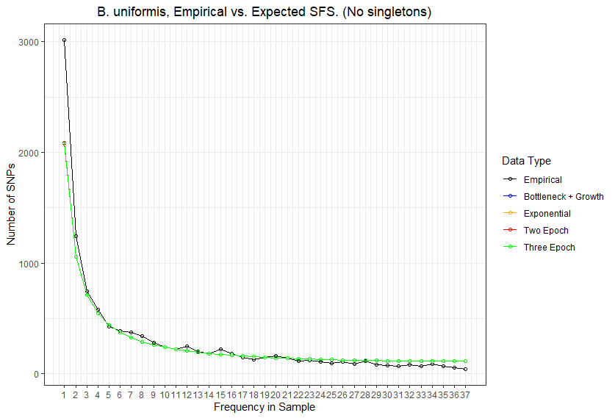

Slide 17
Bacteroides uniformis [masked <= doubletons]
Nu_a: contemporary population relative to ancestral population before first epoch
Nu_b: contemporary population relative to ancestral population before second epoch
T_1: Duration of first epoch (units of 2 * N_a)
T_2: Duration of second epoch (units of 2 * N_a)
Model | Exponential growth | Two-epoch | Bottleneck + growth | Three-epoch
Log Likelihood | -230.274343919 | -230.274343689 | -230.274343838 | -230.274347992
Theta | 1998.25465652 | 1998.25465555 | 1998.25465618 | 1998.2546738
Nu_a | 1.84666920e-01 | 1.86322091e-01 | 1.14669962e-01 | 1.46505347e-01
Nu_b | N/A | N/A | 1.82675926e-01 | 1.49928597e-01
T_12 | 6.48867925e-06 | 5.26371303e-06 | 6.02905845e-06 | 7.63293066e-06
T_23 | N/A | N/A | N/A | 5.99746626e-06

Slide 18
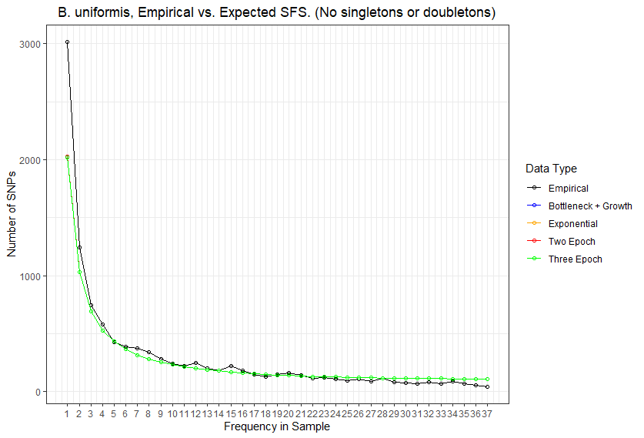

Slide 19
//TODO

Slide 20
Standing questions
Investigate edge length distribution
Compare commensal bacteria to human demography
Compare commensal bacteria to pathogens

