Slide 1
demo_for_ccgb Weekly Update
20211028
Jon Mah
Garud and Lohmueller Labs

Slide 2
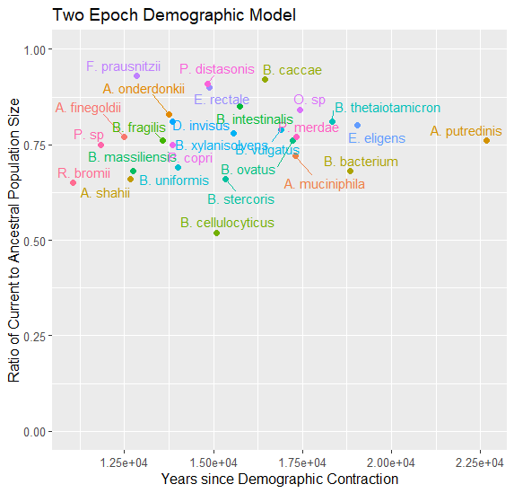
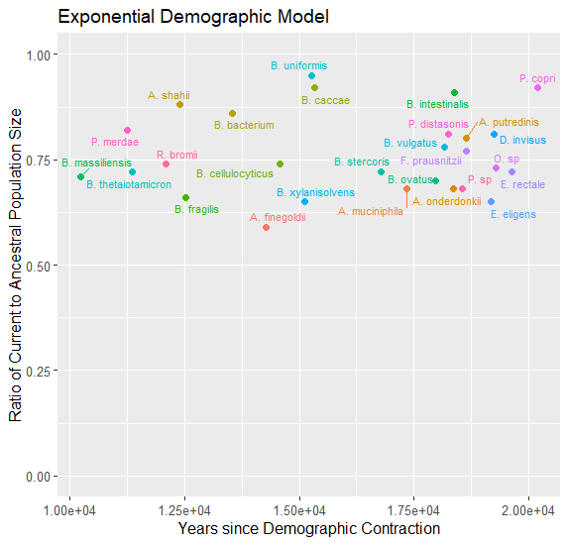
I have MLE’s for 29 species under the two epoch and the exponential model

Slide 3
Oral Data Download
I have all the files downloaded (still including the “v2” files) in fastq.tar.bz2 format.
These are still stored on scratch, but I have them pinged so they won’t be removed, and worst-case scenario it takes about 6 hours to redownload all 501, and shorter to download the 340 that we actually need.
I’m working on a way to systematically decompress and compress them into the right format (current method takes too long). I’m pretty sure I can just use a job array and some bash, but I’m bad at bash so it’s taking a while to figure out.

Slide 4
NDSEG
BAA # N00014-21-S-B001
Gut Microbiology for Wartime Resilience
Host-microbial interactions in response to stressors, with a long-term goal of enhancing warfighter resilience.
Psychological, social, and environmental stressors on the host and its gut microbiota
Focus on host/microbiome interactions relating to sensory systems
Not interested in infectious or autimmune disease, pregnancy or neonatal issues, or metabolic disorders
We might be able to spin urbanization (encompassing changes to diet, introduction of antibiotics and hygiene practices, etc.) as a stressor on the microbiome as evidenced by demographic contractions?
It sounds like they’re typically looking at more short-term exposures.

Slide 5
//TODO
Midas → demographic inference, etc for oral data
Find best fit for remaining demographic models (three epoch and bottleneck)

