Slide 1
demo_for_ccgb Weekly Update
20211021
Jon Mah
Garud and Lohmueller Labs

Slide 2
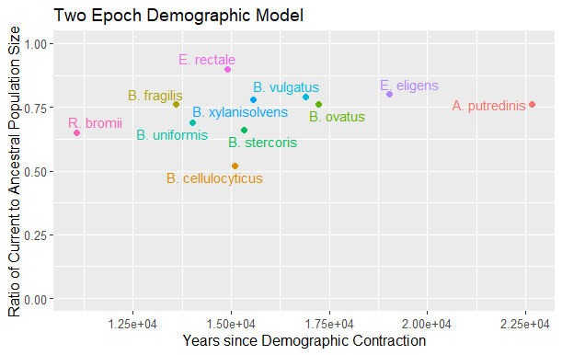
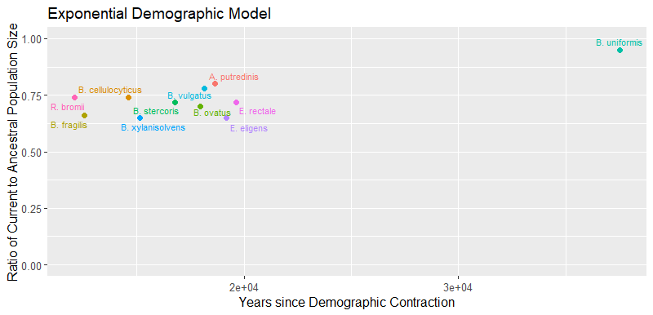
Different demographic models require different starting params for maximum likelihood fit
As an example, I still need to find
the best fit for B. uniformis under a demographic model involving exponential population decay

Slide 3
Oral Data Download
Is happening! (sorry, I didn’t get to this until yesterday)
Still at 232 files / ~500, but I will focus on this for the next week

Slide 4
Boring logistical stuff
Can we reschedule our meeting the week of Halloween? There is a collective action that will be held on Thursday, October 28th

Slide 5
//TODO
Finish Data Download → Midas → demographic inference, etc.
Find best fit for remaining demographic models (currently really only have two epoch for top 30-ish)y

