Slide 1
demo_for_ccgb Weekly Update
20220801
Jon Mah
Garud and Lohmueller Labs

Slide 2
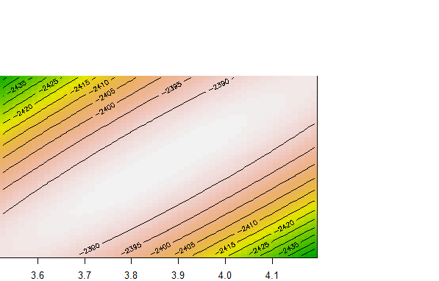
How to show confidence intervals for demographic inference?

Slide 3
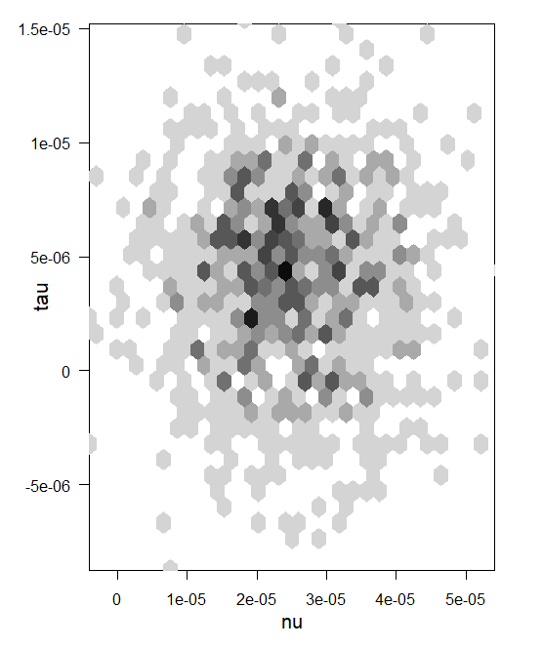
How to show confidence intervals for demographic inference?

Slide 4
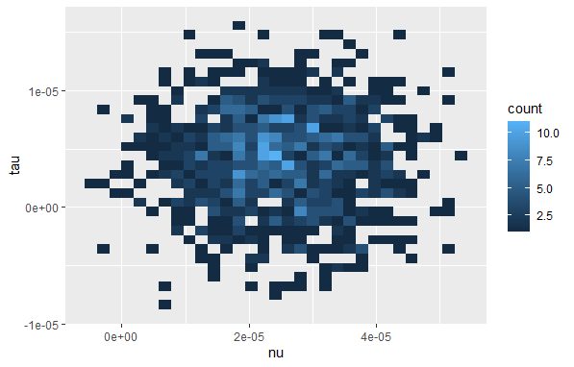
How to show confidence intervals for demographic inference?

Slide 5
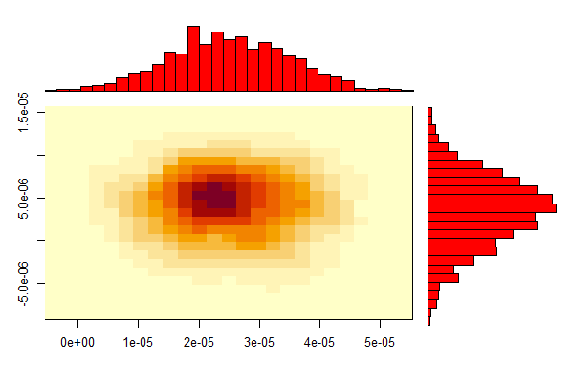
How to show confidence intervals for demographic inference?

