Slide 1
demo_for_ccgb Weekly Update
20220725
Jon Mah
Garud and Lohmueller Labs

Slide 2
Summary / Agenda
Computing nucleotide diversity
Downsampled SFS vs. non-downsampled SFS
Thoughts on plotting log likelihood surface?

Slide 3
Computing Nucleotide Diversity
See `.csv`(s) + code
Make sure that we’re adding raw counts when doing pairwise nucleotide comparison

Slide 4
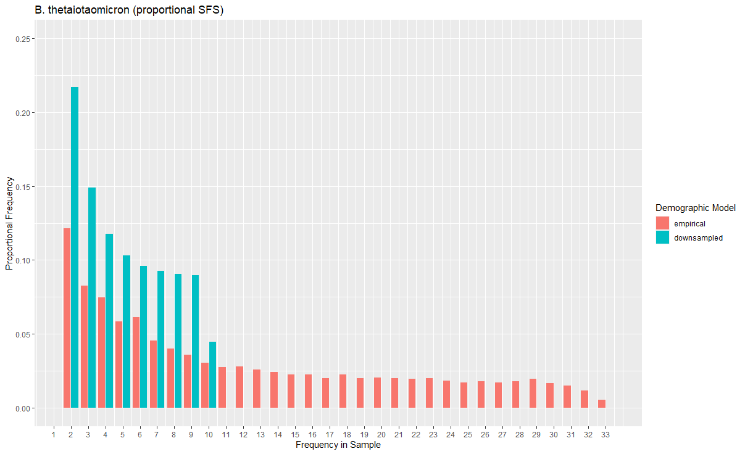
Downsampled vs. Non-downsampled SFS

Slide 5
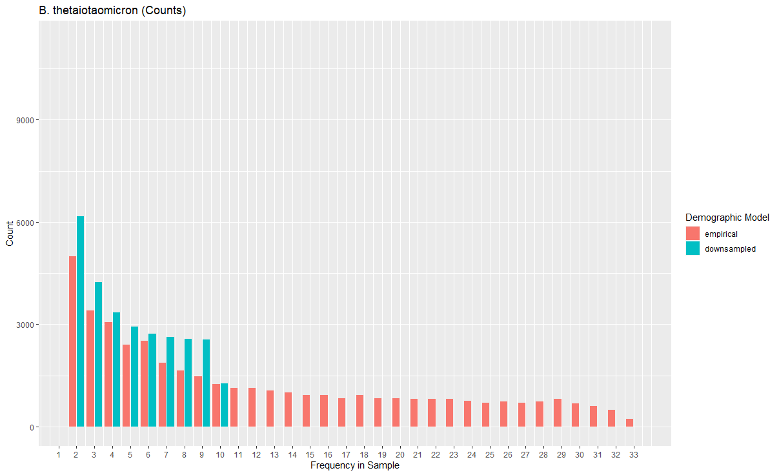
Downsampled vs. Non-downsampled SFS
Notes:
Plot with species that does not demonstrate a contraction

Slide 6
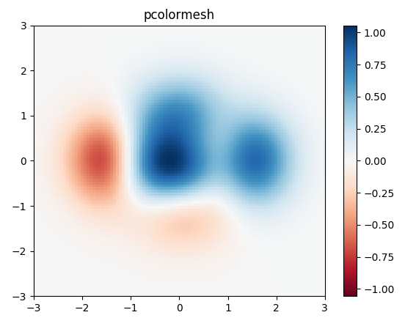
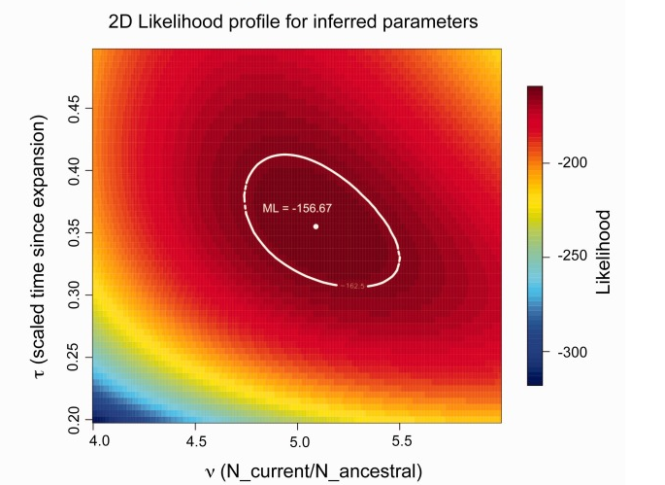
Plotting log likelihood surface
Given MLE estimate of [Nu’, Tau’]
Form grid from 0.5 * Nu’ to 1.5 * Nu’ and from 0.5 * Tau’ to 1.5 * Tau’
For each point on grid, compute log likelihood
Example:

Slide 7
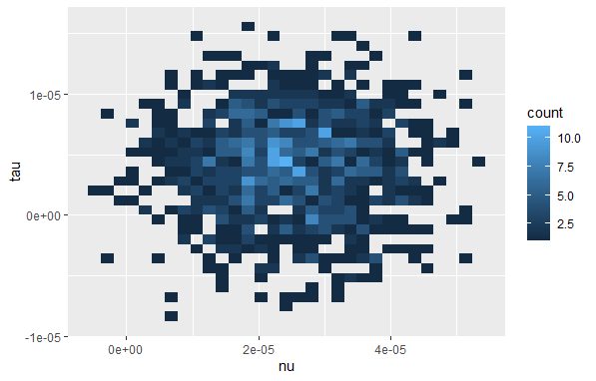
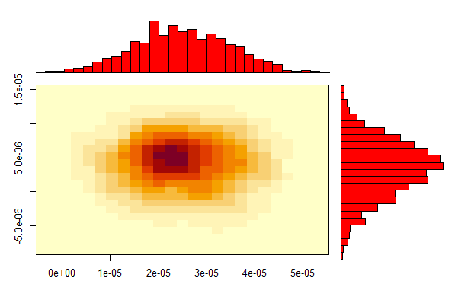
Plotting log likelihood surface
Other ideas

