Slide 1
demo_for_ccgb Rotation Update
20210217
Jon Mah
Garud Lab

Slide 2
Logistics

Slide 3
Project Aim
Science Goal: Infer the demographic history of common commensal gut bacteria
Training Goal: Learn popgen tools / tech for microbiome
Personal Goal: Have fun ☺!

Slide 4
Gameplan
Initially focus on B. vulgatus
Create syn / ns SFSs
Compare to expectation of SFS
Given clade data (e.g., continent of origin), create PCA plot
Run Dadi to determine best fit demographic model
Start with Omar Conejo’s model(s)
Perhaps find link to human demography?
Apply to other species
Apply to other data sets (include African data, Peruvian data)

Slide 5
Progress
Decreased step size during MLE
Constrained parameter boundaries to more closely match what we see in Cornejo
Log likelihood decreased for all models, species
Ignore guesses with params at boundaries
Log likelihood appears to be extremely flat, i.e., very different estimates have similar likelihoods
I took a look at fixing the time of expansion and only inferring population size, but the log likelihood went to -1000000000.
Still working on some of the fancier PCA stuff, e.g., probabilistic PCA to deal with missing data.

Slide 6
Implementation details (for following slides)
Input synonymous SFS’s: output from `plot_within_clade_sfs.py`.
High prevalence species:
B. vulgatus, B. ovatus, A. putredinis, B. uniformis, E. rectale.
Four demographic models
exponential growth, two-epoch, bottleneck + growth, three-epoch
For each input species
For each model:
Take 25 initial guesses for parameter space (parameters differ by model)
For each initial guess:
Iterate through gradient ascent to find maximum likelihood for <= 50 steps
Compute model params and log likelihood
Output log likelihood and model params of best initial guess + iterations
Ignore guesses with params at boundaries

Slide 7
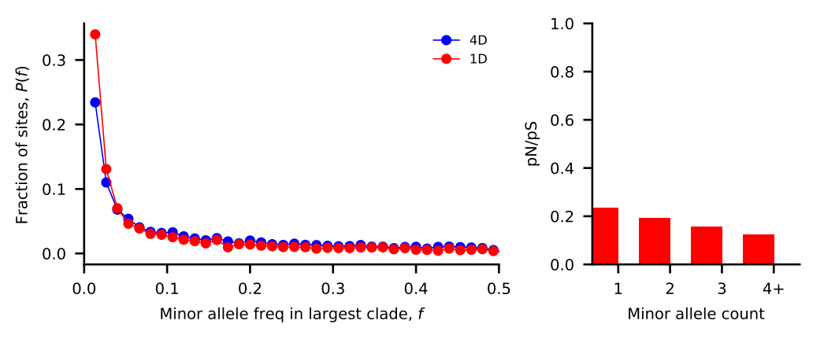
Bacteroides vulgatus
Nu_a: contemporary population relative to ancestral population before first epoch
Nu_b: contemporary population relative to ancestral population before second epoch
T_1: Duration of first epoch (units of 2 * N_a)
T_2: Duration of second epoch (units of 2 * N_a)
Model | Exponential growth | Two-epoch | Bottleneck + growth | Three-epoch
Log Likelihood | -208.162572957 | -208.170592663 | -208.145694409 | -208.080701909
Theta | 2511.2512867 | 2511.26053481 | 2511.23182071 | 2511.15683203
Nu_a | 4.09650015e+00 | 5.16608531e+00 | 7.78137069e-02 | 1.36762028e+00
Nu_b | N/A | N/A | 4.45424563e+00 | 3.41644642e+00
T_12 | 3.35256629e-06 | 2.36745622e-06 | 5.00359433e-06 | 2.74607621e-06
T_23 | N/A | N/A | N/A | 1.19722591e-05

Slide 8
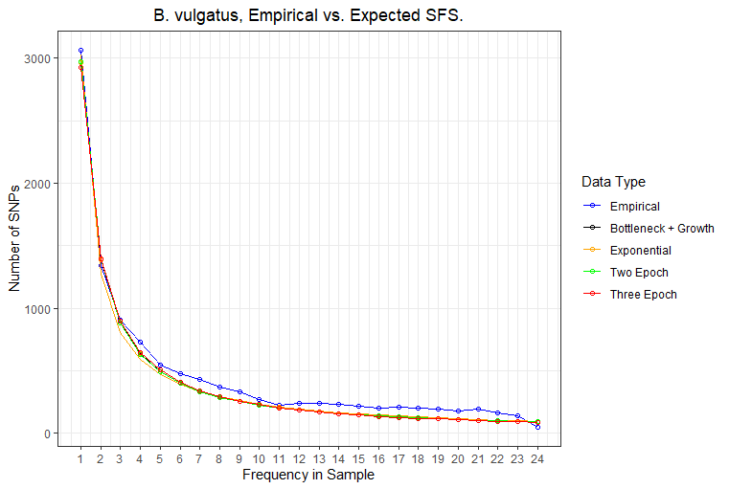
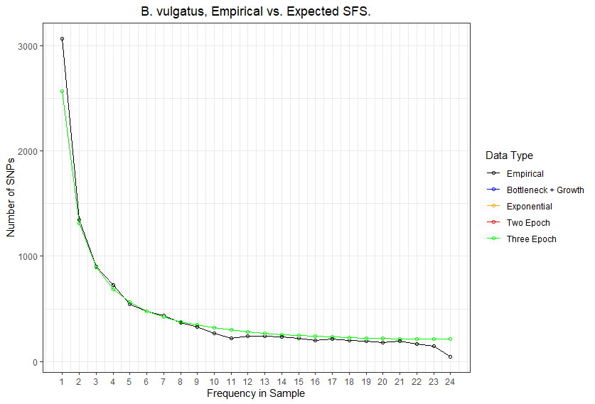

Slide 9
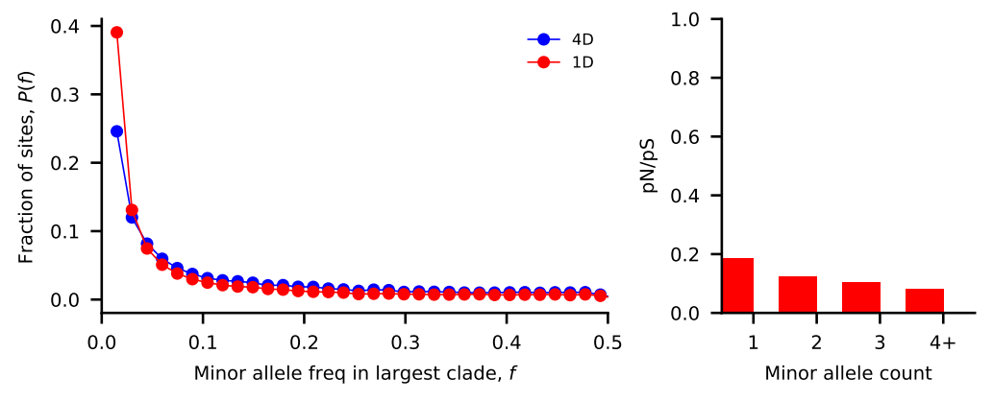
Bacteroides ovatus
Nu_a: contemporary population relative to ancestral population before first epoch
Nu_b: contemporary population relative to ancestral population before second epoch
T_1: Duration of first epoch (units of 2 * N_a)
T_2: Duration of second epoch (units of 2 * N_a)
Model | Exponential growth | Two-epoch | Bottleneck + growth | Three-epoch
Log Likelihood | -223.566950386 | -223.576366468 | -223.545209485 | -223.529434504
Theta | 2415.2446717 | 2415.25855658 | 2415.2126046 | 2415.18932839
Nu_a | 4.22004079e+00 | 5.06866276e-02 | 1.48991313e-01 | 8.72664505e-01
Nu_b | N/A | N/A | 1.09132625e-01 | 2.95430914e+00
T_12 | 2.87734872e-06 | 7.64498992e-06 | 1.64168424e-05 | 1.61170089e-06
T_23 | N/A | N/A | N/A | 9.99437888e-06

Slide 10
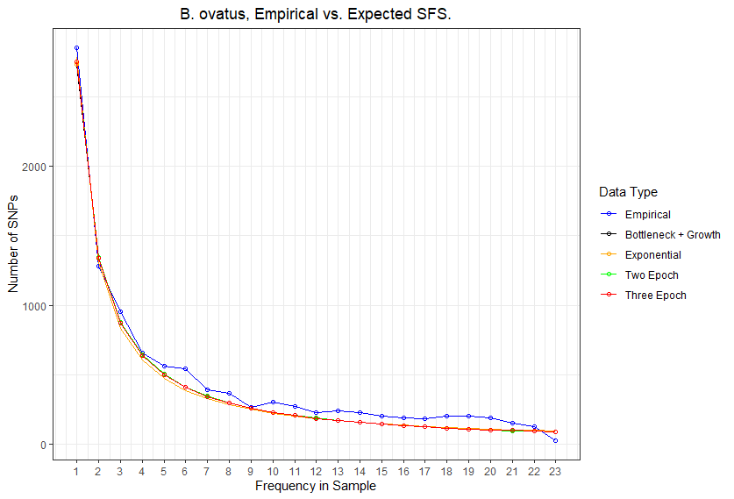
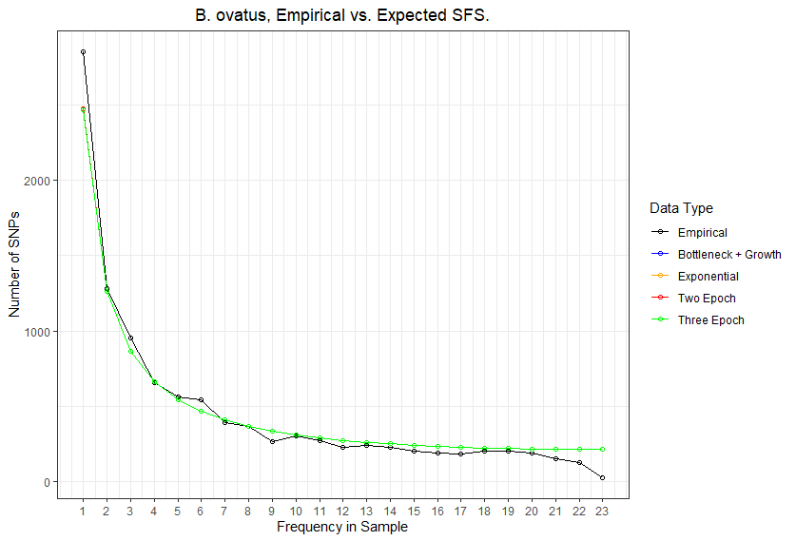

Slide 11
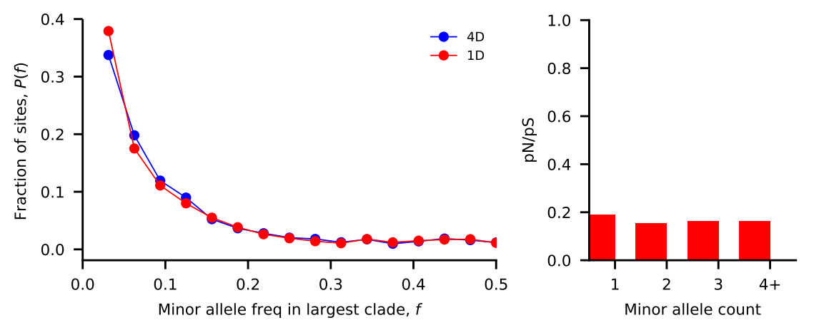
Alistipes putredinis
Nu_a: contemporary population relative to ancestral population before first epoch
Nu_b: contemporary population relative to ancestral population before second epoch
T_1: Duration of first epoch (units of 2 * N_a)
T_2: Duration of second epoch (units of 2 * N_a)
Model | Exponential growth | Two-epoch | Bottleneck + growth | Three-epoch
Log Likelihood | -1722.56029913 | -1722.54653468 | -1722.52576571 | -1722.43277834
Theta | 2961.05778586 | 2961.04969561 | 2961.03748825 | 2960.98282718
Nu_a | 5.32786573e+00 | 5.11933281e+00 | 1.11828810e-01 | 2.71539141e+00
Nu_b | N/A | N/A | 2.75394940e+00 | 3.25585820e+00
T_12 | 2.42838887e-06 | 3.25098838e-06 | 5.60862901e-06 | 5.21114711e-06
T_23 | N/A | N/A | N/A | 6.79649776e-06

Slide 12
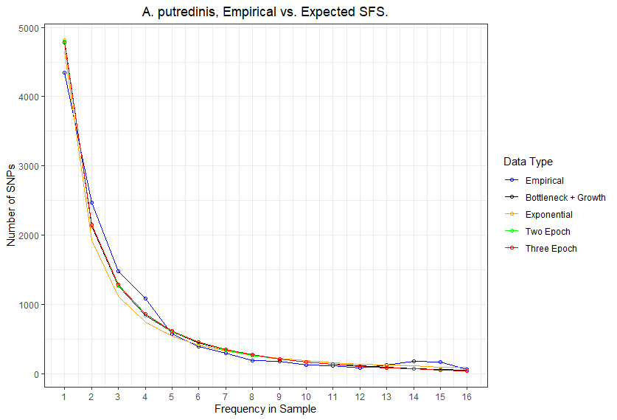
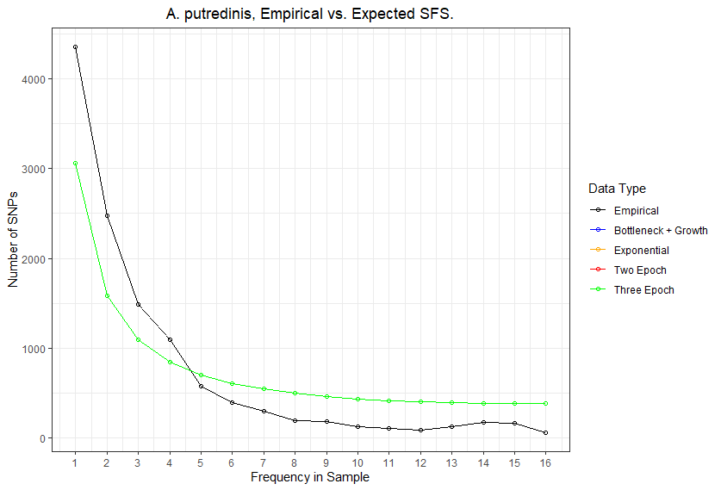

Slide 13
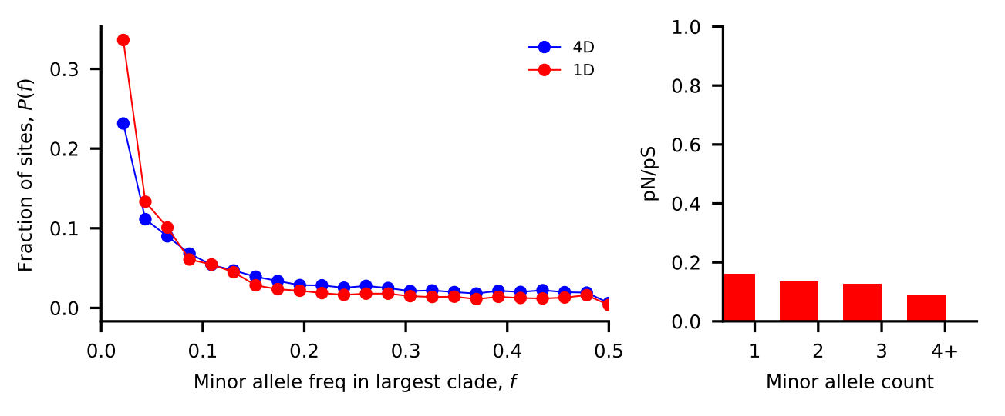
Bacteroides uniformis
Nu_a: contemporary population relative to ancestral population before first epoch
Nu_b: contemporary population relative to ancestral population before second epoch
T_1: Duration of first epoch (units of 2 * N_a)
T_2: Duration of second epoch (units of 2 * N_a)
Model | Exponential growth | Two-epoch | Bottleneck + growth | Three-epoch
Log Likelihood | -398.525891057 | -398.504467277 | -398.548366976 | -398.360442864
Theta | 2245.34072141 | 2245.32714396 | 2245.35496458 | 2245.23581918
Nu_a | 2.19215992e+00 | 4.89667174e+00 | 9.24711675e-02 | 2.87729116e+00
Nu_b | N/A | N/A | 1.00960582e+00 | 9.55869498e-01
T_12 | 1.48526959e-06 | 1.99307987e-06 | 1.00728327e-06 | 1.05506926e-05
T_23 | N/A | N/A | N/A | 1.90954397e-06

Slide 14
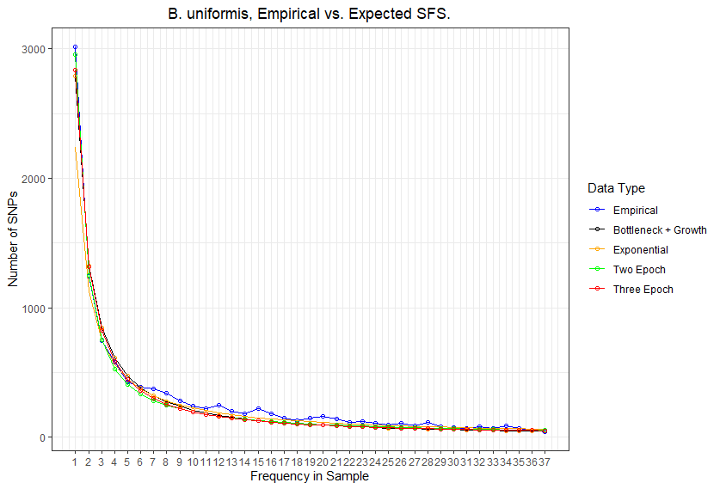
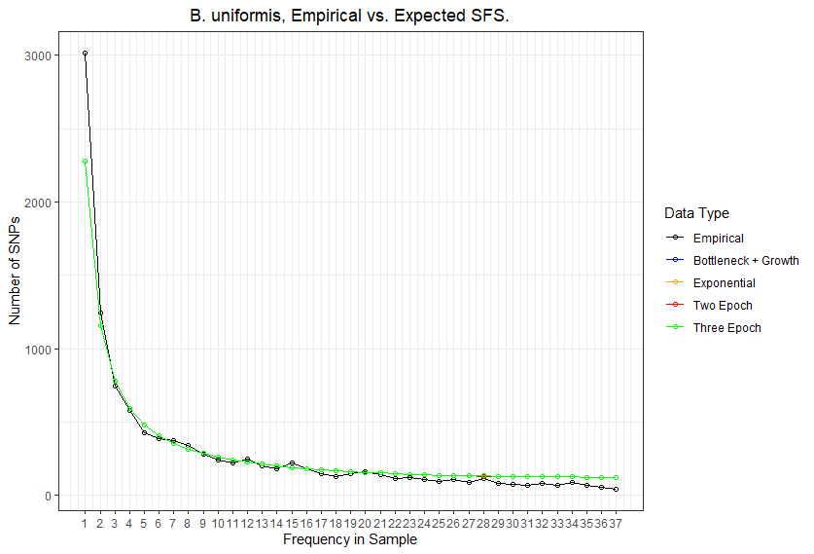

Slide 15
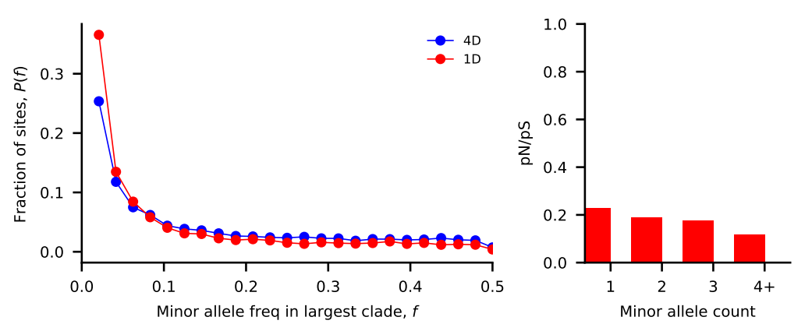
Eubacterium rectale
Nu_a: contemporary population relative to ancestral population before first epoch
Nu_b: contemporary population relative to ancestral population before second epoch
T_1: Duration of first epoch (units of 2 * N_a)
T_2: Duration of second epoch (units of 2 * N_a)
Model | Exponential growth | Two-epoch | Bottleneck + growth | Three-epoch
Log Likelihood | -853.371861584 | -853.427262767 | -853.178639906 | -853.245715963
Theta | 11538.0213712 | 11538.0869002 | 11537.7927562 | 11537.872127
Nu_a | 4.62689363e+00 | 1.63254306e+00 | 1.31305750e-01 | 2.28520138e+00
Nu_b | N/A | N/A | 4.44904916e+00 | 1.37899114e+00
T_12 | 1.28315860e-06 | 5.36187141e-07 | 4.75653382e-06 | 4.01988020e-06
T_23 | N/A | N/A | N/A | 1.73913466e-06

Slide 16
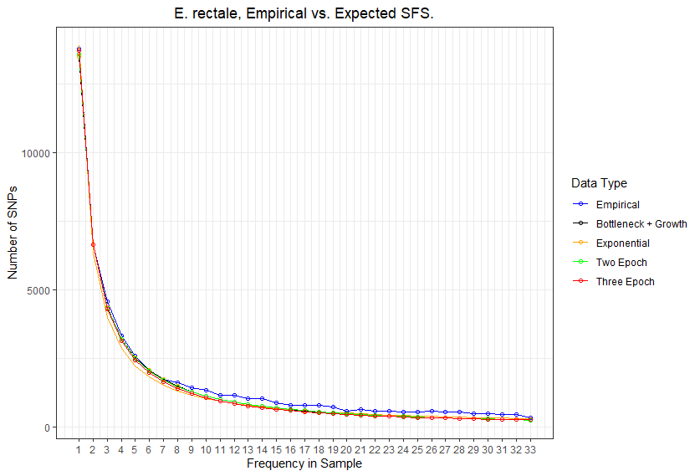
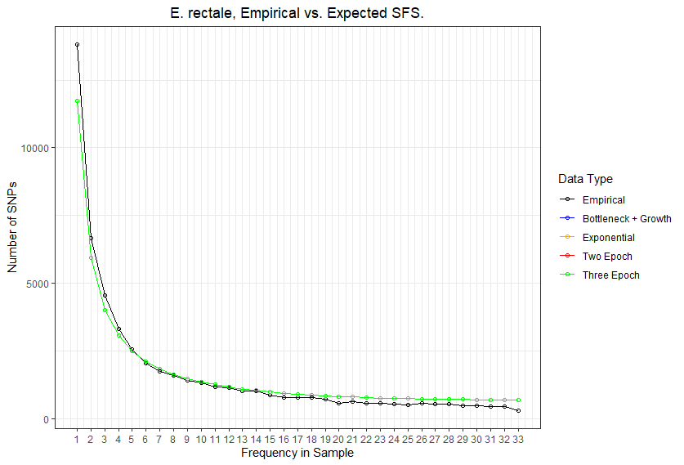

Slide 17
Implementation details (for following slides)
Input synonymous SFS’s: output from `plot_within_clade_sfs.py`.
High recombination / mutation species:
P. copri, A. shahii, O. splanchnicus, Coprococcus species
Four demographic models
exponential growth, two-epoch, bottleneck + growth, three-epoch
For each input species
For each model:
Take 25 initial guesses for parameter space (parameters differ by model)
For each initial guess:
Iterate through gradient ascent to find maximum likelihood for <= 50 steps
Compute model params and log likelihood
Output log likelihood and model params of best initial guess + iterations

Slide 18
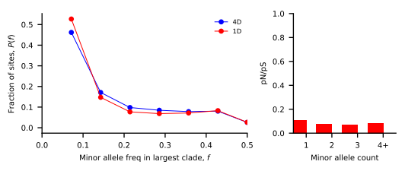
Prevotella copri
Nu_a: contemporary population relative to ancestral population before first epoch
Nu_b: contemporary population relative to ancestral population before second epoch
T_1: Duration of first epoch (units of 2 * N_a)
T_2: Duration of second epoch (units of 2 * N_a)
Model | Exponential growth | Two-epoch | Bottleneck + growth | Three-epoch
Log Likelihood | -1823.60758717 | -1823.5852384 | -1823.50716407 | -1823.40285297
Theta | 10273.1453565 | 10273.1292711 | 10273.0730759 | 10272.9979928
Nu_a | 1.63059704e+00 | 2.66032190e+00 | 1.80222374e-01 | 1.32970280e+00
Nu_b | N/A | N/A | 2.85588940e+00 | 3.15043807e+00
T_12 | 1.02442460e-06 | 1.72381963e-06 | 5.25560399e-06 | 2.26380537e-06
T_23 | N/A | N/A | N/A | 8.84391526e-06

Slide 19
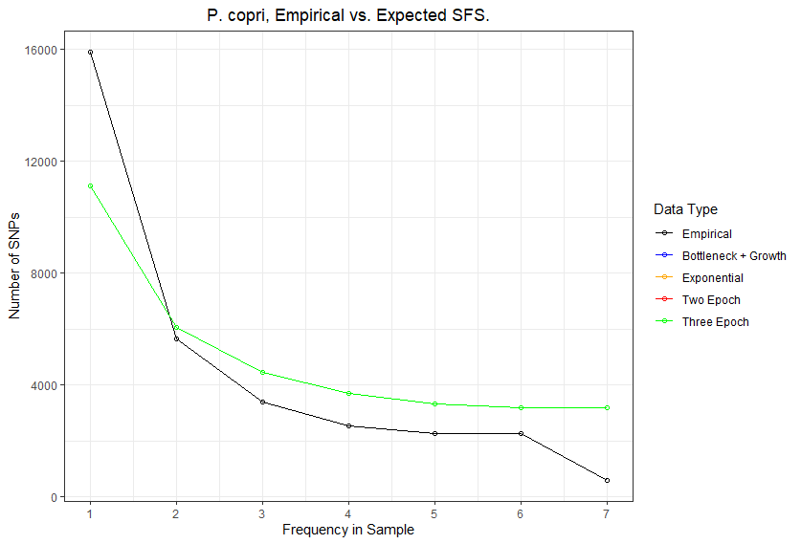

Slide 20
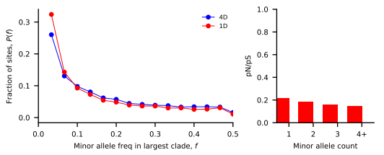
Odoribacter splanchnicus
Nu_a: contemporary population relative to ancestral population before first epoch
Nu_b: contemporary population relative to ancestral population before second epoch
T_1: Duration of first epoch (units of 2 * N_a)
T_2: Duration of second epoch (units of 2 * N_a)
Model | Exponential growth | Two-epoch | Bottleneck + growth | Three-epoch
Log Likelihood | -84.4280361667 | -84.4277430768 | -84.4281943301 | -84.430912171
Theta | 2933.32017328 | 2933.3160406 | 2933.32239952 | 2933.36067766
Nu_a | 4.46379693e+00 | 5.36526908e+00 | 1.05765374e-01 | 1.07461561e+00
Nu_b | N/A | N/A | 2.22963596e+00 | 1.10774051e+00
T_12 | 5.64333732e-06 | 5.82328231e-06 | 7.67217488e-06 | 5.34393417e-06
T_23 | N/A | N/A | N/A | 6.05477793e-06

Slide 21
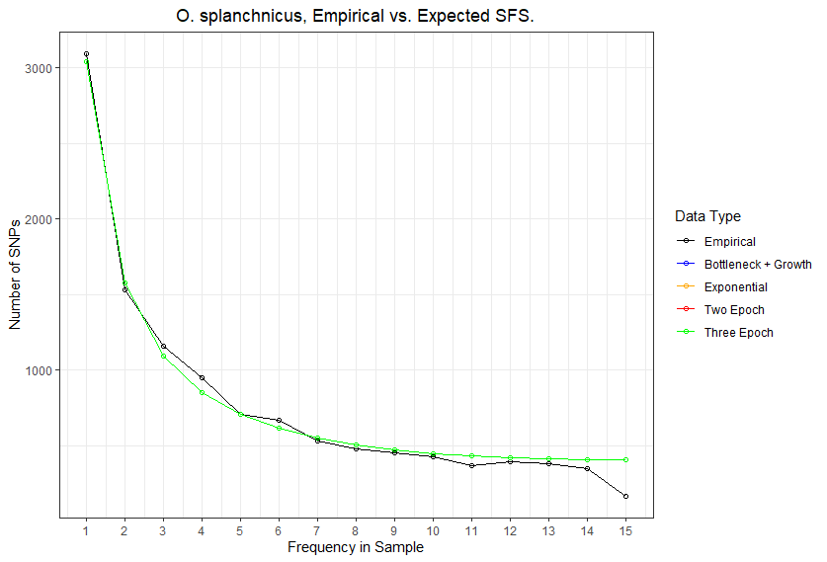

Slide 22
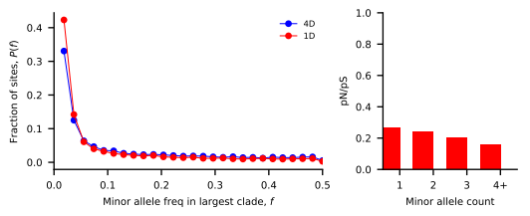
Alistipes shahii
Nu_a: contemporary population relative to ancestral population before first epoch
Nu_b: contemporary population relative to ancestral population before second epoch
T_1: Duration of first epoch (units of 2 * N_a)
T_2: Duration of second epoch (units of 2 * N_a)
Model | Exponential growth | Two-epoch | Bottleneck + growth | Three-epoch
Log Likelihood | -897.498645722 | -897.491777242 | -897.407933484 | -897.266410943
Theta | 4404.72068004 | 4404.71771184 | 4404.68147873 | 9425.8874565
Nu_a | 3.32105135e+00 | 2.26374183e+00 | 8.05076578e-02 | 1.54383833e+00
Nu_b | N/A | N/A | 4.20940794e+00 | 2.09339726e+00
T_12 | 9.53897473e-07 | 1.37011541e-06 | 2.74200337e-06 | 3.18891527e-06
T_23 | N/A | N/A | N/A | 6.13812088e-06

Slide 23
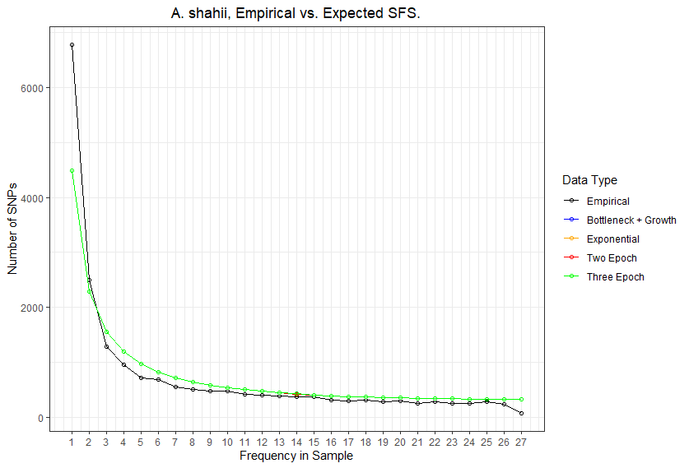

Slide 24
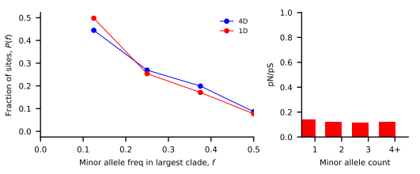
Coprococcus species
Nu_a: contemporary population relative to ancestral population before first epoch
Nu_b: contemporary population relative to ancestral population before second epoch
T_1: Duration of first epoch (units of 2 * N_a)
T_2: Duration of second epoch (units of 2 * N_a)
Model | Exponential growth | Two-epoch | Bottleneck + growth | Three-epoch
Log Likelihood | -128.163159689 | -128.162733832 | -128.157934733 | -128.156369625
Theta | 3906.10107241 | 3906.09965379 | 3906.08366661 | 3906.07845237
Nu_a | 4.27886621e+00 | 3.39036114e+00 | 1.70825988e-01 | 1.65557183e+00
Nu_b | N/A | N/A | 3.38212536e+00 | 1.87413557e+00
T_12 | 3.15374995e-06 | 3.72256834e-06 | 7.29367339e-06 | 6.28519567e-06
T_23 | N/A | N/A | N/A | 7.74858409e-06

Slide 25
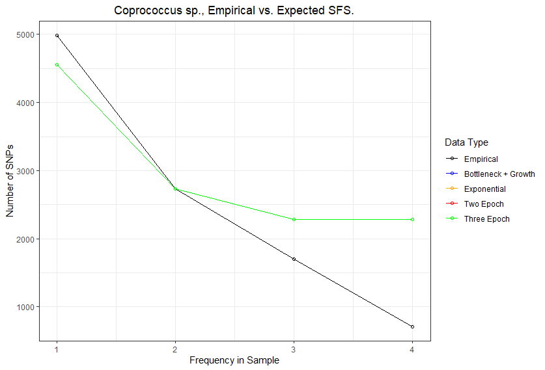

Slide 26
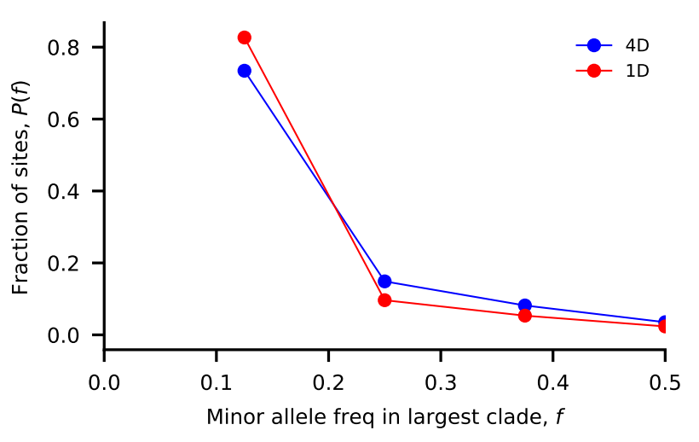
Bacteroides massiliensis
Nu_a: contemporary population relative to ancestral population before first epoch
Nu_b: contemporary population relative to ancestral population before second epoch
T_1: Duration of first epoch (units of 2 * N_a)
T_2: Duration of second epoch (units of 2 * N_a)
Model | Exponential growth | Two-epoch | Bottleneck + growth | Three-epoch
Log Likelihood | -198.754592695 | -198.754329559 | -198.749679615 | -198.756543857
Theta | 339.777255355 | 339.777110828 | 339.774556808 | 339.778326981
Nu_a | 4.32759476e+00 | 4.43082804e+00 | 7.81905393e-02 | 1.16476667e+00
Nu_b | N/A | N/A | 4.26742967e+00 | 1.35510600e+00
T_12 | 5.66811422e-06 | 5.96464548e-06 | 1.21224728e-05 | 4.40423001e-06
T_23 | N/A | N/A | N/A | 7.13473226e-06

Slide 27
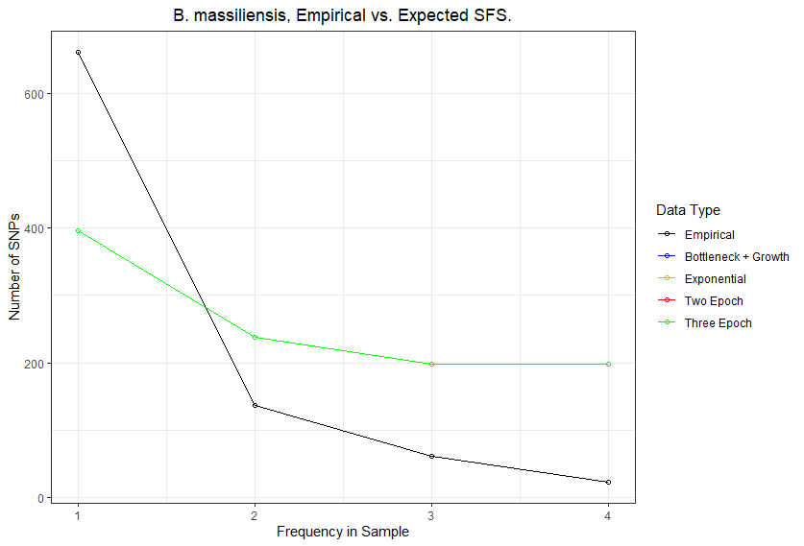

Slide 28
//TODO

Slide 29
Standing questions
Investigate edge length distribution
Compare commensal bacteria to human demography
Compare commensal bacteria to pathogens

