Slide 1
demo_for_ccgb Rotation Update
20210125
Jon Mah
Garud Lab

Slide 2
Logistics
As a heads-up I’m helping with some of the Bioinformatics Recruitment stuff this week (Wednesday through Friday), but there shouldn’t be any schedule conflicts with meetings or anything on my end.
Bioinformatics recruitment is this week, and EEB + Genetics / Genomics is next week. Do you have any schedule changes?
Izabel (new postdoc in Kirk’s group) might want to shift around her lab meeting with us (currently scheduled for Feb 4th) so that Kirk can attend and provide input. Feb 4th is EEB / Genetics + Genomics recruitment week so he wouldn’t be able to make that meeting.

Slide 3
Project Aim
Science Goal: Infer the demographic history of common commensal gut bacteria
Training Goal: Learn popgen tools / tech for microbiome
Personal Goal: Have fun ☺!

Slide 4
Gameplan
Initially focus on B. vulgatus
Create syn / ns SFSs
Compare to expectation of SFS
Given clade data (e.g., continent of origin), create PCA plot
Run Dadi to determine best fit demographic model
Start with Omar Conejo’s model(s)
Perhaps find link to human demography?
Apply to other species
Apply to other data sets (include African data, Peruvian data)

Slide 5
Progress
Better inferences for demographic models (more iterations, initial guesses)
Computed expectation for SFS and compared to empirical
“Downloaded” Midas (it’s already on the cluster, but I can run it)
Download(ing?) Madagascar and Ethiopian data
I’m a little stumped on this!
It appears that the sra directory: ftp://ftp-trace.ncbi.nih.gov/sra/sra-instant/ is missing.
SRAtools requires GLIBC ver. 2.14, which I can’t sudo apt-update on Hoffman.
I am trying to build some form of conda environment or docker container with sratools on local, and then importing to hoffman2.

Slide 6
Implementation details (for following slides)
Input synonymous SFS’s: output from `plot_within_clade_sfs.py`.
B. vulgatus, B. ovatus, A. putredinis, B. uniformis, E. rectale.
Four demographic models
exponential growth, two-epoch, bottleneck + growth, three-epoch
For each input species
For each model:
Take 25 initial guesses for parameter space (parameters differ by model)
For each initial guess:
Iterate through gradient ascent to find maximum likelihood for <= 100 steps
Compute model params and log likelihood
Some results were mostly the same (since random seeding is controlled)
Output log likelihood and model params of best initial guess + iterations

Slide 7
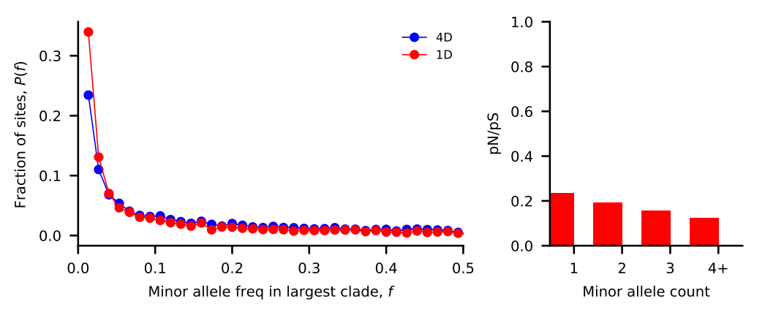
Bacteroides vulgatus
Nu_a: contemporary population relative to ancestral population before first epoch
Nu_b: contemporary population relative to ancestral population before second epoch
T_1: Duration of first epoch (units of 2 * N_a)
T_2: Duration of second epoch (units of 2 * N_a)
Model | Exponential growth | Two-epoch | Bottleneck + growth | Three-epoch
Log Likelihood | -123.582830394 | -115.548611105 | -114.478986615 | -115.763713816
Nu_a | 2.34360421 | 1.46471105 | 0.99063457 | 1.43575234
Nu_b | N/A | N/A | 1.53009861 | 1.43566152
T_12 | 0.05432866 | 0.20111674 | 0.44283702 | 0.28861314
T_23 | N/A | N/A | N/A | 0.01340126

Slide 8
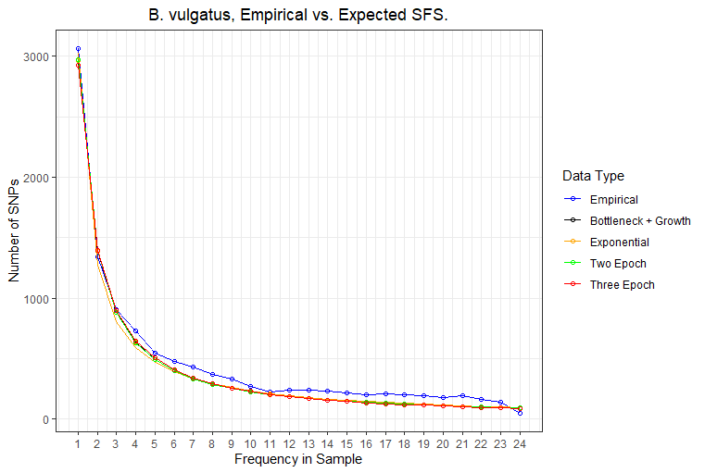
Bacteroides vulgatus SFS comparison
The empirical sfs is shown in blue, while the expected SFS under different demographic models is shown in either black, orange, green, or red.
The expected SFS’s have high precision, i.e., are close to each other, but visibly differ from the empirical SFS, particularly are higher allele frequencies.

Slide 9
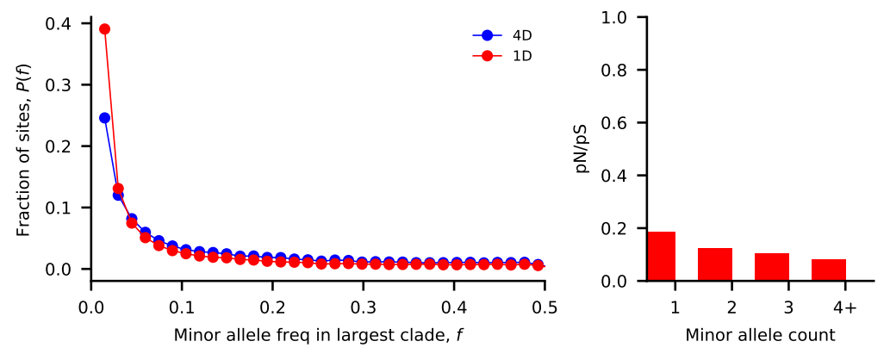
Bacteroides ovatus
Nu_a: contemporary population relative to ancestral population before first epoch
Nu_b: contemporary population relative to ancestral population before second epoch
T_1: Duration of first epoch (units of 2 * N_a)
T_2: Duration of second epoch (units of 2 * N_a)
Model | Exponential growth | Two-epoch | Bottleneck + growth | Three-epoch
Log Likelihood | -119.348788944 | -112.924572671 | -113.082924889 | -113.060715703
Nu_a | 1.43394881 | 1.4790958 | 1.46992089 | 1.33943782
Nu_b | N/A | N/A | 1.42640515 | 1.44808057
T_12 | 0.3079758 | 0.70549535 | 0.61551285 | 0.29004047
T_23 | N/A | N/A | N/A | 0.38515666

Slide 10
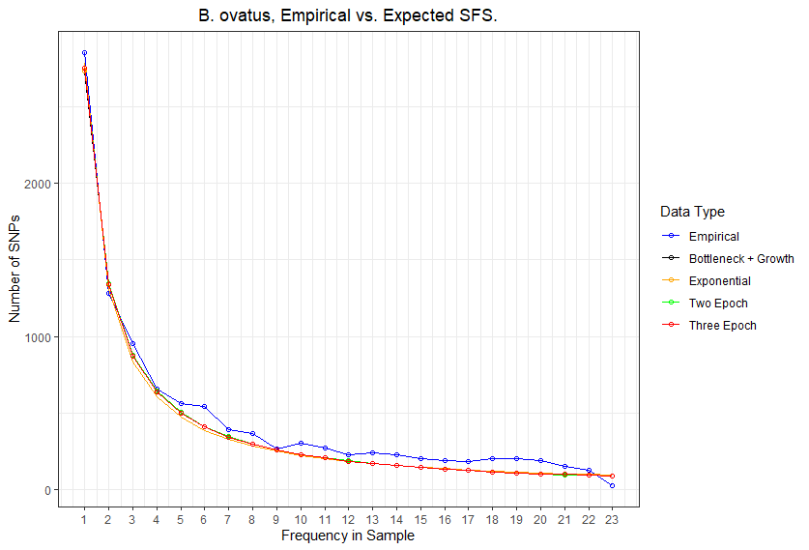
Bacteroides ovatus SFS comparison
The empirical sfs is shown in blue, while the expected SFS under different demographic models is shown in either black, orange, green, or red.
The expected SFS’s have high precision, i.e., are close to each other, but visibly differ from the empirical SFS, particularly are higher allele frequencies.

Slide 11
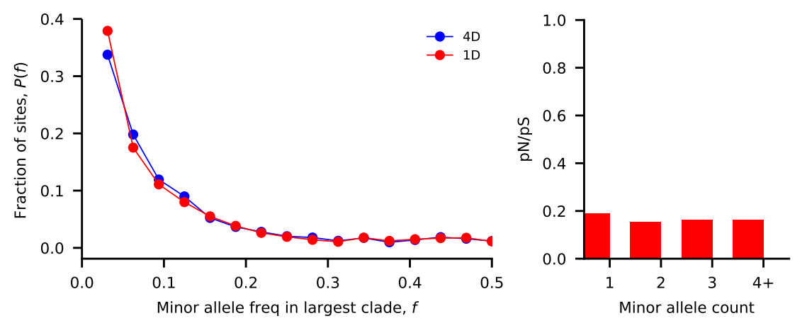
Alistipes putredinis
Nu_a: contemporary population relative to ancestral population before first epoch
Nu_b: contemporary population relative to ancestral population before second epoch
T_1: Duration of first epoch (units of 2 * N_a)
T_2: Duration of second epoch (units of 2 * N_a)
Model | Exponential growth | Two-epoch | Bottleneck + growth | Three-epoch
Log Likelihood | -417.014902652 | -283.836375864 | -291.177506155 | -284.467464745
Nu_a | 37.70628513 | 12.85982032 | 40.83825475 | 0.01045419
Nu_b | N/A | N/A | 51.02541362 | 3.04038303
T_12 | 27.47992853 | 5.26353859 | 24.36432521 | 0.79722362
T_23 | N/A | N/A | N/A | 1.54418863

Slide 12
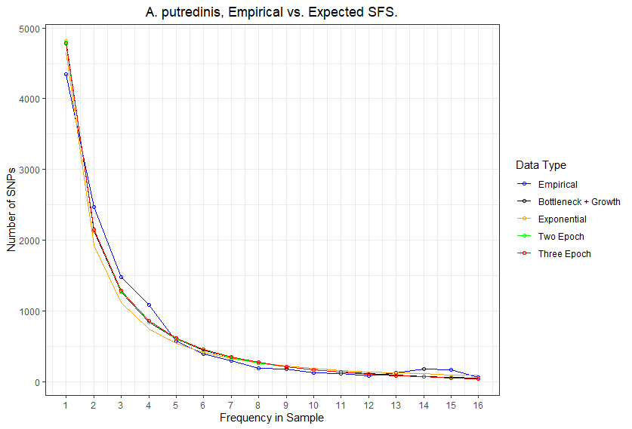
Alistipes putredinis SFS comparison
The empirical sfs is shown in blue, while the expected SFS under different demographic models is shown in either black, orange, green, or red.
The expected SFS’s have high precision, i.e., are close to each other, but visibly differ from the empirical SFS, particularly are higher allele frequencies.

Slide 13
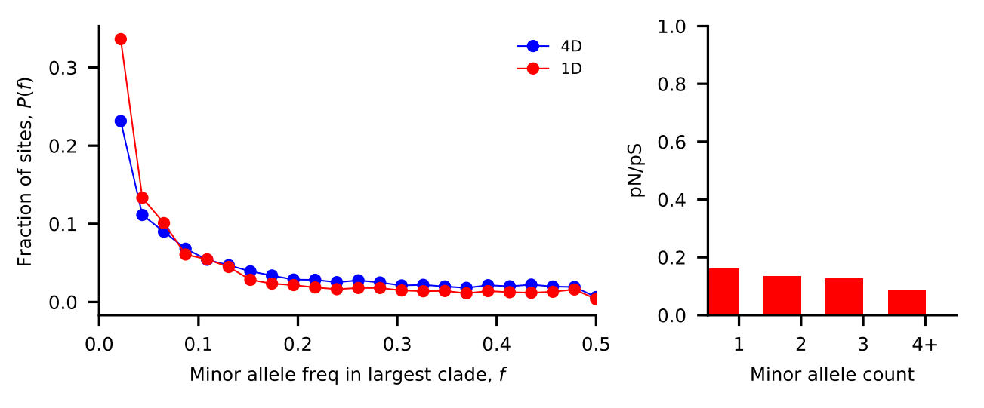
Bacteroides uniformis
Nu_a: contemporary population relative to ancestral population before first epoch
Nu_b: contemporary population relative to ancestral population before second epoch
T_1: Duration of first epoch (units of 2 * N_a)
T_2: Duration of second epoch (units of 2 * N_a)
Model | Exponential growth | Two-epoch | Bottleneck + growth | Three-epoch
Log Likelihood | -399.504374725 | -232.981268472 | -220.698891194 | -232.890550466
Nu_a | 3.72253633e-01 | 1.98374712 | 1.40119388 | 1.42262676
Nu_b | N/A | N/A | 1.81254464 | 1.69965725
T_12 | 5.84878255e-06 | 0.0658422 | 0.49713158 | 0.04668702
T_23 | N/A | N/A | N/A | 0.15294058

Slide 14
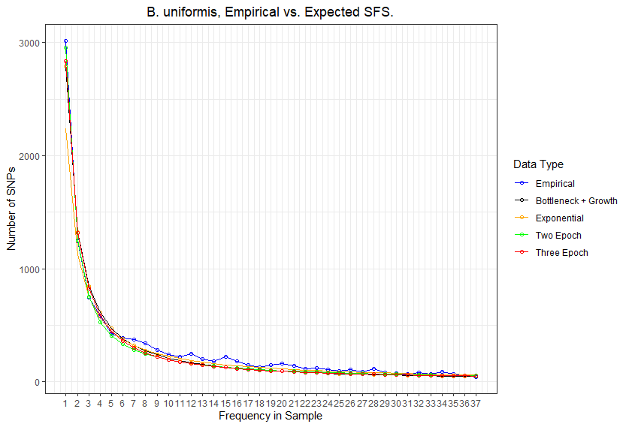
Bacteroides uniformis SFS comparison
The empirical sfs is shown in blue, while the expected SFS under different demographic models is shown in either black, orange, green, or red.
The expected SFS’s have high precision, i.e., are close to each other, but visibly differ from the empirical SFS, particularly are higher allele frequencies.

Slide 15
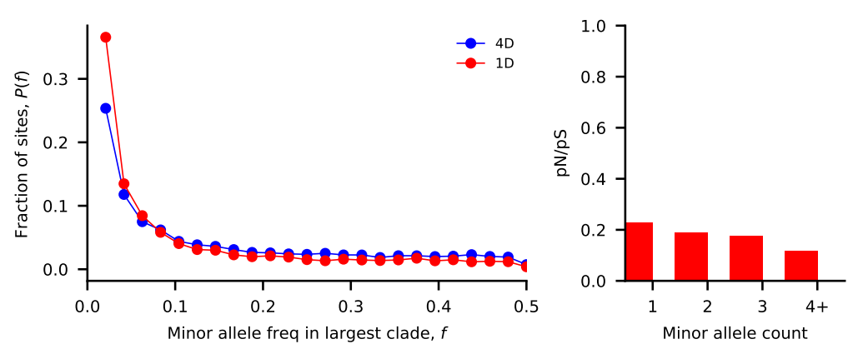
Eubacterium rectale
Nu_a: contemporary population relative to ancestral population before first epoch
Nu_b: contemporary population relative to ancestral population before second epoch
T_1: Duration of first epoch (units of 2 * N_a)
T_2: Duration of second epoch (units of 2 * N_a)
Model | Exponential growth | Two-epoch | Bottleneck + growth | Three-epoch
Log Likelihood | -360.132009673 | -188.144695197 | -189.599130013 | -200.178555584
Nu_a | 1.61936896 | 1.86276421 | 2.0649441 | 0.15087902
Nu_b | N/A | N/A | 1.7472377 | 0.60463415
T_12 | 0.21071071 | 0.98340861 | 0.77825979 | 0.23744711
T_23 | N/A | N/A | N/A | 0.27554825

Slide 16
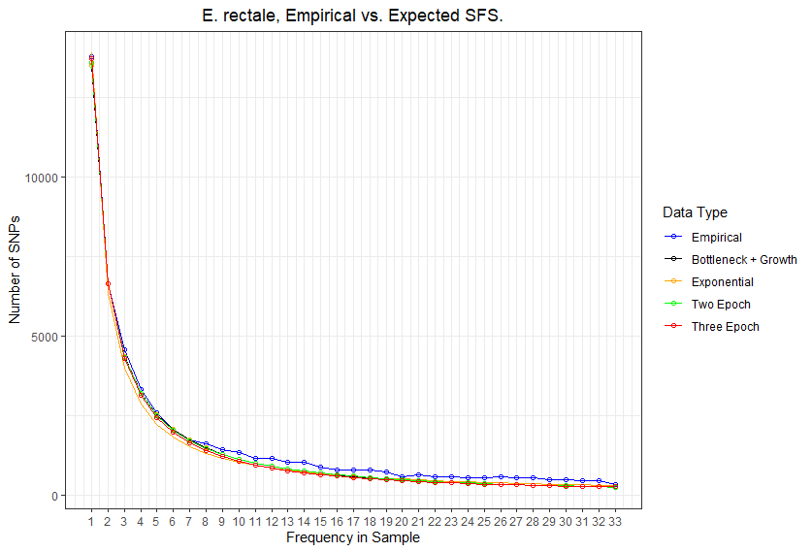
Eubacterium rectale SFS comparison
The empirical sfs is shown in blue, while the expected SFS under different demographic models is shown in either black, orange, green, or red.
The expected SFS’s have high precision, i.e., are close to each other, but visibly differ from the empirical SFS, particularly are higher allele frequencies.

Slide 17
Chalkboard math / diagrams
Assuming mutation rate is 1e-9 for bacteria in general.
Each species and each model has a different inferred optimal theta
Theta = 4 * N_e * mu
N_e = Theta / (4 * mu) = Theta * 1e9 / 4
B. vulgatus, B. ovatus, A. putredinis, B. uniformis, E. rectale

Slide 18
Bottleneck growth demographic diagram
N_a = 5.47E+11, 3.33E+11,
9.93E+10, 2.96E+11, 9.41E+11
Nu_b = 8.37E+11, 4.75E+11,
2.91E+10, 5.36E+11, 1.64E+12
T_12 = 2.4219E+11, 2.0494E+11, 265.387133,
1.4699E+11, 7.3223E+11
N_e = 5.42E+11, 4.89E+11 , 2.71E+10 , 4.14E+11, 1.94E+12

Slide 19
Exponential growth demographic diagram
N_a = 2.49E+11, 3.81E+11,
1.4E+09, 1.51E+12, 1.56E+12
T_12 = 1.353E+10,
1.1721E+11, 3.8374E+10,
8810428.06, 3.2791E+11
N_e = 5.84E+11, 5.46E+11, 5.27E+10, 5.61E+11, 2.52E+12

Slide 20
Three-epoch demographic diagram
N_a = 3.73E+11, 3.65E+11, 1.09E+12, 3.20E+11, 3.89E+13
T_12 = 2.16E+11, 2.11E+11, 3.78E+11, 2.99E+10, 3.63E+12
N_2 = 5.36E+11, 5.28E+11, 8.13E+11, 5.44E+11, 2.35E+13
T_23 = 1.34E-02, 3.85E-01, 9.40E-02, 1.53E-01, 2.76E-01
N_e = 5.36E+11, 4.88E+11, 4.36E+11, 4.55E+11, 5.87E+12

Slide 21
Two-epoch demographic diagram
N_a = 3.74E+11, 3.22E+11, 2.55E+09, 2.44E+11, 1.00E+12
T_12 = 1.51E+11, 4.54E+11, 2.68E+10, 3.21E+10, 1.97E+12
N_e = 5.48E+11, 4.76E+11, 3.28E+10, 4.84E+11, 1.86E+12

Slide 22
//TODO
Figure out data download, Midas
Look at Dadi’s internal sfs comparison
Look at 2D heatmap
Apply inference pipeline to P. copri
Species with high recombination rates
Reread Cornejo
Difference in methodology and results

Slide 23
Standing questions
Investigate edge length distribution
Compare commensal bacteria to human demography
Compare commensal bacteria to pathogens

