Slide 1
demo_for_ccgb Weekly Update
20220513
Jon Mah
Garud and Lohmueller Labs

Slide 2
Summary of Update
Comparing rho (recombination) vs. mu (mutation rate) and increase in log likelihood.
Model outputs
Some literature review = thoughts

Slide 3
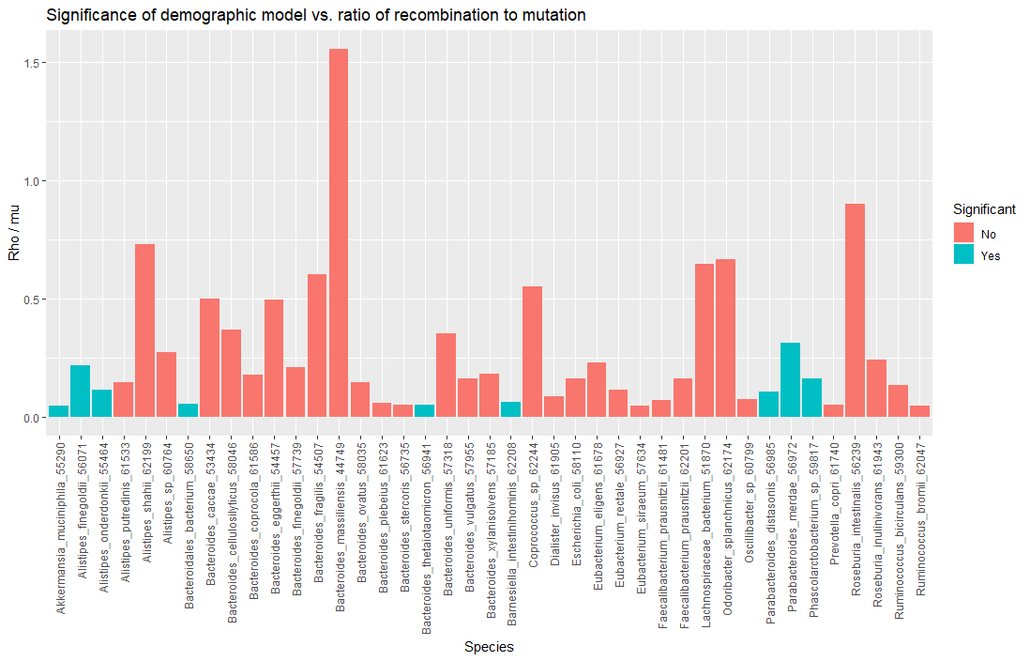
Rho vs. Mu

Slide 4
Thoughts
The demographic models which were significant all have a low rho/mu ratio, which is not promising.

Slide 5
//TODO

