Slide 1
demo_for_ccgb Rotation Update
20210125
Jon Mah
Garud Lab

Slide 2
Logistics
As a heads-up I’m helping with some of the Bioinformatics Recruitment stuff this week (Wednesday through Friday), but there shouldn’t be any schedule conflicts with meetings or anything on my end.
Bioinformatics recruitment is this week, and EEB + Genetics / Genomics is next week. Do you have any schedule changes?
Izabel might want to shift around her lab meeting with us (currently scheduled for Feb 4th) so that Kirk can attend and provide input.

Slide 3
Project Aim
Science Goal: Infer the demographic history of common commensal gut bacteria
Training Goal: Learn popgen tools / tech for microbiome
Personal Goal: Have fun ☺!

Slide 4
Gameplan
Initially focus on B. vulgatus
Create syn / ns SFSs
Compare to expectation of SFS
Given clade data (e.g., continent of origin), create PCA plot
Run Dadi to determine best fit demographic model
Start with Omar Conejo’s model(s)
Perhaps find link to human demography?
Apply to other species
Apply to other data sets (include African data, Peruvian data)

Slide 5
Progress
Better inferences for demographic models (more iterations, initial guesses)
“Downloaded” Midas (it’s already on the cluster)
Download(ing) Madagascar data
Download(ing) Ethiopian data
Might have those by tomorrow.

Slide 6
Implementation details (for following slides)
Input synonymous SFS’s: output from `plot_within_clade_sfs.py`.
B. vulgatus, B. ovatus, A. putredinis, B. uniformis, E. rectale.
Four demographic models
exponential growth, two-epoch, bottleneck + growth, three-epoch
For each input species
For each model:
Take 25 initial guesses for parameter space (parameters differ by model)
For each initial guess:
Iterate through gradient ascent to find maximum likelihood for <= 100 steps
Compute model params and log likelihood
Output log likelihood and model params of best initial guess + iterations

Slide 7
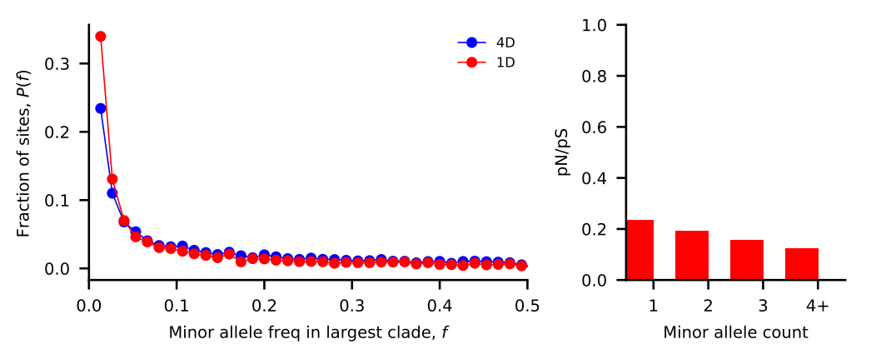
Bacteroides vulgatus
Nu_a: contemporary population relative to ancestral population before first epoch
Nu_b: contemporary population relative to ancestral population before second epoch
T_1: Duration of first epoch (units of 2 * N_a)
T_2: Duration of second epoch (units of 2 * N_a)
Model | Exponential growth | Two-epoch | Bottleneck + growth | Three-epoch
Log Likelihood | -123.582830394 | -115.548611105 | -114.478986615 | -115.763713816
Nu_a | 2.34360421 | 1.46471105 | 0.99063457 | 1.43575234
Nu_b | N/A | N/A | 1.53009861 | 1.43566152
T_12 | 0.05432866 | 0.20111674 | 0.44283702 | 0.28861314
T_23 | N/A | N/A | N/A | 0.01340126

Slide 8
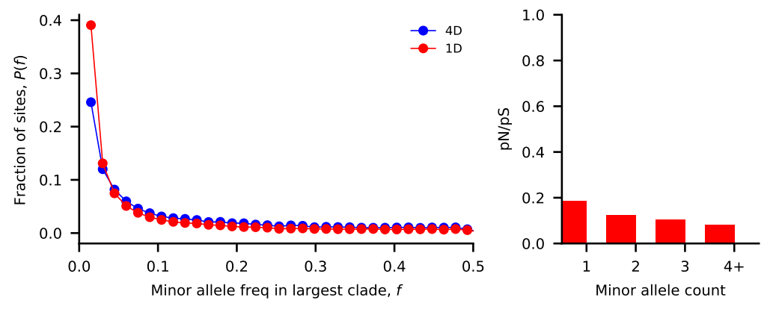
Bacteroides ovatus
Nu_a: contemporary population relative to ancestral population before first epoch
Nu_b: contemporary population relative to ancestral population before second epoch
T_1: Duration of first epoch (units of 2 * N_a)
T_2: Duration of second epoch (units of 2 * N_a)
Model | Exponential growth | Two-epoch | Bottleneck + growth | Three-epoch
Log Likelihood | -119.348788944 | -112.924572671 | -113.082924889 | -113.060715703
Nu_a | 1.43394881 | 1.4790958 | 1.46992089 | 1.33943782
Nu_b | N/A | N/A | 1.42640515 | 1.44808057
T_12 | 0.3079758 | 0.70549535 | 0.61551285 | 0.29004047
T_23 | N/A | N/A | N/A | 0.38515666

Slide 9
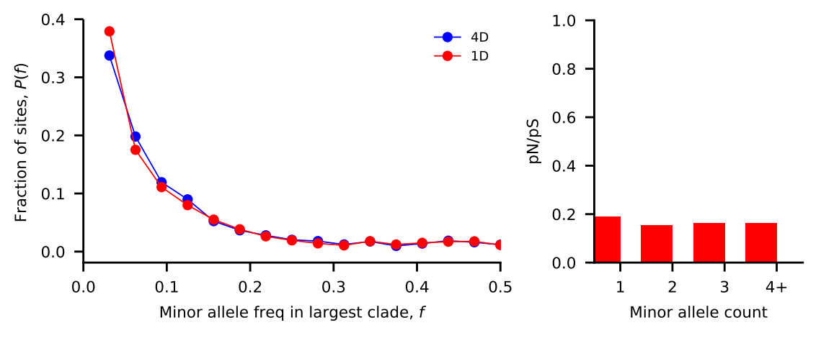
Alistipes putredinis
Nu_a: contemporary population relative to ancestral population before first epoch
Nu_b: contemporary population relative to ancestral population before second epoch
T_1: Duration of first epoch (units of 2 * N_a)
T_2: Duration of second epoch (units of 2 * N_a)
Model | Exponential growth | Two-epoch | Bottleneck + growth | Three-epoch
Log Likelihood | -417.014902652 | -283.836375864 | -1666.69273895 | -1670.63816752
Nu_a | 37.70628513 | 12.85982032 | 2.72608089e-01 | 0.40136306
Nu_b | N/A | N/A | 2.93160455e-01 | 0.749287
T_12 | 27.47992853 | 5.26353859 | 2.67384328e-09 | 0.17426896
T_23 | N/A | N/A | N/A | 0.09401605

Slide 10
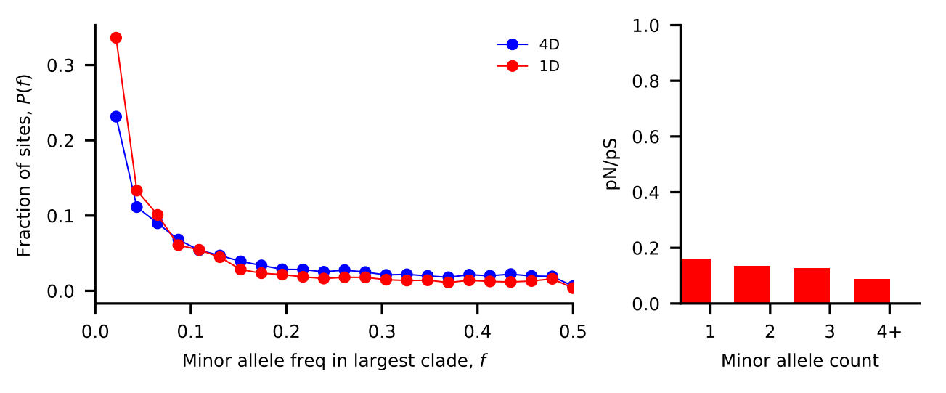
Bacteroides uniformis
Nu_a: contemporary population relative to ancestral population before first epoch
Nu_b: contemporary population relative to ancestral population before second epoch
T_1: Duration of first epoch (units of 2 * N_a)
T_2: Duration of second epoch (units of 2 * N_a)
Model | Exponential growth | Two-epoch | Bottleneck + growth | Three-epoch
Log Likelihood | -399.504374725 | -232.981268472 | -220.698891194 | -232.890550466
Nu_a | 3.72253633e-01 | 1.98374712 | 1.40119388 | 1.42262676
Nu_b | N/A | N/A | 1.81254464 | 1.69965725
T_12 | 5.84878255e-06 | 0.0658422 | 0.49713158 | 0.04668702
T_23 | N/A | N/A | N/A | 0.15294058

Slide 11
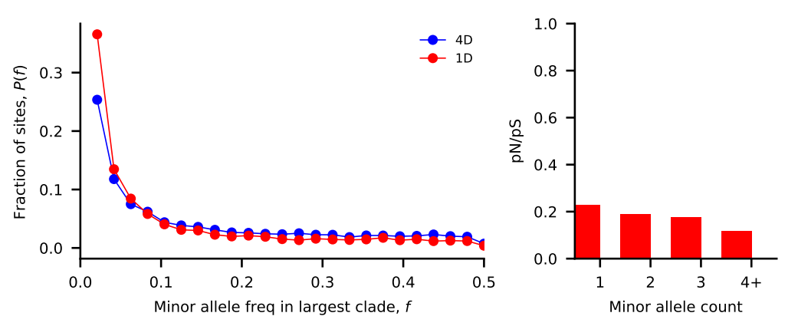
Eubacterium rectale
Nu_a: contemporary population relative to ancestral population before first epoch
Nu_b: contemporary population relative to ancestral population before second epoch
T_1: Duration of first epoch (units of 2 * N_a)
T_2: Duration of second epoch (units of 2 * N_a)
Model | Exponential growth | Two-epoch | Bottleneck + growth | Three-epoch
Log Likelihood | -360.132009673 | -188.144695197 | -189.599130013 | -200.178555584
Nu_a | 1.61936896 | 1.86276421 | 2.0649441 | 0.15087902
Nu_b | N/A | N/A | 1.7472377 | 0.60463415
T_12 | 0.21071071 | 0.98340861 | 0.77825979 | 0.23744711
T_23 | N/A | N/A | N/A | 0.27554825

Slide 12
Chalkboard math / diagrams
Assuming mutation rate is 1e-9 for bacteria in general.
Each species and each model has a different inferred optimal theta
Theta = 4 * N_e * mu
N_e = Theta / (4 * mu) = Theta * 1e9 / 4
B. vulgatus, B. ovatus, A. putredinis, B. uniformis, E. rectale

Slide 13
Bottleneck growth demographic diagram
N_a = 5.47E+11, 3.33E+11,
9.93E+10, 2.96E+11, 9.41E+11
Nu_b = 8.37E+11, 4.75E+11,
2.91E+10, 5.36E+11, 1.64E+12
T_12 = 2.4219E+11, 2.0494E+11, 265.387133,
1.4699E+11, 7.3223E+11
N_e = 5.42E+11, 4.89E+11 , 2.71E+10 , 4.14E+11, 1.94E+12

Slide 14
Exponential growth demographic diagram
N_a = 2.49E+11, 3.81E+11,
1.4E+09, 1.51E+12, 1.56E+12
T_12 = 1.353E+10,
1.1721E+11, 3.8374E+10,
8810428.06, 3.2791E+11
N_e = 5.84E+11, 5.46E+11, 5.27E+10, 5.61E+11, 2.52E+12

Slide 15
Three-epoch demographic diagram
N_a = 3.73E+11, 3.65E+11, 1.09E+12, 3.20E+11, 3.89E+13
T_12 = 2.16E+11, 2.11E+11, 3.78E+11, 2.99E+10, 3.63E+12
N_2 = 5.36E+11, 5.28E+11, 8.13E+11, 5.44E+11, 2.35E+13
T_23 = 1.34E-02, 3.85E-01, 9.40E-02, 1.53E-01, 2.76E-01
N_e = 5.36E+11, 4.88E+11, 4.36E+11, 4.55E+11, 5.87E+12

Slide 16
Two-epoch demographic diagram
N_a = 3.74E+11, 3.22E+11, 2.55E+09, 2.44E+11, 1.00E+12
T_12 = 1.51E+11, 4.54E+11, 2.68E+10, 3.21E+10, 1.97E+12
N_e = 5.48E+11, 4.76E+11, 3.28E+10, 4.84E+11, 1.86E+12

Slide 17
//TODO
Touch up plotting script
E.g., parse input and output so that it can quickly plot different a different species.
Download microbiome data, run Midas

Slide 18
Standing questions
Investigate edge length distribution
Compare commensal bacteria to human demography
Compare commensal bacteria to pathogens

