Slide 1
demo_for_ccgb Weekly Update
20220314
Jon Mah
Garud and Lohmueller Labs

Slide 2
Summary of Update
Before I update the script to include the confidence intervals, I’m ensuring reproducibility for what we have so far
Updated table with one-epoch models, two epoch models with/without singletons

Slide 3
DFE Analysis approach
I have some of the DFE jobs in queue (gamma distributed), and am working on a script to fit other types of DFE’s
90% neutral, 10% deleterious
Discrete gamma distribution, i.e., four bins where sites are assigned to s values at the median of each bin
My understanding is that, as in Cornejo, the idea is fitting a DFE will let us search for evidence of negative selection (e.g., contraction)
I’m chatting with Eduardo soon about updates to our DFE inference methods

Slide 4
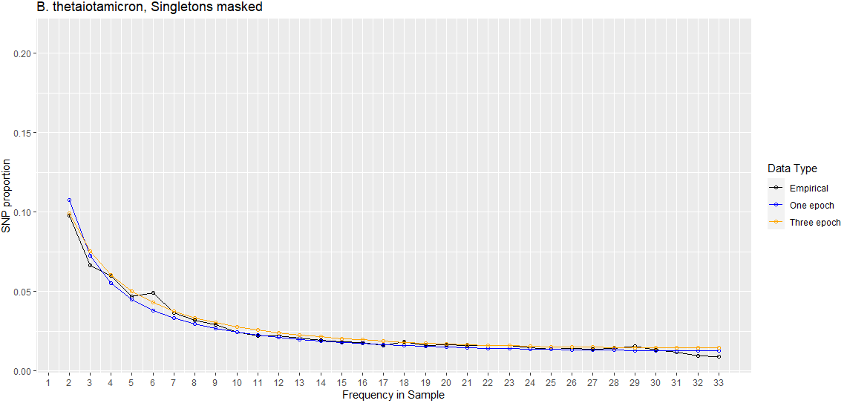
Three Epoch | Masking Singletons
Best Nu | 1.06804355e-01
Best T (in years) | 15225.36953
Three-epoch log likelihood | -294.274998577
One-epoch log likelihood | -360.547850479
Notes:
For paper, focus on evidence for claims, e.g., rigorously test alternative hypothesis
for our story.

Slide 5
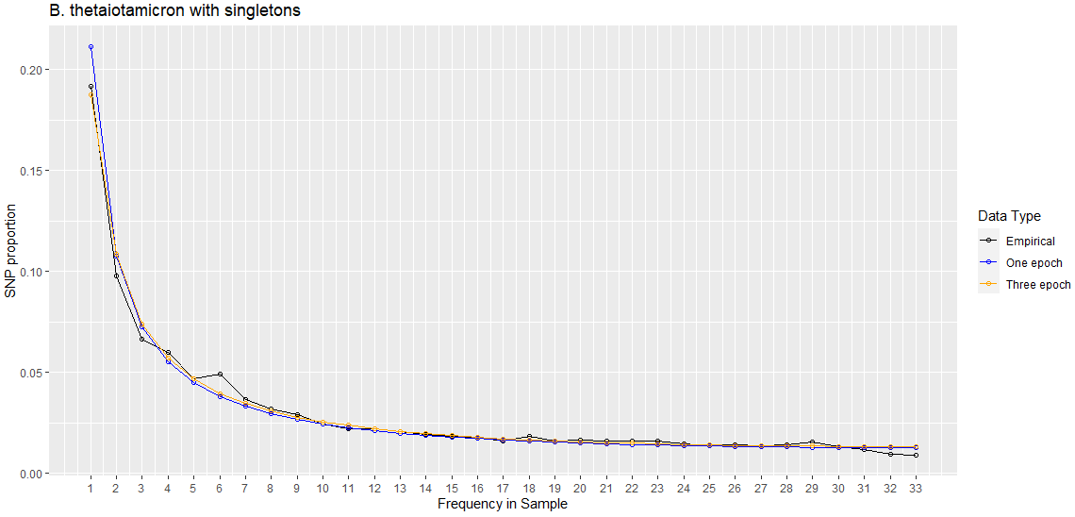
Three Epoch | With Singletons
Best Nu | 7.94514730e-03
Best T (in years) | 8949490.755
Three-epoch log likelihood | -348.566328737
One-epoch log likelihood | -432.953887663

Slide 6
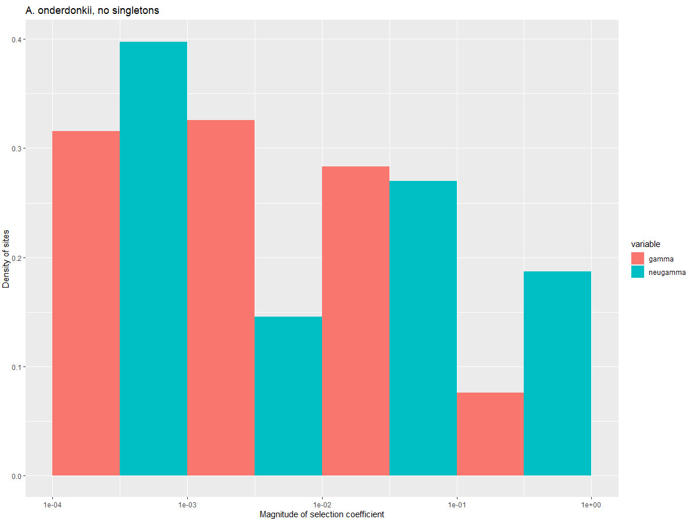
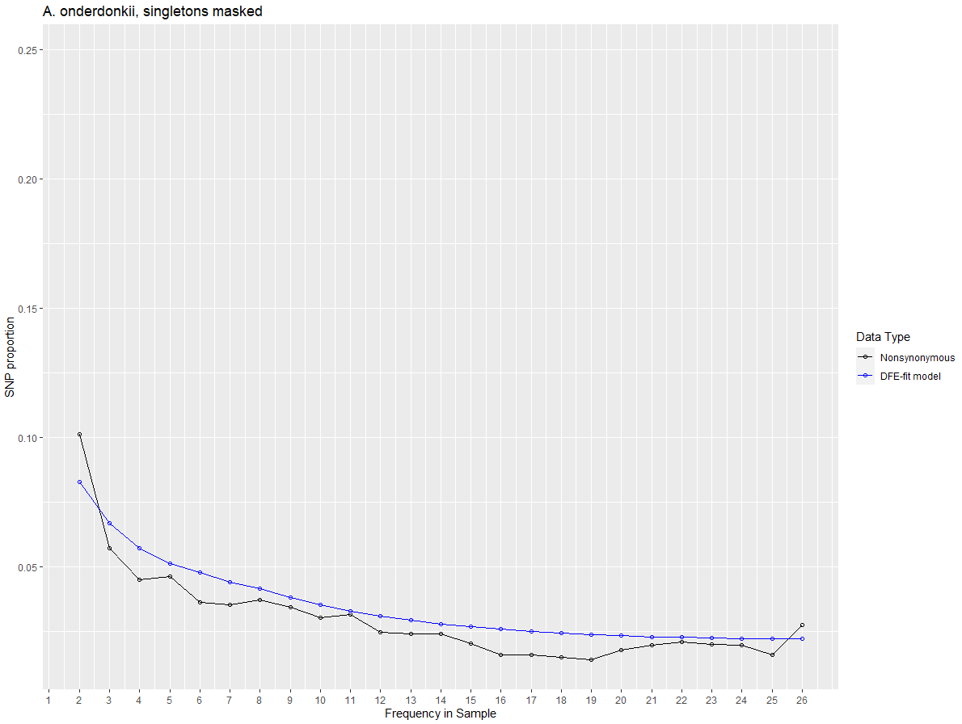

Slide 7
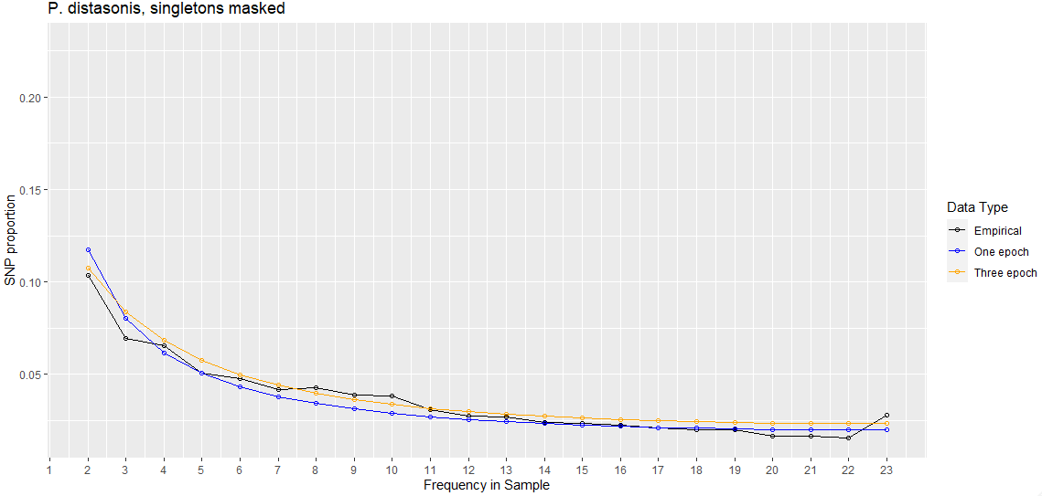
Three Epoch | Masking Singletons
Best Nu | 0.00352228
Best T (in years) | 13485.86161
Three-epoch log likelihood | -318.036213868
One-epoch log likelihood | -421.232898312

Slide 8
Three Epoch | With Singletons
Best Nu | 7.94514730e-03
Best T (in years) | 8949490.755
Three-epoch log likelihood | -348.566328737
One-epoch log likelihood | -432.953887663

Slide 9
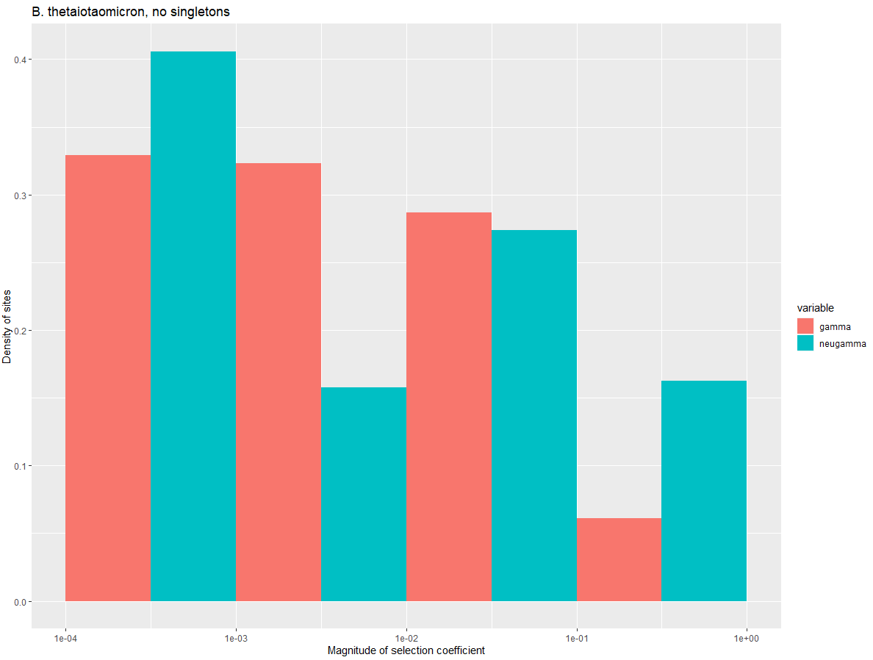
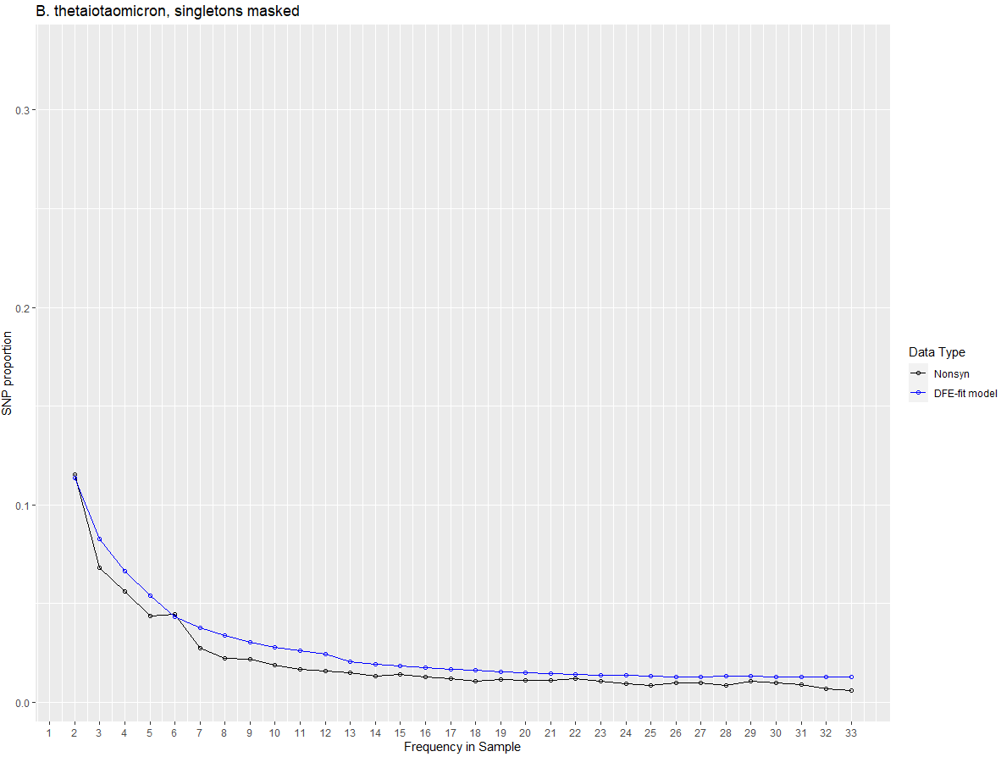

Slide 10
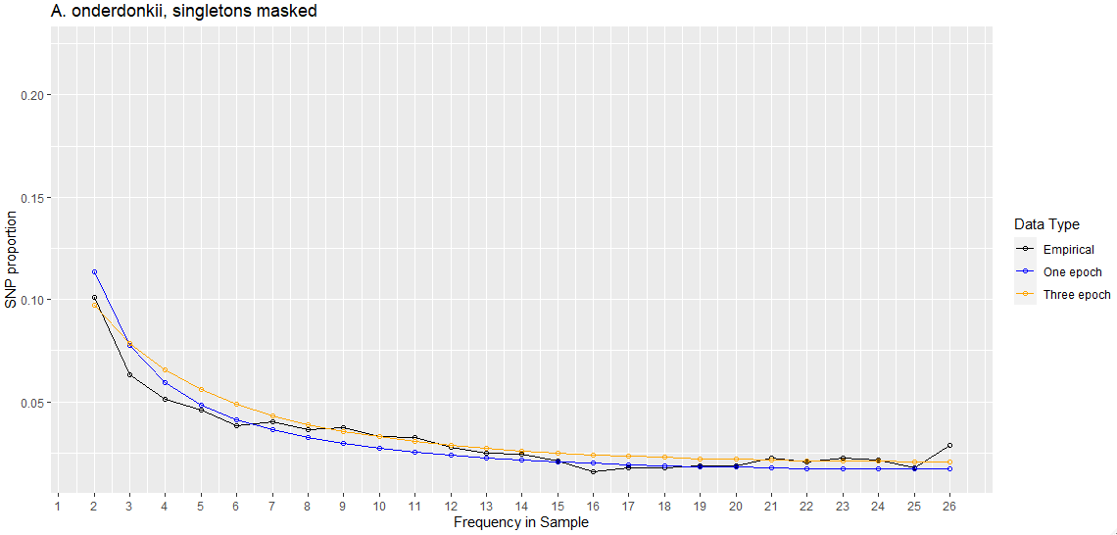
Three Epoch | Masking Singletons
Best Nu | 0.00684189
Best T (in years) | 13446.23105
Three-epoch log likelihood | -306.804782802
One-epoch log likelihood | -409.666652485
Supplement / writing:
What happens when we include singletons
Take observations and put them into prose
With testing

Slide 11
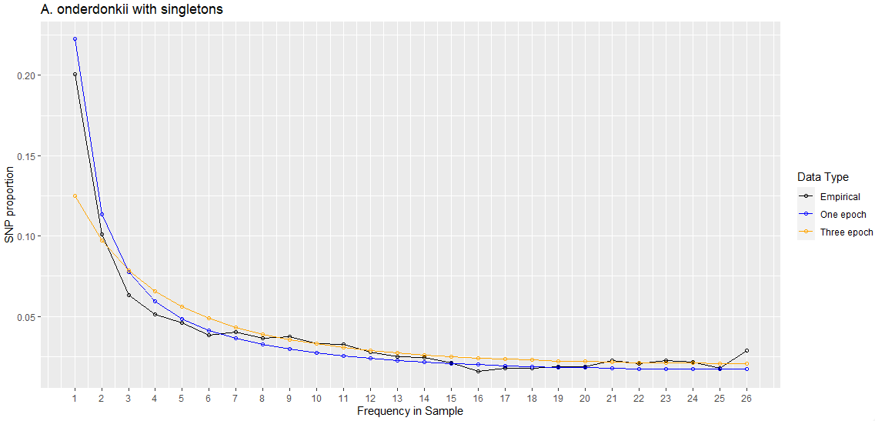
Three Epoch | With Singletons
Best Nu | 0.01698749
Best T (in years) | 9944895.084
Three-epoch log likelihood | -400.467168718
One-epoch log likelihood | -453.284486831

Slide 12
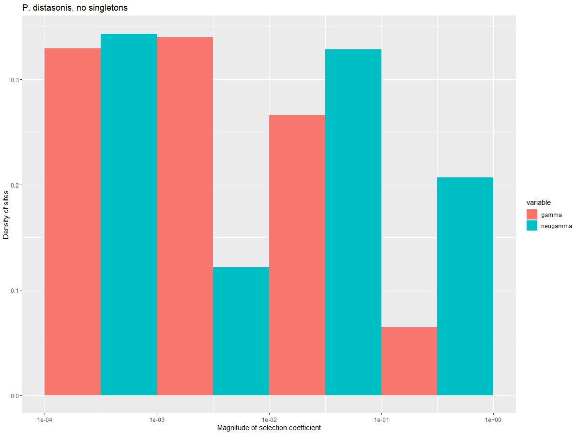
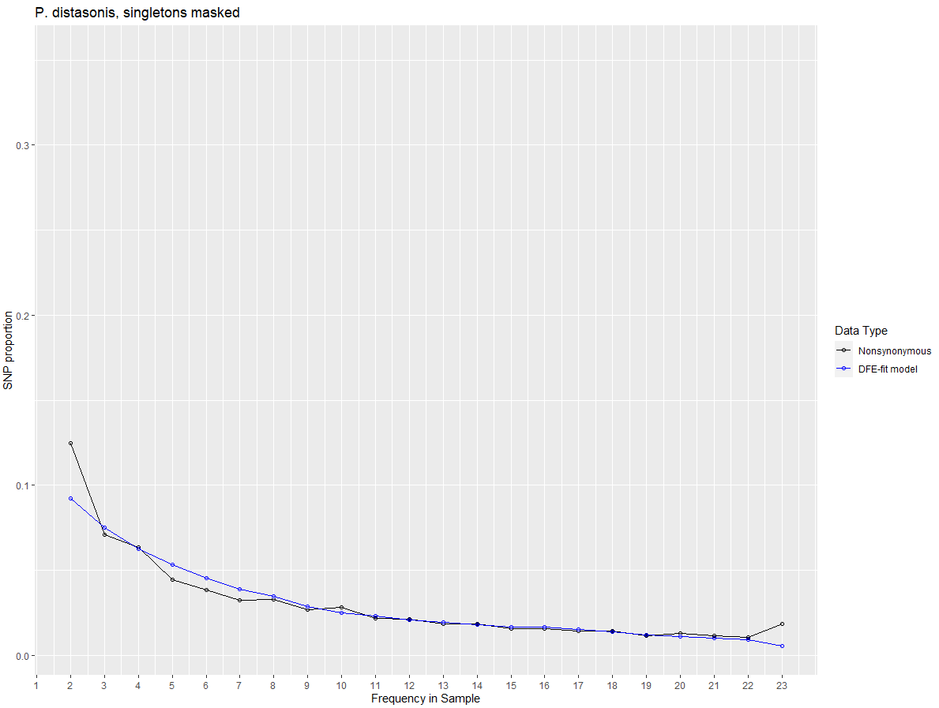

Slide 13
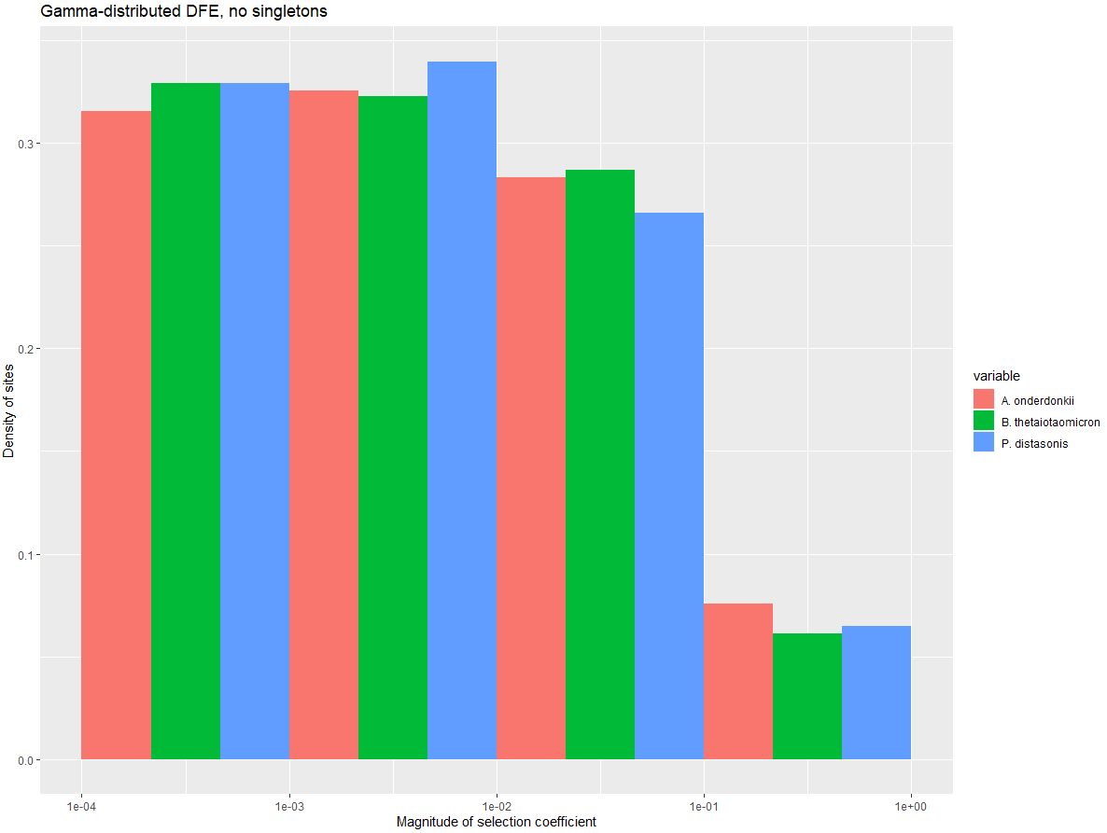

Slide 14
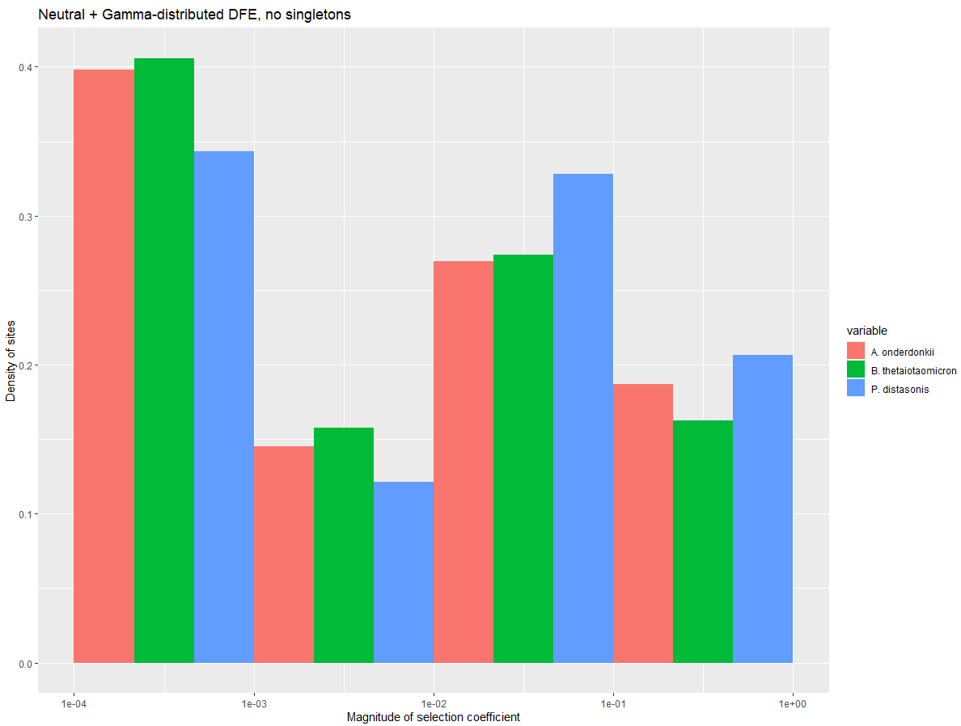

Slide 15
Thoughts
More complex models don’t seem to fit especially better in terms of likelihood or SFS than two-epoch models (but still fit better than one-epoch models)
Inferences still consistently suggest an expansion on a time-scale coincident with 10,000-20,000 years ago

Slide 16
//TODO
Look into confidence intervals
Poisson sample SFS
Dadi.Spectrum_mod.sample(self)
Bootstrap VCF
1000 SFS’s, run MLE inference on each SFS, 5% and 95% of param space is our CI
By end of quarter:
Try and finish fecal analysis
Try and finish MIDAS stuff
Look at sparsing SFS
Instead of doing all the populations and models, just take a closer look at two
Search space really well

