Slide 1
demo_for_ccgb Weekly Update
20220314
Jon Mah
Garud and Lohmueller Labs

Slide 2
Summary of Update
Before I update the script to include the confidence intervals, I’m ensuring reproducibility for what we have so far
Updated table with one-epoch models, two epoch models with/without singletons
I’m chatting with Eduardo on the DFE stuff later today
DFE inferences for 9 species that I’ve been focusing on (the species which have demonstrated improvement in likelihood over one-epoch models)

Slide 3
DFE workflow
Infer best demographic model to synonymous SFS
Fit DFE to best demographic model using gamma-distributed DFE assumption (or neugamma-distributed DFE assumptions) to nonysynonymous SFS
Distribution is given by shape and scale parameters
Partition all sites into four discrete categories based on selective coefficient
S values are assumed negative
Left hand side of distribution corresponds to less deleterious, while righthand side corresponds to more deleterious

Slide 4
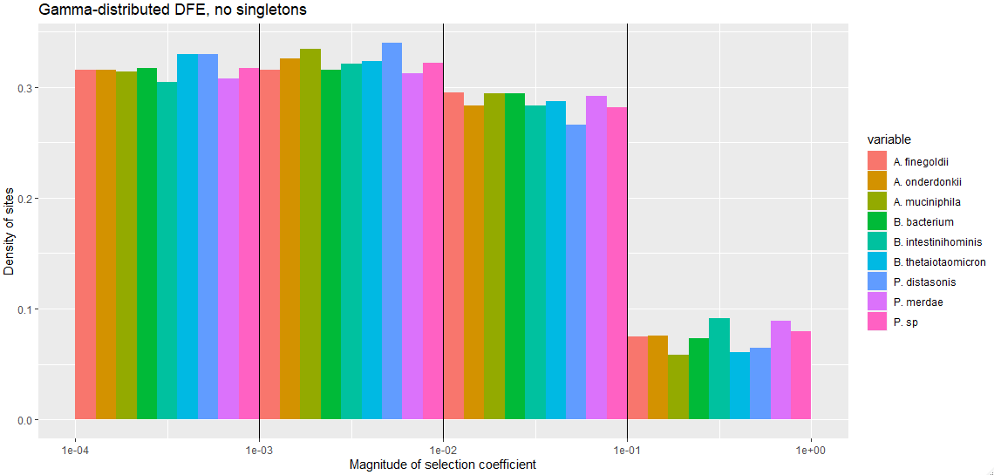
Gamma-distributed DFE
*

Slide 5
Thoughts
DFE’s look fairly similar across species based on highest likelihood demographic model as basis
This is a good sanity check as I wouldn’t expect bacteria to have wildly different DFE’s from each other
Some variance in the inference is expected even if the underlying conditions are identical – it’s very hard to definitively say if two DFE’s are significantly different unless it’s visually obvious.

Slide 6
//TODO
Look into confidence intervals
Poisson sample SFS
Dadi.Spectrum_mod.sample(self)
Bootstrap VCF
1000 SFS’s, run MLE inference on each SFS, 5% and 95% of param space is our CI
By end of quarter:
Try and finish fecal analysis
Try and finish MIDAS stuff
Look at sparsing SFS

