Slide 1
demo_for_ccgb Weekly Update
20220314
Jon Mah
Garud and Lohmueller Labs

Slide 2
Summary of Update
One-epoch and two-epoch inferences filled in
Prevalence for each species
SIB draft

Slide 3
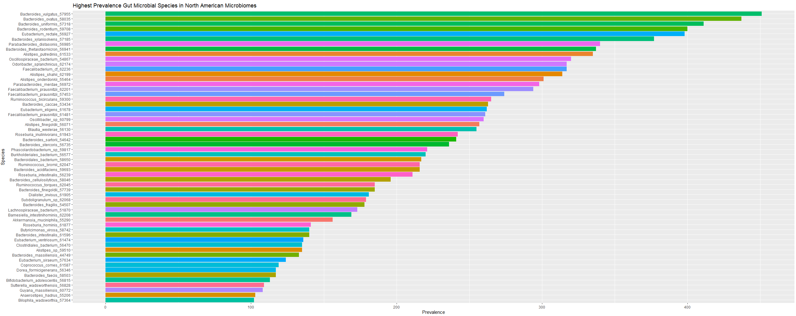
Species >= 100 prevalence in NA Gut Microbiome

Slide 4
//TODO
Take one of test files
Delete old files
Rerun species
Species
Check if species are reverse order by coverage
Run snps on weird

