Slide 1
demo_for_ccgb Weekly Update
20220411
Jon Mah
Garud and Lohmueller Labs

Slide 2
Summary of Update
Gamma-distributed DFE for 9 species in which we have a statistically significant difference between the one-epoch model and more complex models
Comparison for DFE vs. nonsynonymous and also including demography vs. synonymous

Slide 3
DFE workflow
Infer best demographic model to synonymous SFS
Fit DFE to best demographic model using gamma-distributed DFE assumption (or neugamma-distributed DFE assumptions) to nonysynonymous SFS
Distribution is given by shape and scale parameters
Partition all sites into four discrete categories based on selective coefficient
S values are assumed negative
Left hand side of distribution corresponds to less deleterious, while righthand side corresponds to more deleterious

Slide 4
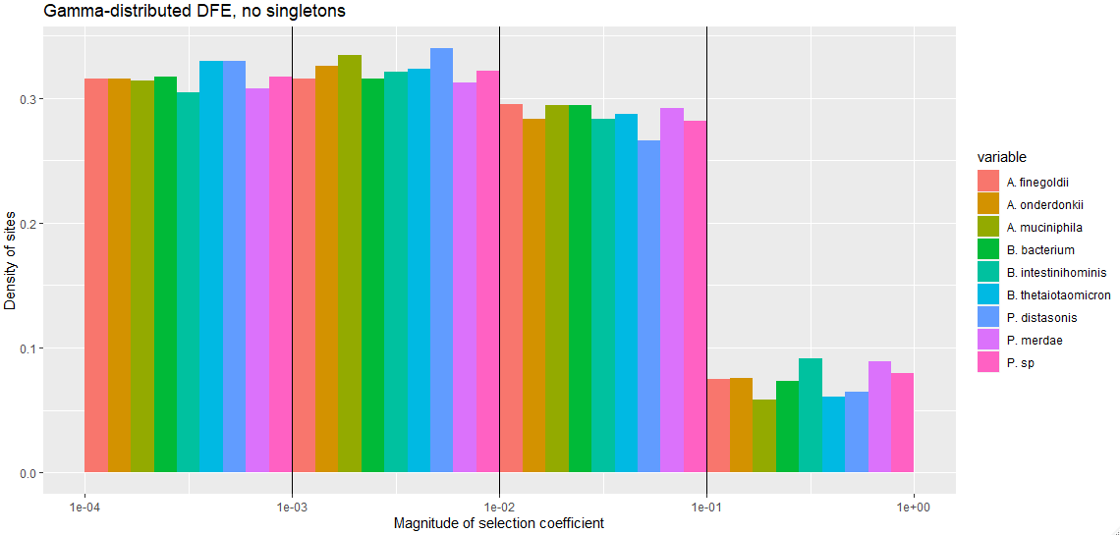
Gamma-distributed DFE
*

Slide 5
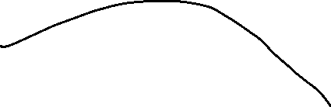
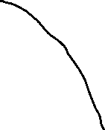



Slide 6
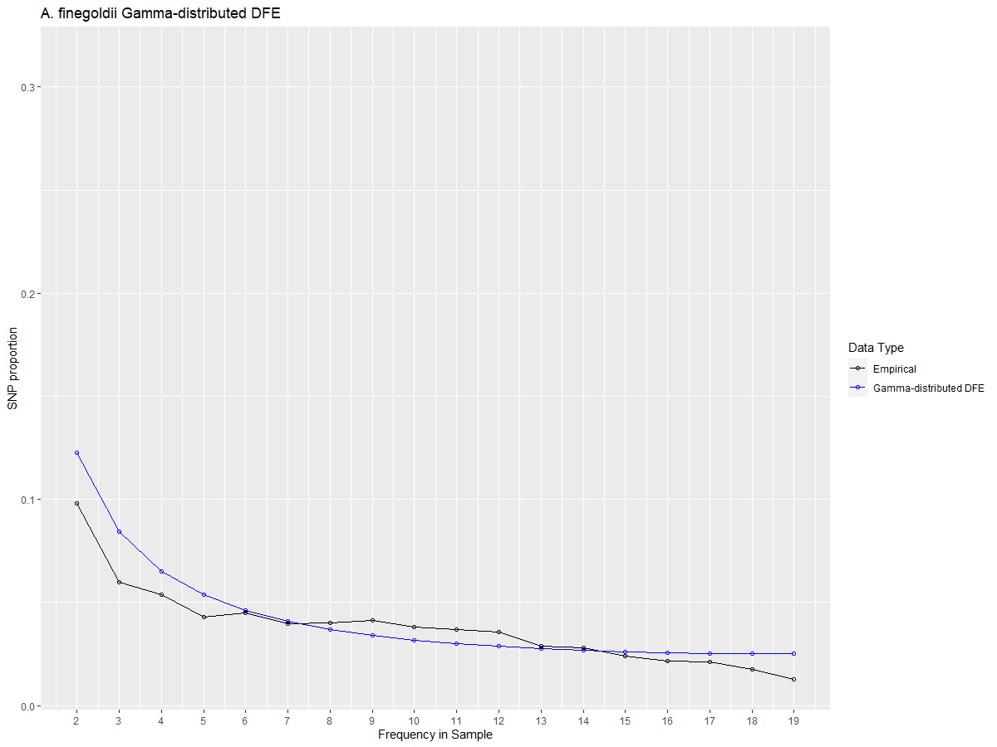
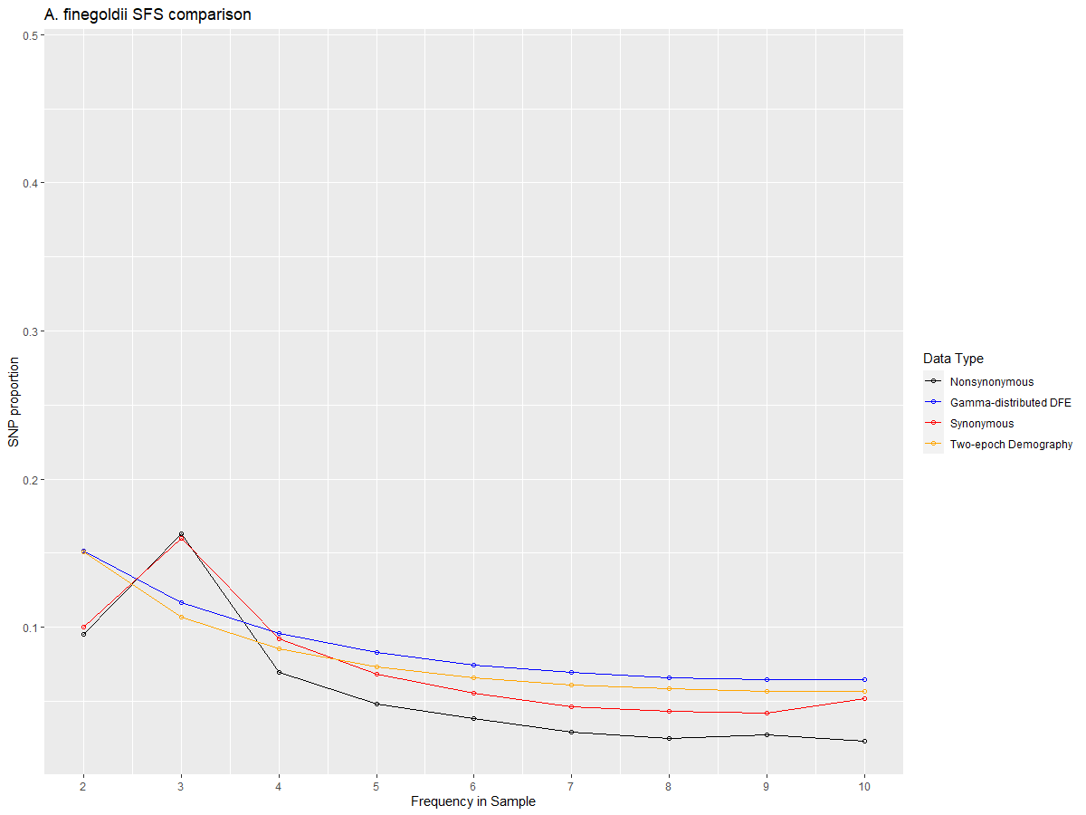
A. finegoldii

Slide 7
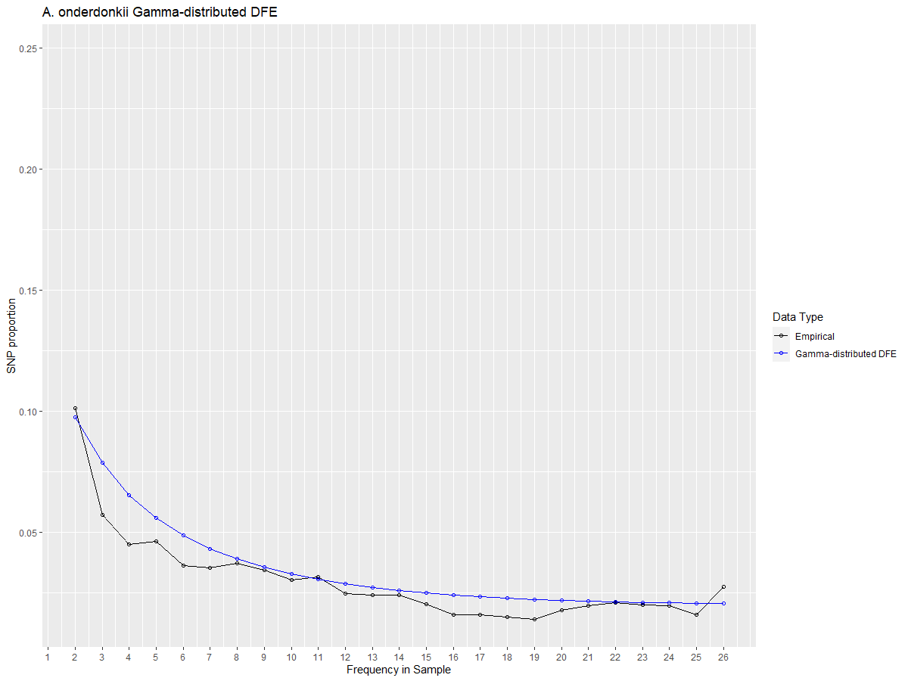
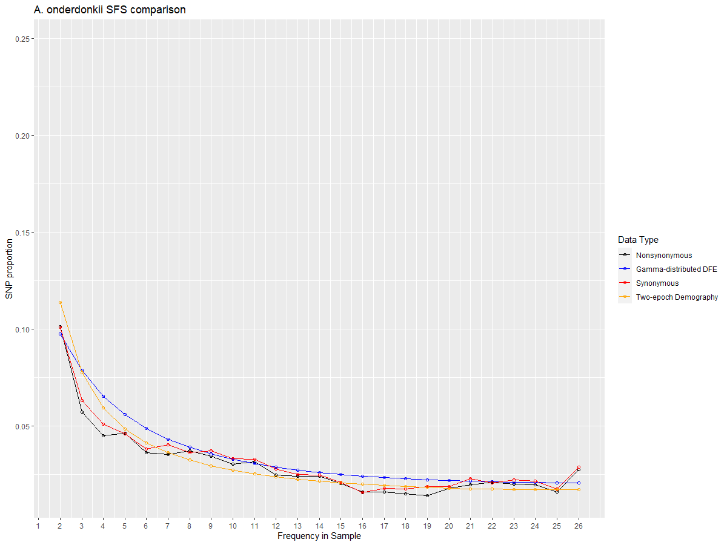
A. onderdonkii

Slide 8
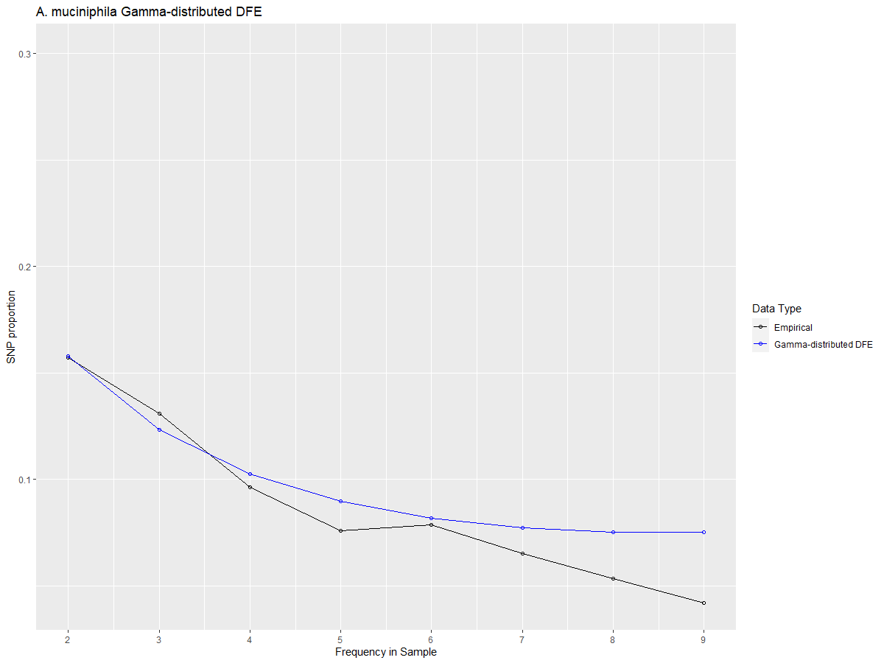
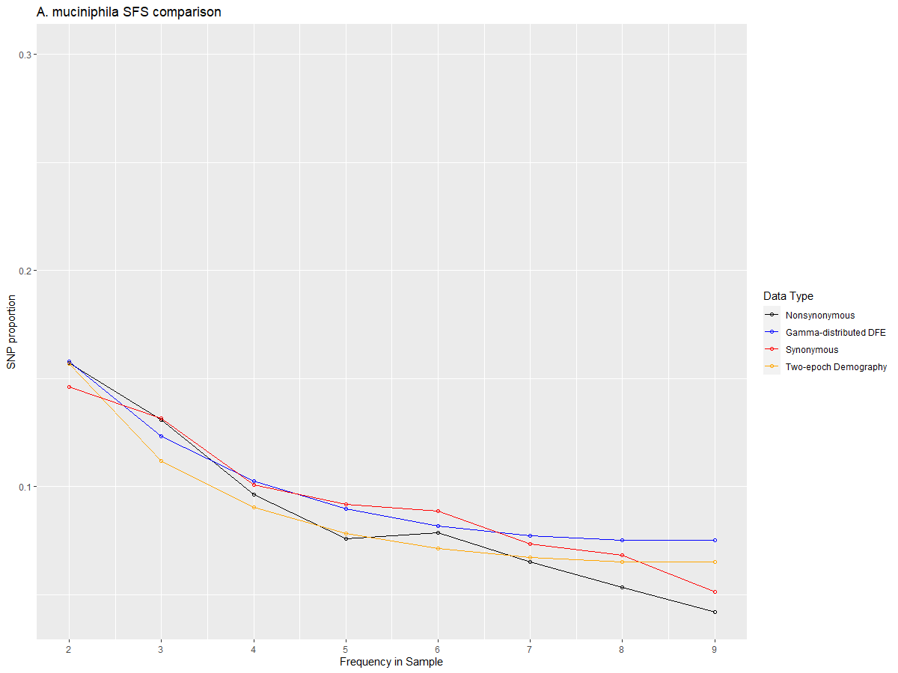
A. muciniphila

Slide 9
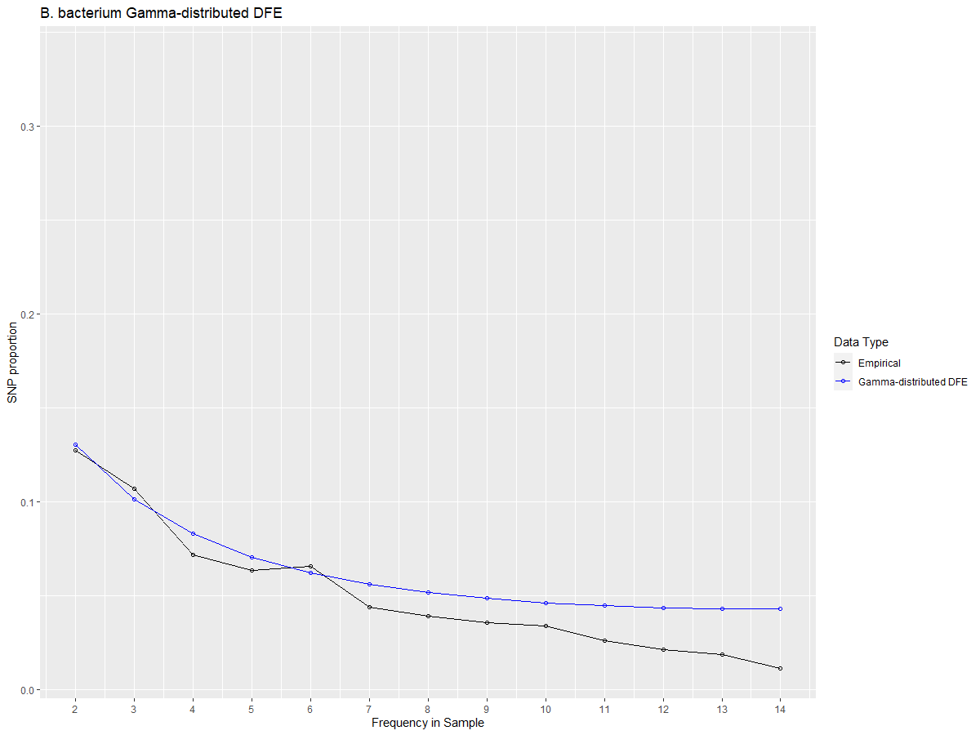
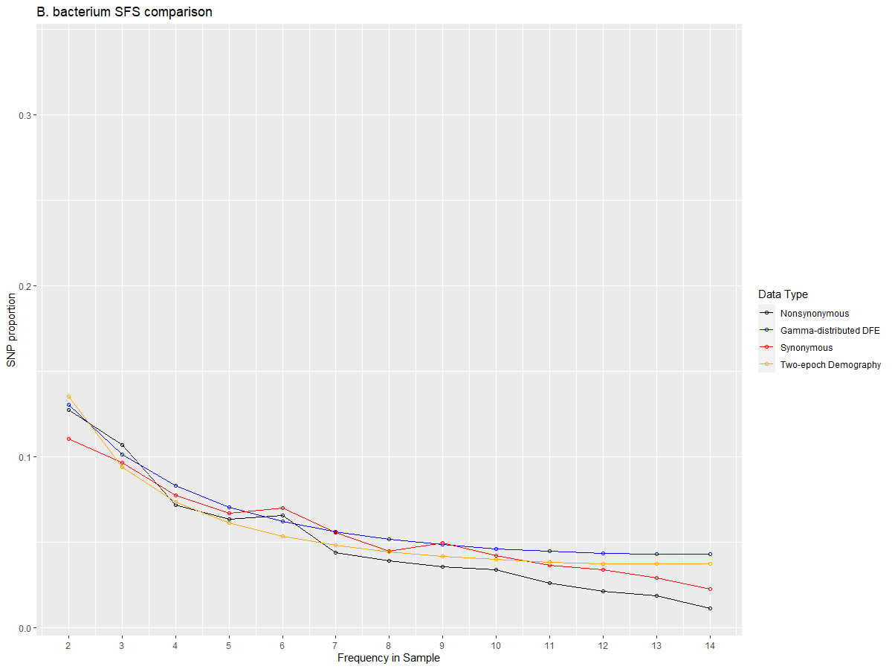
B. bacterium

Slide 10
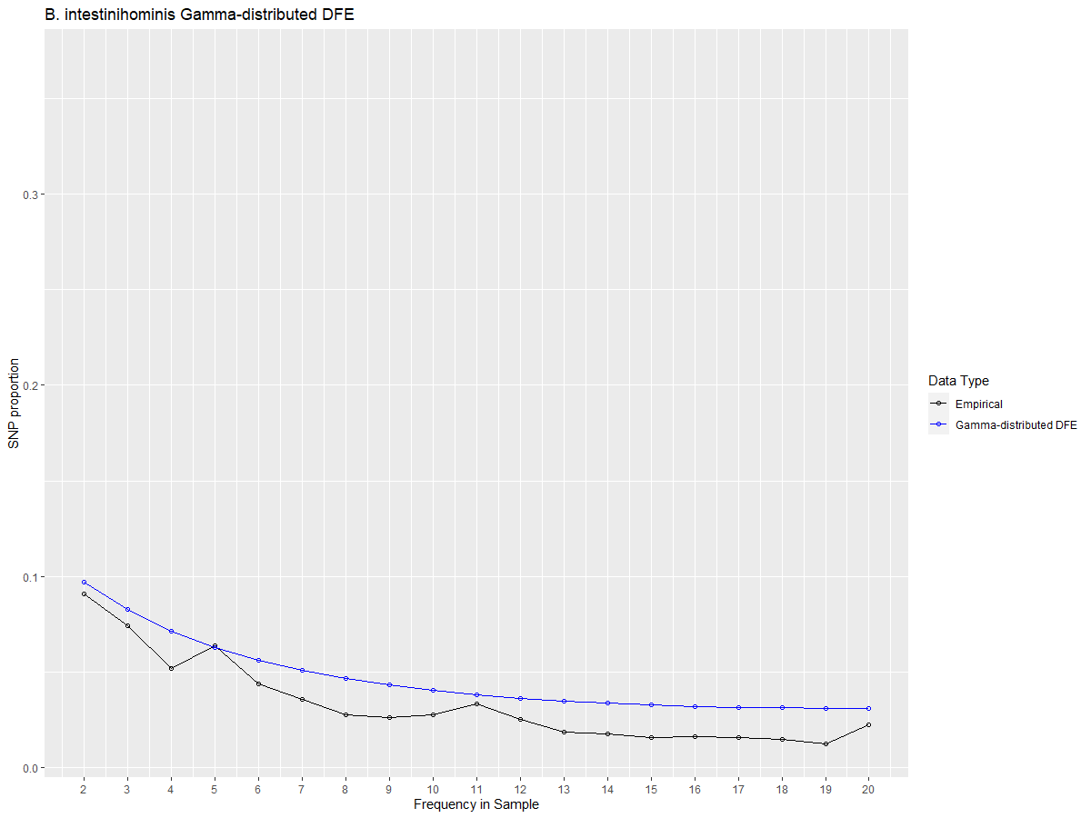
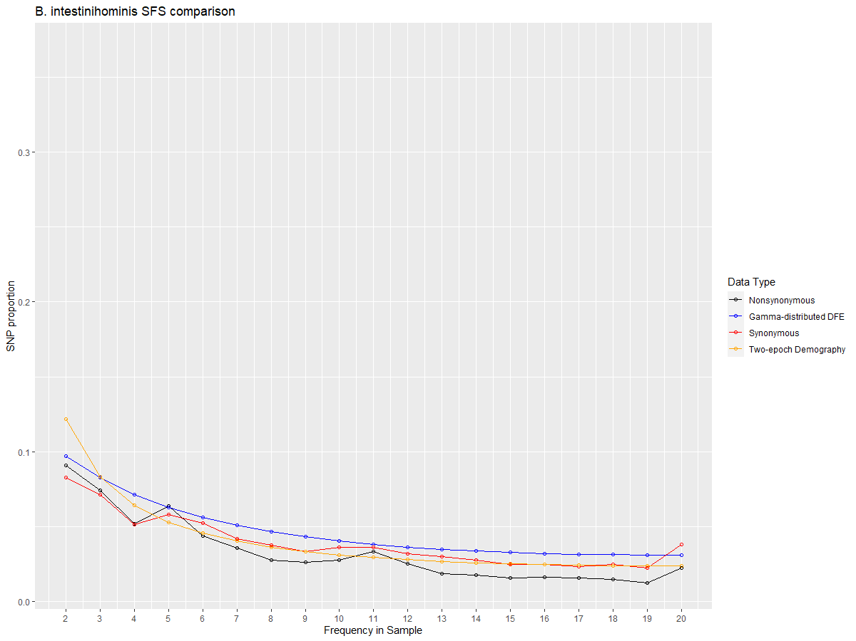
B. intestinihominis

Slide 11
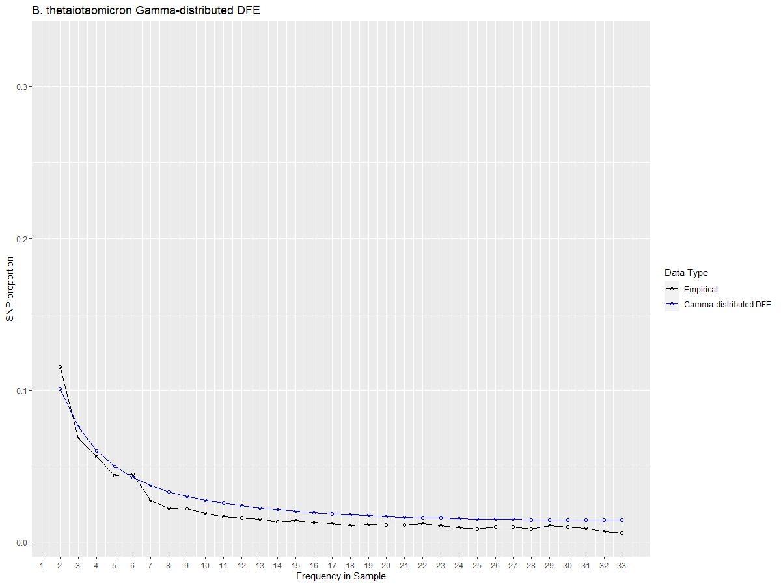
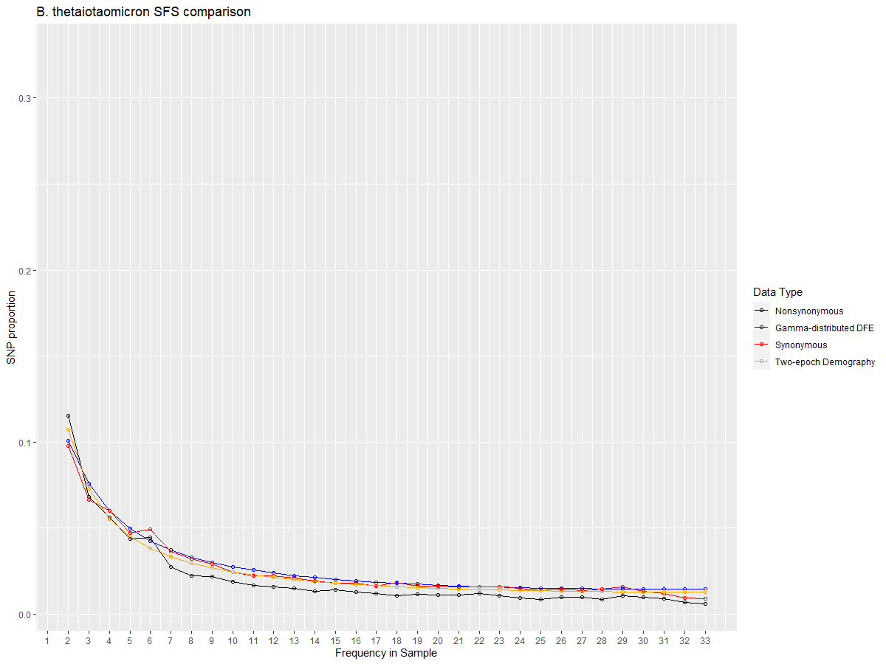
B. thetaiotaomicron

Slide 12

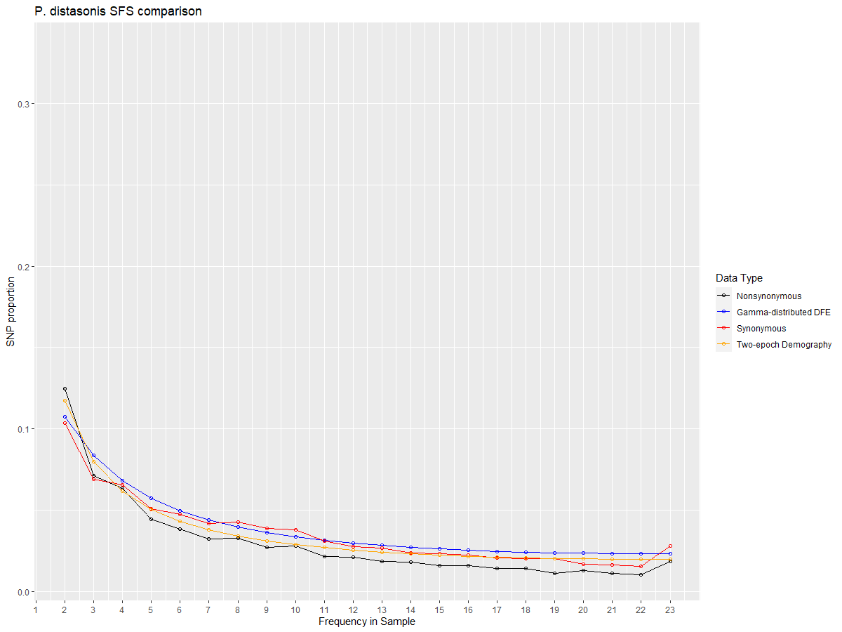
P. distasonis

Slide 13

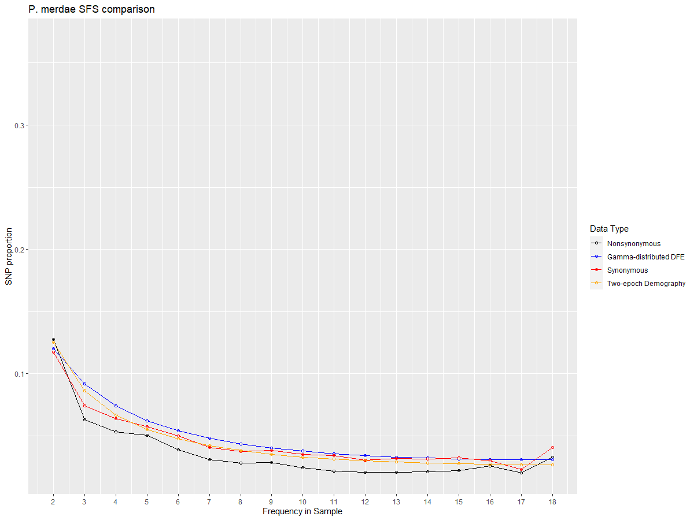
P. merdae

Slide 14
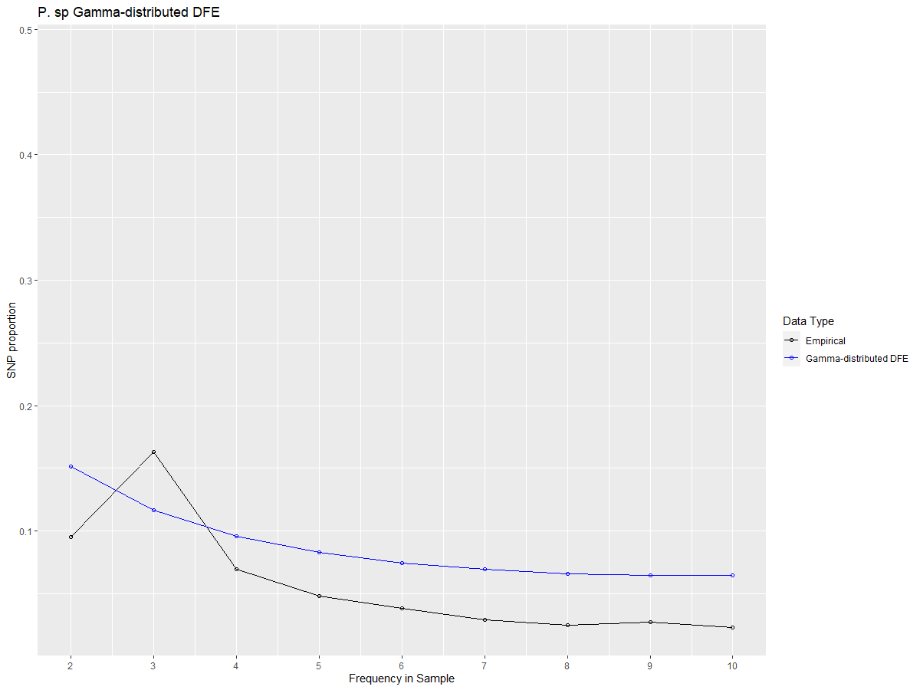
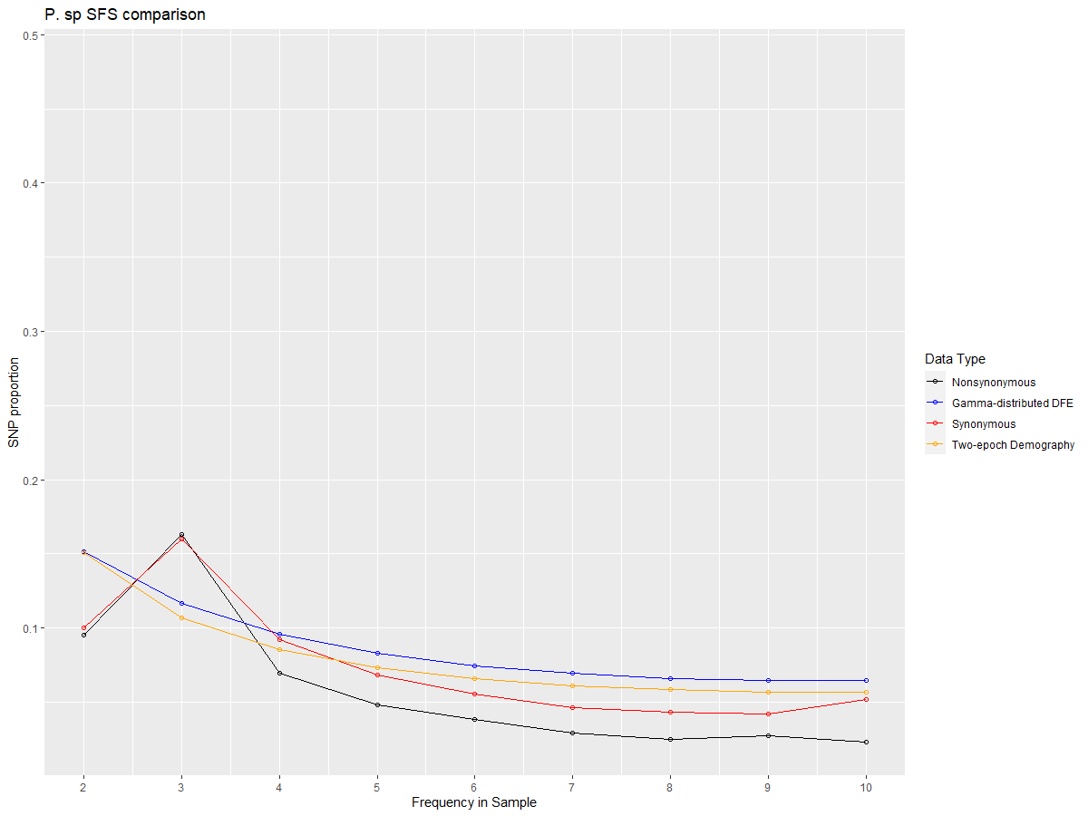
P. sp

Slide 15
Thoughts
Synonymous and Nonsynomous sfs’s differ
Model sfs’s (either for demography or for DFE) differ less (as best I can tell)
Synonymous to Demography has better fit than Nonsynonymous to DFE
There might be a systematic weakness in our inference and fitting – I am not sure why.
DFE inferences in general are pretty close to each other in microbiome

Slide 16
//TODO
species prevalence figure
data export script
writing
midas merge

