Slide 1
demo_for_ccgb Weekly Update
20220214
Jon Mah
Garud and Lohmueller Labs

Slide 2
Summary of Update
Testing different N cases for MIDAS species step
One N (one line)
20% N (one line)
50% N (one line)
90% N (one line)
100% N (one line)
All entries are N (five lines)
100,000 lines from file with many 100% N lines
100,000 lines from file that works
Ultimately, all work, but there are different time and memory requirements.

Slide 3
First class of cases
One N (one line)
20% N (one line)
50% N (one line)
90% N (one line)
100% N (one line)
All work, when one line (out of five) has the specified number of N entries

Slide 4
Second class of cases
All entries are N
Does work (I was mistaken when I thought it didn’t), it just takes longer.

Slide 5
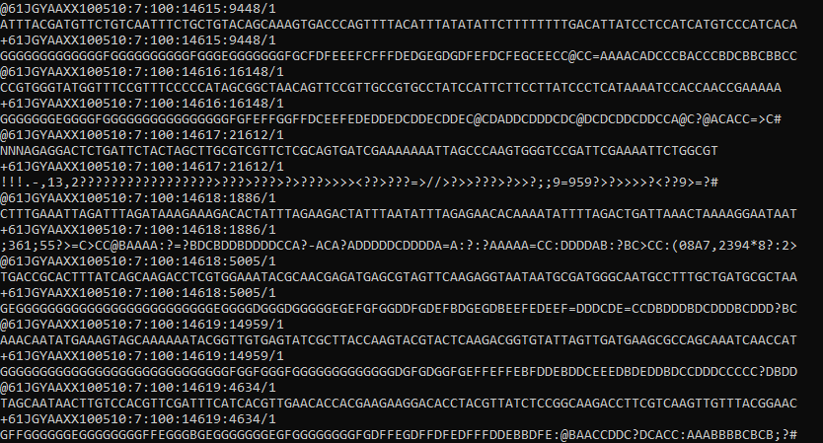

100,000 lines from file that works
Notably, there are a few
lines with N entries, but
in the working files, there
are few to no lines entirely
comprised of N’s.
Time to run: 24.357 seconds
Memory usage: maxvmem of 4.907G

Slide 6
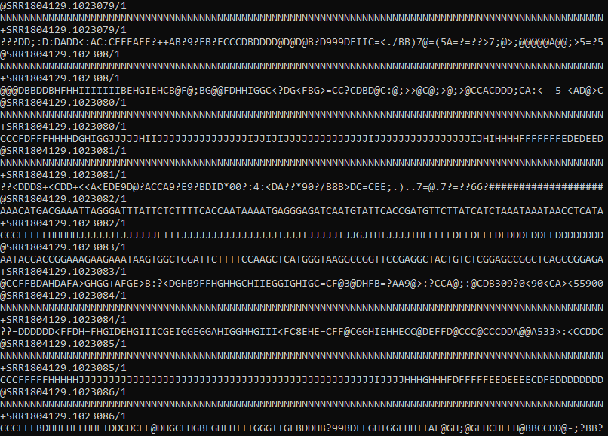
100,000 lines from file with many N’s
Anecdotally (I checked about 20
files) many of the files for which
the species step is taking so long
have many 100% N lines, typically
somewhere in the middle of the file,
so they aren’t immediately caught
by checking the head or tail in most
cases.
Time to run: 191.550 seconds
Memory usage: maxvmem of 3.412G

Slide 7
Quick benchmarking
Working runtime (sec) | Working Vmem (Gb) | “Failing” runtime (sec) | “Failing” Vmem (Gb)
32.298 | 2.160 | 84.428 | 4.260
36.348 | 1.971 | 129.368 | 4.816
27.506 | 3.624 | 139.318 | 2.977
30.217 | 2.347 | 67.382 | 3.612
28.034 | 4.543 | 89.129 | 2.437
41.347 | 3.127 | 114.932 | 4.216
22.320 | 2.569 | 97.310 | 4.172
28.754 | 3.302 | 102.328 | 3.912
38.217 | 4.457 | 139.214 | 3.217
There doesn’t seem to be a trend in memory usage, but there’s a pretty notable increase in runtime.

Slide 8
Thoughts
The files which are “failing” the species step are able to complete, it just takes significantly longer.
I suspect the memory issues encountered are just a side effect of the greatly increased run time.

Slide 9
//TODO
Look into confidence intervals
Poisson sample SFS
Dadi.Spectrum_mod.sample(self)
Bootstrap VCF
1000 SFS’s, run MLE inference on each SFS, 5% and 95% of param space is our CI
By end of quarter:
Try and finish fecal analysis
Try and finish MIDAS stuff
Look at sparsing SFS
Instead of doing all the populations and models, just take a closer look at two
Search space really well

