Slide 1
demo_for_ccgb Weekly Update
20220202
Jon Mah
Garud and Lohmueller Labs

Slide 2
Summary of Update (part 2)
Log likelihoods for one-epoch vs. multi-epoch inferences.
As a side note, I took the best inference from across 4 models, so the more complex models are not limited to just two-epoch inferences.

Slide 3
Overall thoughts on status of project
I’m somewhat disappointed that many of these inferences essentially suggest that there is not strong evidence of such a contraction, but this was for sure a good thing to check
It still holds that for some species we find a population contraction, and I think that reporting demographic models of ~30 species (of which some demonstrate interesting demographic trends) is still cool.
I think that maybe looking a little more closely into why only some species have demographic contractions is also potentially exciting (e.g., is it due to certain selective pressures on specific mutations or microbial functions?)

Slide 4
Log Likelihood Results
Species | A. finegoldii | A. muciniphila | A. onderdonkii | A. putredinis | A. shahii
Multiple Epochs | -278.496899764 | -108.804915489 | -309.462783761 | -1377.6483033 | -216.820717424
One Epoch (SNM) | -479.21577207 | -154.628390672 | -409.666652485 | -1377.64826898 | -216.820715173
Species | B. bacterium | B. caccae | B. cellulolyticus | B. fragilis | B. intestinihominis
Multiple Epochs | -181.902408471 | -97.7997475199 | -1167.48967523 | -311.019501502 | -268.082419973
One Epoch (SNM) | -224.025922804 | -98.8749495265 | -1167.48954551 | -311.019473484 | -701.532028657

Slide 5
Log Likelihood Results
Species | B. massiliensis | B. ovatus | B. stercoris | B. thetaiotamicron | B. uniformis
Multiple Epochs | -20.3617434171 | -181.635396867 | -508.742298381 | -292.268240631 | -253.217173904
One Epoch (SNM) | -20.3617427569 | -181.635395821 | -508.742293081 | -360.547850479 | -253.217142467
Species | B. vulgatus | B. xylanisolvens | D. invisus | E. eligens | E. rectale
Multiple Epochs | -142.247487889 | -166.0628826 | -140.340722705 | -226.737990541 | -621.965867927
One Epoch (SNM) | -142.247482051 | -166.062883792 | -140.340721113 | -226.737989406 | -621.965862866

Slide 6
Log Likelihood Results
Species | F. prausnitzii | O. sp | P. copri | P. distasonis | P. merdae
Multiple Epochs | -867.452254515 | -1370.77198462 | -302.787657196 | -320.731290313 | -145.417035346
One Epoch (SNM) | -867.452252566 | -1370.77198195 | -302.787655984 | -421.232898312 | -179.740046365
Species | P. sp | R. bromii
Multiple Epochs | -430.474558031 | -569.361933978
One Epoch (SNM) | -446.321619655 | -569.361932584

Slide 7
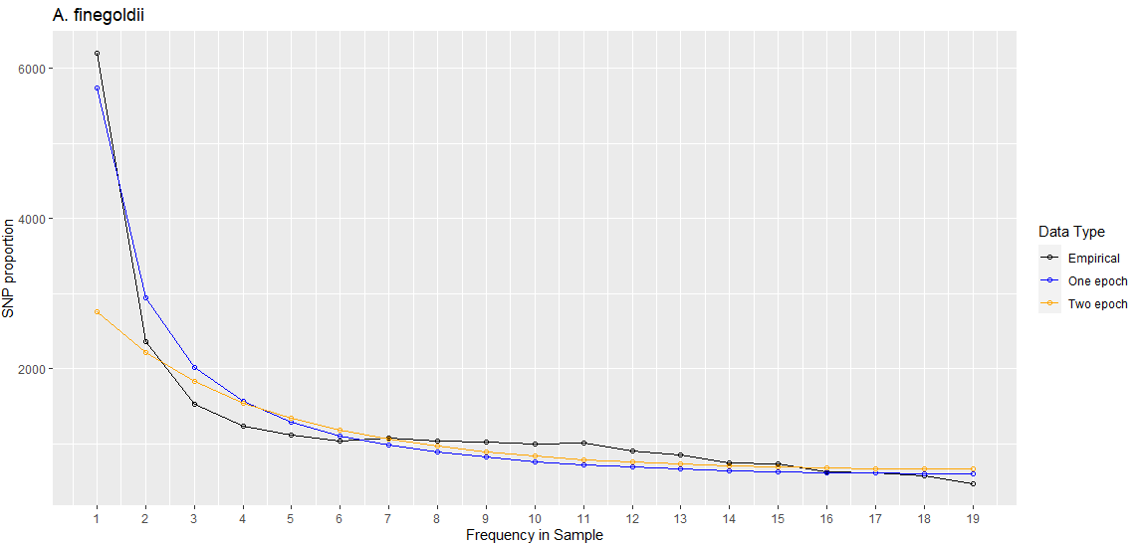
A. finegoldii

Slide 8
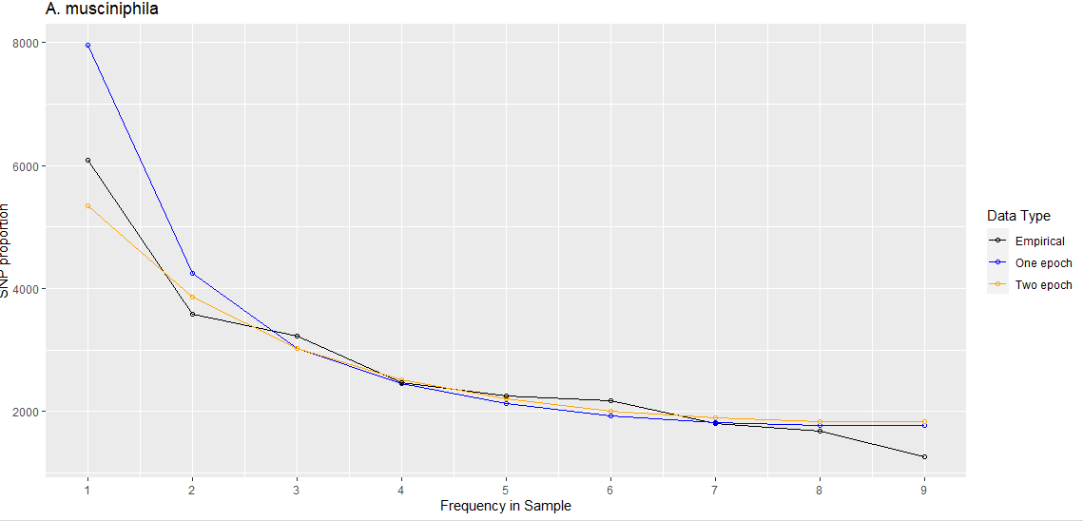
A. muciniphila

Slide 9
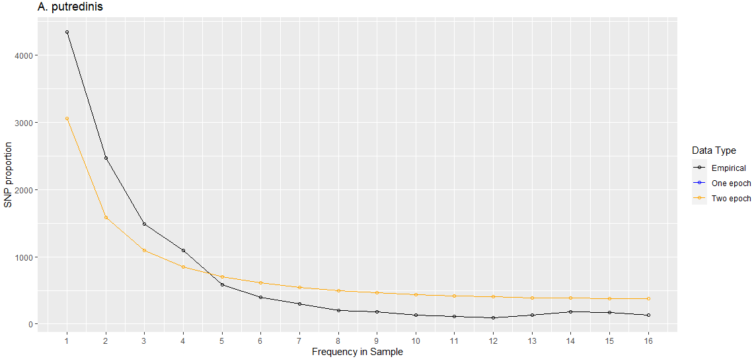
A. putredinis (sfs and likelihood are the same)

