Slide 1
demo_for_ccgb Weekly Update
20220203
Jon Mah
Garud and Lohmueller Labs

Slide 2
Summary of Update
Input multiple initial params, allowing for contraction or expansion inference
Only ran two-epoch model
Much looser restraints, more varied initial guesses
Inferred contraction is much more dramatic

Slide 3
Methodology
Param search space for [Nu, T] limited to [0, 8] for Nu and [0, 0.0015] for T
Initial guesses for Nu are: [0.1, 0.2, 0.3, 0.4, 0.5, 0.6, 0.7, 0.8, 0.9 1.0, 1.25, 1.5, 1.75, 2.0, 2.25, 2.5, 2.75, 3.0, 3.33, 3.66, 4.0, 5.0, 6.0, 7.0, 8.0], so we’re actually searching the entire param space for contraction vs. expansion.

Slide 4
Methodology
The first initial guess is set-up to be perturbed randomly by a factor, so the actual initial guess for an input of Nu=7 might be Nu=6.89400657e+00
Previously, all initial guesses were a random perturbation of a given initial guess (so we start with 25 different initial guesses, but they are normally distributed around a mean, essentially)
After initial guess is given, 25 gradient descent steps are taken to find MLE, which is then output.

Slide 5
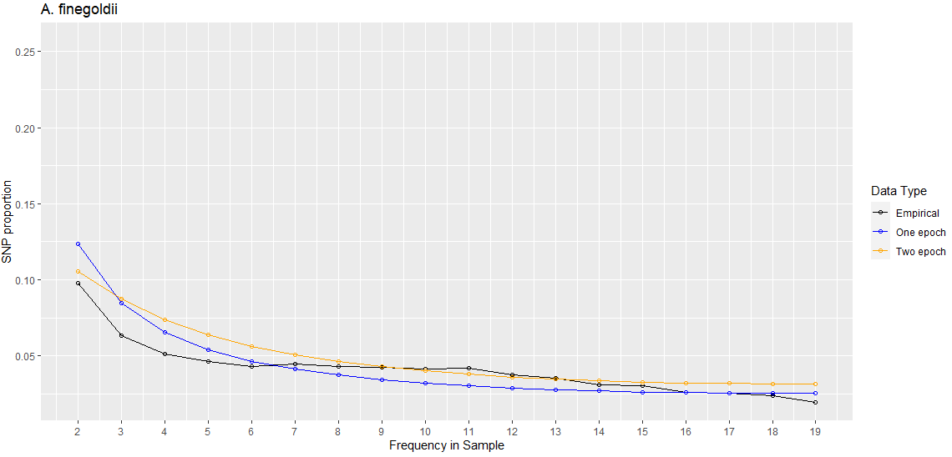
Species | A. finegoldii [shown] | No masking
Best Nu | 0.00233553
Best Starting params | [7.15395598e-02, 8.46888606e-06]
Two-epoch log likelihood | -258.020487646 | -491.701645262
One-epoch log likelihood | -479.21577207 | -498.896273053

Slide 6
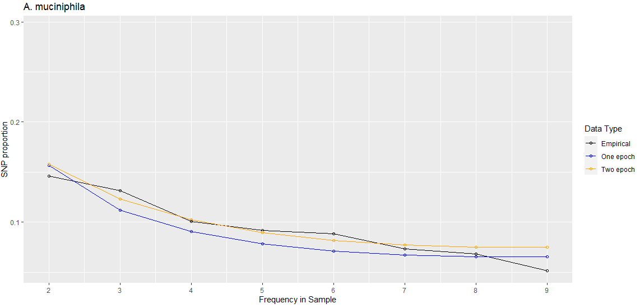
Species | A. muciniphila [shown] | No masking
Best Nu | 0.00315201
Best Starting params | [6.95824984e-02, 1.26594098e-05]
Two-epoch log likelihood | -258.020487646
One-epoch log likelihood | -154.628390672

Slide 7
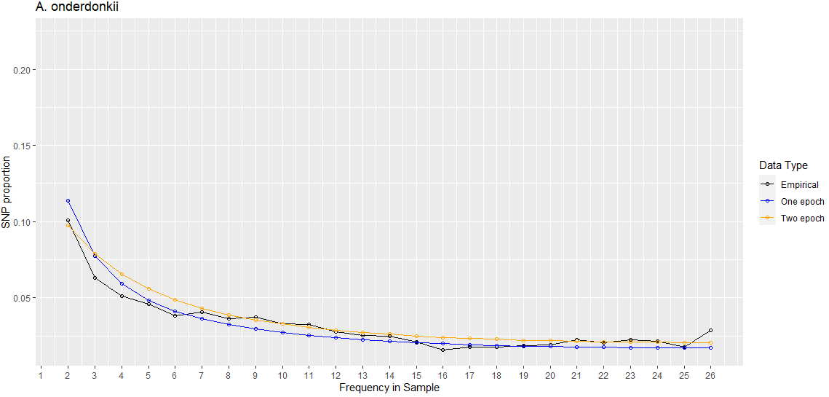
Species | A. onderdonkii [shown] | No masking
Best Nu | 0.00684189
Best Starting params | [1.75492930e-01, 1.72045434e-05]
Two-epoch log likelihood | -306.804782802
One-epoch log likelihood | -409.666652485

Slide 8
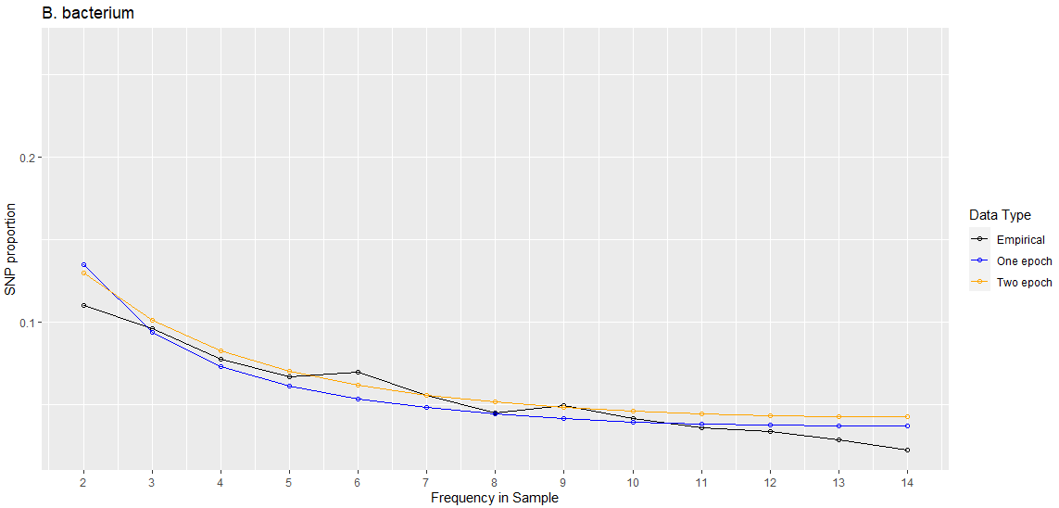
Species | B. bacterium [shown] | No masking
Best Nu | 0.00384582
Best Starting params | [1.43685810e-01, 8.31714592e-06]
Two-epoch log likelihood | -172.294607416 | -229.216380647
One-epoch log likelihood | -224.025922804 | -229.453899008

Slide 9
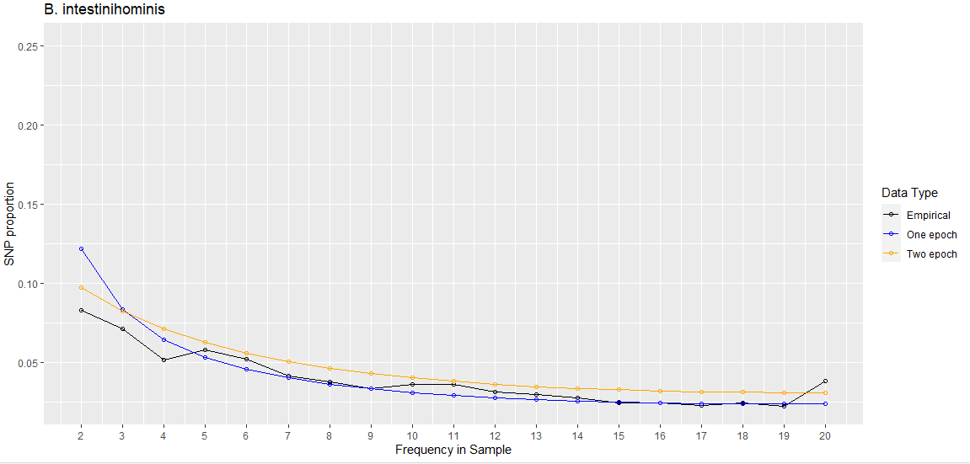
Species | B. intestinihominis [shown] | No masking
Best Nu | 0.0037498
Best Starting params | [1.05727090e-01, 1.41697945e-05]
Two-epoch log likelihood | -254.234850576 | -724.158464668
One-epoch log likelihood | -701.532028657 | -739.501271233

Slide 10
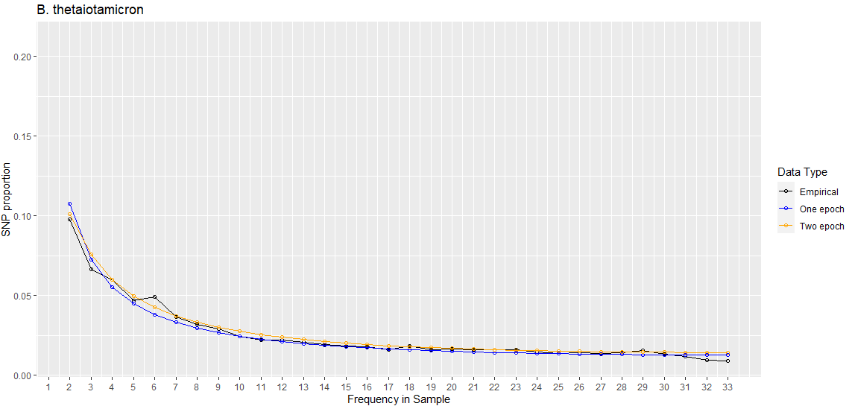
Species | B. thetaiotamicron [shown] | No masking
Best Nu | 0.00633643
Best Starting params | [1.11098337e-01, 9.27590937e-06]
Two-epoch log likelihood | -292.381165778
One-epoch log likelihood | -360.547850479

Slide 11
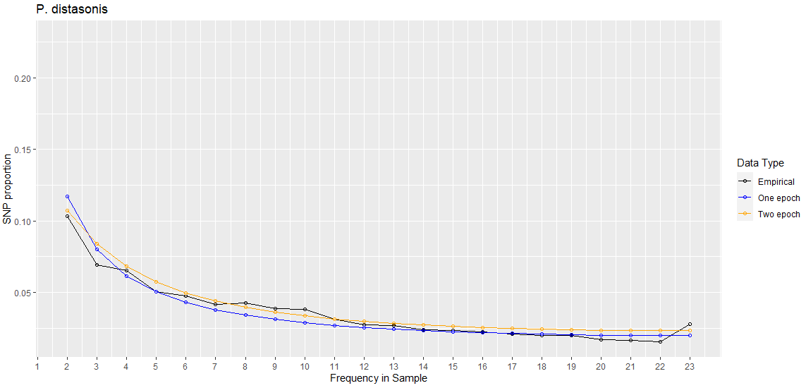
Species | P. distasonis [shown] | No masking
Best Nu | 0.00352228
Best Starting params | [7.44134295e-02, 7.45804647e-06]
Two-epoch log likelihood | -318.036213868
One-epoch log likelihood | -421.232898312

Slide 12
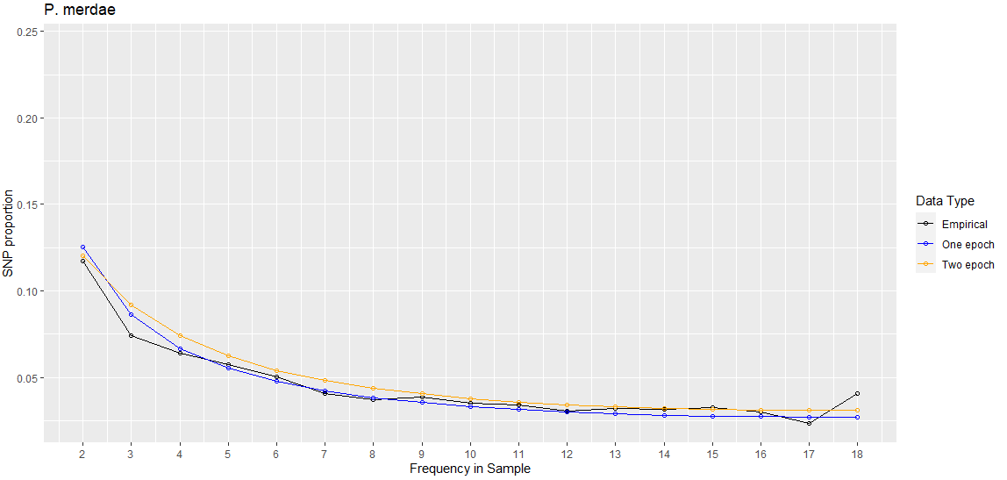
Species | P. merdae [shown] | No masking
Best Nu | 0.00600145
Best Starting params | [1.14191974e-01, 1.50772180e-05]
Two-epoch log likelihood | -153.083354001
One-epoch log likelihood | -179.740046365

Slide 13
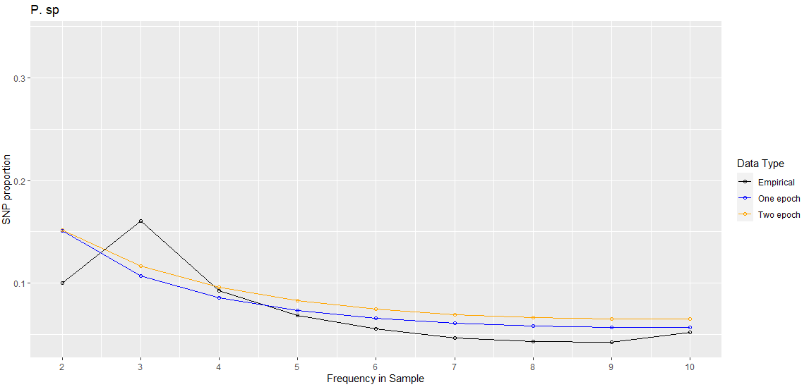
Species | P. sp [shown] | No masking
Best Nu | 0.00395808
Best Starting params | [7.44995804e-02, 1.30477726e-05]
Two-epoch log likelihood | -418.920443969 | -538.651173833
One-epoch log likelihood | -446.321619655 | -548.201437719

Slide 14
Log Likelihood Results
Species | A. finegoldii | A. muciniphila | A. onderdonkii | A. putredinis | A. shahii
Multiple Epochs | -257.574711504 | -108.804915489 | -309.462783761 | -1377.6483033 | -216.820717424
One Epoch (SNM) | -479.21577207 | -154.628390672 | -409.666652485 | -1377.64826898 | -216.820715173
Species | B. bacterium | B. caccae | B. cellulolyticus | B. fragilis | B. intestinihominis
Multiple Epochs | -181.902408471 | -97.7997475199 | -1167.48967523 | -311.019501502 | -268.082419973
One Epoch (SNM) | -224.025922804 | -98.8749495265 | -1167.48954551 | -311.019473484 | -701.532028657

Slide 15
Log Likelihood Results
Species | B. massiliensis | B. ovatus | B. stercoris | B. thetaiotamicron | B. uniformis
Multiple Epochs | -20.3617434171 | -181.635396867 | -508.742298381 | -292.268240631 | -253.217173904
One Epoch (SNM) | -20.3617427569 | -181.635395821 | -508.742293081 | -360.547850479 | -253.217142467
Species | B. vulgatus | B. xylanisolvens | D. invisus | E. eligens | E. rectale
Multiple Epochs | -142.247487889 | -166.0628826 | -140.340722705 | -226.737990541 | -621.965867927
One Epoch (SNM) | -142.247482051 | -166.062883792 | -140.340721113 | -226.737989406 | -621.965862866

Slide 16
Log Likelihood Results
Species | F. prausnitzii | O. sp | P. copri | P. distasonis | P. merdae
Multiple Epochs | -867.452254515 | -1370.77198462 | -302.787657196 | -320.731290313 | -145.417035346
One Epoch (SNM) | -867.452252566 | -1370.77198195 | -302.787655984 | -421.232898312 | -179.740046365
Species | P. sp | R. bromii
Multiple Epochs | -430.474558031 | -569.361933978
One Epoch (SNM) | -446.321619655 | -569.361932584

