Slide 1
demo_for_ccgb Weekly Update
20220725
Jon Mah
Garud and Lohmueller Labs

Slide 2
Summary / Agenda
Species step works now for oral data
300/382
Technical check in
Dadi outputs for downsampled gut species
Write-up on paper (WIP)
Check in about Bryan
TODO
Update figures (Make pretty, number of qp vs. non-qp samples)
Writing

Slide 3
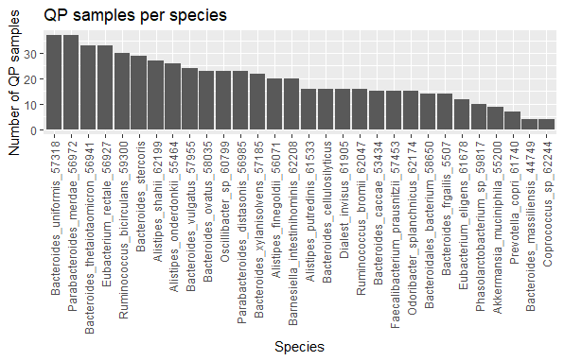
What have we done?
Given species + clade control, randomly select 20 SNPs from each site
Note that this only applies for species with at least 20 QP samples
Then, infer demog params + compare one-epoch vs. Multi-epoch

Slide 4
Summary of (downsampled) Dadi outputs
Improvement for multi-epoch models
A. muciniphila
A. onderdonkii
B. thetaiotaomicron
B. xylanisolvens
B. intestinihominis
P. distasonis
P. merdae
Null model has equivalent fit
B. uniformis
E. rectale
R. bicurculans
B. stercoris
A. shahii
B. vulgatus
B. ovatus
Osc. Sp.
A. finegoldii
Not sure what’s happening
Phascolarctobac-terium sp.
Likelihood is NaN
I suspect some sort of overflow error

Slide 5
Summary of (downsampled) Dadi outputs
Improvement for multi-epoch models
A. muciniphila
A. onderdonkii
B. thetaiotaomicron
B. xylanisolvens
B. intestinihominis
P. distasonis
P. merdae
Null model has equivalent fit
B. uniformis
E. rectale
R. bicurculans
B. stercoris
A. shahii
B. vulgatus
B. ovatus
Osc. Sp.
A. finegoldii
Not sure what’s happening
Phascolarctobac-terium sp.
Likelihood is NaN
I suspect some sort of overflow error
Highlighted species demonstrate improvement in likelihood for multi-epoch models in non-downsampled data

Slide 6
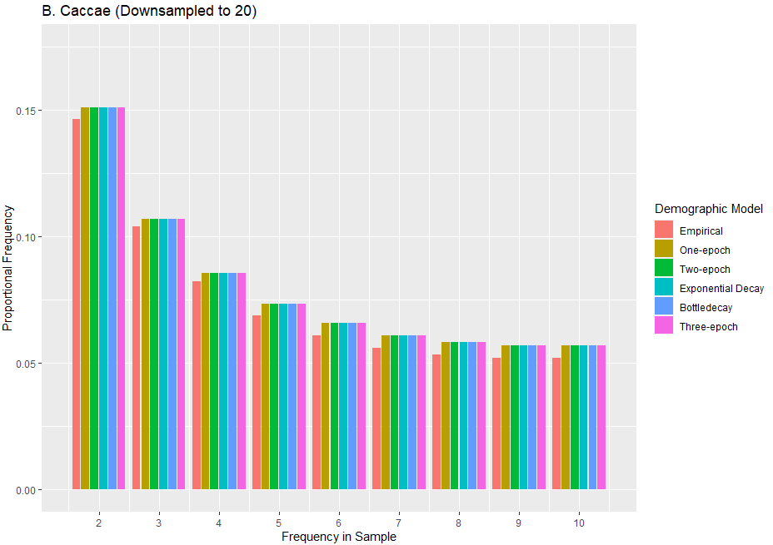
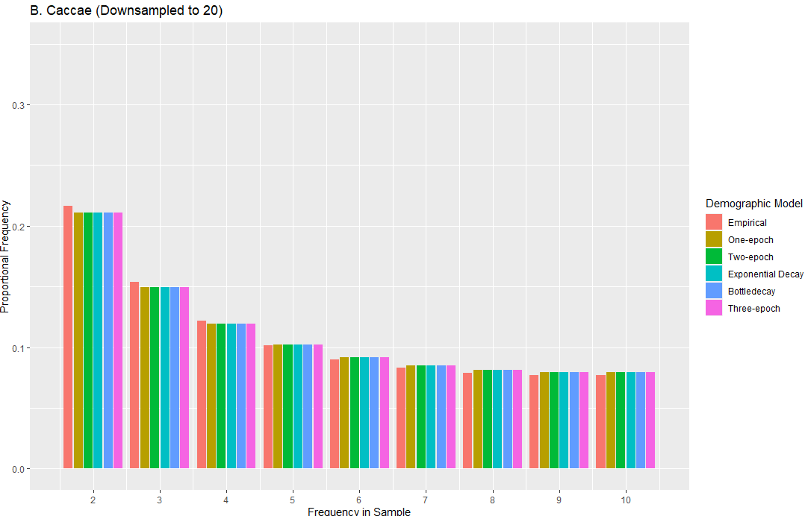
Technical check-in: plotting
Notes:
Emphacize thouroughness of search

Slide 7
Most species demonstrate no improvement in log likelihood for multi-epoch models, e.g., B. caccae
Model | Log Likelihood | Time | Nu
One-epoch | -40.6396533694 | -- | --
Two-epoch | -40.6396529731 | N/A | N/A
Exponential | -40.6396530346 | N/A | N/A
Bottlegrowth/Bottledecay | -40.6396533672 | N/A | N/A
Three-epoch | -40.6396533631 | N/A | N/A

Slide 8
A. muciniphila
Model | Log Likelihood | Theta | Nu | Time
One-epoch | -224.208927048 | 7938.412893 | -- | --
Two-epoch | -46.473283214 | 8165.312789 | 3.83E-02 | 3.01E+05
Exponential | -62.321732146 | 7794.958421 | 4.16E-03 | 1.82E+05
Bottlegrowth/Bottledecay | -46.748270573 | 8163.382109 | 2.17E-04 | 2.15E+05
Three-epoch | -46.647918739 | 8144.372181 | 1.33E-02 | 9.02E+04

Slide 9
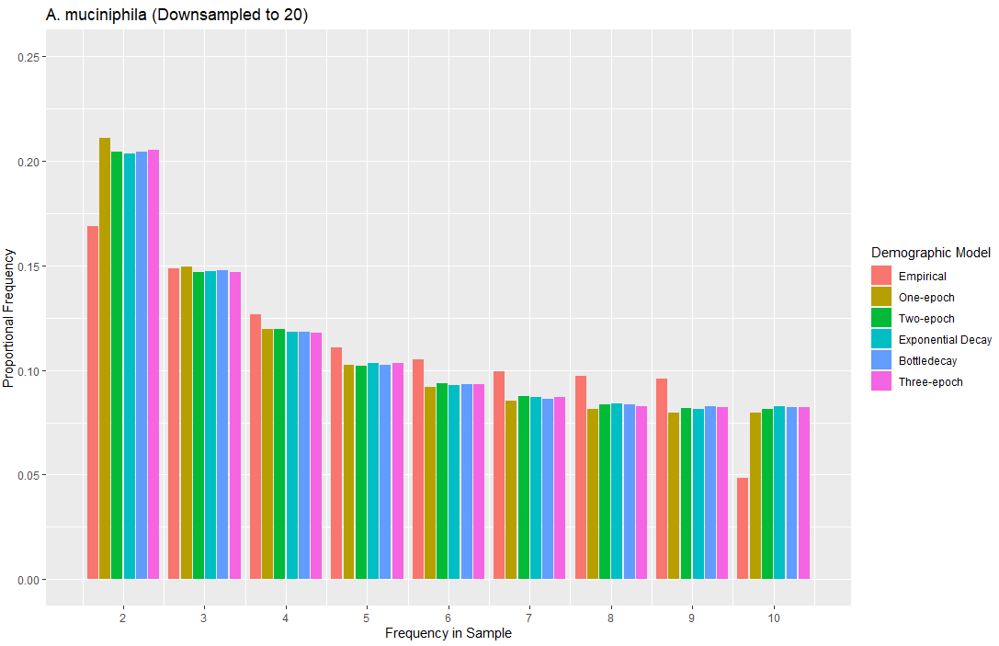
A. muciniphila

Slide 10
A. onderdonkii
Model | Log Likelihood | Theta | Nu | Time
One-epoch | -262.472801947 | 6517.68622821 | -- | --
Two-epoch | -59.643270381 | 6523.52768976 | 1.13E-03 | 2.13E+05
Exponential | -69.267893821 | 6219.46378293 | 7.73E-04 | 1.99E+05
Bottlegrowth/Bottledecay | -60.467201846 | 6623.54276891 | 3.91E-04 | 3.93E+05
Three-epoch | -59.346879321 | 6999.28957543 | 1.27E-03 | 8.41E+04

Slide 11
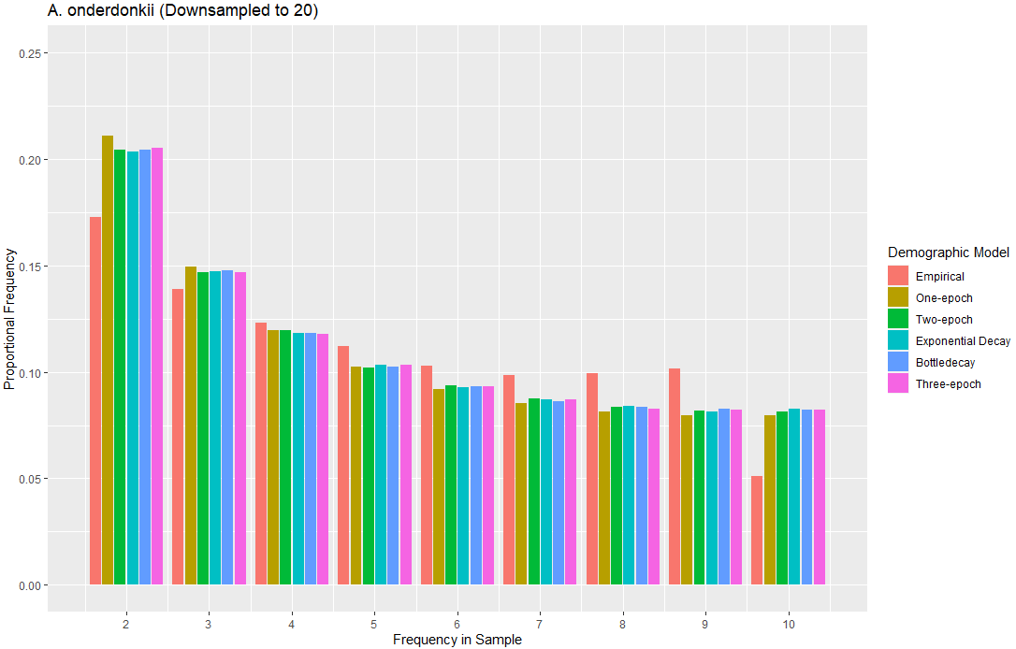
A. onderdonkii

Slide 12
B. thetaiotaomicron
Model | Log Likelihood | Theta | Nu | Time
One-epoch | -92.52090808 | 11395.0209801 | -- | --
Two-epoch | -86.5301510885 | 11581.1227564 | 0.00575632 | 1.88E+08
Exponential | -64.9961779681 | 264426447.48 | 3.73E-05 | 1.59E+16
Bottlegrowth/Bottledecay | -82.8501379233 | 11714.94 | 4.39E-04 | 2.37E+05
Three-epoch | -86.5515264317 | 11576.2633545 | 1.88051641e-03 | 7340897.36

Slide 13
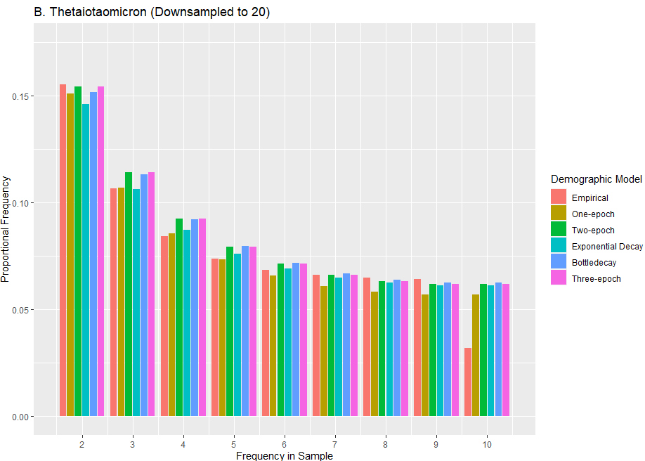
B. thetaiotaomicron

Slide 14
B. xylanisolvens
Model | Log Likelihood | Theta | Nu | Time
One-epoch | -50.2618661588 | 2225.83848516 | -- | --
Two-epoch | -39.7148435578 | 2341.43627247 | 0.0034628 | 8.09E+04
Exponential | -38.5561319553 | 2384.39089893 | 0.00351175 | 9.78E+04
Bottlegrowth/Bottledecay | -38.5627074329 | 2386.99684026 | 5.51082277e-04 | 9.89E+04
Three-epoch | -39.7328722885 | 2338.91902834 | 1.21915434e-04 | 7.25E+04

Slide 15
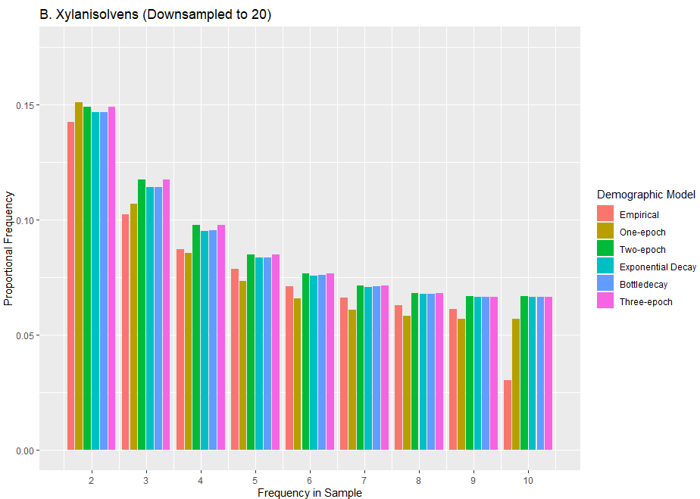
B. xylanisolvens

Slide 16
B. intestinihominis
Model | Log Likelihood | Theta | Nu | Time
One-epoch | -153.938217391 | 11485.3921 | -- | --
Two-epoch | -66.32178912 | 11025.8540 | 0.0042781 | 9.26E+04
Exponential | -80.75209377 | 13053.2202 | 0.0048392 | 9.11E+04
Bottlegrowth/Bottledecay | -72.32189287 | 11085.9532 | 5.653478E-03 | 8.27E+04
Three-epoch | -69.05848302 | 11057.4281 | 1.0129387e-02 | 1.06E+05

Slide 17
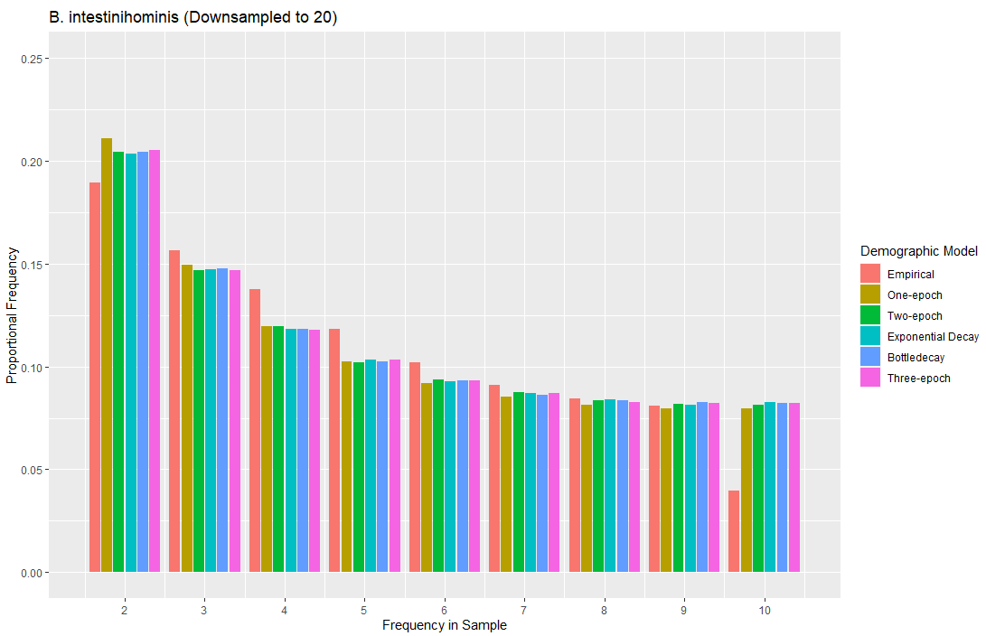
B. intestinihominis

Slide 18
P. distasonis
Model | Log Likelihood | Theta | Nu | Time
One-epoch | -82.2436293232 | 10370.6320975 | -- | --
Two-epoch | -55.1947933147 | 10728.9379823 | 0.00238249 | 2.79E+08
Exponential | -55.515466054 | 10788.8441123 | 1.72496170e-04 | 2.84E+04
Bottlegrowth/Bottledecay | -55.2361631109 | 10713.7914273 | 1.17980842e-04 | 4.91E+05
Three-epoch | -55.1972716964 | 10729.3296602 | 4.29101656e-04 | 3.62E+05

Slide 19
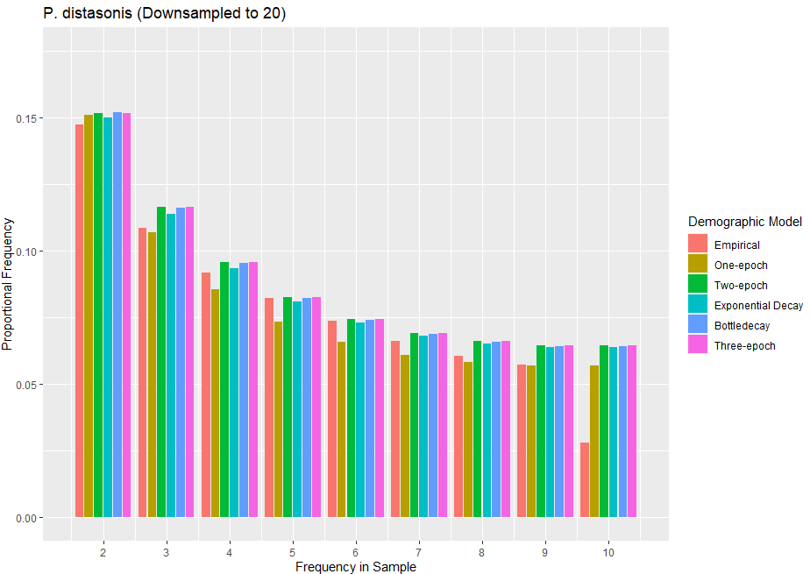
P. distasonis

Slide 20
P. merdae
Model | Log Likelihood | Theta | Nu | Time
One-epoch | -75.4127931523 | 6465.3627 | -- | --
Two-epoch | -43.4537691412 | 6834.8321 | 0.0034628 | 1.05E+05
Exponential | -52.4637893463 | 1331425.543 | 1.75E-02 | 3.38E+11
Bottlegrowth/Bottledecay | -48.4538923421 | 6634.5217 | 1.082E-02 | 2.11E+05
Three-epoch | -44.7648395324 | 6946.3218 | 7.2467e-04 | 4.14E+05

Slide 21
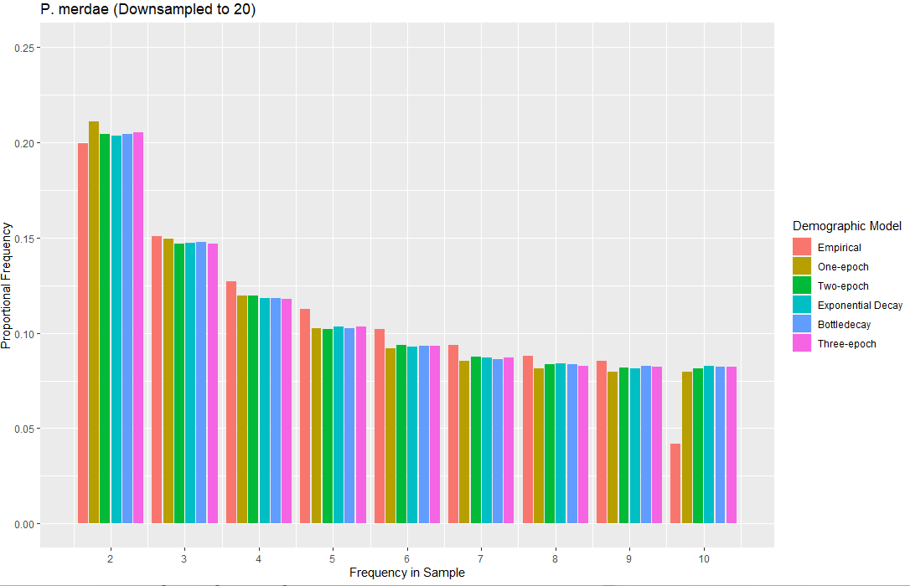
P. merdae

Slide 22
Todo
Downsampled SFS vs. non-downsampled

