Slide 1

MINI-PROJECT
BASIC BUshsyILDING ON AI CHATBOT
Guide Name: Batch No.:21PA19
Mr.G.Ashok Kumar Year/Semester: IV/ I
Associate Professor Section:CSE-A
Team Members:
D.Bindu(22P65A0504)
K.Shiva Shankar Reddy(22P65A0506)
K.Pranay Chandra(22P65A0506)

Slide 2
TABLE OF CONTENTS:
Abstract
Introduction
Literature Survey
Research Gap/Challenges
Problem Statement
Objective
Existing System
System Requirements
References

Slide 3
ABSTRACT:
This paper explores the development and implementation of an AI chatbot designed to enhance user interaction through natural language processing (NLP), machine learning, and contextual understanding. Key features include user engagement, personalized responses, and continuous learning capabilities. The chatbot aims to improve customer service, streamline communication, and provide real-time support across various platforms. By leveraging data analytics, the system adapts to user preferences, ensuring a more efficient and satisfying experience. Future research directions will focus on ethical considerations, data privacy, and integration with emerging technologies.
Keywords:Natural Language Processing,Data Analytics,Streamlined Communication,Ethical Considerationds ,Efficiency.

Slide 4
INTRODUCTION:
AI chatbots are intelligent software applications designed to simulate human conversation through text or voice interactions. Utilizing advanced technologies such as natural language processing (NLP) and machine learning, these chatbots can understand and respond to user queries in a human like manner.
The rise of AI chatbots is largely driven by the need for efficient customer service, enhanced user engagement, and the demand for 24/7 support across various platforms. They can be deployed in a range of industries, from e-commerce to healthcare, providing instant responses and personalized experiences that improve user satisfaction.
In summary, AI chatbots represent a significant advancement in human-computer interaction, offering practical solutions that enhance communication and efficiency in various contexts.

Slide 5
LITERATURE SURVEY:
Title | Author | Year | Objective | Methodology | Type of data used | Findings | Models | Limitations | Future Work
The impact of AI on Chatbot technology | Maya Grigolia,Machaidze,lasha labadze. | 2023 | To explore advancements in ai power technology,assess their impact on user’s behaviour. | The research employs a comprehensive literature review and analysis of existing studies related to AI-powered chatbots. | It utilizes a variety of data sources,conference paper,journal articles and reputable online publications.It uses ML models,NLP algorithms,etc.. | It indicate that AI-powered chatbots can significantly enhance user experience. | While specific model results are not detailed in the provided excerpts. | The study acknowledges limitations related to the accuracy of AI chatbots,particularly those not developed by specialized professionals | It is recommended to focus on establishinhg collabarating ethical frameworks..
Artificial Intelligence (AI) Chatbot as Language Learning Medium: An Inquiry | N.Haristiani | 2019 | The objective of the study is to explore the use of AI chatbots as a medium for language learning, particularly focusing on their effectiveness . | The study employs a descriptive method, utilizing literature reviews to gather information on previous research related to chatbots and their applications in education. | The study does not specify a traditional dataset but rather relies on literature reviews and observational data from the Gengobot implementation. | The findings indicate that chatbots can serve as effective language learning partners, providing accessible . | The paper discusses the mechanism of chatbots, including their structure . | The study acknowledges limitations related to the reliance on existing literature and the specific context of the Gengobot . | It is suggested to explore further enhancements in chatbot design, more advanced AI techniques.

Slide 6
Erasmus AI Chatbot: A Tool for College Information Retrieval | Jash takar,Yash Doshi,Krishma Parekh. | 2017 | The primary objective of the Erasmus AI Chatbot is to facilitate easy access. | Developing a chatbot that utilizes natural language processing . | The chatbot uses a knowledge base or database that contains information related to college activities. | The findings suggest that the chatbot significantly enhances the accessibility . | The chatbot's effectiveness is demonstrated through its ability to provide accurate . | - Dependence on the quality and comprehensiveness of the database. - Potential issues. | - Enhancing the chatbot's capabilities with more advanced AI features.
Introduction to AI Chatbots | Aishwarya Gupta,Divya Hathwar,Vijayakumar. | 2020 | The objective of the document is to explore the advancements in AI. | Analyzing different types of chatbots (keyword recognition-based, contextual chatbots). | The document does not specify a particular dataset used for empirical analysis. | Chatbots become increasingly versatile and are utilized in various domains. | The document does not present specific model results or quantitative . | The limitations of keyword recognition-based chatbots | Enhancing the capabilities of chatbots to better understand context and user sentiment.
A Review Paper on Human Computer Interaction | Himanshu Bansal,Rizwan Khan. | 2018 | The objective of the paper is to review and analyze various aspects of Human Computer Interaction | The paper employs a review methodology, analyzing existing research and literature on HCI | The paper does not explicitly mention the use of a specific dataset. | The paper discusses various findings related to HCI, including the importance of understanding the relationship between humans and computers | The paper does not present specific model results, as it primarily focuses on reviewing and analyzing. | The paper does not explicitly outline limitations. However, it may be limited by the scope of the reviewed literature. | The paper suggests future work in the field of HCI, including addressing the challenges of involving older participants in HCI.
A Study of Today’s A.I. through Chatbots and Rediscovery of Machine Intelligence | A khanna | 2015 | To discuss current trends in AI, critique existing chatbot systems, and propose an alternative theory for machine intelligence. | The paper analyzes the structure and functioning of chatbots, evaluates their limitations, and suggests a new theoretical framework. | The study does not specify a particular dataset but discusses the organization of chatbot databases and their response mechanisms. | # Findings Current AI systems, particularly chatbots, lack true understanding, creativity, and the ability to learn or hold memories. | The paper introduces the concepts of "Partially Intelligent Systems" and "Completely Intelligent Systems,". | The existing chatbot systems do not simulate human-like intelligence and have fixed response patterns, limiting their effectiveness. | The paper calls for the development of new theories and innovative approaches to enhance AI capabilities.

Slide 7
Programming challenges of chatbot: Current and future prospective | AI Mahamadhur Rahman,Alma Islam. | 2017 | To explore the programming challenges faced by chatbots and discuss current and future prospects | The paper provides an overview of cloud-based chatbot services and discusses the integration of machine learning and AI concepts | he paper does not specify a particular dataset but discusses various cloud-based chatbot services | Chatbots enhance business effectiveness by providing better user experiences at lower costs. | The paper highlights the importance of using AI and NLP for effective chatbot responses. | The design and development of chatbots are hindered by the need for extensive logic. | Future work should focus on improving the handling of complex queries.
Chatbot Technologies: A Literature Review and Case Study Implementation | G caldarini | 2022 | To review chatbot technologies, build a taxonomy for comparison, and implement a chatbot. | Literature review followed by the development of a taxonomy to evaluate various chatbot technologies. | Prototypes of chatbot integrations and customer satisfaction data from a help desk CRM. | The study revealed that existing chatbot technologies are not as mature as expected. | The implemented chatbot solution showed a decrease in customer satisfaction by ten percent. | The implementation did not utilize all available features, and the initial testing was limited to a subset of questions. | Further testing in real-world scenarios is needed to assess stability and effectiveness, along with improvements.
Design and Implementation of AI Chatbot for COLREGs Training. | A. Sharma et al. | 2015 | To develop and evaluate an AI chatbot (FLOKI) for enhancing the learning of Collision Avoidance Regulations (COLREGs) | he study involved a usability assessment using the System Usability Scale (SUS). | Usability data collected from student respondents through a 10-item SUS questionnaire. | The chatbot received a SUS score of 73.72, indicating good usability, effectiveness, and satisfaction. | The internal consistency of the SUS was confirmed with a Cronbach's alpha of 0.884. | Small sample size (n=18) and specific university context limit generalizability; the chatbot's content. | Recommendations include expanding the chatbot's dialogue capabilities to cover all COLREGs rules.
An Overview of Chatbot Technology | E. Adamopoulou and L. Moussiades | 2019 | To provide a comprehensive understanding of chatbot technology. | Literature review and analysis of existing chatbot systems and technologies. | Various studies and existing chatbot platforms referenced in the literature. | Chatbots can significantly enhance customer service efficiency and user interaction. | Not explicitly stated; focuses on the general effectiveness and user perception. | Ethical concerns regarding user trust and the potential for deception. | Investigate existing chatbot platforms in detail, assess their ingenuity.

Slide 8
RESEARCH GAPS/CHALLENGES:
Contextual Understanding
Natural Language Understanding(NLU)
Ethical Considerations
Multi-Model Interaction
Domain Adaptability
User Trust and Acceptance

Slide 9
PROBLEM STATEMENT:
This study aims to address these challenges by investigating advanced techniques in contextual management, natural language understanding, and personalization, ultimately contributing to the development of more effective and user-friendly AI chatbot systems.

Slide 10
OBJECTIVE:
Improve the chatbot’s abil;ity to maintain context and coherence in conversations,Ensuring relevant and meaningful interactions across multiple turns.
Implement mechanisms for chatbot to tailor responsers based on individual user preferences and histories.

Slide 11
EXISTING SYSTEM:
Components of the System
User Interaction
Key Features
Error Handling
Environment Requirements
System Limitations

Slide 12
PROPOSED SYSTEM:
Advanced Contextual Awareness
Enhanced Natural Language Processing
Dynamic Personalization
Integrated Emotional Intelligence
Multi-Model Interaction Capabilites
Trust and Transperency Features

Slide 13
SYSTEM REQUIREMENTS:
Software Requirements
Operating System: Windows 7/8/10
Coding Language: Python
IDE: Visual Studio, PyCharm
Hardware Requirements:
RAM: 4GB to 8GB
Hard Disk: 1GB
GPU(High performance)

Slide 14
MODULES:
Natural Language Processing(NLP)
Purpose: To enable the chatbot to understand and process human language.
Functionality: Text preprocessing (tokenization, stemming, lemmatization)
Named Entity Recognition (NER)
User Interface (UI)
Purpose:To provide a user-friendly interface for interaction.
Functionality:Designing intuitive chat interfaces (web, mobile, messaging apps).
Ensuring accessibility and ease of use for all users.

Slide 15
Dialogue Management:
Purpose: To manage the conversation flow and context.
Functionality: Maintaining state information (tracking user context).Implementing rules or algorithms
Implementing rules or algorithms to guide the conversation based on user input
Response Generation
Purpose:To create appropriate responses based on user input and intent.
FunctionalityGenerating responses using predefined templates, rules, or machine learning models.
Ensuring responses are contextually relevant and coherent.

Slide 16
IMPLEMENTATION:
Install Python
Download and install Python from the official website.
Set Up Your Development Environment
Open Command Prompt (Windows) or Terminal (macOS/Linux).
Create a project directory.
Navigate to the project directory.
Create a Virtual Environment (Optional)
Create a virtual environment to isolate dependencies.
Activate the virtual environment.
Install Required Libraries
Use pip to install the following libraries:
SpeechRecognition
gTTS
Transformers
Numpy

Slide 17
Set Up Your Microphone
Ensure your microphone is connected and working properly.
Create the Python Script
1.Create a new Python file (e.g., chatbot.py).
2.Structure the code into appropriate classes and functions:
Import necessary libraries.
Define the ChatBot class with methods for:
Speech recognition.
Text-to-speech conversion.
Wake-up phrase detection.
Getting the current time.
Run the Chatbot
Navigate to the project directory in the command line.
Execute the Python script.
Interact with the Chatbot
Speak to the chatbot and receive responses based on your input

Slide 18
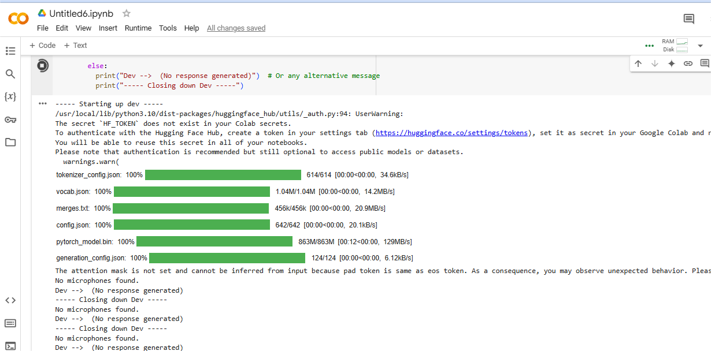
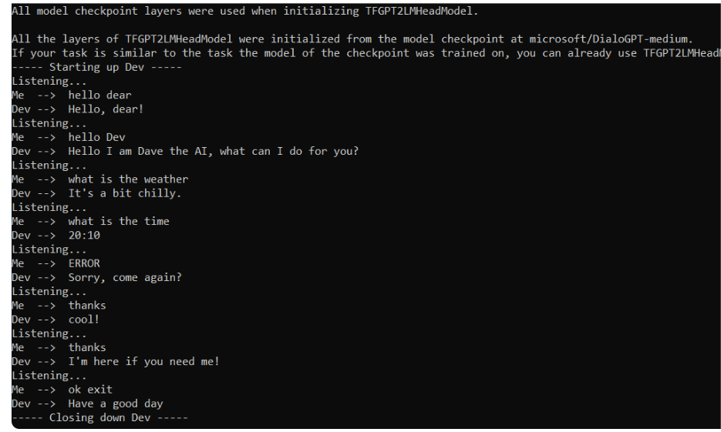
OUTPUT :
Response is not Generated : If the Microphone is Dectected :

Slide 19
REFERENCES:
The_Impact_of_Artificial_Intelligence_on_Chatbot_Technology_A_Study_on_the_Current_Advancements_and_Leading_Innovations.(2019)
An_Overview_of_Chatbot_Technology.(2015)
A_bibliometric_analysis_of_artificial_intelligence_chatbots_in_educational_contexts.(2022)
Systematic_Literature_Review_on_Implementation_of_Chatbots_for_Commerce_Use.(2017)
A_Study_of_Today's_AI_through_Chatbots_and_Rediscovery_of_Machine_Intelligence.(2015)
A_Review_Paper_on_Human_Computer_Interaction.(2020)
Net/publication/342880348_Introduction_to_AI_Chatbots.(2017)
The_Impact_of_Artificial_Intelligence_on_Chatbot_Technology_A_Study_on_the_Current_Advancements_and_Leading_Innovations.(2023)
Net/figure/Chatbot-researches-on-language-learning_tbl2(2019)

Slide 20
THANK YOU

