Slide 1

RESOURCE ALLOCATION IN CLOUD USING REINFORCEMENT LEARNING
TEAM
SAMPATH-21P61A0548
OMPRAKASH-21P61A0547
AVINASH-21P61A0515
TEAM :
Sampath – 21P61A0548
Omprakash - 21P61A0547
Avinash – 21P61A0515
GUIDE: G. Arun
GUIDE : Mr. G. Arun
Associate Professor

Slide 2
CONTENT
ABSTRACT
EXISTING SYSTEM
PROPOSED SYSTEM
LITERATURE SURVEY
SYSTEM REQUIREMENTS

Slide 3
ABSTRACT
Cloud computing has revolutionized the way IT resources are managed and consumed. However, the efficient allocation of these resources to meet varying workloads while minimizing costs remains a significant challenge.
This project explores the application of Reinforcement Learning (RL) as a promising solution for automated resource allocation in cloud environments.
RL agents can learn optimal resource allocation policies through interaction with the cloud environment, adapting to dynamic workloads and resource constraints.
We delve into the key components of RL-based resource allocation systems, including state representation, action space, reward function, and learning algorithms.
The AI algorithm Markovnikov process makes the project much more reliable and error free which increases the accuracy furthermore making it much more dependent. Keywords:
Cloud computing, Reinforcement Learning, Dynamic workloads, Cloud environment, Markovnikov process

Slide 4
INTRODUCTION
The cloud computing paradigm has transformed the IT landscape, offering scalable and on-demand access to a wide range of resources.
However, the efficient utilization of these resources is critical to ensuring optimal performance, cost-effectiveness, and service quality.
Traditional resource allocation methods often rely on static policies or heuristics that may not be able to adapt to the dynamic nature of cloud workloads.
Reinforcement Learning (RL) presents a compelling approach to addressing this challenge. RL agents can learn to make optimal resource allocation decisions through trial and error, interacting with the cloud environment and receiving feedback in the form of rewards or penalties.
By continuously improving their policies, RL agents can effectively allocate resources to meet varying demands while minimizing costs and maximizing resource utilization.

Slide 5
LITERATURE SURVEY
SNo | TITLE | DATE | OBJECTIVE | METHODOLOGY | FINDINGS & LIMITATIONS
1 | Resources Allocation in Cloud Computing: A Survey | Jan-20 | the quality of service and the resources allocation become a crucial challenge. | This paper presents the challenges of resource allocation and some recent contributions to minimize them, henneed for paper reviews and surveys to identify the area of our research.ce the | The survey provided the valuable information of the cloud limitations
2 | Resource Management in Cloud Computing Using Machine Learning: A Survey | Dec-20 | Reduce the efforts by optimizing container placement, job scheduling and multi-resource scheduling. | optimal resource management in cloud computing environments in different ways, such as container placement, job scheduling and multi-resource scheduling. Machine learning techniques are extensively used in this area | The container placement, job scheduling and multi-resource scheduling. Are only few factors effecting the cloud management
3 | Deep Reinforcement Learning Based Resource Allocation Strategy in Cloud-Edge Computing System | Aug-22 | Creation of new platforms such as the public node and the private node | The Edge nodes are considered the parent nodes and are. private cloud environment, the edge node must allocate resources between the cloud node and the edge node. In a public cloud environment, since public cloud service providers offer various pricing modes for users’ different computing demands, the edge node also must select the appropriate pricing mode of cloud service | The data in the public node went completely unorganised.

Slide 6
PROBLEM STATEMENT & EXISTING SOLUTION
Challenges:
Scalability: RL agents can become computationally expensive as the state space and action space grow larger.
Exploration-exploitation trade-off: The agent must balance exploring new actions to discover optimal policies with exploiting known good actions to maximize rewards.
Uncertainty and noise: Cloud environments are often subject to uncertainty and noise, which can make learning more challenging.
Benefits:
Adaptability: RL agents can learn to adapt to dynamic workloads and changing resource conditions.
Optimality: RL can potentially achieve near-optimal resource allocation policies.
Automation: RL can automate resource allocation decisions, reducing human intervention and improving efficiency.

Slide 7
OBJECTIVES
Development of a Reinforcement Learning Framework: The project focuses on creating a reinforcement learning (RL) framework that optimizes resource allocation in cloud computing environments.
This includes minimizing operational costs associated with over-provisioning and under-utilization of resources while enhancing the performance and scalability of cloud applications through dynamic resource scaling based on real-time workload demands.
Evaluation and Improvement of Resource Allocation Methods: The effectiveness of the proposed RL-based approach will be evaluated against traditional resource allocation methods.
This evaluation will help identify areas for further improvement, contributing to both academic knowledge and practical applications of reinforcement learning in cloud computing, particularly in autonomous cloud management environments that adapt to changing conditions without manual intervention.

Slide 8
PROPOSED METHODOLOGY
This This methodology outlines a systematic approach to implementing a cloud resource allocation system using reinforcement learning, particularly through the application of a Deep Q-Network (DQN).
The goal is to optimize resource allocation based on simulated workload demands while minimizing costs and maintaining performance metrics.
Utilize libraries such as NumPy for numerical operations, Pandas for data manipulation, Matplotlib and Seaborn for visualization, and TensorFlow/Keras for building neural networks.
This proposed methodology outlines a structured approach to implementing a cloud resource allocation system using reinforcement learning principles through DQNs. By simulating different workloads and employing a DQN agent for learning optimal strategies, this approach aims to enhance efficiency in cloud resource management while minimizing costs.

Slide 9
SYSTEM REQUIREMENTS
Software Requirements:
Stabled Internet connection with access of google Co-Lab. (or)
Installed Jupyter notebook.
TensorFlow
Hardware Requirements:
Processor : Intel(R) Core(TM) i5-1035G1 CPU @ 1.19GHz - i10-1035G1 CPU @ 5.3GHz, i7.
RAM : 8.00 GB - 16GB
Operating System: Windows 10 Home or Windows 11, 64-bit, Mac OS.

Slide 10
MODULES
Importing Libraries NumPy: For numerical operations and handling arrays.
Pandas: For data manipulation and analysis, especially in creating datasets.
Matplotlib & Seaborn: For visualizing results through various plots.
Collections (deque): To implement experience replay for the DQN agent.
TensorFlow & Keras: Frameworks for building and training the neural network model.
Creating a Synthetic Dataset The dataset simulates various cloud resource metrics, including: Workload Levels: Categories like Low, Medium, High, Very High, and Critical.
Resource Allocations: Random integers representing the level of resources assigned.
Cost Metrics: Random integers indicating operational costs.
Performance Metrics: Metrics such as CPU usage, memory usage, disk I/O, network bandwidth, latency, uptime, and error rate.
Categorical Features: Includes regions, instance types, security levels, backup statuses, scaling policies, and maintenance windows.
Incident History: Number of incidents recorded.
DQN Agent Class Definition The DQN agent encapsulates the functionality necessary for learning optimal resource allocation strategies: Initialization: Sets parameters such as memory size for experience replay, discount factor (gamma), exploration rate (epsilon), and learning rate.
Model Building: Constructs a neural network with input layers for state representation and output layers for action predictions (Q-values).
Action Selection: Implements an epsilon-greedy strategy to balance exploration and exploitation in decision-making.
Experience Replay: Samples experiences from memory to train the model using Bellman’s equation.
Training Loop The agent interacts with the environment over multiple episodes: Actions are selected based on the current policy.
Rewards are calculated based on resource allocation decisions.
The agent's memory is updated with experiences which are then used to train the model.

Slide 11
IMPLEMENTATION
Importing Libraries: Import essential libraries such as NumPy, Pandas, Matplotlib, Seaborn, TensorFlow, and Keras to facilitate data manipulation, numerical computations, and neural network development.
Creating a Synthetic Dataset: Develop a function to generate a synthetic dataset that includes various features representing cloud resource metrics and scenarios.
DQN Agent Class Definition: Create a class encapsulating the functionality of the DQN agent to learn optimal resource allocation strategies.
Model Building Method: Construct a neural network model using Keras to predict Q-values based on state representations.
Action Selection Method: Implement an epsilon-greedy strategy for selecting actions during training to balance exploration and exploitation.
Experience Replay Method: Store experiences in memory and sample them for training to improve the learning process of the DQN agent.
Visualization Functions: Create functions to visualize training outcomes, including total rewards per episode and Q-value distributions.
Main Function Execution: Combine all components into a main function that orchestrates dataset creation, agent initialization, training, and result visualization.
Example Problems and Formulas: Formulate problems such as minimizing operational costs while maintaining performance metrics and define relevant reward calculation formulas.
Graphical Representation: After running the code, visualize the results through plots showing total rewards changes, moving averages, and reward distributions.

Slide 12
REWARDS FOR LEARNING
1/1 ━━━━━━━━━━━━━━━━━━━━ 0s 31ms/step
State 199: [ 0.00755466 -0.00943569 -0.01444937 0.00358578 -0.00721031 0.02371383
0.03178295 0.00321443 0.00284971 -0.00924545 -0.00389145 -0.01431997
0.02318165 -0.01092724 0.01868253 -0.02362045 0.0082883 0.01544155
-0.00692467 -0.02108774 -0.01950792 0.00907932 0.01917189 0.00735621
0.01026673 0.00133774 -0.00773128 0.01259433 0.04271248 -0.00846347
-0.02251305 -0.01852513 -0.00238143 0.02019706 -0.01254657 0.03501041
0.04078664 -0.01450981 0.00067524 -0.01102013 -0.01067804 0.01546698
-0.00888638 -0.02722951 -0.01847385 -0.00583828 0.00235868 0.00051791
0.0063365 -0.00773504 0.02040071 0.02045187 -0.02023086 -0.00711899
-0.02226158 0.00484214 -0.0310023 0.00338551 -0.01729596 0.01961466
-0.01219015 -0.00580774 -0.00892658 -0.03295736 0.0176174 0.0245307
-0.02623788 -0.01770559 0.02015807 0.01776165 0.01840567 0.00562393
-0.00838409 -0.00359938 0.01316619 0.02362427 -0.00494513 -0.01471013
-0.01284471 0.00689025 0.00730164 0.00334168 -0.02532724 -0.01016794
0.00453564 -0.01330784 0.0129509 -0.00247586 0.0074992 -0.00699798
0.00382002 -0.03544134 -0.011689 -0.00548056 -0.00228745 0.0096916
-0.01393863 0.01602084 -0.00074412 0.04136334]
1/1 ━━━━━━━━━━━━━━━━━━━━ 0s 39ms/step
State 200: [-0.0018269 -0.0024566 -0.00804851 -0.00705984 0.00174238 0.00511283
0.0191568 -0.0026137 0.00648917 -0.00547463 0.00313121 -0.01370093
0.03612794 -0.03548957 0.03189763 -0.02723347 0.00129923 0.02359647
0.01026368 -0.01840356 0.00055956 -0.0142039 0.03359026 -0.00465447
0.02229127 0.02108027 0.00578266 0.01381999 0.04397012 -0.03240266
-0.00011578 -0.02610445 -0.01900521 0.03103672 -0.01459398 0.02986998
0.0269249 -0.00998947 0.00230238 -0.02221912 -0.01091521 0.02464116
0.00068274 -0.03672228 -0.01798171 -0.00791147 0.00455035 -0.00707943
0.00198206 -0.00424652 0.02054439 0.02107595 0.00023054 -0.01008612
-0.02990285 -0.01104889 -0.0.5405169 0.01804667 -0.02492652 -0.00173931
-0.04359036 -0.0272744 -0.01227264 -0.01536564 -0.01035195 0.03855556
-0.03641206 -0.011299 0.01460573 0.01406519 0.02112086 -0.00663247
-0.0055788 -0.00515628 0.00577691 0.02506316 -0.01592586 0.00367204
-0.0310304 0.01038328 0.01307302 -0.00350981 -0.04822469 -0.0164544
0.0060712 -0.00069678 0.01028094 -0.00245963 0.02653868 -0.00892235
-0.00186961 -0.03538615 0.01166636 -0.00354179 -0.02428476 -0.00840441
-0.00039643 0.03572294 0.00204476 0.05293859]

Slide 13
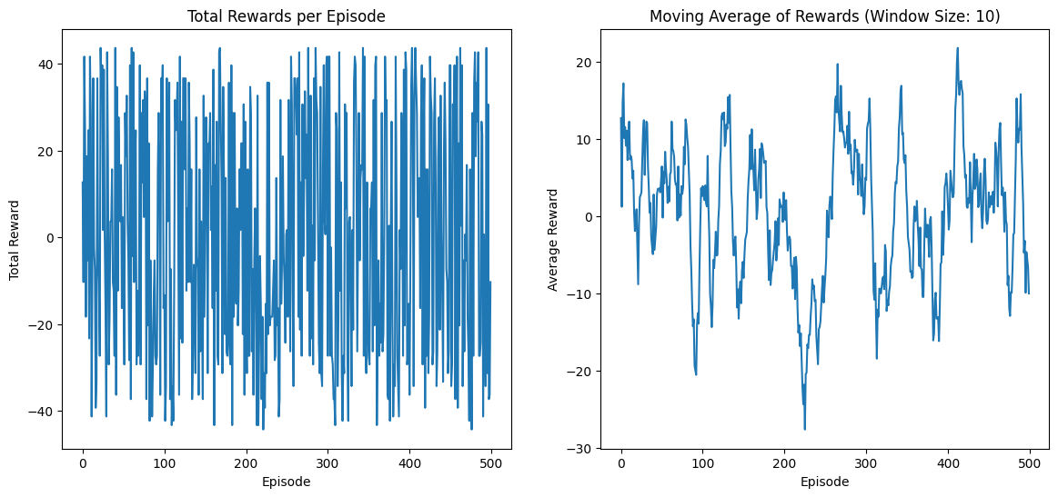
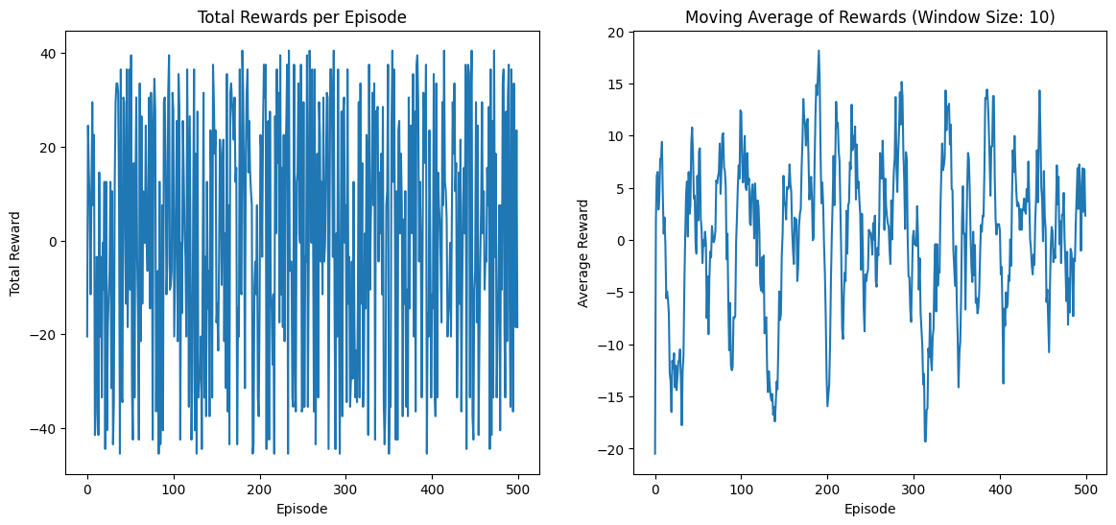
RESULT

Slide 14
REFERENCES
Deep Reinforcement Learning-Based Algorithms for Resource Scheduling: This paper discusses a scheduling framework that selects appropriate algorithms for different scheduling scenarios in cloud computing, highlighting the application of deep reinforcement learning in resource management. Zhou et al., 2022 .
Review of Deep Reinforcement Learning Methods for Resource Scheduling: This comprehensive review focuses on deep reinforcement learning methods for resource scheduling in cloud computing, discussing theoretical formulations and the advantages of DRL in scheduling. Zhou et al., 2024 .
Reinforcement Learning-Based Application Autoscaling: This survey covers various approaches to autoscaling applications in cloud environments using reinforcement learning, providing insights into different strategies and their effectiveness. Garía et al., 2021 .
Q-Learning for Dynamic Task Scheduling: This paper presents a Q-learning-based approach for dynamic task scheduling aimed at energy efficiency in cloud computing, providing a practical example of RL application in resource allocation. Yin & Zeng, 2020 .

Slide 15
THANK YOU

