Slide 1

A MINI PROJECT ON
Unified IOT Management Portal
Project Guide: Team Members:
Mr. Srinivas Goud
(Assistant professor)
Batch Number
21P61A02 Vaishnavi. CH (21P61A0546)
Pallavi. A (21P61A0502)
Harini. CH (21P61A0542)
CSE-A
IV/II (2024-25)

Slide 2
Contents
Abstract with Keywords
⁠Introduction
Literature Survey
⁠⁠Problem statement
⁠Objectives
Software and Hardware requirements
Proposed Methodology
Design
Modules
Implementation
Results
References

Slide 3
ABSTRACT
The rapid growth of IoT devices has created a demand for efficient management solutions to handle the complexities of different devices in one place. This project presents a unified IoT management platform that simplifies device integration, monitoring, and control. The platform provides a user-friendly interface, real-time data visualization, and robust security measures, enabling businesses to optimize their IoT operations and gain valuable insights from collected data.
Keywords:
IoT management, web platform, device integration, data visualization, security, real-time monitoring, data analytics

Slide 4
INTRODUCTION
s.
.
The Internet of Things (IoT) has become a pivotal force in the digital transformation of industries, connecting billions of devices and generating massive volumes of data.
However, managing these heterogeneous devices across different protocols and networks presents a significant challenge. To fully utilize the potential of IoT, there is a need for a comprehensive platform that can manage, monitor, and secure IoT devices efficiently.
This project aims to develop a unified IoT management portal that offers a centralized hub for all IoT-related activities.

Slide 5
PROBLEM STATEMENT
Disconnected Management: Many current methods for managing IoT devices are scattered and depend on manual tasks, which can lead to mistakes and wasted time.
Scalability Issues: Existing systems struggle to grow and often can’t handle automated data processing or provide real-time insights.
Need for a Unified Approach: We need a simple, all-in-one solution that makes managing IoT devices automated, scalable, and secure.

Slide 6
OBJECTIVE
All-in-One IoT Control: Create a web platform that brings together different IoT devices, allowing users to monitor and control them easily in real time.
Smart Data Insights: Use data analytics to turn IoT information into useful insights that help users make better decisions.
Safe and Scalable: Ensure strong security for data and communication, while designing the platform to grow with the rising number of IoT devices.

Slide 7
LITERATURE SURVEY
TITLE | AUTHOR | SUMMARY | PROS | LIMITATIONS | CONCLUSION
A Survey on IoT Device Management Systems | Khan, M. A., & Alghamdi, A. | Reviews existing IoT device management systems. | Comprehensive analysis; identifies key functionalities. | Limited case studies in real-world applications. | While thorough, it lacks practical insights into deployment challenges.
Challenges in IoT Device Management: A Survey | Al-Fuqaha, A., et al. | Discusses technical and non-technical challenges. | Addresses various dimensions of device management. | Lacks empirical validation of challenges. | Identifies critical issues but requires further empirical studies for validation.

Slide 8
IoT Device Management Frameworks: A Comparative Analysis | Javed, A. R., et al. | Compares several IoT device management frameworks. | Detailed comparison; highlights strengths and weaknesses. | Does not assess user experiences. | A solid comparative framework, though user perspectives are needed for completeness.
An Overview of IoT Device Management Technologies | Bui, T. D., & Han, D. | Provides a broad overview of management technologies. | Covers a wide range of technologies. | Lacks in-depth analysis of specific systems. | A useful primer, yet deeper insights into specific technologies are necessary.
Security Challenges in IoT Device Management: A Survey | Moustafa, N., & Slay, J. | Focuses on security issues in device management systems. | Addresses critical security aspects. | Limited focus on scalability. | Highlights important security concerns but needs broader scope to include scalability.

Slide 9
Interoperability Issues in IoT Device Management: A Survey | Baccour, N., et al. | Discusses interoperability problems faced by management systems. | Highlights the importance of interoperability. | Limited practical implementation examples. | Essential for future frameworks, yet requires real-world validation of proposed solutions.
A Survey on IoT Device Discovery Mechanisms | Song, H., & Chen, H. | Reviews mechanisms for discovering IoT devices. | Reviews mechanisms for discovering IoT devices. | Lacks assessment of deployment scenarios. | An important area, yet needs more focus on how these mechanisms are applied in practice.
Evaluating IoT Device Management Frameworks: A User Perspective | Guo, J., et al. | Evaluates frameworks based on user feedback. | User-centric approach; highlights real-world applicability. | Small sample size. | Provides valuable user insights but should expand sample for better generalization.

Slide 10
EXISTING SYSTEM
1. Seamless Device Onboarding
Feature: Automatic integration of devices using protocols like LwM2M.
Limitation: Inefficiencies in high-density environments can delay device discovery.
2. Configuration and Monitoring
Feature: Centralized platforms enable easy configuration and real-time monitoring.
Limitation: Complexity increases with more devices, making management challenging for non-technical users.
3. Security Measures
Feature: Strong encryption and role-based access controls protect data.
Limitation: Systems may still have vulnerabilities due to evolving security threats.

Slide 11
4. Interoperability
Feature: Standards like MQTT promote communication between diverse devices.
Limitation: Inconsistent compliance can lead to integration issues.
5. User-Friendly Interfaces and Scalability
Feature: Intuitive dashboards and mobile apps enhance user experience.
Limitation: High implementation costs and reliance on stable internet can limit accessibility, especially for smaller organizations.

Slide 12
PROPOSED METHODOLOGY
Frontend Development: Leverage modern web technologies to deliver an intuitive user interface.
Backend Processing: Utilize SQL and Java for server-side processing and data analytics.
Secure Communication: Integrate protocols such as MQTT, CoAP, and HTTPS for device communication.
Predictive Analytics: Implement machine learning algorithms for anomaly detection and predictive analytics in IoT data.

Slide 13
SOFTWARE AND HARDWARE REQUIREMENTS
.
Hardware Requirements:
RAM: 4GB
Hard Disk: 1GB of free space
Processor: Intel i3 or higher
Software Requirements:
Operating System: Windows 10 or Linux
IDE: NetBeans
Web Server: Apache
Programming Languages: Java, JavaScript ,HTML
Database: SQL
IoT Communication Protocols: HTTPs

Slide 14
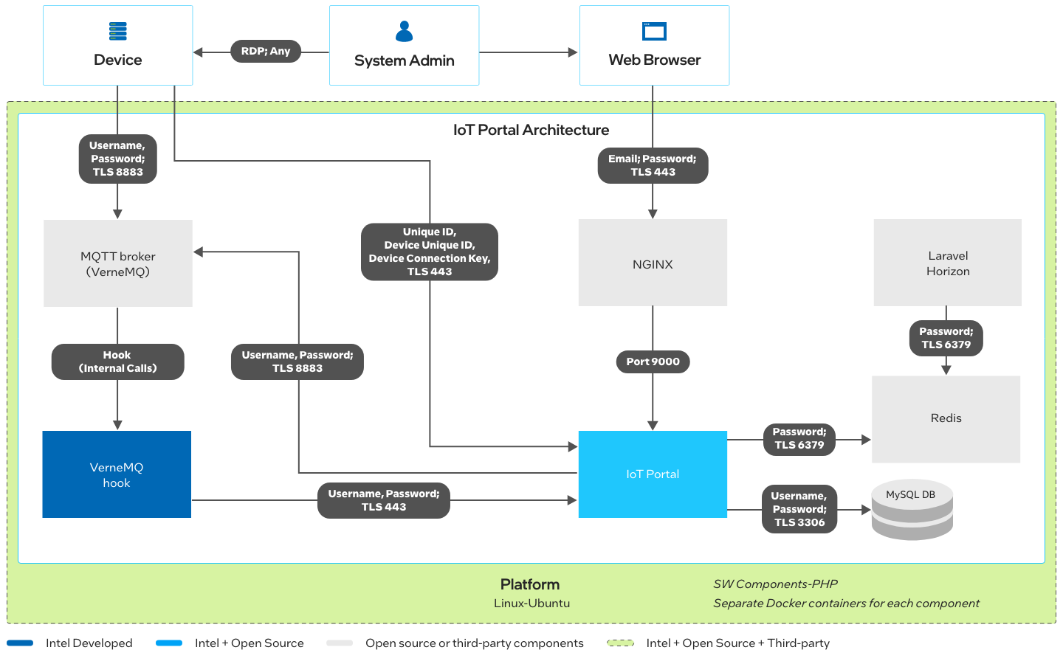
DESIGN

Slide 15
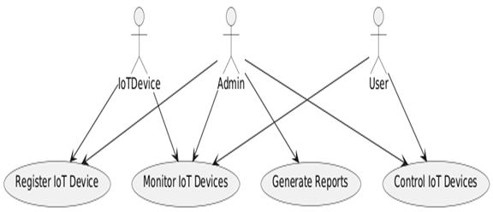
USE CASE

Slide 16
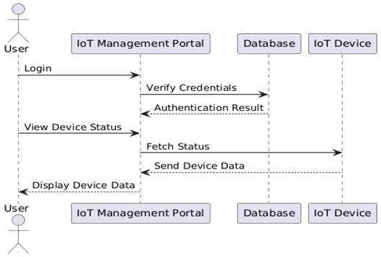
SEQUENCE DIAGRAM

Slide 17
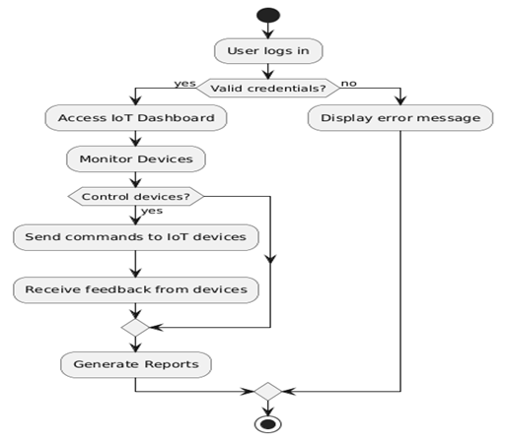
ACTIVITY DIAGRAM

Slide 18
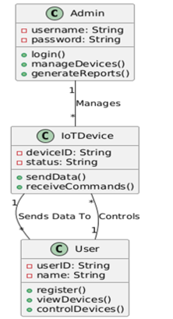
CLASS DIAGRAM

Slide 19
MODULES
Device Management
Purpose: Efficiently manage IoT devices, including registration, configuration, and monitoring.
Functionality:
Device onboarding and offboarding.
Real-time monitoring and health status tracking.
Remote configuration and firmware updates
Data Ingestion and Storage
Purpose: Collect and store data from various IoT devices for later analysis.
Functionality:
Interface to receive data in multiple formats (e.g., JSON, CSV, XML).
Store raw data in a time-series database or cloud storage.
Handle high-velocity data streams efficiently.

Slide 20
Dashboard and Visualization
Purpose: Offer an interactive interface for users to view device status, analytics, and trends.
Functionality:
Customizable dashboard with device information, metrics, and data trends.
Graphical representation of real-time and historical data.
Interactive controls to filter, drill down, and access specific metrics.
Security and Compliance
Purpose: Ensure data privacy, integrity, and regulatory compliance.
Functionality:
Implement data encryption and secure authentication.
Ensure compliance with standards relevant to IoT health data.
Monitor access logs and implement role-based access controls.

Slide 21
IMPLEMENTATION
Frontend
HTML:
Structures the webpage (e.g., login page, dashboard, device management forms).
CSS:
Provides styling for the interface.
Ensures responsive design for different screen sizes.
JavaScript:
Adds interactivity (e.g., form validation, button actions).
Data Visualization:
Uses libraries like Chart.js to display live graphs and other data visualizations on the dashboard.

Slide 22
Backend
Java Server:
Handles the business logic of the application.
Processes requests from the frontend and communicates with the database.
MySQL Database:
Stores data (e.g., user details, device info, sensor readings).
Uses SQL queries for CRUD operations (Create, Read, Update, Delete).
Security Mechanisms:
Implements authentication (e.g., user login).
Uses encryption for sensitive data.
Enforces role-based access control for different user levels.

Slide 23
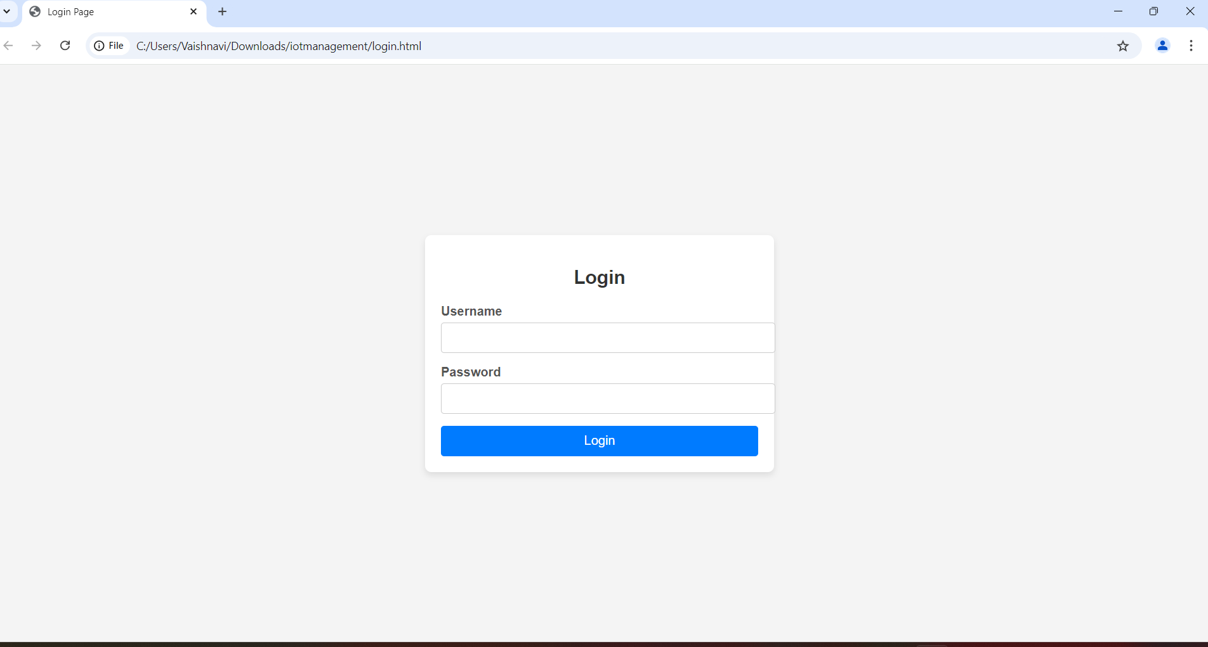
OUTPUT RESULTS
User Login: The User Login Page serves as the authentication gateway to the IoT device management portal. It requires users to enter their credentials (username and password) to access the platform.

Slide 24
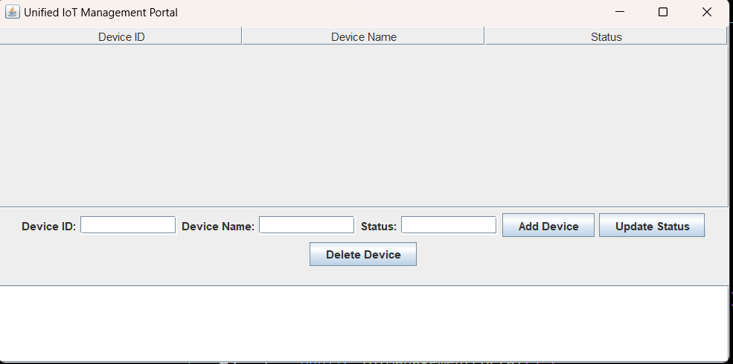
Device Addition/ Deletion: The Device Add/Delete Page allows users to easily manage their IoT devices. Users can add new devices by entering necessary details such as device type, ID, and configuration settings.

Slide 25
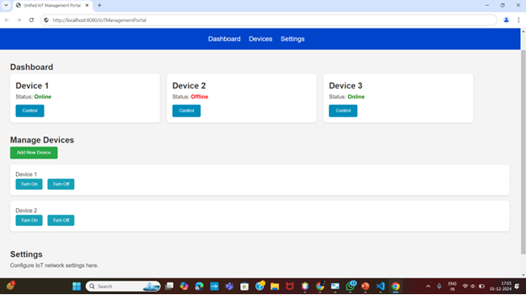
Home Page: The page may include quick links or widgets for managing devices, viewing analytics, accessing security settings, and checking alerts. Visual elements like graphs, charts, and device status indicators provide a snapshot of IoT operations

Slide 26
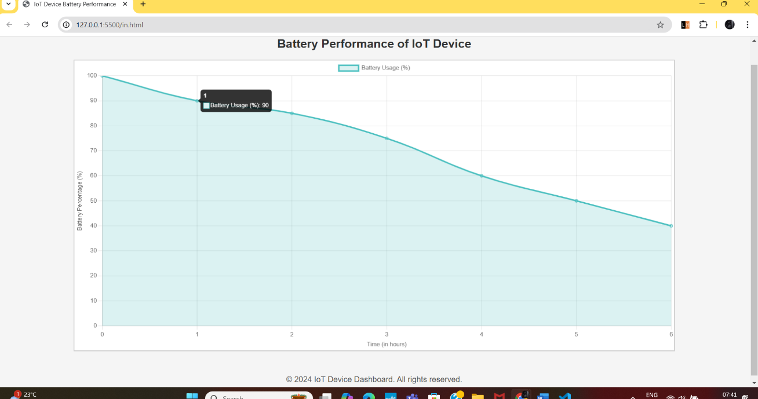
Charge Display Chart Page: The Charge Display Chart Page provides a visual representation of the battery or charge levels of connected IoT devices. It typically features charts or graphs showing current charge levels, trends over time, and alerts for devices with low battery, helping users to monitor device health and plan maintenance.

Slide 27
REFERENCES
- Khan, M. A., & Alghamdi, A. (2020). A survey on IoT device management systems. Journal of Network and Computer Applications. Link
- Al-Fuqaha, A., et al. (2015). Challenges in IoT device management: A survey. IEEE Communications Surveys & Tutorials. Link
- Javed, A. R., et al. (2018). IoT device management frameworks: A comparative analysis. IEEE Access. Link
- Bui, T. D., & Han, D. (2019). An overview of IoT device management technologies. Future Generation Computer Systems. Link
- Moustafa, N., & Slay, J. (2015). Security challenges in IoT device management: A survey. Journal of Network and Computer Applications. Link
- Baccour, N., et al. (2018). Interoperability issues in IoT device management: A survey. IEEE Internet of Things Journal.Link
- Song, H., & Chen, H. (2018). A survey on IoT device discovery mechanisms. IEEE Communications Surveys & Tutorials. Link
- Guo, J., et al. (2020). Evaluating IoT device management frameworks: A user perspective. Sensors. Link

